Slide 1
Algorithmic Analysis
Charl du Plessis and Robert Ketteringham

Slide 2
Basic Terminology
Time Efficiency – this indicates the speed of an algorithm
Space Efficiency – this indicates the amount of extra space an algorithm requires
Mostly interested in Time Efficiency
We will use some notation (O) Big-O for this

Slide 3
Starting Analysis
Measure the input size.
Describe its efficiency as a function on some parameter, say N.
Usually, we let the number of data elements in the input be N.
Note that some algorithms will require more than one function such as the number of vertices (V) and edges (E).

Slide 4
Starting Analysis
Now let us put the time = F(N).
Observe that we are not very interest in the running time for a program for small inputs.
We will use what is called Big-Oh (O) as a way to compare the growth rates of functions

Slide 5
Big-Oh (O)
Constant values are usually ignored.
We also ignore smaller cases of input.
Growth rate of algorithm:
  Linear
  Quadratic
  Cubic
  Logarithmic
Since we ignore constant values, function takes upon most dominant term.

Slide 6
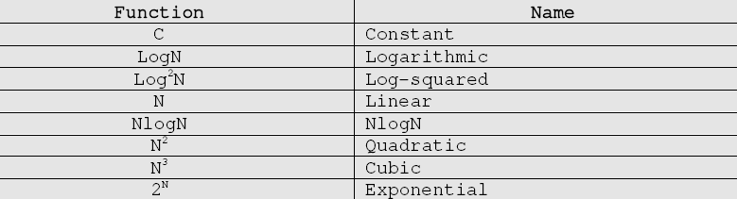
Big-Oh (O)
Is an upper-bound of the growth rate of the algorithm.
T(N) = O(F(N)) if there are positive constants M and c such that:
T(N) <= c.F(N) when N >= M

Slide 7
Other Terminology
Big-Omega: gives lower bound on the growth of T(N).
T(N) = Ω(F(N)) if there are positive constants c and M such that
T(N) >= c.F(N) when N >= M

Slide 8
Other Terminology
Big-theta: growth rate of T(N) is equal to F(N)
T(N) = Θ(F(N))
iff T(N) = O(F(N))
and T(N) = Ω(F(N))

Slide 9
Other Terminology
Little-Oh: growth rate of T(N) is less than F(N)
T(N) = o(F(N)) if there are postive constants M and c such that:
T(N) < c.F(N) when N >= M

Slide 10
Big-Oh Rules
Rule 1: If T(N) is a polynomial of degree k, then:
T(N) = Θ (N^k)
Rule 2: If T_1(N) = O(F(N)) and T_2(N) = O(G(N)) then:
T_1(N) + T_2(N) = max{O(F(N)),O(G(N))}
T_1(N)*T_2(N) = O(F(N)*G(N))
Rule 3:
(Log N)^k = O(N)

Slide 11
Big-Oh Disadvantages
It gives the worst case run bound – and this might not happen often
Sometimes it is better to use average case run bound, but is often difficult to calculate
Not useful for small input – since only indicates how fast the algorithm grows
Two different algorithms can have the same Big-Oh, but can run differently

Slide 12
Analysis – Sequential Search
Given an array N elements and key, we search every given element for the key.
Worst case: N
Best case: 1
Average case: Let p be the probability that the key is in the array.
Then the probability that the key will be in the ith position is p/N.
We will look at the average number of comparisons the program must make.

Slide 13
Analysis – Sequential Search
Avg = (1*p/N + 2*p/N + … + N*p/N) + N*(1-p)
= p/N * (1+2+…+N) + N*(1-p)
= p/N * N(N+1)/2 + N(1-p)
= p(N+1)/2 + N(1-p)
If p = 1 (the key will definitely be in the list), then the average number of comparisons is:
(N+1)/2

Slide 14
Analysis of Iterative Algorithms
Choose parameter(s) to indicate the input’s size
Determine the algorithm’s basic operation (operation in its most inner loop)
Check if the number of times the basic operation depends only on the input size. If it depends on some other factors observe worst-case, best-case, avg-case seperately.
Use the rules of Big-Oh and analyze the order of growth.

Slide 15
Analysis of Recursive Algorithms
Choose parameter(s) to indicate the input’s size
Determine the algorithm’s basic operation (operation in its most inner loop)
Check if the number of times the basic operation depends only on the input size. If it depends on some other factors observe worst-case, best-case, avg-case seperately.
Set up a recurrence relation for the number of times the that the basic operation is executed.
Solve the recurrence or determine the order of growth of its solution.

