Slide 1
Eulerian Paths and Cycles

Slide 2
What is a Eulerian Path
Given an graph.
Find a path which uses every edge exactly once.
This path is called an Eulerian Path.
If the path begins and ends at the same vertex, it is called a Eulerian Cycle.

Slide 3
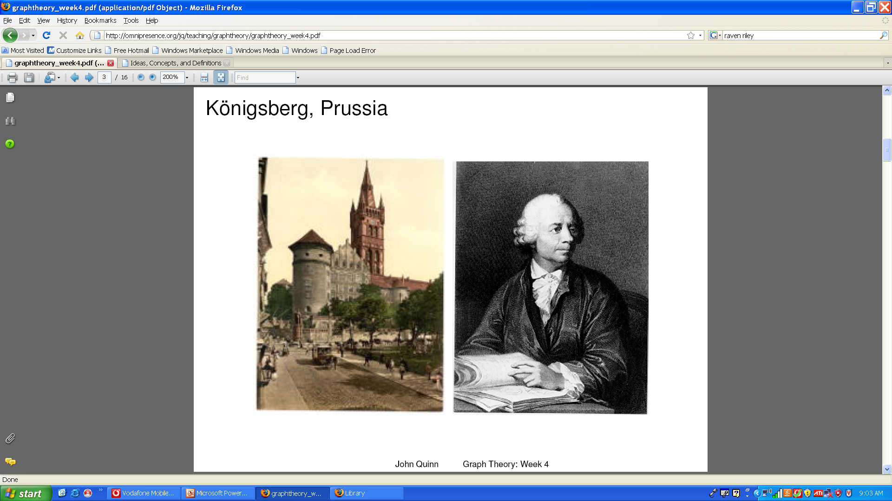
Where did all start: Koningsberg

Slide 4
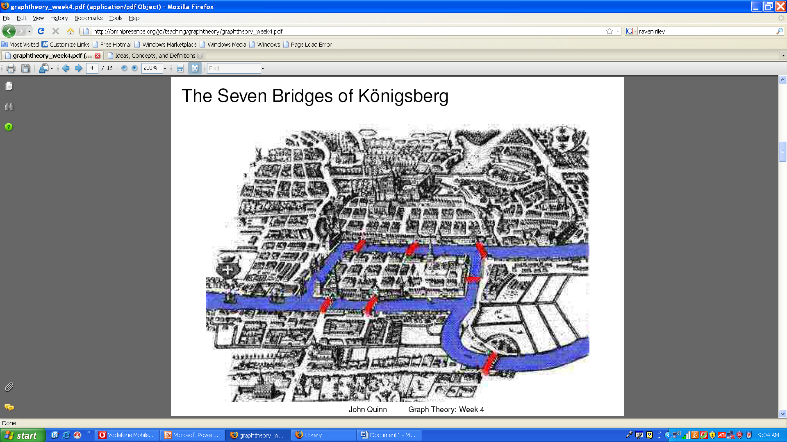
Koningsberg
Find a route which crosses each bridge exactly once?

Slide 5
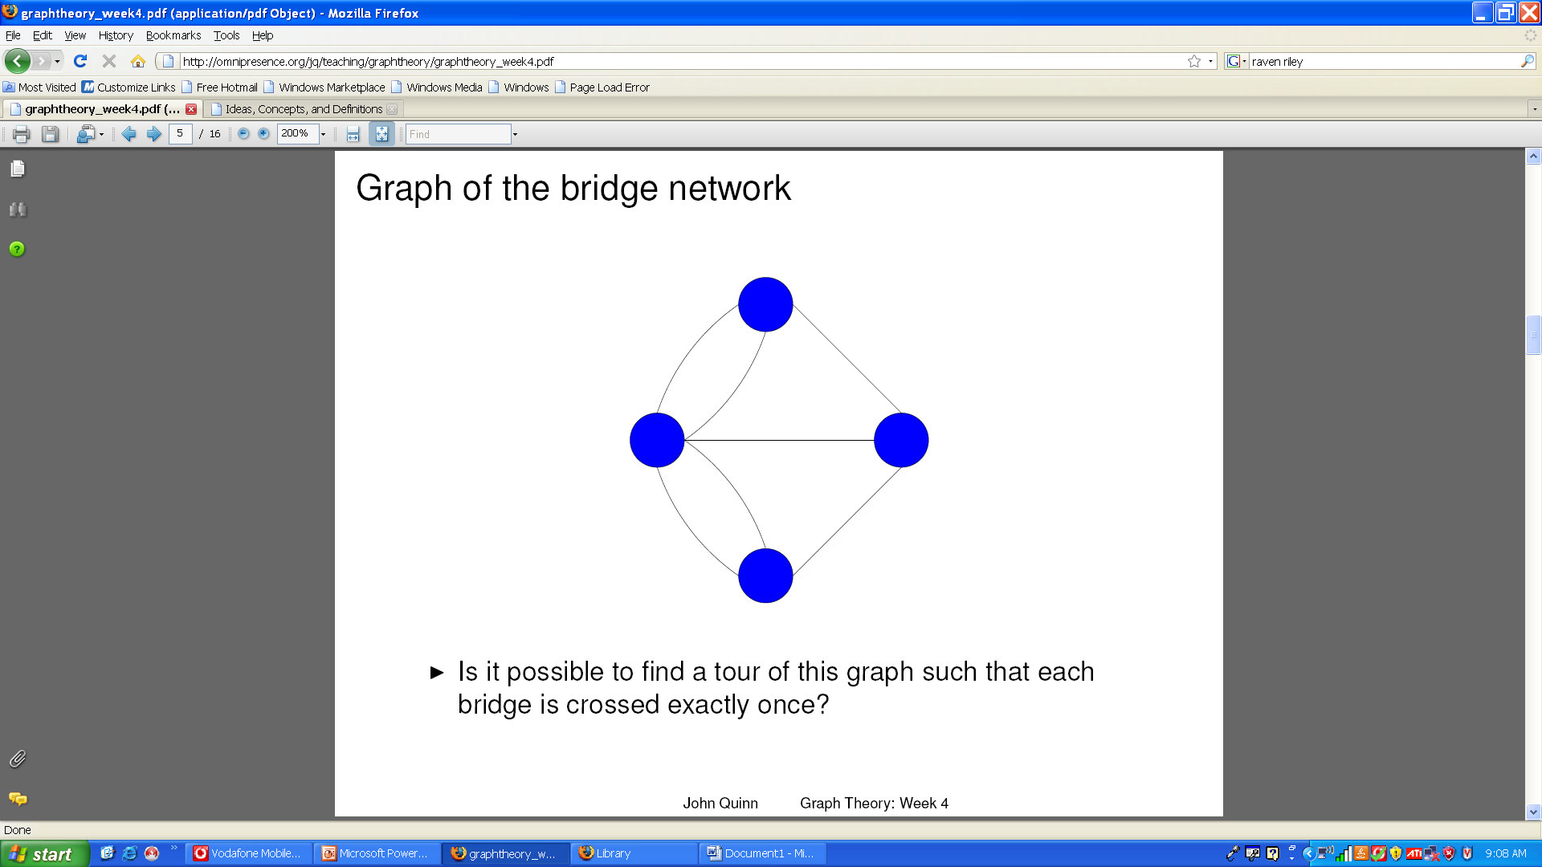
Koningsberg Graph
This graph represents the Koningsburg bridges

Slide 6
When do Eulerian Paths and Cycles exist?
Euler’s solution
An Eulerian cycle exists if and only if it is connected and every node has ‘even degree’.
An Eulerian path exists if and only if it is connected and every node except two has even degree.
In the Eulerian path the 2 nodes with odd degree have to be the start and end vertices

Slide 7
Proof: a Eulerian graph must have all vertices of even degree
Let C be an Eulerian cycle of graph G, which starts and ends at vertex u.
Each time a vertex is included in the cycle C, two edges
connected to that vertex are used up.
Every edge in G is included in the cycle. So every vertex
other than u must have even degree.
The tour starts and ends at u, so it must also have even
degree.

Slide 8
Proof: a graph with all vertices of even degree must be Eulerian
Assume the opposite: G is a non-eulerian graph with all
vertices of even degree.
G must contain a cycle. Let C be the largest possible
cycle in the graph.
Because of our assumption, C must have missed out some
of the graph G, call this D.
C is Eulerian, so has no vertices of odd degree. D
therefore also has no vertices of odd degree.
D must have some cycle E which shares a common vertex with C
Combination of C and E therefore makes a cycle larger than C, which violates our assumption in (2). Contradiction.

Slide 9
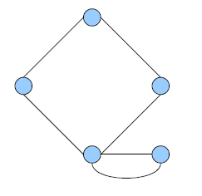
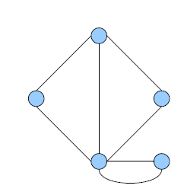
Examples
Eulerian Cycle:
Eulerian Path:

Slide 10
And Koningsburg?
No Eulerian Path or cycle!

Slide 11
Finding Eulerian Cycles
Start off with a node
Find a cycle containing that node
Find a node along that path which has an edge that has not been used
Find a cycle starting at this node witch uses the unused edge
Splice this new cycle into the existing cycle
Continue in this way until no nodes exist with unused edges
Since the graph is connected this implies we have found a Eulerian Cycle

Slide 12
Formal Algorithm
Pick a starting node and recurse on that node. At each step:
  If the node has no neighbors, then append the node to the circuit and return
  If the node has a neighbor, then make a list of the neighbors and process them until the node has no more neighbors
  To process a neighbour, delete the edge between the current node and its neighbor, recurse on the neighbor
  After processing all neighbours append current node to the circuit.

Slide 13
Pseudo-Code
find_circuit (node i)
if node i has no neighbors
circuit [circuitpos] = node i
circuitpos++
else
while (node i has neighbors)
pick a neighbor j of node i
delete_edges (node j, node i)
find_circuit (node j)
circuit [circuitpos] = node i
circuitpos++

Slide 14
Execution Example
4
2
6
3
7
5
1
Stack:
Location:
Circuit:

Slide 15
Execution Example
4
2
6
3
7
5
1
Stack:
Location:
Circuit:

Slide 16
Execution Example
4
2
6
3
7
5
1
Stack:
Location: 1
Circuit:

Slide 17
Execution Example
4
2
6
3
7
5
1
Stack:
Location: 1
Circuit:

Slide 18
Execution Example
4
2
6
3
7
5
1
Stack: 1
Location: 4
Circuit:

Slide 19
Execution Example
4
2
6
3
7
5
1
Stack: 1 4
Location: 2
Circuit:

Slide 20
Execution Example
4
2
6
3
7
5
1
Stack: 1 4 2
Location: 5
Circuit:

Slide 21
Execution Example
4
2
6
3
7
5
1
Stack: 1 4 2 5
Location: 1
Circuit:

Slide 22
Execution Example
4
2
6
3
7
5
1
Stack: 1 4 2
Location: 5
Circuit: 1

Slide 23
Execution Example
4
2
6
3
7
5
1
Stack: 1 4 2 5
Location: 6
Circuit: 1

Slide 24
Execution Example
4
2
6
3
7
5
1
Stack: 1 4 2 5 6
Location: 2
Circuit: 1

Slide 25
Execution Example
4
2
6
3
7
5
1
Stack: 1 4 2 5 6 2
Location: 7
Circuit: 1

Slide 26
Execution Example
4
2
6
3
7
5
1
Stack: 1 4 2 5 6 2 7
Location: 3
Circuit: 1

Slide 27
Execution Example
4
2
6
3
7
5
1
Stack: 1 4 2 5 6 2 7 3
Location: 4
Circuit: 1

Slide 28
Execution Example
4
2
6
3
7
5
1
Stack: 1 4 2 5 6 2 7 3 4
Location: 6
Circuit: 1

Slide 29
Execution Example
4
2
6
3
7
5
1
Stack: 1 4 2 5 6 2 7 3 4 6
Location: 7
Circuit: 1

Slide 30
Execution Example
4
2
6
3
7
5
1
Stack: 1 4 2 5 6 2 7 3 4 6 7
Location: 5
Circuit: 1

Slide 31
Execution Example
4
2
6
3
7
5
1
Stack: 1 4 2 5 6 2 7 3 4 6
Location: 7
Circuit: 1 5

Slide 32
Execution Example
4
2
6
3
7
5
1
Stack: 1 4 2 5 6 2 7 3 4
Location: 6
Circuit: 1 5 7

Slide 33
Execution Example
4
2
6
3
7
5
1
Stack: 1 4 2 5 6 2 7 3
Location: 4
Circuit: 1 5 7 6

Slide 34
Execution Example
4
2
6
3
7
5
1
Stack: 1 4 2 5 6 2 7
Location: 3
Circuit: 1 5 7 6 4

Slide 35
Execution Example
4
2
6
3
7
5
1
Stack: 1 4 2 5 6 2
Location: 7
Circuit: 1 5 7 6 4 3

Slide 36
Execution Example
4
2
6
3
7
5
1
Stack: 1 4 2 5 6
Location: 2
Circuit: 1 5 7 6 4 3 7

Slide 37
Execution Example
4
2
6
3
7
5
1
Stack: 1 4 2 5
Location: 6
Circuit: 1 5 7 6 4 3 7 2

Slide 38
Execution Example
4
2
6
3
7
5
1
Stack: 1 4 2
Location: 5
Circuit: 1 5 7 6 4 3 7 2 6

Slide 39
Execution Example
4
2
6
3
7
5
1
Stack: 1 4
Location: 2
Circuit: 1 5 7 6 4 3 7 2 6 5

Slide 40
Execution Example
4
2
6
3
7
5
1
Stack: 1
Location: 4
Circuit: 1 5 7 6 4 3 7 2 6 5 2

Slide 41
Execution Example
4
2
6
3
7
5
1
Stack:
Location: 1
Circuit: 1 5 7 6 4 3 7 2 6 5 2 4

Slide 42
Execution Example
4
2
6
3
7
5
1
Stack:
Location:
Circuit: 1 5 7 6 4 3 7 2 6 5 2 4 1

Slide 43
Analysis
To find an Eulerian path, find one of the nodes which has odd degree (or any node if there are no nodes with odd degree) and call find_circuit with it.
This algorithm runs in O(m + n) time, where m is the number of edges and n is the number of nodes, if you store the graph in adjacency list form.

