Slide 1
String Algorithms
Matching

Slide 2
Finite State Machine
n
a
n
o

Slide 3
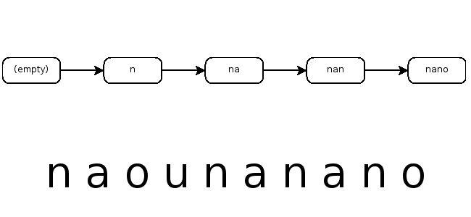
Simulation
n
a
n
o

Slide 4
Simulation
n
a
n
o

Slide 5
Simulation
n
a
n
o

Slide 6
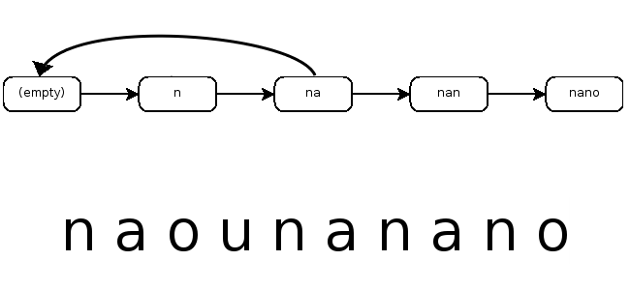
Simulation
n
a
n
o

Slide 7
Simulation
n
a
n
o

Slide 8
Simulation
n
a
n
o

Slide 9
Simulation
n
a
n
o

Slide 10
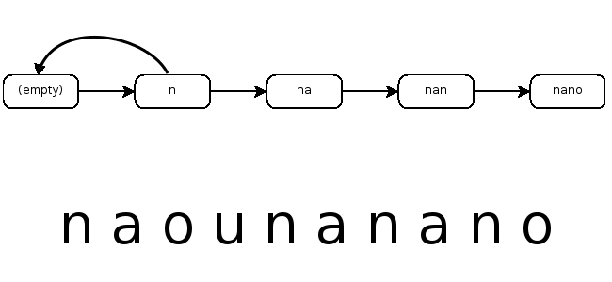
Simulation
n
a
n
o

Slide 11
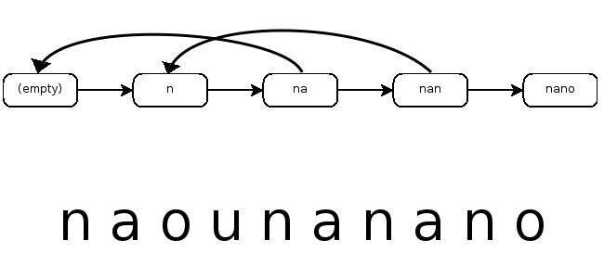
Simulation
n
a
n
o

Slide 12
Simulation
n
a
n
o

Slide 13
Simulation
n
a
n
o

Slide 14
Simulation
n
a
n
o

Slide 15
String Algorithms
Longest Common
Subsequence

Slide 16
Recursive Solution
a b r a c a d a b r a
b a r b a r a

Slide 17
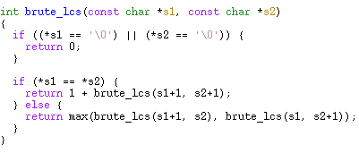
Recursive Solution

Slide 18
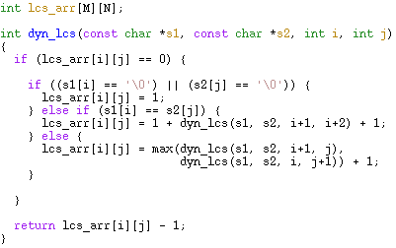
Dynamic Programming

Slide 19
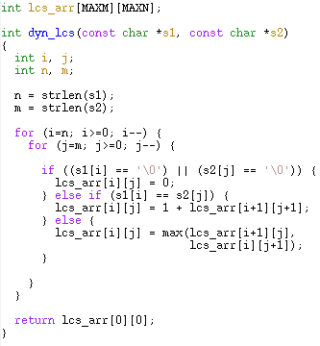
Dynamic Programming

Slide 20
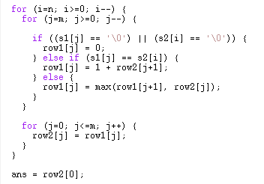
Dynamic Programming

Slide 21
String Algorithms
Suffix Tries

Slide 22
Suffix Tries
a a b b a a
0. a a b b a a
1. a b b a a
2. b b a a
3. b a a
4. a a
5. a

Slide 23
Suffix Tries
(empty)

Slide 24
Suffix Tries
(empty)
a
a
b
b
a
a

Slide 25
Suffix Tries
(empty)
a
a
b
b
b
b
a
a
a
a

Slide 26
Suffix Tries
(empty)
a
b
a
b
b
b
b
a
b
a
a
a
a
a

Slide 27
Suffix Tries
(empty)
a
b
a
a
b
b
b
a
b
a
b
a
a
a
a
a

Slide 28
Suffix Tries
(empty)
a
b
a
a
b
b
b
a
b
a
b
a
a
a
a
a

Slide 29
Suffix Tries
(empty)
a
b
a
a
b
b
b
a
b
a
b
a
a
a
a
a

Slide 30
Suffix Tries
(empty)
a
b
a
a
b
b
b
a
b
a
b
a
a
a
a
a

Slide 31
Suffix Array
a a b b a a
0. a a b b a a
1. a b b a a
2. b b a a
3. b a a
4. a a
5. a
6. (empty)
0. (empty)
1. a
2. a a
3. a a b b a a
4. a b b a a
5. b a a
6. b b a a

