Slide 1
Interval Trees
Marco Gallotta

Slide 2
Problem
Given a collection of items i, each with value Vi
Want to answer many queries of the form: How many items are in the interval [x, y]?

Slide 3
Binary Tree
At each node Vi, store the count o of interval [0, Vi]
Problem: unbalanced trees:
13
1
01
36
2
24
3
4

Slide 4
Radix Tree
Root node contains the interval [0, max]
A node containing the interval [A, B] has children with interval [A, (A+B)/2] and [(A+B)/2 + 1, B]
Each node holds the count over its range
Every number has a well-defined position

Slide 5
Radix Tree: Example
[0, 3]6
[0, 1]3
[2, 3]3
[0, 0]1
[1, 1]2
[2, 2]1
[3, 3]2

Slide 6
Radix Tree: Update
To insert the value Vi:
  Increment the root node's count
  If Vi <= (A+B)/2
    Insert Vi into the left child
  Else
    Insert Vi into the right child
Similar process for deletion

Slide 7
Radix Tree: Query
To find the number of items in the interval [x, y]:
  If [A, B] covers [x, y]
    return root node's count
  Let sum = 0
  If [A, (A+B)/2] overlaps [x, y]
    sum += count in left child over [x, y]
  If [(A+B)/2 + 1, B] overlaps [x, y]
    sum += count in right child over [x, y]
  Return sum

Slide 8
Binary Indexed Trees
Any number can be represented as the sum of powers of two
Assume intervals are of the form [1, x]
An interval count can be represented in a similar manner
[1, 13] = [1, 8] + [9, 12] + [13, 13]
So we only store counts of interval of the form [x – 2^{r} + 1, x]

Slide 9
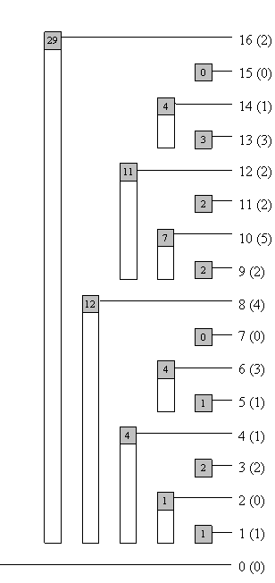
Binary Indexed Trees: Example

Slide 10
Binary Indexed Trees
13 = 11012
c[1101] = tree[1101] + tree[1100] + tree[1000]
To isolate last 1 in binary form: n & -n
  Proof in reference article

Slide 11
Binary Indexed Trees: Update
void update(int idx ,int val){
  while (idx <= MaxVal){
    tree[idx] += val;
    idx += (idx & -idx);
  }
}

Slide 12
Binary Indexed Trees: Query
int read(int idx){
  int sum = 0;
  while (idx > 0){
    sum += tree[idx];
    idx -= (idx & -idx);
  }
  return sum;
}

Slide 13
Sample Problem:
TopCoder SRM 310
n cards face down on table
  T i j: turn cards from index i to index j, include i-th and j-th card
  Q i: is the i-th card face?)

Slide 14
Sample Problem:
Solution
Array f (of length n + 1) holds our BIT
f[i]++ and f[j + 1]--
For each card k between i and j, sum f[1] + f[2] + ... + f[k] will be incremented
For each query, the answer is f[i] % 2

Slide 15
Analysis
Binary Tree: common, but balancing can be difficult and expensive
Radix Tree: guaranteed O(logN) for update and query
Binary Index Tree: Same as Radix Tree, but very short code

Slide 16
Questions
?

Slide 17
References
http://www.topcoder.com/tc?module=Static&d1=tutorials&d2=binaryIndexedTrees

