Slide 1
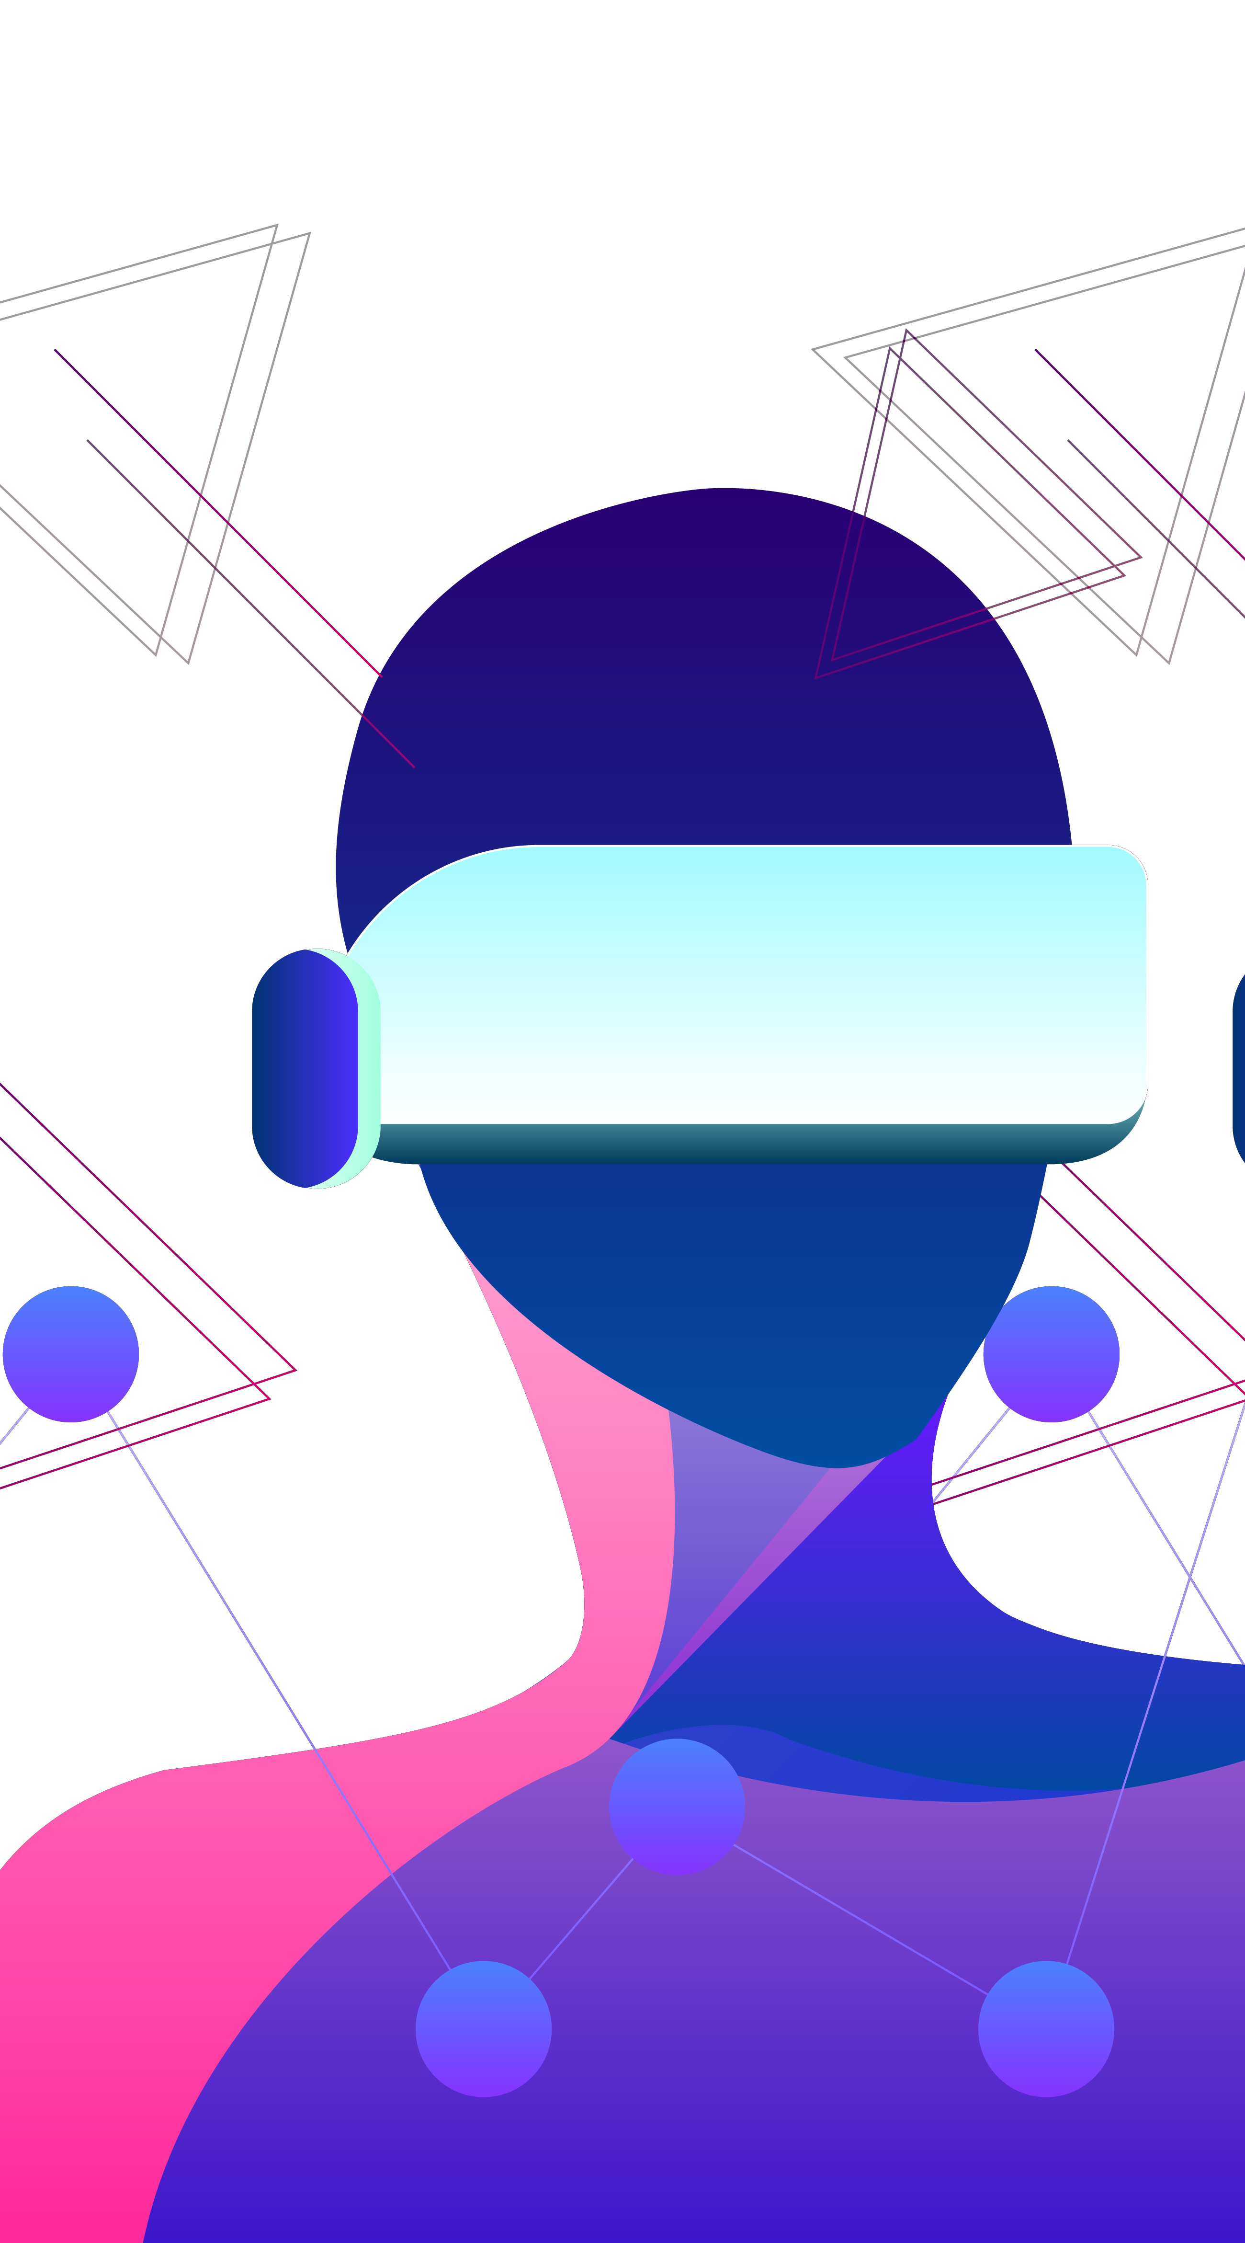
Meta - Identity
Create Your Presence in Another Reality

Slide 2
5,070,530,901
$ 162.71 Bn
65%
The Number of People on the internet every Day!
Current value of AR/VR market
Of the day, spent on average online.

Slide 3
What is Meta-Identity?
As we go into the future, the size and power of the social media and internet has been increasing exponentially.
With the enhancement of social technology, every person is having a stronger social presence day by day.
Meta-Identity comes here and translates a person’s identity and clones personality into the digital sphere and the metaverse.
Meta-identity gives every human a chance to clone themselves with their personality, speech and looks, to create a digital presence for eternity.

Slide 4
What does Meta-Identity Solve?
Here you have a list of items

Slide 5
How are we unique?
Security

Slide 6
How we built it?
- Meta-Identity of a person in built with 3 steps – 1) Personality cloning via chat data, 2) Speech and voice cloning and 3) Face and looks cloning. The web app accepts chat data, speech and input image.
- We used a variety of ML models, dockerized, deployed on Google cloud and cascaded together in parallel, along with RESTful services and chat support to generate a human digital clone of oneself.
- We used federated learning to train our personality ML model, which protects the privacy of the people, as the model does not know where the data is coming from for training.

Slide 7
The Privacy Architecture

Slide 8

The Network Architecture - Overall
Twilio
Google Cloud Platform
Image
GPT 2 – NLP Bot
Speech2Text
gTTS
Text2Speech Clone
Speech
Flask Server
Digital Avatar Model (Style GAN)
Chat
Video Synthesizer – Audio + Image (RNN LSTM)
Front End
Backend Server

Slide 9

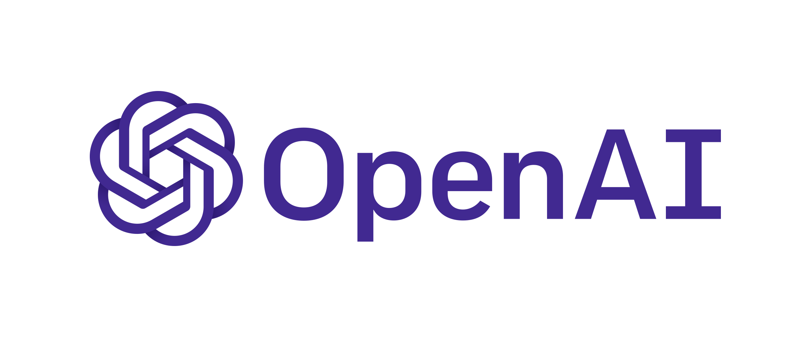


The Network Architecture – In Depth
Model Prediction Response
Response from Clone
Personality Clone NLP Bot (GPT-2)
WhatsApp
Twilio API
Request from user
Request from user
Text from User
Response from Clone
Speech from User
User Front End
Speech to Text gTTS
Text to Speech Model (Cloning voice)
Synthesized Output Video
Response In Clone’s voice
Face Image to Clone
Toonify Digital Image
Digital Avatar
(StyleGAN)
Speech Driven Video Generator (RNN LSTM)
Image,
Speech,
Chat Data
Transfer learning – Speech + Image

Slide 10
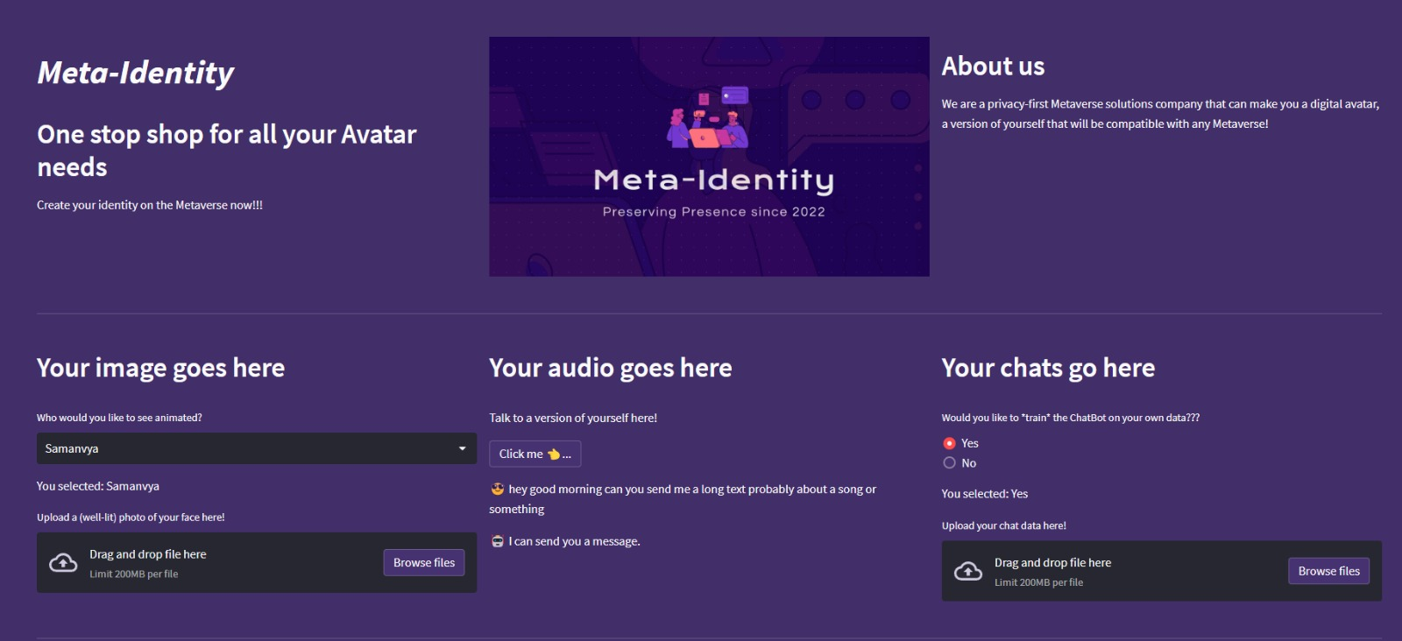
Meta - Identity
Web Portal

Slide 11
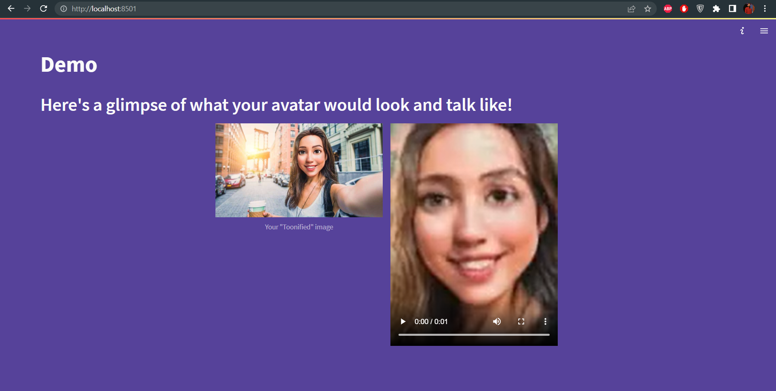
Meta - Identity
Web Portal

Slide 12

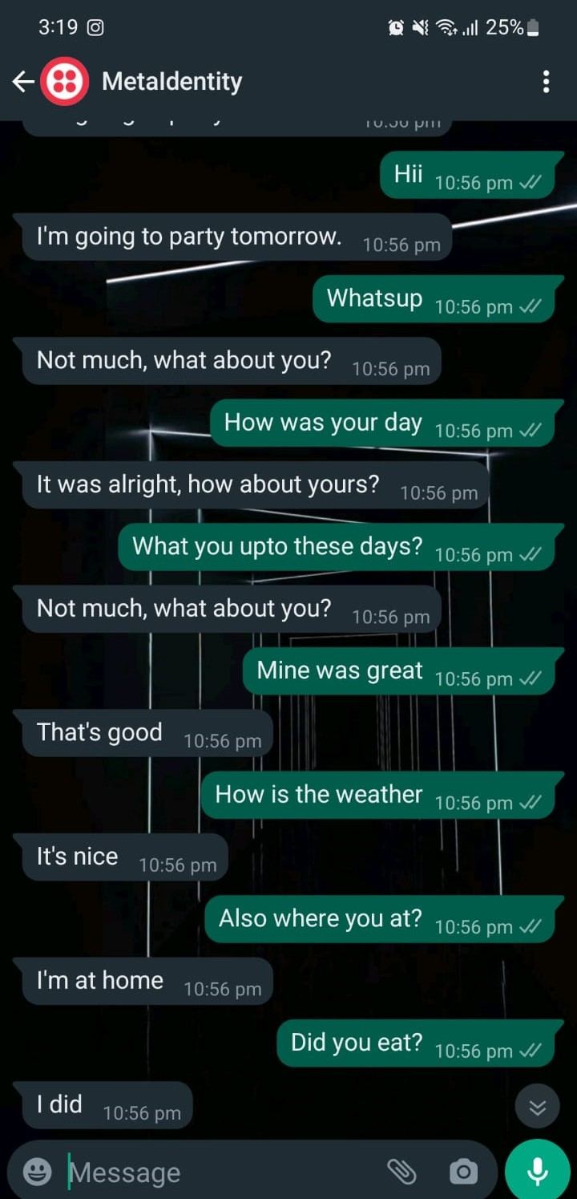
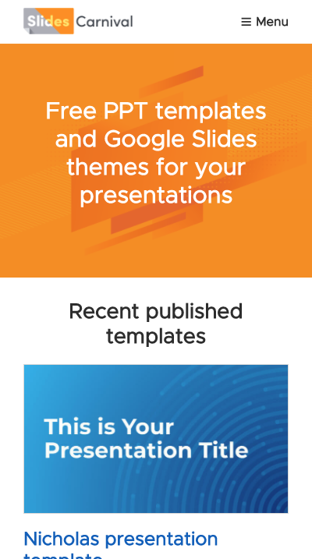
Twilio -WhatsApp And Digital Persona Integration
Integrated pipeline for digital avatar to communicate with the real world via WhatsApp, powered by Twilio.

Slide 13
Digital personification chat bot
- The chat bot is built using GPT-2, trained on WhatsApp, Facebook and Instagram chat data.
- The Bot is pipelined to interact with a real human speaker or another AI.
- The Bot utilized the power of Twilio in order to create a bridge between a digital persona and real life persona.

Slide 14
Demo!

Slide 15
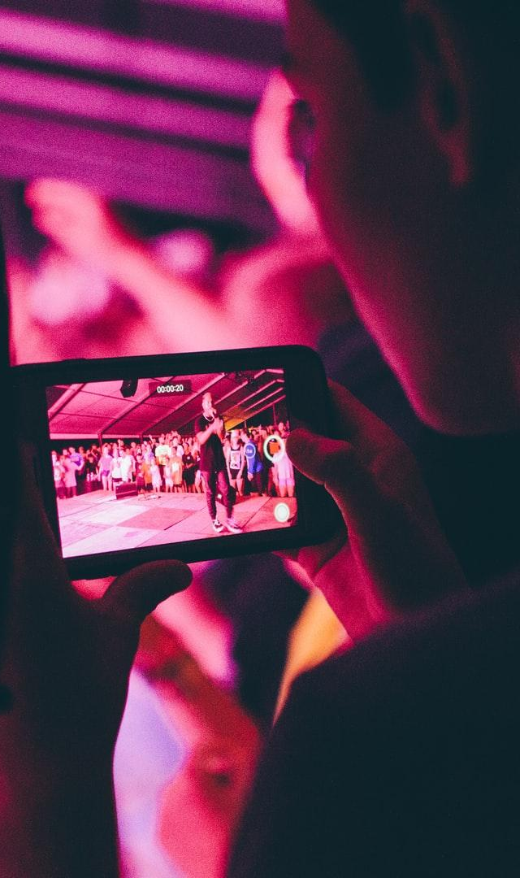
Future Scope
Make the video experience more real time.
The next step to this is to build an AR digital clone into the metaverse.
The future scope includes giving almost full thought process autonomy to the digital clone.

Slide 16


Thank You!
Rajat Keshri
Northeastern University
Samanvya Tripathi
Northeastern University

