Slide 1
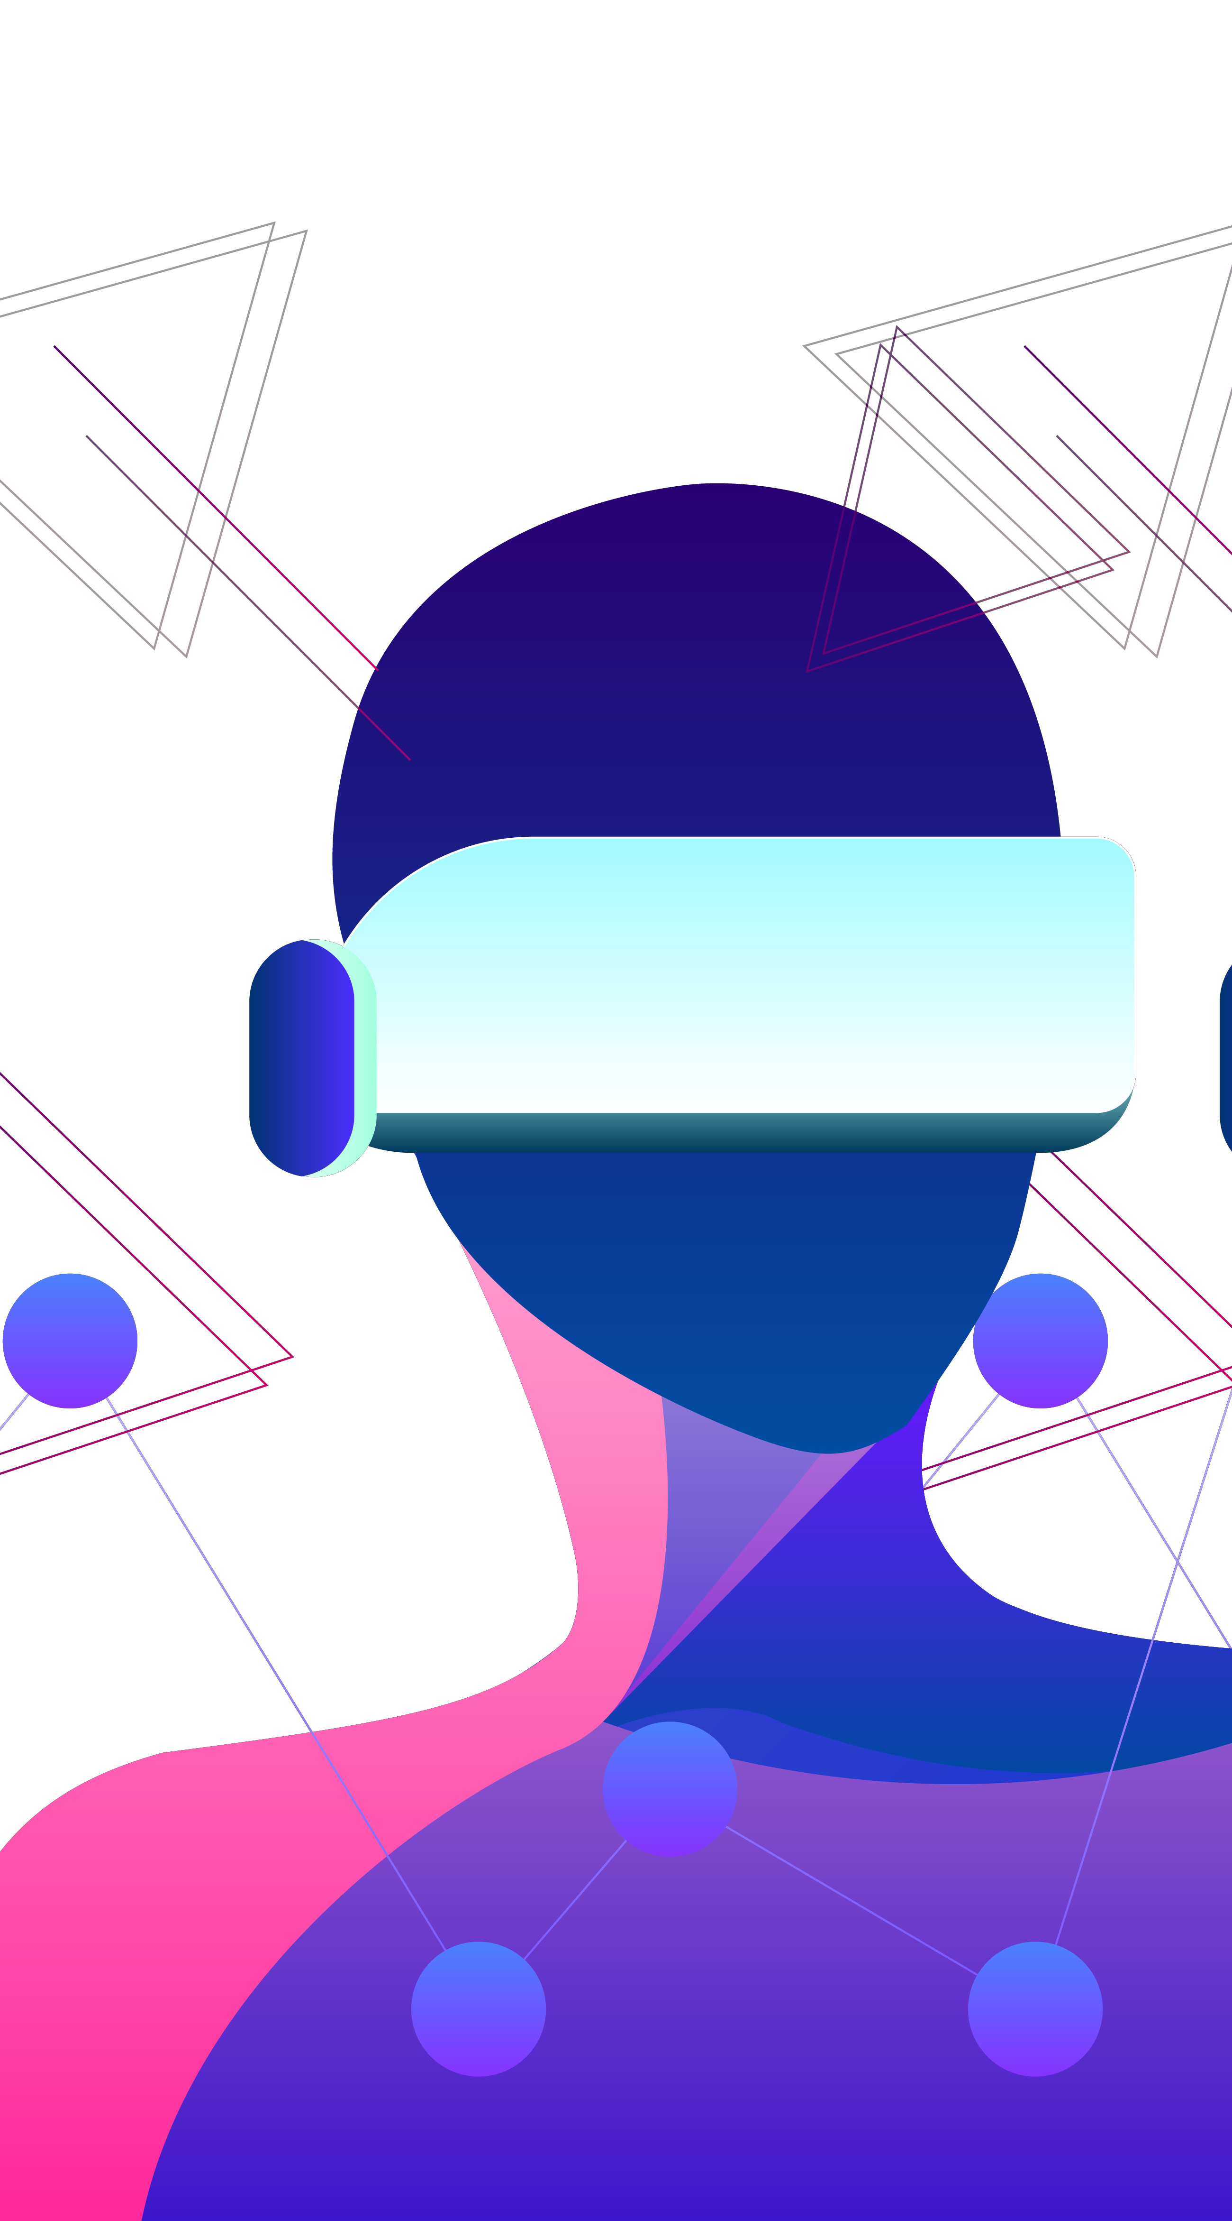
Meta - Identity
Create Your Presence in Another Reality

Slide 2
5,070,530,901
$ 162.71 Bn
65%
The Number of People on the internet every Day!
Current value of AR/VR market
Of the day is spent online!

Slide 3
What is Meta-Identity?
Meta-Identity is a platform that lets users build an avatar which then acts as the single source of truth for all their interactions on the internet/metaverses.
This creator of the avatar has the power to teach it (the avatar) to
Look
Speak
Think
like the creator themselves.

Slide 4
What is Meta-Identity? Contd…
As we go into the future, the size and power of the social media and internet has been increasing exponentially.
With the enhancement of social technology, every person is having a stronger social presence day by day.
Meta-Identity comes here and translates a person’s identity and clones personality into the digital sphere and the metaverse.
Meta-identity gives every human a chance to clone themselves with their personality, speech and looks, to create a digital presence for eternity.
The best part is, this “cloned presence” can be used with any verse that a company builds, and your avatar will be compatible with all the leading “Metaverses”.

Slide 5
What does Meta-Identity Solve?
Consistency: One avatar for all your metaverses.
Compatibility: Plug and play the same avatar into every metaverse: we provide an easy to use API to help interact with avatars.
Security: User data does not leave the client’s machine needed for cloning.
Hyper-personalisation of Avatars: Let you set a lot of fine-grained details to make yourself stand-out in the metaverse

Slide 6
How are we unique?
Security: We use an adaptation of federated learning along with strong server side encryption to store our (your) language models. We periodically finetune and improve the model on your device, so your data doesn’t leave your device. We then follow the best encryption practices to secure your model on cloud!
Plug and Play: One avatar, multi metaverses
Feedback Loop: We let the user go through the avatar’s interactions and improve the way it replies/interacts

Slide 7
How we built it?
- Meta-Identity of a person is built in 3 steps – 1) Personality cloning via chat data, 2) Speech and voice cloning and 3) Face and looks cloning. The web app accepts chat data, speech and input image.
- We used a variety of SOTA DL Models for Language and Vision tasks, some/most of them running in containers on cloud. We also provide an interface to integrate 3rd party APIs to expose your chatbot.

Slide 8
Demo!

Slide 9
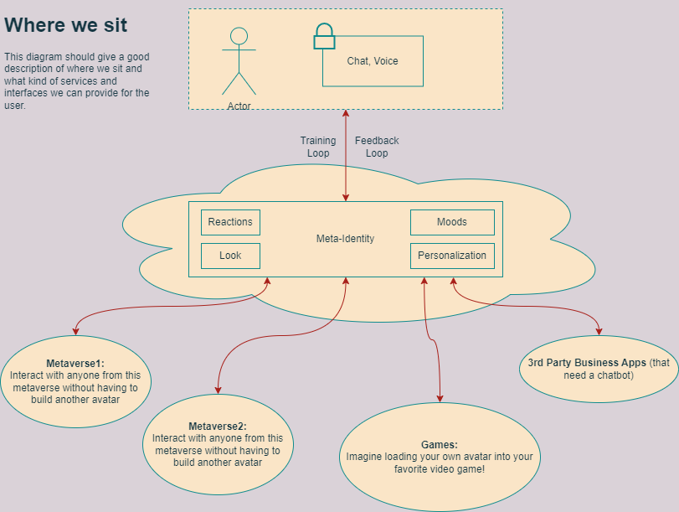
Solutions Architecture

Slide 10
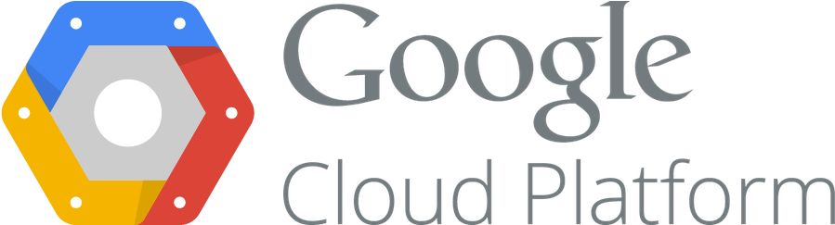
The Network Architecture - Overall
Twilio
Google Cloud Platform
Image
GPT 2 – NLP Bot
Speech2Text
gTTS
Text2Speech Clone
Speech
Flask Server
Digital Avatar Model (Style GAN)
Chat
Video Synthesizer – Audio + Image (RNN LSTM)
Front End
Backend Server

Slide 11

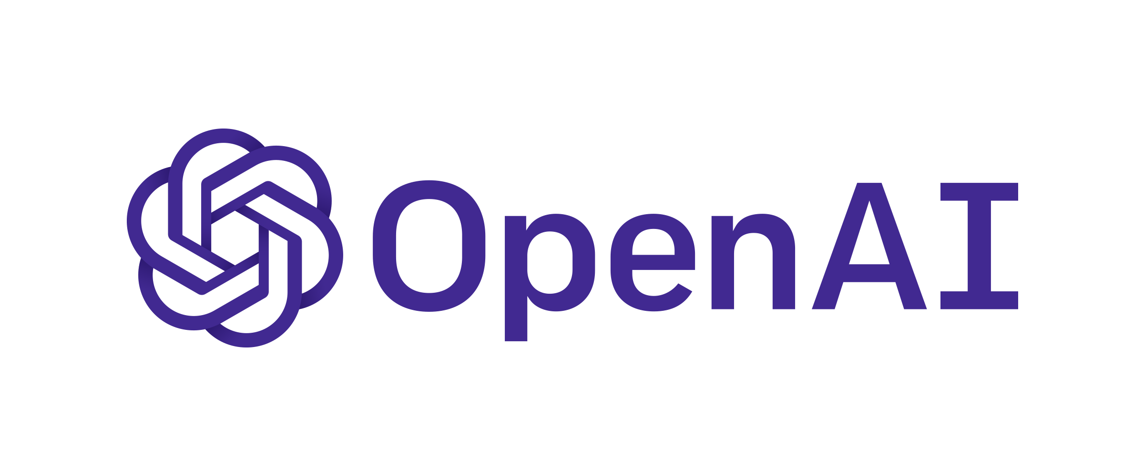


The Network Architecture – In Depth
Model Prediction Response
Response from Clone
Personality Clone NLP Bot (GPT-2)
WhatsApp
Twilio API
Request from user
Request from user
Text from User
Response from Clone
Speech from User
User Front End
Speech to Text gTTS
Text to Speech Model (Cloning voice)
Synthesized Output Video
Response In Clone’s voice
Face Image to Clone
Toonify Digital Image
Digital Avatar
(StyleGAN)
Speech Driven Video Generator (RNN LSTM)
Image,
Speech,
Chat Data
Transfer learning – Speech + Image

Slide 12
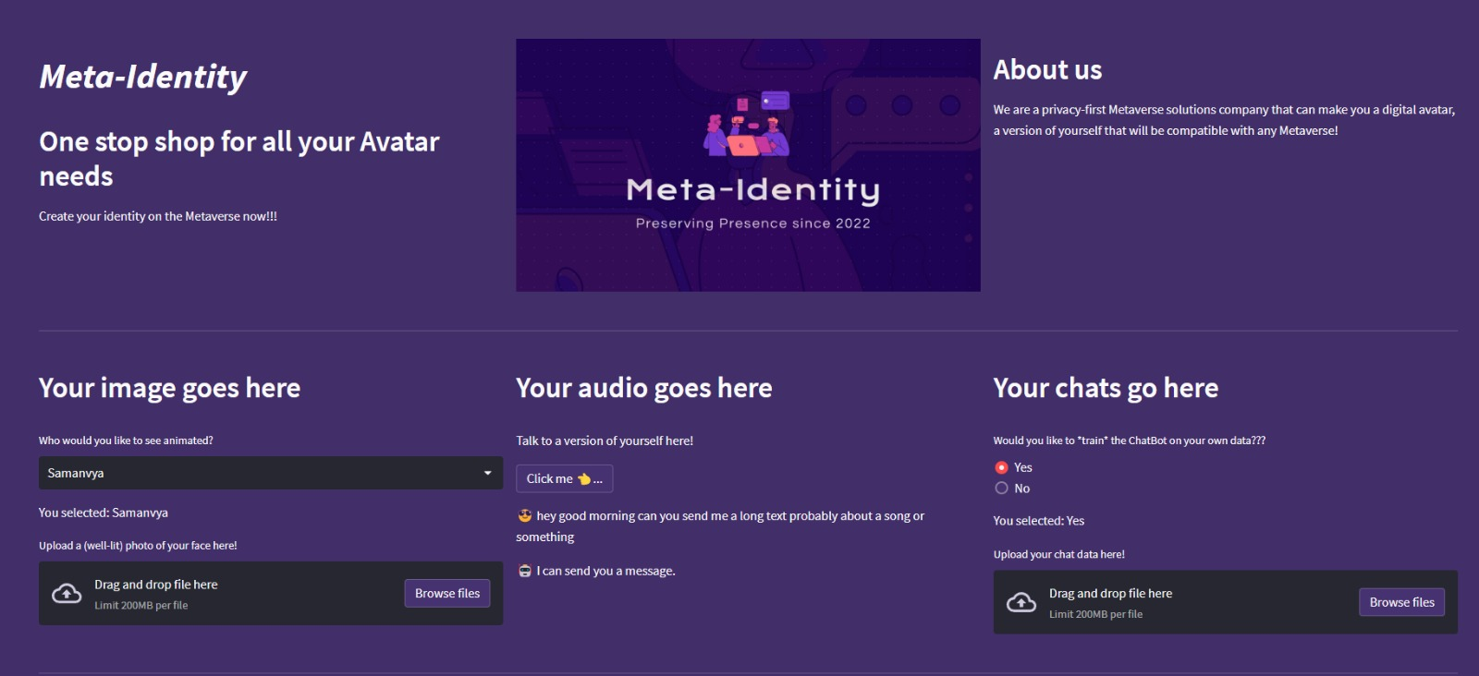
Meta - Identity
Web Portal

Slide 13
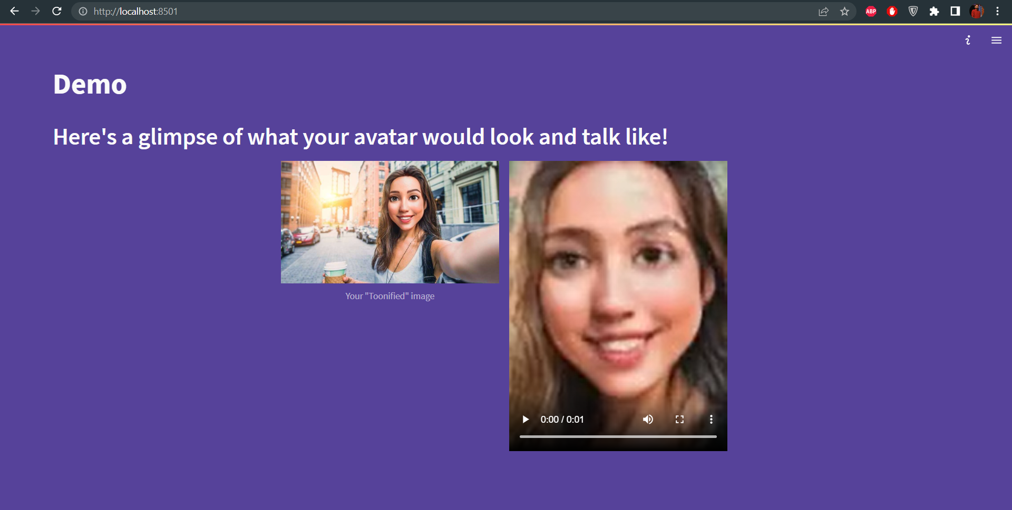
Meta - Identity
Web Portal

Slide 14

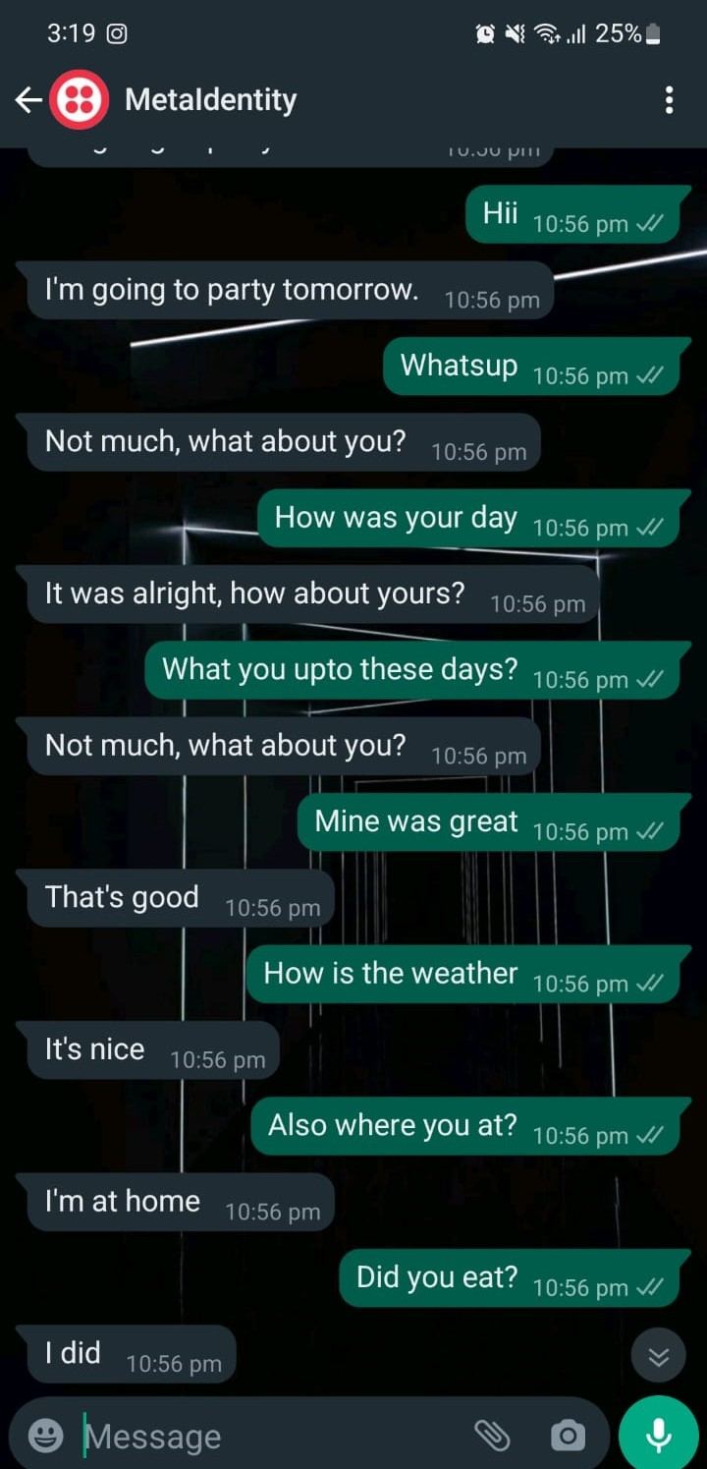

Twilio -WhatsApp And Digital Persona Integration
Integrated pipeline for digital avatar to communicate with the real world via WhatsApp, powered by Twilio.

Slide 15
Digital personification chat bot
- The chat bot uses GPT-2 as it’s backbone, trains on users’ WhatsApp, Facebook and Instagram chat data.
- The Bot has a clean interface that lets it interact with a real human speaker or another AI.
- The Bot utilizes the power of Twilio in order to create a bridge between a digital persona and real life persona.

Slide 16
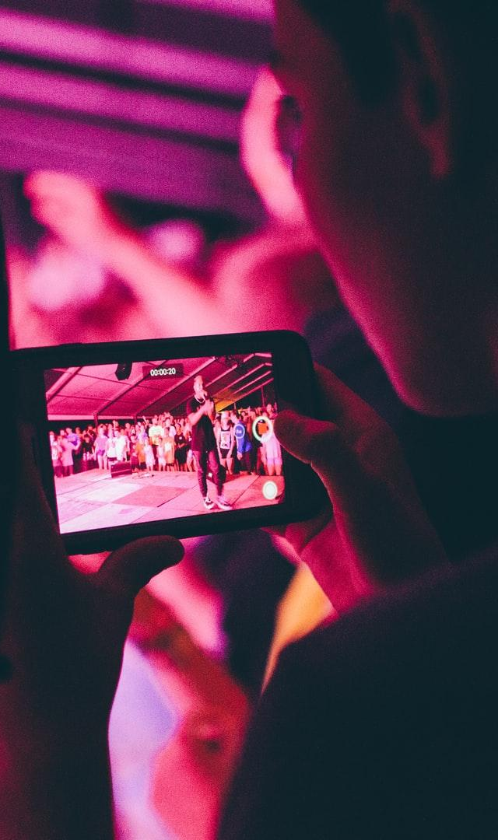
Future Scope
Make the video experience more real time.
The next step to this is to build an AR digital clone into the metaverse.
The future scope includes giving almost full thought process autonomy to the digital clone.

Slide 17


Thank You!
Rajat Keshri
Northeastern University
Samanvya Tripathi
Northeastern University

