Slide 1
Aegis Sprint 4
Team C

Slide 2
Tasks Done
Finished setup repo
Every local machine can share code through repo
Code works on all local machines
Google Maps Framework
UI Design Mockup (Partially Done)
Local database ERD
JSON Crime Decoder Framework
Crime Algorithm Framework
Settings Library Framework
Current Location on Map

Slide 3
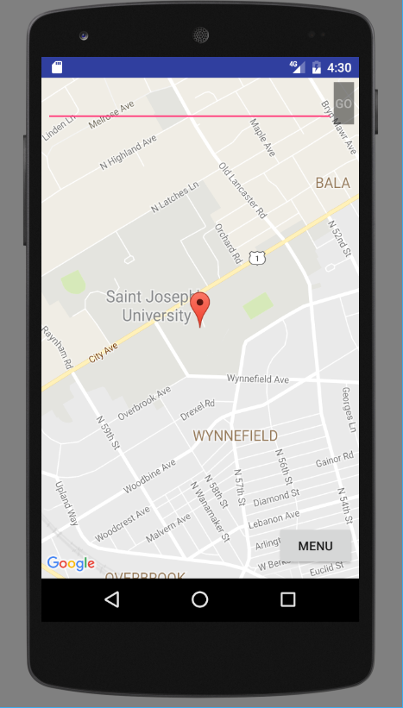
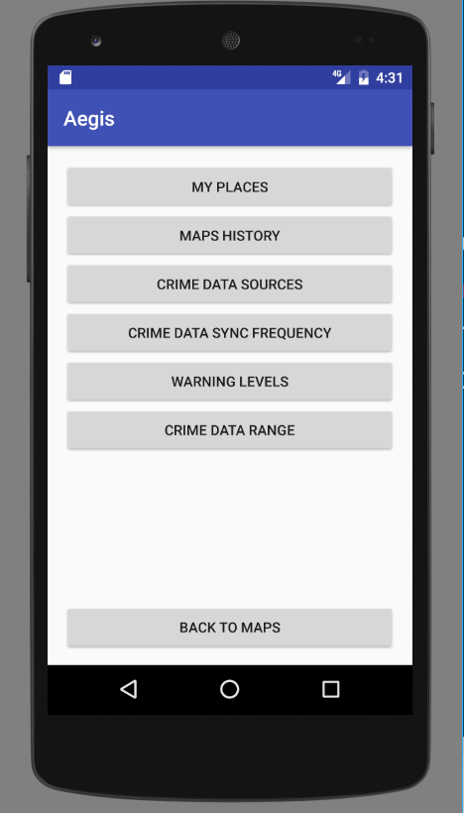
Settings Framework

Slide 4
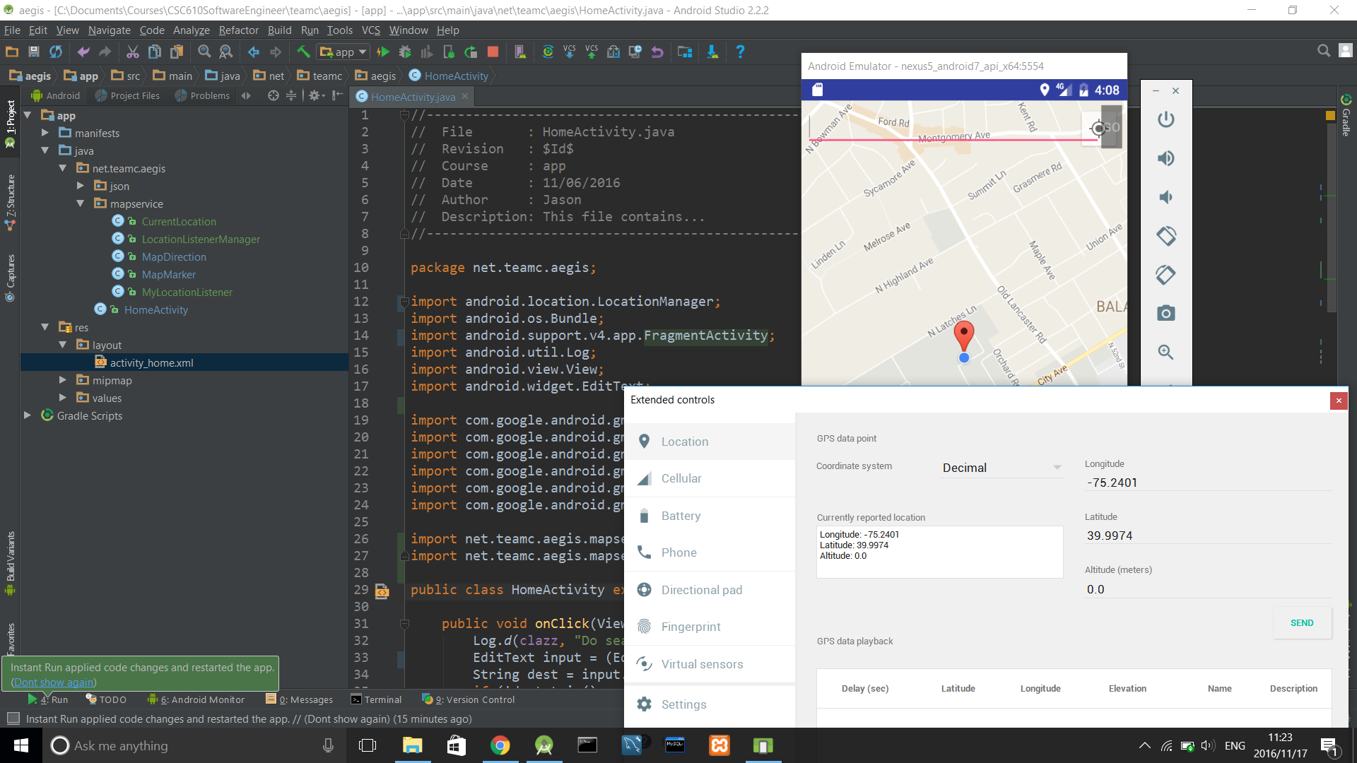
Current Location sample

Slide 5
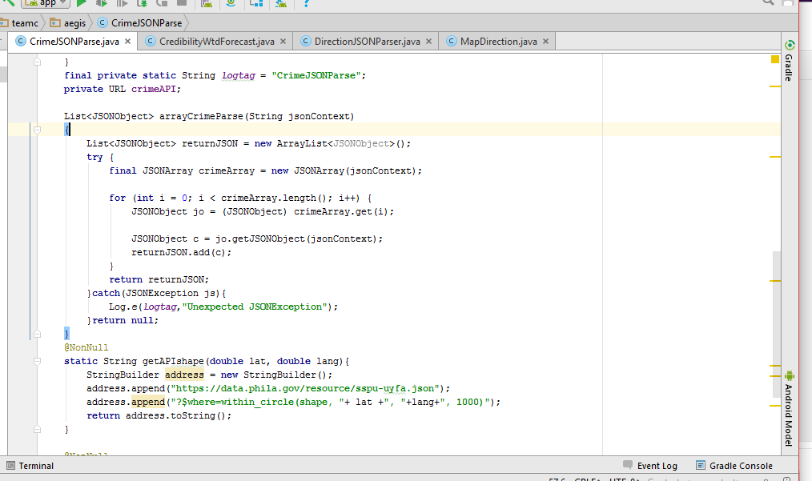
CrimeJSONParse
Arraylist ends up being absurdly massive

Slide 6
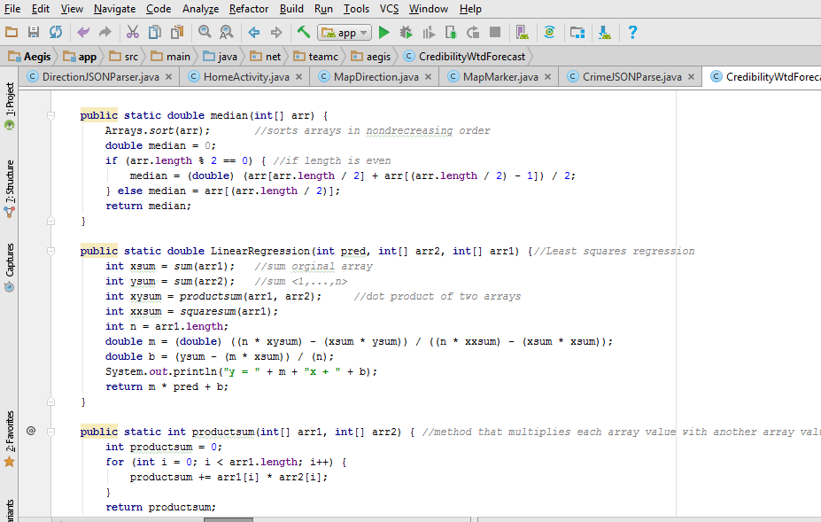
Algorithm Sample Code

Slide 7
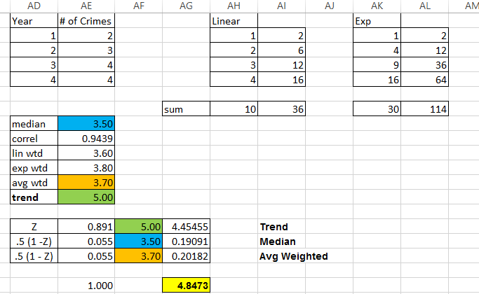
Algorithm Sample

Slide 8
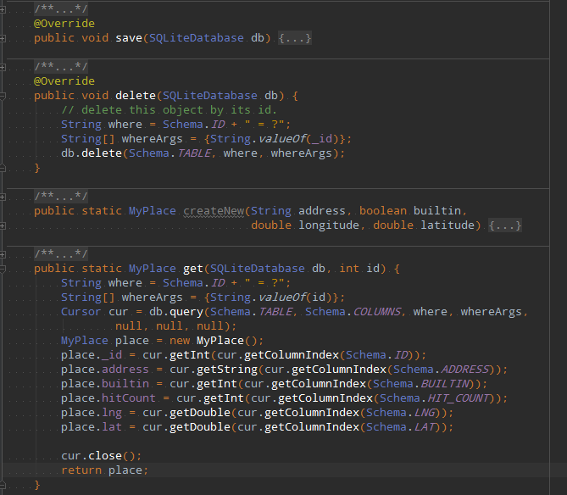
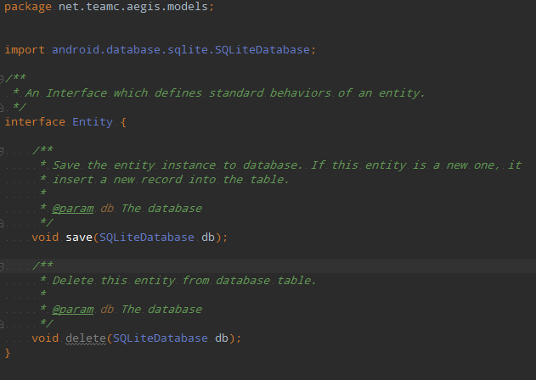
User Preference & Places

Slide 9
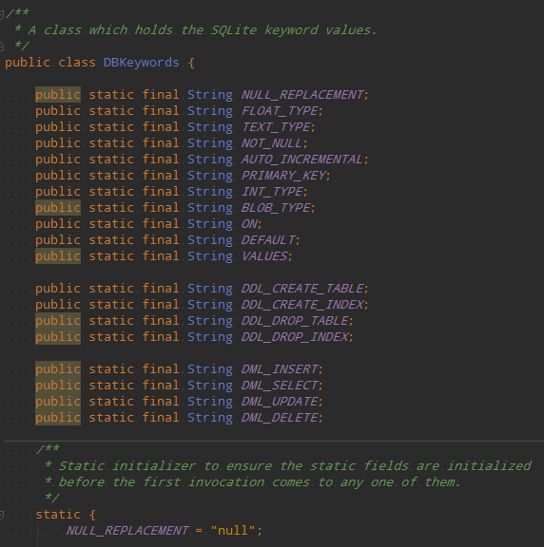
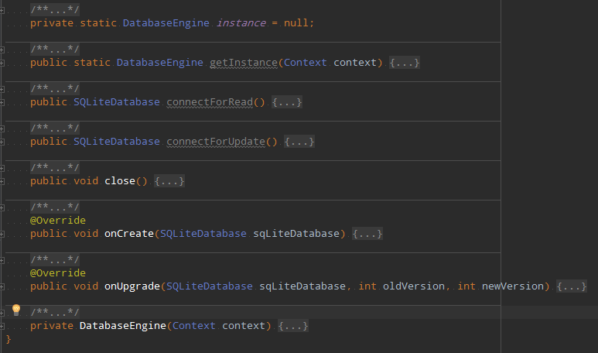
DB Driver

Slide 10
Next Sprint
Lou: Finish controller objects for settings
Jason: Finish user preference related objects
Victor: Searching Ul design
Kevin: Implement CrimeJSONParse into algorithm
Peter: Hopefully finish up CrimeJSONParse

