Slide 1
Aegis Sprint3
Team C

Slide 2
Tasks Done
Finished setup repo
Every local machine can share code through repo
Code works on all local machines
Google Maps Framework
UI Design Mockup (Partially Done)
Local database ERD

Slide 3
Ongoing
Let map zoom in your physical address and zoom in your searching address
Customizable settings library
Object Modeling

Slide 4
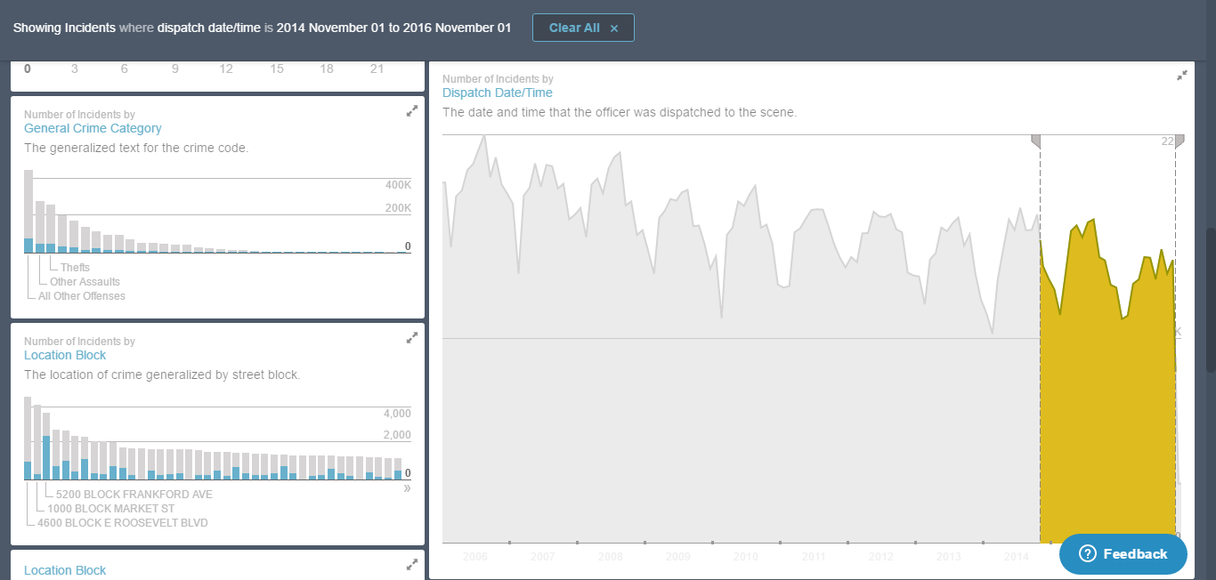
Crime Rates/Trend

Slide 5
Crime Algorithm
Ideal algorithm: combine forecast from past 10 years’ data and recent 30 day activity
Forecast = Z*Trend + .5(1-Z)*Median + .5(1-Z)*(Linear Weighted + Exponential Weighted)/2
Z is correlation squared → forecast changes depending on linearity
Potential Problem: can the app query to find all the data needed from JSON parser?

Slide 6
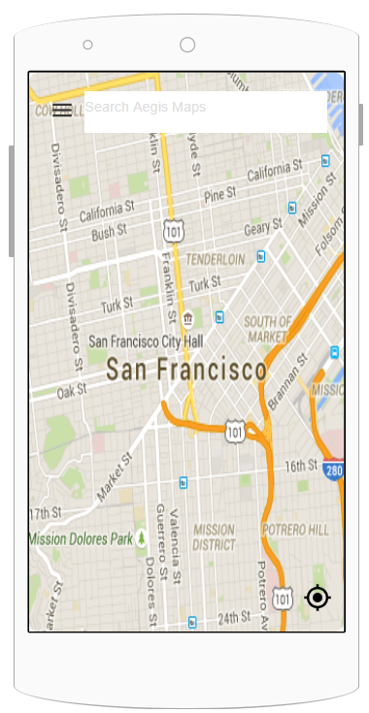
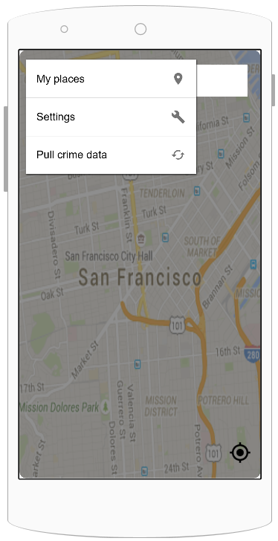
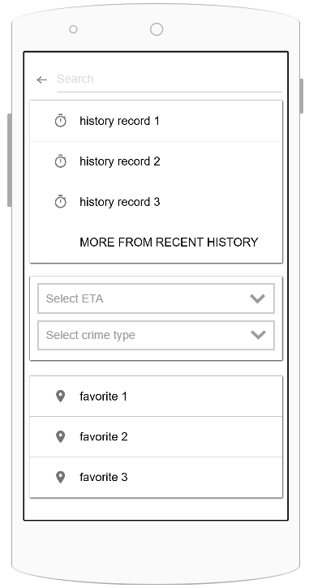
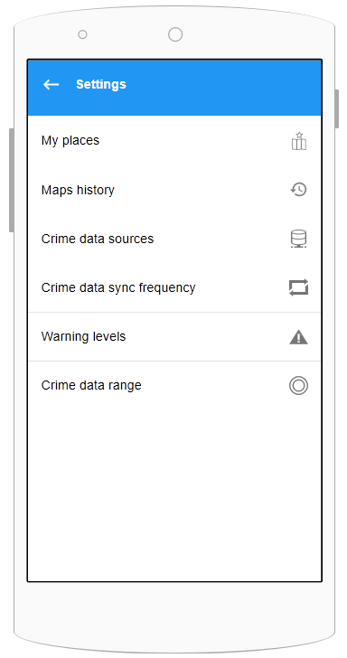
UI Mockup

Slide 7
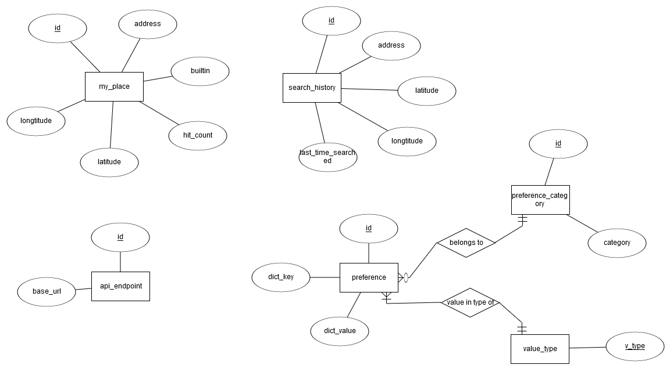
Object Modeling

Slide 8
Next Sprint
Jason: DB driver and object classes, public interfaces for controller classes
Lou: Finish setup of settings library, begin to write functions that integrate controller classes into settings library.
Peter: Continue work on CrimeJSONParse class.
Mingyuan ：Continue working current location
Kevin: work on getting access to Phila’s crime level weighting, implement algorithm with Peter’s code

