Slide 1

Detecção de Áreas de Florestas Invariantes em Séries Temporais Utilizando Random Forest
Eduardo Ribeiro Lacerda
Fluminense Federal University (UFF)
International Institute for Sustainability (IIS)

Slide 2
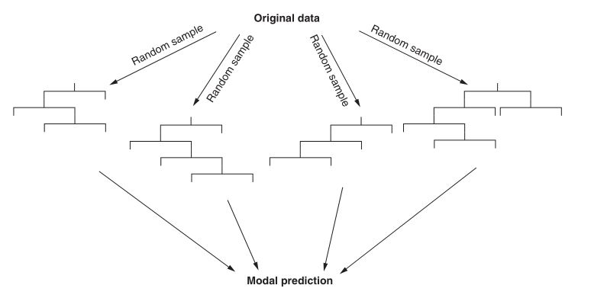
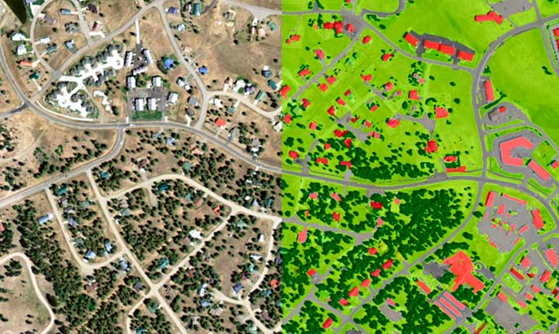
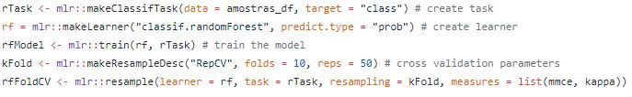
What is this course about?

Slide 3

Extra material
Decision Trees:
https://www.youtube.com/watch?v=7VeUPuFGJHk&ab_channel=StatQuestwithJoshStarmer
Random Forest:
https://www.youtube.com/watch?v=J4Wdy0Wc_xQ&t=7s&ab_channel=StatQuestwithJoshStarmer
https://www.youtube.com/watch?v=nyxTdL_4Q-Q&ab_channel=StatQuestwithJoshStarmer

