Slide 1

Land Use Land Cover Classification using Machine Learning Methods
Eduardo Ribeiro Lacerda
Fluminense Federal University (UFF)
International Institute for Sustainability (IIS)

Slide 2
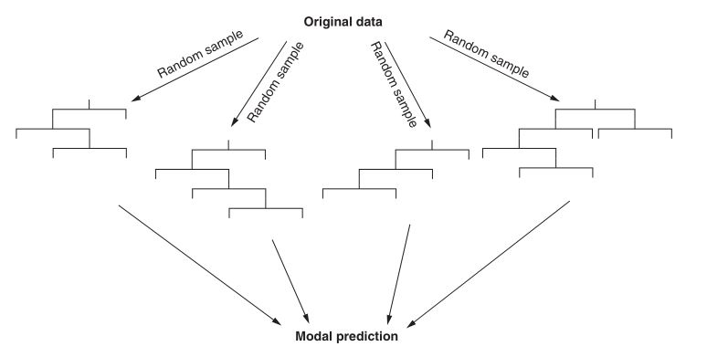
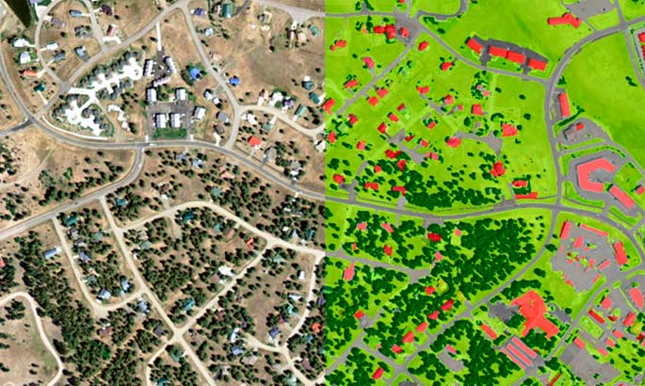
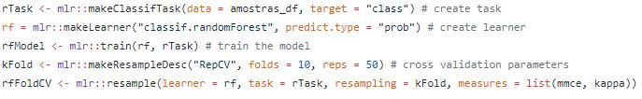
What is this course about?

Slide 3
What will we learn?
How to work with raster and vector data in R and Google Earth Engine
How to get some good samples to train your model
How to clean and prepare your data
How to apply machine learning methods like Random Forest to classify satellite images
How to improve your model
How to validate your results
Export and visualize output data

Slide 4
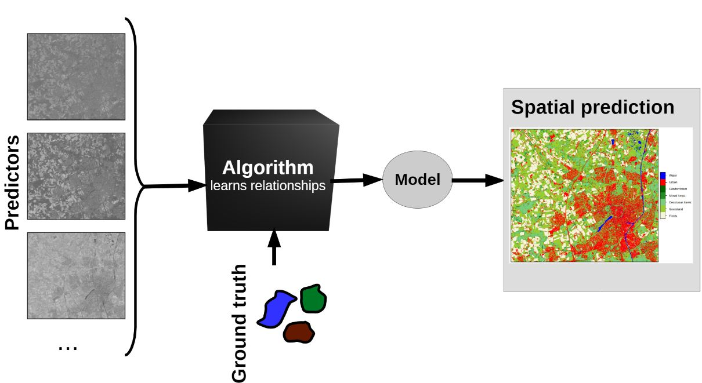
So…the main idea is to…
First get some good input satellite image to serve as predictor variables
Collect good samples to train the model
Train the model to do some tests to improve even more the final results
Use the model to classify the satellite raster data and create a beautiful final land use map :-)
Hanna Meyer 2020

Slide 5
About the input data: examples of available satellite/sensor data
Platform/Sensor | Spatial Resolution | Temporal Resolution | Availability
Landsat MSS | 79 | 16 days | started in 1972
Landsat TM | 30 | 16 days | started in 1982
Landsat ETM+ | 30 | 16 days | started in 1999
Landsat 8 OLI | 30 | 16 days | started in 2013
Landsat 9 OLI-2 | 30 | 16 days | mid 2021
Sentinel 2 | 10-20 | 5/10 days | started in 2014
MODIS | 250-1000 | 4 per day | started in 2000

Slide 6
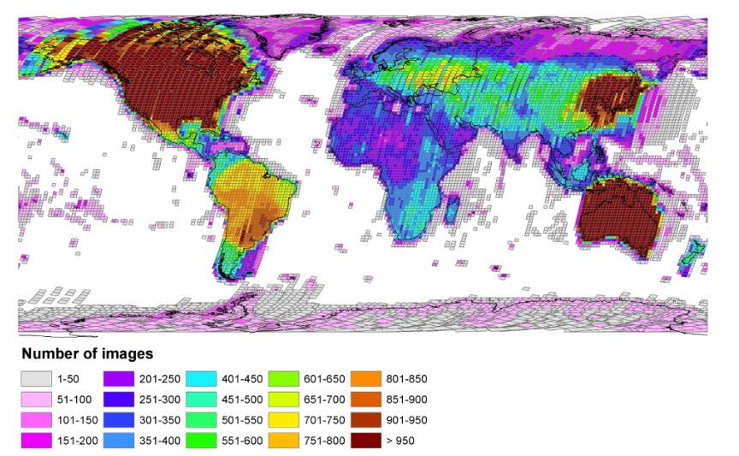
Accessible Landsat data
Wulder et al., 2015

Slide 7
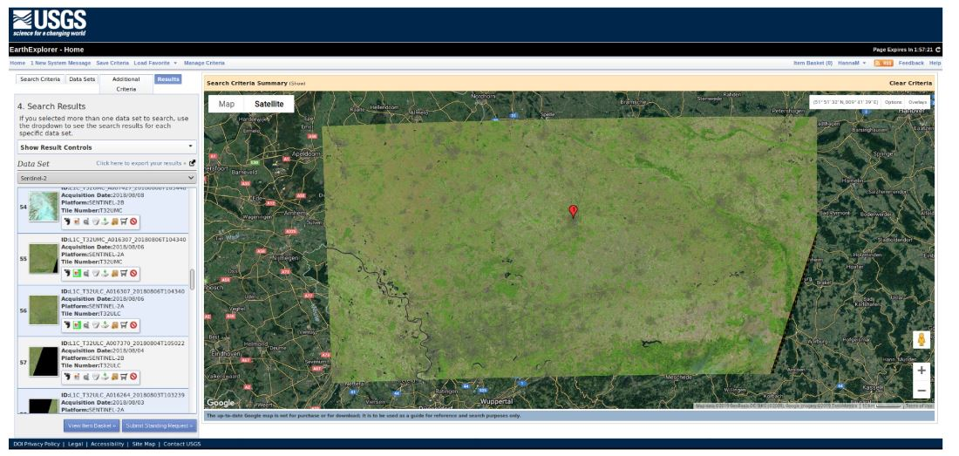
And how we can access them?

Slide 8
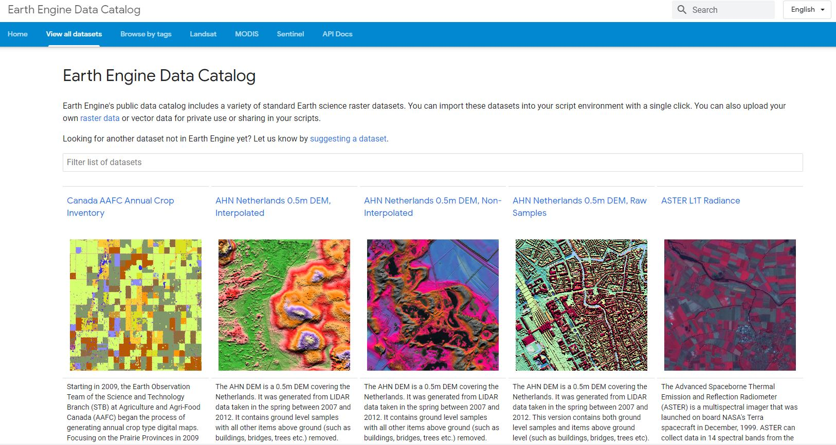
And how we can access them?

Slide 9
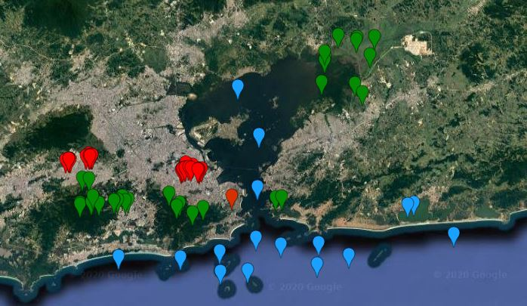
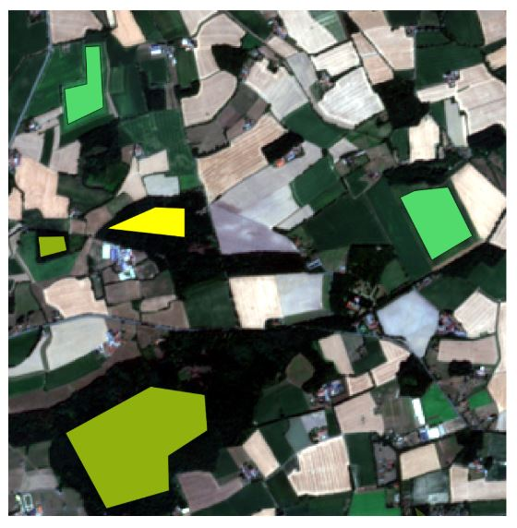
I downloaded the image. What do I do now?
Point data
Polygon data
Hanna Meyer 2020

Slide 10
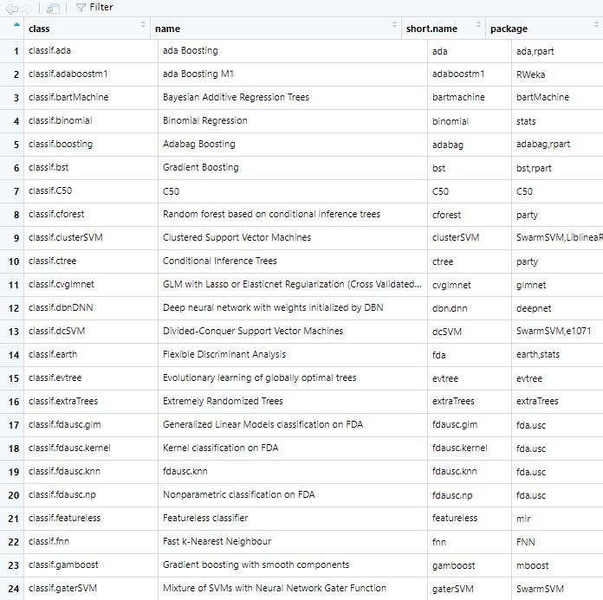
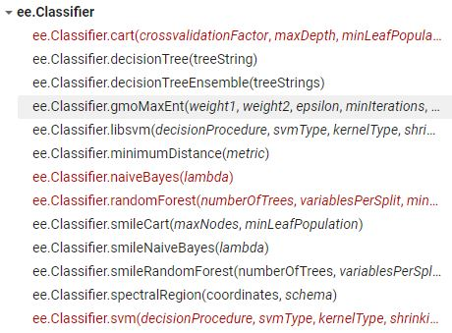
Now we choose the algorithm to use
There are many options…

Slide 11
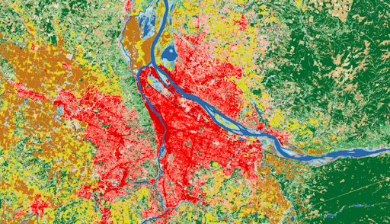
Output data
Urban
Forest
Bare Soil
Grasslands
Pasture
Others?

Slide 12
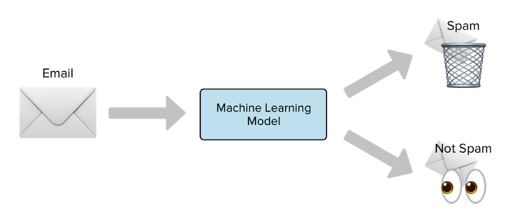
Bias-variance trade-off

Slide 13
Bias-variance trade-off
Underfitting and Overfitting are two important sources of error in model building. It also reduce the generalizability of our model.
Underfitted – Your model is too simple and is biased towards misclassifying certain types of classes. A model that is underfitted will perform poorly on both the data we use to train it and with new data.
Overfitted – Your model is too complex and is modeling noise in the data that you used to train it. A model that is overfitted will perform well on the data used to train it, but poorly on new data. So, that not good!
With overfitting we are modeling noise. And the pattern of noise is very specific to an individual dataset!
Ryns, 2020

Slide 14
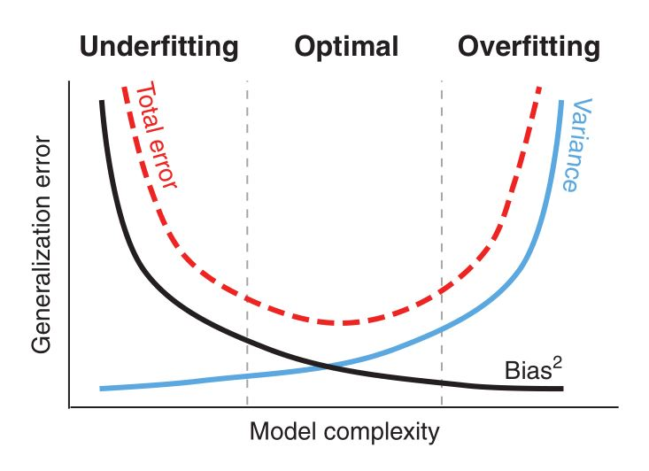
Bias-variance trade-off
Generalization error is the proportion of erroneous predictions a model makes and is a result of overfitting and underfitting.
The error associated with overfitting (too complex a model) is variance.
The error associated with underfitting (too simple a model) is bias.
An optimal model balances this trade-off.
Ryns, 2020

Slide 15
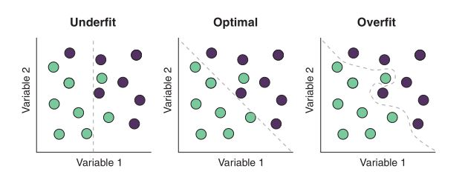
Bias-variance trade-off
The dotted line represents a decision boundary (model)
The more complex model is more likely to moss local differences in our data!
So, how can I tell if I’m underfitting or overfitting? The question is a technique called cross-validation.
Ryns, 2020

Slide 16
Cross-validation
The solution is to evaluate the performance of our model using data that the model hasn’t seen yet! We can do that collection future data, but its better to just split the training set as training and test set.
Doing that we can use some performance metrics to show how well the model will perform on unseen data.
Types of cross-validation
Holdout cross-validation
K-fold cross-validation
Leave-one-out cross-validation
Ryns, 2020

Slide 17
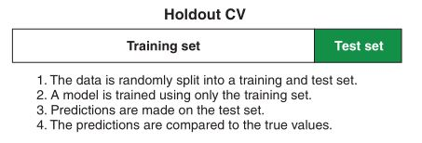
Cross-validation
Ryns, 2020

Slide 18
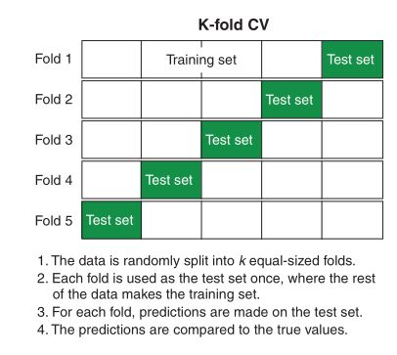
Cross-validation
Ryns, 2020

Slide 19
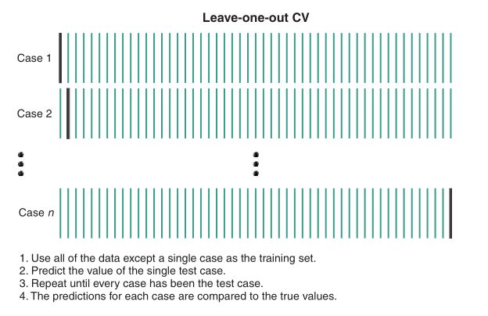
Cross-validation
Ryns, 2020

Slide 20
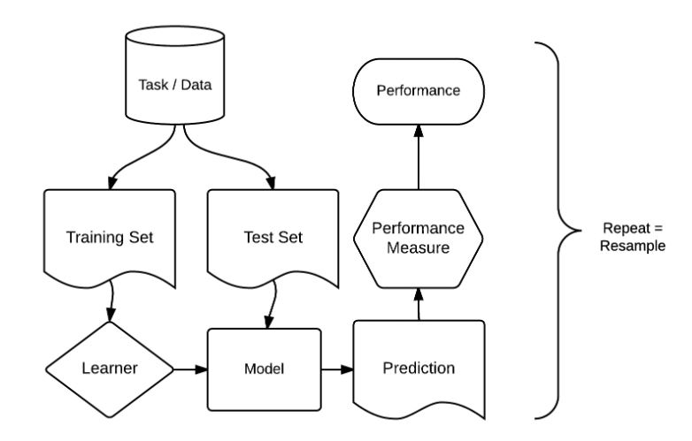
The typical workflow

Slide 21
Practice time!

Slide 22

Extra material
Decision Trees:
https://www.youtube.com/watch?v=7VeUPuFGJHk&ab_channel=StatQuestwithJoshStarmer
Random Forest:
https://www.youtube.com/watch?v=J4Wdy0Wc_xQ&t=7s&ab_channel=StatQuestwithJoshStarmer
https://www.youtube.com/watch?v=nyxTdL_4Q-Q&ab_channel=StatQuestwithJoshStarmer

Slide 23
Extra material
MLR documentation:
https://arxiv.org/pdf/1609.06146.pdf
MLR3 documentation:
https://mlr3book.mlr-org.com/
Tidymodels:
https://www.tidymodels.org/
https://www.tmwr.org/

