Slide 1

Exercises using Random Forest

Slide 2
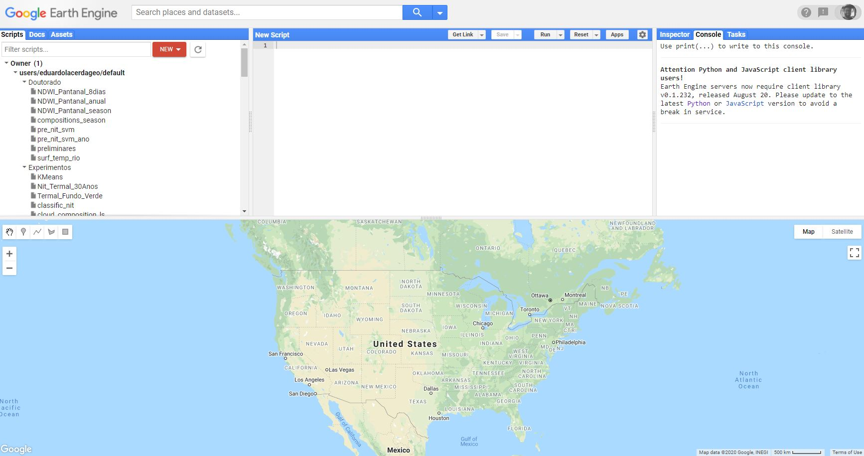
What to do
Access your Google Earth Engine account

Slide 3
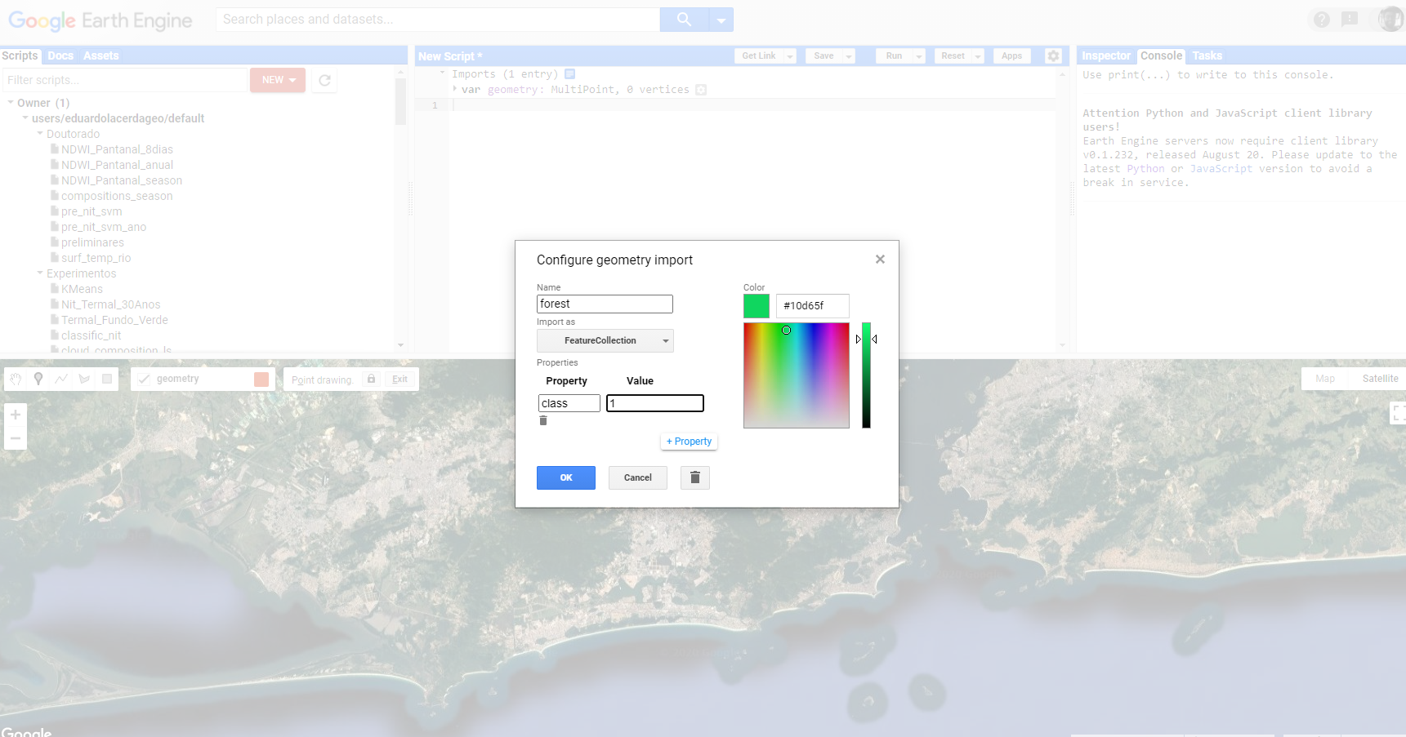
What to do
Collect some (point) samples from a region of your interest (roi). Change the “import as” field from Geometry to Feature Collection, add the property of your point data and name it too.

Slide 4
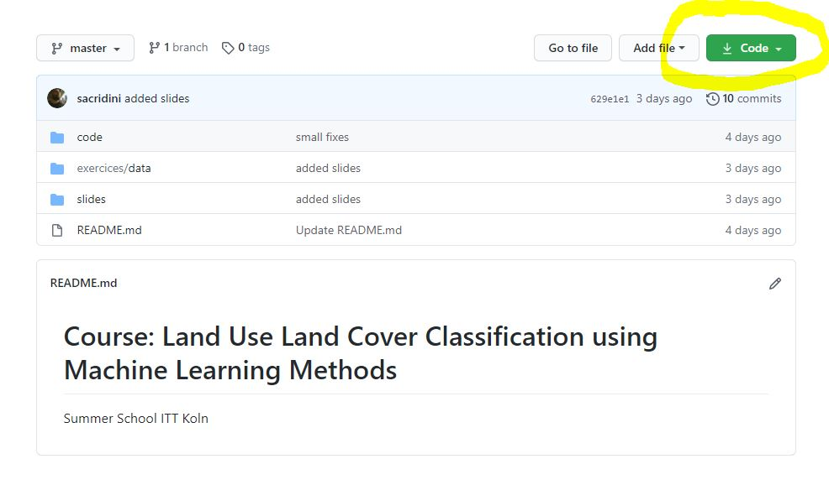
What to do
Go to: https://github.com/sacridini/lulc_ml_methods_course
Download the repository content

Slide 5
What to do
Copy the code from: https://github.com/sacridini/lulc_ml_methods_course/blob/master/code/gee/lulc_gee.js
Paste it in your Earth Engine project and change the script to work with your data

Slide 6
What to do
Export the results and load in a GIS software of your preference

Slide 7
Exercise Number 2
Get the R scripts from the repository
Get the raster file and the samples shapefile file from the repository
Install the Raster, SF and MLR packages in your computer
Run the “mlr_class.R” script in your R setup

