Slide 1

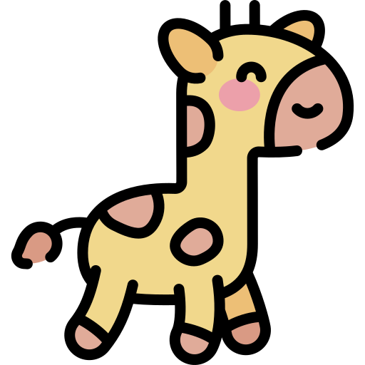


Does the animal have a long tail?
Yes
No
Do they eat leaves?
Do they have a trunk?
Yes
Yes
No
No

