Slide 1
A SEMI-SUPERVISED BI-LINGUAL TOPIC MODEL FOR IT TICKETS
ANWIN VARGHESE
2021MCS120017
December 10, 2023

Slide 2
CONTENTS
Introduction
Problem Statement
Challenges
Project Objectives
Project Plan
Datasets
Topic Models & Evaluation Metrics
Objective-1 Implementation
Objective-2 Implementation
Proposed Novel TM Design
Summary
References

Slide 3
INTRODUCTION
Customer support is one of the main aspects of any business – products or services for retaining customers and a key goodwill feature that can lead to further market capture.
Support request is received in multiple ways. Customer requests in social media, call helpline number, email customer support mailbox, use product/service chatbot, visits service centre etc. All these get aggregated in an IT ticket management tools.
All the support tickets needs to be classified to the correct product/service problem area in order to provide the right support within expected Service Level Agreements (SLA). Breach of SLA leads to huge financial penalty & loss of goodwill.
In order to provide timely support within agreed SLA there is need to classify the IT tickets accurately and fast.
Practical industry scenarios do not generally require either a supervised or an unsupervised classification and generally requires a semi-supervised short text classification.

Slide 4
CHALLENGES
IT ticket text is user generated content (UGC) and is short-text with limited count of words.
IT ticket text might contain domain related jargons. Hence, it is challenging to come up with a generic topic classification model which is domain agnostic.
IT ticket text might be composed of different languages due to the globalization effect.
IT tickets might require topic categorization and sub-categorization depending on the product/service.
IT ticket text might contain private, confidential & restricted text, hence we need to mask or remove these texts before applying the classification model.
There exists very few non-English IT ticket datasets.

Slide 5
PROBLEM STATEMENT
Given a large corpus of IT tickets in English and French, we need to optimally categorize and segregate the tickets.

Slide 6
PROJECT OBJECTIVES
Project Objective 1 (PO1) – What are the existing Topic Models available for short text and IT ticket classification?
Project Objective 2 (PO2) – What are the various short-text Topic Modeling evaluation metrics available ?
Project Objective 3 (PO3) – Propose a novel semi-supervised short text classification algorithm intended for IT ticket classification.

Slide 7
PROJECT PLAN
Milestone | Timelines (tentative)
Domain identification & dataset collection | September 15, 2023
Implementation of Objective 1 | October 15, 2023
Implementation of Objective 2 | November 30, 2023
Implementation of Objective 3 | March 15, 2024

Slide 8
DATASETS
latest_ticket_data.csv
Dataset of an IT company, internal service requests. The data set is in the csv format and contains 3000 internal service requests with 2 features.
URL - https://www.kaggle.com/datasets/aniketg11/supportticketsclassification/download?datasetVersionNumber=1
all_tickets.csv
Dataset of an IT company, internal service requests. The data set is in the csv format and contains 48,549 internal service requests with 9 features.
URL - https://www.kaggle.com/datasets/aniketg11/supportticketsclassification/download?datasetVersionNumber=1
complaints-2021-05-14_08_16_.json
Dataset of a Bank – JP Morgan, external customer complaints. The data set is in the Json format and contains 78,313 internal service requests with 22 features.
URL - https://www.kaggle.com/datasets/venkatasubramanian/automatic-ticket-classification/download?datasetVersionNumber=1
support-logiciels-libres-interministeriel-2012-2015-tickets.csv
Dataset contains list of tickets in French language opened as part of the inter-ministerial free software support market between the end of 2012 and 2015. It contains 517 internal service requests with 10 features.
URL - https://www.data.gouv.fr/fr/datasets/r/69b7e2c1-36e1-4ef4-a709-6f694b85735e

Slide 9
TOPIC MODELS & EVALUATION METRICS
Topic Models
Latent Semantic Analysis (LSA)
Latent Dirichlet Allocation (LDA)
Hierarchical Dirichlet Process (HDP)
Non-negative Matrix Factorization (NMF)
Correlation Explanation (CorEX)
BERT - Bidirectional Encoder Representations from Transformers – BERTopic
TM Evaluation Metrics
Qualitative Metrics
Quantitative Metrics

Slide 10
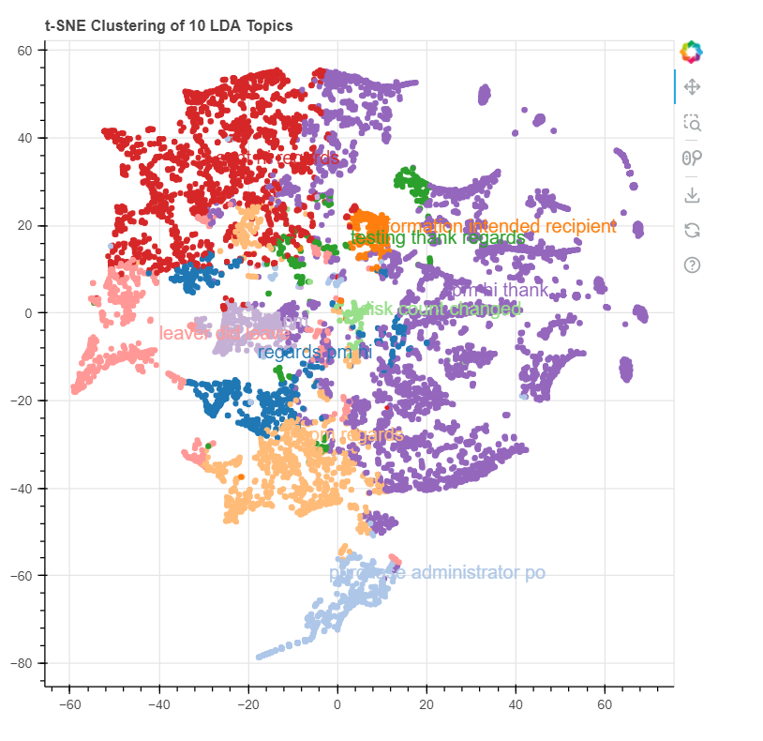
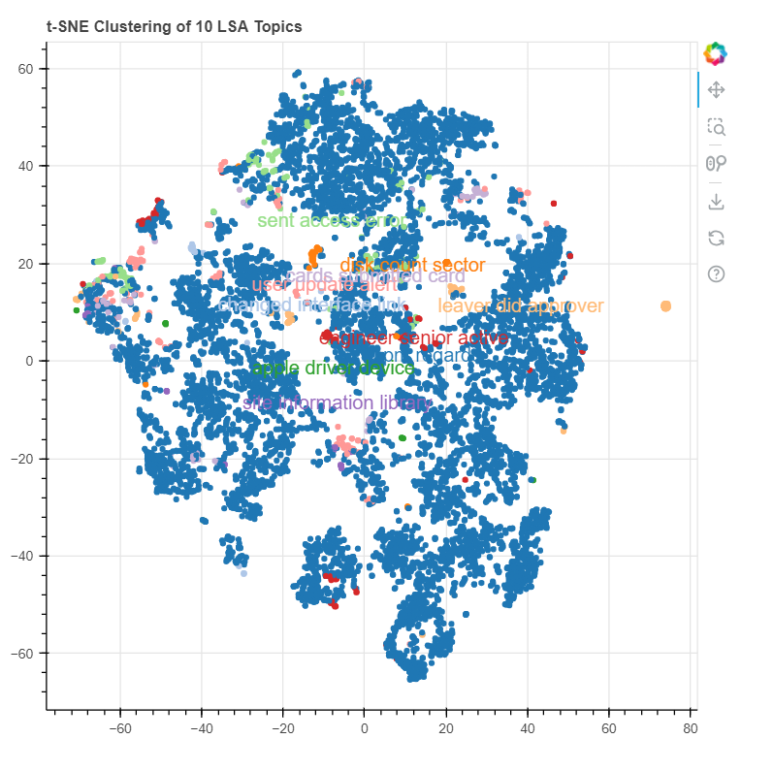
OBJECTIVE-1 IMPLEMENTATION SciKit Learn- LDA & LSA

Slide 11
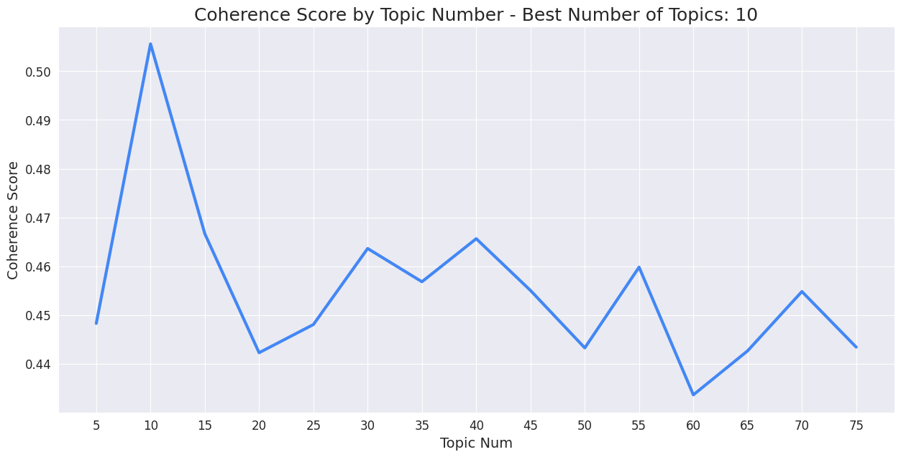
OBJECTIVE-1 IMPLEMENTATION Gensim - NMF

Slide 12
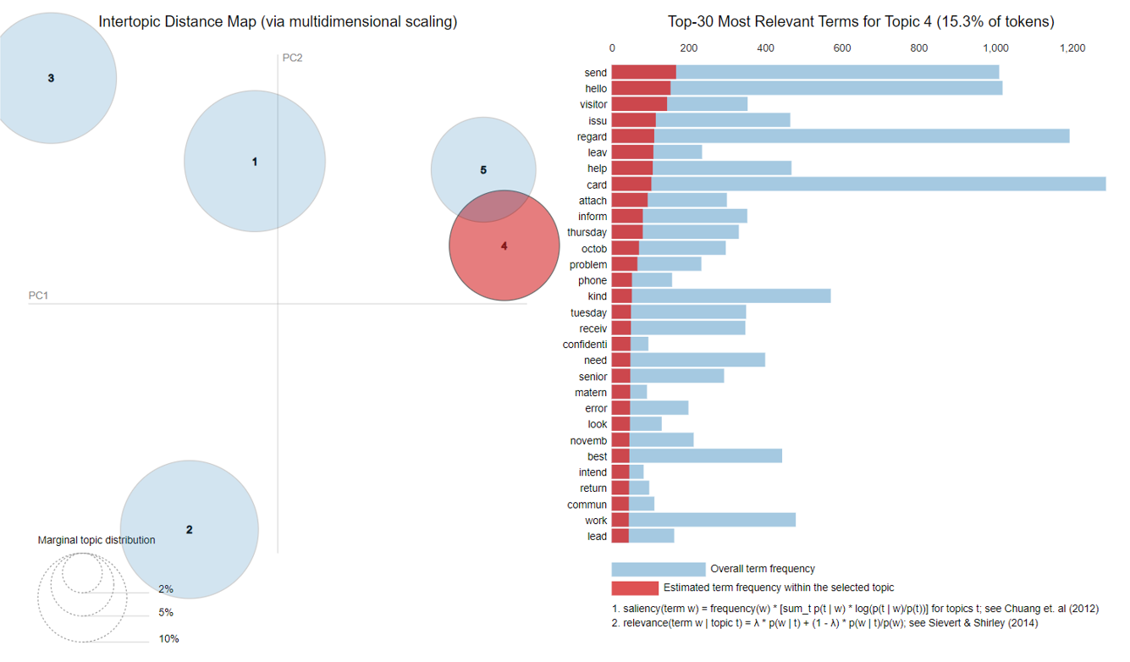
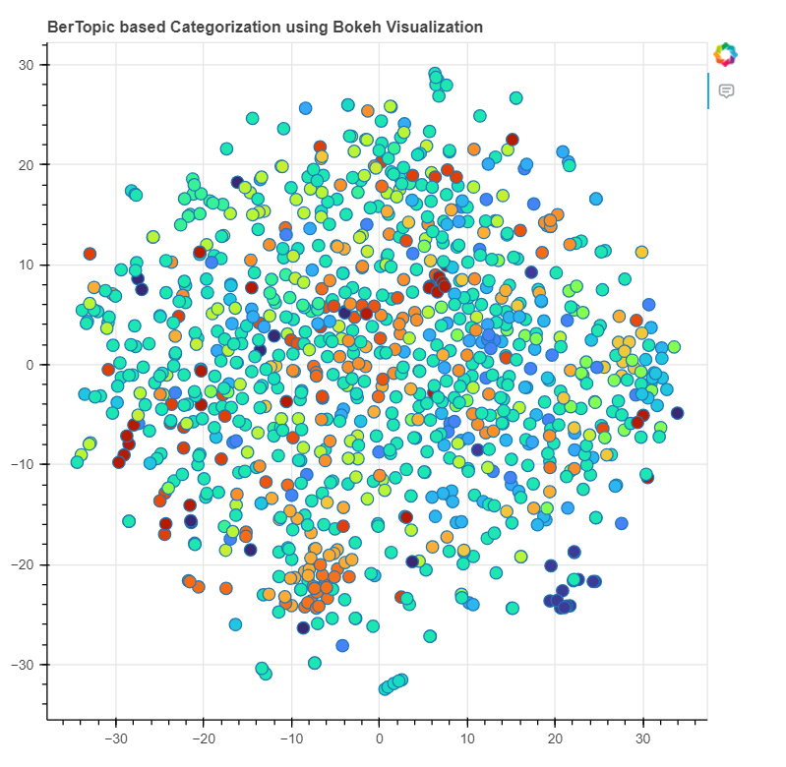
OBJECTIVE-1 Visualization pyLDAvis & Bokeh

Slide 13
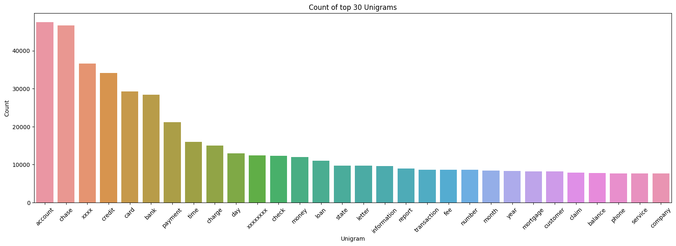
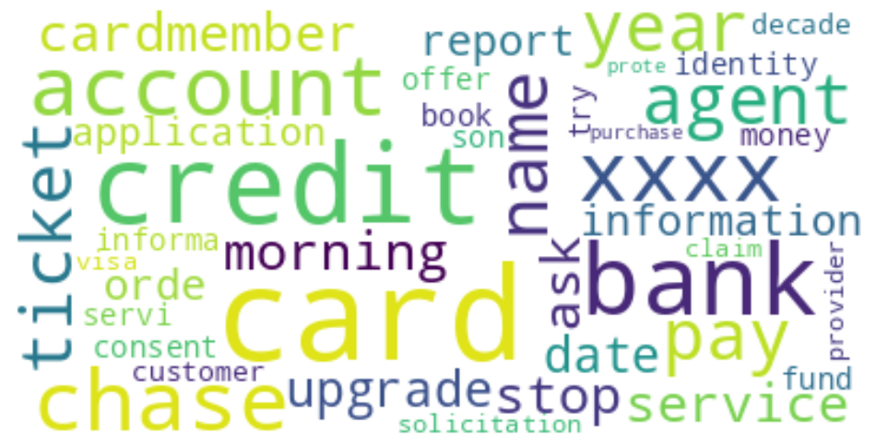
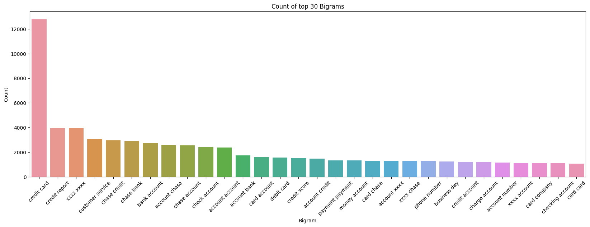
OBJECTIVE-2 IMPLEMENTATION Quality Metrics – Word Cloud & Top n words

Slide 14
OBJECTIVE-2 IMPLEMENTATION Model Evaluation for all_tickets
Model | Coherence Score (c_v) | Coherence Score (u_mass) | Coherence Score (c_uci) | Coherence Score (c_npmi)
LDA | 0.7308994079114373 | -19.153225808973993 | -12.93062346333321 | -0.4684703853988069
LDA Multicore | 0.7338597967242195 | -19.144084181043894 | -13.089750994834631 | -0.4740096418208119
Ensemble LDA | 0.7066598801063046 | -18.581058351487716 | -12.456365427104426 | -0.4511255906960396
LSI | 0.6872399455544336 | -17.672569947901017 | -11.006821573535806 | -0.40597623585281106
HDP | 0.7553662975462837 | -19.687586738830632 | -13.13538967144806 | -0.4755634626871647
NMF | 0.7012034363093355 | -18.332419877402383 | -12.788289975364261 | -0.46583825240001814
CorEX | 0.44277923134354824 | -4.335385217665007 | -2.029696947662671 | -0.031675891913764485
BerTopic | 0.49108100127495175 | -5.797941219415932 | -1.9587533293244106 | 0.036257978391834346

Slide 15
OBJECTIVE-2 IMPLEMENTATION Model Evaluation for complaints
Model | Coherence Score (c_v) | Coherence Score (u_mass) | Coherence Score (c_uci) | Coherence Score (c_npmi)
LDA | 0.7195216847431853 | -18.64964066879893 | -12.580378895406016 | -0.45678583211515306
LDA Multicore | 0.6547900487206105 | -17.234188595419884 | -11.228701099762565 | -0.4069495895289611
Ensemble LDA | 0.5824401685143206 | -15.36872627636032 | -9.638171191794743 | -0.35029990502053676
LSI | 0.6118690708072779 | -15.697452121300406 | -10.842321267634834 | -0.3955119071279773
HDP | 0.7443648901047881 | -19.459504232968918 | -12.235247979953696 | -0.4434985139158049
NMF | 0.6778730187096647 | -17.472318166060347 | -12.590358805766675 | -0.45969405877446834
CorEX | 0.4043841528097378 | -2.467365338613526 | -0.21512798629177698 | 0.0054825905980013965
BerTopic | 0.5304336847668605 | -2.0991738393963684 | -0.16214295288344877 | 0.052055372170235786

Slide 16
OBJECTIVE-2 IMPLEMENTATION Model Evaluation for latest_tickets
Model | Coherence Score (c_v) | Coherence Score (u_mass) | Coherence Score (c_uci) | Coherence Score (c_npmi)
LDA | 0.7832244706640701 | -21.009950636239633 | -16.133576597787588 | -0.5781194831584026
LDA Multicore | 0.782590625787148 | -20.997562481908282 | -16.12280441955316 | -0.5779547165429033
Ensemble LDA | 0.7819971614661654 | -20.996827589613474 | -16.067431566363272 | -0.5760336643574712
LSI | 0.7982852663214071 | -21.470707540584513 | -16.471058664580795 | -0.5916522029694039
HDP | 0.798053673614751 | -21.37442244023256 | -16.5057534546176 | -0.5930764386865868
NMF | 0.7810169740126216 | -20.939570312150575 | -16.0832767367334 | -0.5758110704051623
CorEX | 0.39927431534158636 | -6.411422793204243 | -6.410802634834008 | -0.1887245213971136
BerTopic | 0.5016714665051119 | -5.106595975418942 | -2.2791326503119773 | 0.06153880262997759

Slide 17
OBJECTIVE-2 IMPLEMENTATION Model Evaluation for support_tickets
Model | Coherence Score (c_v) | Coherence Score (u_mass) | Coherence Score (c_uci) | Coherence Score (c_npmi)
LDA | 0.5497929557871808 | -23.038906709338264 | -19.44823501196065 | -0.7117129979274066
LDA Multicore | 0.5497929557871808 | -22.983634806459513 | -19.44823501196065 | -0.7117129979274066
Ensemble LDA | 0.5497929557871808 | -22.983634806459513 | -19.44823501196065 | -0.7117129979274066
LSI | 0.5497929557871809 | -22.764989383135845 | -19.44823501196065 | -0.7117129979274065
HDP | 0.549792955787181 | -22.806187180967324 | -19.448235011960648 | -0.7117129979274066
NMF | 0.5497929557871809 | -22.75547854596353 | -19.44823501196065 | -0.7117129979274066
CorEX | 0.4815246979171907 | -18.7793655343436 | -14.190163078440397 | -0.44581259054100075
BerTopic | 0.38927932703655355 | -10.927026441593382 | -6.517487748752832 | -0.09106441464177345

Slide 18
Semi-Supervised Topic Models
Guided LDA (Seeded LDA)
Anchored CorEX
Guided BERT
Zero-Shot and Few-Shot
Task-aware representation of sentences (TARS) within Flair
NLI BART (Bidirectional and Auto-Regressive Transformer) & roBERTa (Robustly Optimized BERT Pretraining Approach) within Hugging Face
These Models largely used for short text data User Generated Content emotions detection, summarization etc. Possibly can be used for IT tickets first-level categorizations as well.

Slide 19
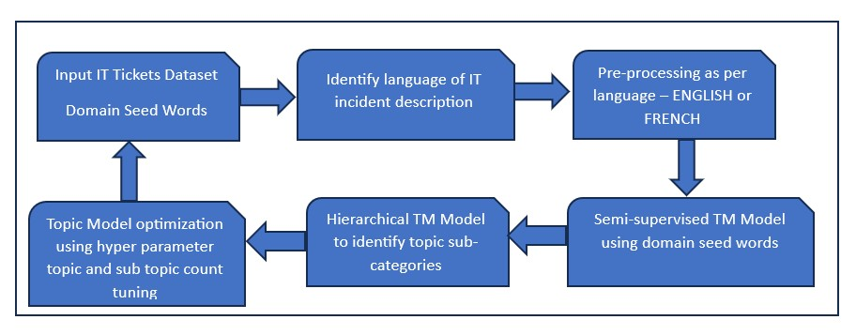
PROPOSED NOVEL TM DESIGN

Slide 20
SUMMARY
The project objectives PO1 is implemented using LDA, LSA, HDP, NMF, CorEX & BERTopic
The project objective PO2 is implemented using qualitative & quantitative TM evaluations metrics
For project objective PO3, experiments on leveraging a semi-supervised and hierarchical TM as per the proposed TM design is currently in progress.

Slide 21
REFERENCES
Alessandro Zangari, Matteo Marcuzzo, Michele Schiavinato, Andrea Gasparetto, Andrea Albarelli, Ticket automation: An insight into current research with applications to multi-level classification scenarios, Expert Systems with Applications, Volume 225, 2023
Gabriele Papadia, Massimo Pacella, Massimiliano Perrone, and Vincenzo Giliberti. A comparison of different topic modeling methods through a real case study of italian customer care. Algorithms, 16(2):94, February 2023.
C. Pidej and S. Thaicharoen, "Bilingual IT Service Desk Ticket Classification Using Language Model Pre-training Techniques," 2021 16th International Joint Symposium on Artificial Intelligence and Natural Language Processing (iSAI-NLP), Ayutthaya, Thailand, 2021, pp. 1-6, doi: 10.1109/iSAI-NLP54397.2021.9678179.
Zicari P., Folino G., Guarascio M., Pontieri L. Discovering accurate deep learning based predictive models for automatic customer support ticket classification. Proceedings of the 36th annual acm symposium on applied computing, Association for Computing Machinery, New York, NY, USA (2021), pp. 1098-1101
Al-Hawari F., Barham H., A machine learning based help desk system for IT service management
Journal of King Saud University - Computer and Information Sciences, 33 (6) (2021), pp. 702-718, 10.1016/j.jksuci.2019.04.001
A Kishaloy Task-Halder et al, Aware Representation of Sentences for Generic Text Classification, roceedings of the 28th International Conference on Computational Linguistics, 2020
Jacob Devlin, Ming-Wei Chang, Kenton Lee, and Kristina Toutanova. BERT: Pre-training of deep bidirectional transformers for language understanding. 2018.
Koehler, Jana, et al. "Towards intelligent process support for customer service desks: Extracting problem descriptions from noisy and multi-lingual texts." Business Process Management Workshops: BPM 2017 International Workshops, Barcelona, Spain, September 10-11, 2017, Revised Papers 15. Springer International Publishing, 2018.

