Slide 1
A MULTI SHOT TOPIC MODEL FOR IT SUPPORT TICKETS
ANWIN VARGHESE
2021MCS120017
PHASE II – REVIEW II
April 6, 2024

Slide 2
CONTENTS
Introduction
Challenges
Problem Statement
Project Objectives
Project Plan
Datasets
Topic Models & Evaluation Metrics
Objective-1 Implementation
Objective-2 Implementation
Keyword Extraction
Novel NLTK Wordnet Sysnet Based Keyword Extraction Model Algorithm
Implementation - Seeded LDA Model using different keyword extraction techniques
Implementation - Few Shot Models
Implementation - Zero Shot Models
LSTM RNN Topic Model
Proposed Multi Shot Topic Model
Novel NLTK Wordnet Shortest Path Based & WuPalmer Score Multi Shot Topic Model Algorithms
Implementation of novel NLTK Wordnet Shortest Path Based & WuPalmer Score Algorithms on multi shot topic model
Challenges, Limitations and Future
References

Slide 3
Summary until last review
Model evaluations using user input keywords on existing TM models including
LDA
LSI
NMF
HDP
CorEX
BerTopic
SeededLDA

Slide 4
INTRODUCTION
Customer support is one of the main aspects of any business – products or services for retaining customers and a key goodwill feature that can lead to further market capture.
Support request is received in multiple ways. Customer requests in social media, call helpline number, email customer support mailbox, use product/service chatbot, visits service centre etc. All these get aggregated in an IT ticket management tools.
All the support tickets needs to be classified to the correct product/service problem area in order to provide the right support within expected Service Level Agreements (SLA). Breach of SLA leads to huge financial penalty & loss of goodwill.
In order to provide timely support within agreed SLA there is need to classify the IT tickets accurately and fast.
Practical industry scenarios do not generally require either a supervised or an unsupervised classification and generally requires a semi-supervised short text classification.

Slide 5
CHALLENGES
IT ticket text is user generated content (UGC) and is short-text with limited count of words.
IT ticket text might contain domain related jargons. Hence, it is challenging to come up with a generic topic classification model which is domain agnostic.
IT ticket text might be composed of different languages due to the globalization effect.
IT tickets might require topic categorization and sub-categorization depending on the product/service.
IT ticket text might contain private, confidential & restricted text, hence we need to mask or remove these texts before applying the classification model.
There exists very few non-English IT ticket datasets.

Slide 6
PROBLEM STATEMENT
Given a large corpus of IT tickets in English, we need to optimally categorize and segregate the tickets.

Slide 7
PROJECT OBJECTIVES
Project Objective 1 (PO1) – Study existing NLP pre-processing techniques and Topic Models for classification especially in the context of IT tickets.
Project Objective 2 (PO2) – Study existing Topic Modeling evaluation metrics.
Project Objective 3 (PO3) – Propose a novel multi shot text classification model intended for IT tickets

Slide 8
DATASETS
latest_ticket_data.csv
Dataset of an IT company, internal service requests. The data set is in the csv format and contains 3000 internal service requests with 2 features.
URL - https://www.kaggle.com/datasets/aniketg11/supportticketsclassification/download?datasetVersionNumber=1
all_tickets.csv
Dataset of an IT company, internal service requests. The data set is in the csv format and contains 48,549 internal service requests with 9 features.
URL - https://www.kaggle.com/datasets/aniketg11/supportticketsclassification/download?datasetVersionNumber=1
complaints-2021-05-14_08_16_.json
Dataset of a Bank – JP Morgan, external customer complaints. The data set is in the Json format and contains 78,313 internal service requests with 22 features.
URL - https://www.kaggle.com/datasets/venkatasubramanian/automatic-ticket-classification/download?datasetVersionNumber=1
support-logiciels-libres-interministeriel-2012-2015-tickets.csv
Dataset contains list of tickets in French language opened as part of the inter-ministerial free software support market between the end of 2012 and 2015. It contains 517 internal service requests with 10 features.
URL - https://www.data.gouv.fr/fr/datasets/r/69b7e2c1-36e1-4ef4-a709-6f694b85735e

Slide 9
TOPIC MODELS & EVALUATION METRICS
Topic Models
Latent Semantic Analysis (LSA)
Latent Dirichlet Allocation (LDA)
Hierarchical Dirichlet Process (HDP)
Non-negative Matrix Factorization (NMF)
Correlation Explanation (CorEX)
BERT - Bidirectional Encoder Representations from Transformers – BERTopic
Seeded/Guided LDA
Guided BERT
Zero Shot, One Shot or Few Shot Models
Embedding Models – all-MiniLM-L6-v2, thenlper/gte-small, thenlper/gte-base, BAAI/bge-base-en-v1.5, gtr-t5-base
Pretrained models – NER Flair, TARS, SetFit (Hugging Face)

Slide 10
TM Evaluation Metrics
TM Evaluation Metrics
Qualitative Metrics – Coherence
Topic Coherence Metric assesses is how well a topic is ‘supported’ by a text set (called reference corpus). It uses statistics and probabilities drawn from the reference corpus, especially focused on the word’s context, to give a coherence score to a topic.
There is no one way to determine whether the coherence score is good or bad. The score and its value depend on the data that it's calculated from. For instance, in one case, the score of 0.5 might be good enough but in another case not acceptable.
Maximize the C_V (Coherent Vector) score
U_mass to be close to zero
Maximise C_npmi (Normalized pointwise mutual information) ranges from -1 to 1
Maximise C_UCI (pmi with words and top words)
Quantitative Metrics – Accuracy
Accuracy is defined as the percentage of correct predictions out of all the observations
Accuracy = (True positives + True Negatives)/ (True positives + True negatives + False positives + False negatives)
Accuracy = (TP + TN)/ (TP + TN + FP + FN)

Slide 11
OBJECTIVE-2 IMPLEMENTATION Model Evaluation for all_tickets
Model | Accuracy | Coherence Score (c_v) | Coherence Score (u_mass) | Coherence Score (c_uci) | Coherence Score (c_npmi)
LDA | 0.089 | 0.462 | -3.609 | -1.842 | -0.041
LDA Multicore | 0.055 | 0.415 | -3.963 | -3.034 | -0.080
Ensemble LDA |  | 0.513 | -2.637 | -2.754 | -0.024
LSI |  | 0.369 | -3.161 | -1.884 | -0.071
HDP |  | 0.408 | -4.997 | -3.511 | -0.116
NMF |  | 0.600 | -18.332 | -12.788 | -0.466
CorEX |  | 0.443 | -4.335 | -2.030 | -0.032
BerTopic |  | 0.491 | -5.798 | -1.959 | 0.036

Slide 12
OBJECTIVE-2 IMPLEMENTATION Model Evaluation for complaints
Model | Coherence Score (c_v) | Coherence Score (u_mass) | Coherence Score (c_uci) | Coherence Score (c_npmi)
LDA | 0.458 | -2.286 | -0.947 | -0.011
LDA Multicore | 0.462 | -2.029 | -0.747 | -0.006
Ensemble LDA | 0.522 | -1.853 | -0.208 | 0.015
LSI | 0.390 | -1.983 | -0.965 | -0.032
HDP | 0.610 | -13.763 | -8.497 | -0.307
NMF | 0.495 | -1.885 | -0.501 | 0.004
CorEX | 0.404 | -2.467 | -0.215 | 0.005
BerTopic | 0.530 | -2.099 | -0.162 | 0.052

Slide 13
OBJECTIVE-2 IMPLEMENTATION Model Evaluation for latest_tickets
Model | Accuracy | Coherence Score (c_v) | Coherence Score (u_mass) | Coherence Score (c_uci) | Coherence Score (c_npmi)
LDA | 0.292 | 0.440 | -6.937 | -5.045 | -0.120
LDA Multicore | 0.179 | 0.462 | -5.753 | -4.619 | -0.103
Ensemble LDA | 0.2 | 0.516 | -3.163 | -1.034 | 0.031
LSI | 0.190 | 0.406 | -6.371 | -6.798 | -0.177
HDP | 0.005 | 0.639 | -16.336 | -13.552 | -0.479
NMF | 0.204 | 0.532 | -3.339 | -5.430 | -0.117
CorEX |  | 0.399 | -6.411 | -6.411 | -0.189
BerTopic |  | 0.502 | -5.107 | -2.279 | 0.062

Slide 14
OBJECTIVE-2 IMPLEMENTATION Model Evaluation for support_tickets
Model | Accuracy | Coherence Score (c_v) | Coherence Score (u_mass) | Coherence Score (c_uci) | Coherence Score (c_npmi)
LDA | 0.010 | 0.384 | -10.543 | -7.903 | -0.245
LDA Multicore | 0.0116 | 0.389 | -10.632 | -8.067 | -0.258
Ensemble LDA |  | 0.381 | -10.340 | -7.817 | --0.255
LSI |  | 0.374 | -10.979 | -8.152 | -0.252
HDP |  | 0.518 | -14.389 | -11.491 | -0.385
NMF |  | 0.448 | -12.642 | -9.725 | -0.307
CorEX |  | 0.482 | -18.779 | -14.190 | -0.446
BerTopic |  | 0.389 | -10.927 | -6.517 | -0.091

Slide 15
Keyword Extraction
User provided
Word Count
TF-IDF
KeyBERT
YAKE
Challenge
WordCount, TF-IDF, KeyBERT & YAKE would need a subset of document corpus to generate the keywords. However, the IT ticket classification would need to generate keywords from just the topic names (labels) alone. Domain expert User input of related words to the topic name can form the keywords. Hence, we need a novel keyword generator to automatically generate keywords,

Slide 16
Novel NLTK Wordnet Sysnet Based Keyword Extraction Model Algorithm
Feed Input as the list of topic names or labels
Get count of the topic names
For each topic name get the keywords (synonyms as default)
Remove any duplicates
Aggregate the keywords for all topic names as list

Slide 17
Seeded LDA Model using different keyword extraction techniques
Model | Accuracy | Coherence Score (c_v) | Coherence Score (u_mass) | Coherence Score (c_uci) | Coherence Score (c_npmi)
Raw | 0.219 | 0.504 | -4.581 | -4.464 | -0.115
Word Count | 0.229 | 0.426 | -6.907 | -5.015 | -0.119
TF-IDF | 0.182 | 0.490 | -6.797 | -6.111 | -0.189
KeyBERT | 0.230 | 0.371 | -6.875 | -5.523 | -0.150
YAKE | 0.241 | 0.392 | -6.786 | -5.081 | -0.118
Synonyms | 0.216 | 0.506 | -4.328 | -4.372 | -0.114

Slide 18
Seeded Multi-Core LDA Model using different keyword extraction techniques
Model | Accuracy | Coherence Score (c_v) | Coherence Score (u_mass) | Coherence Score (c_uci) | Coherence Score (c_npmi)
Raw | 0.286 | 0.487 | -4.547 | -4.607 | -0.104
Word Count | 0.418 | 0.419 | -5.741 | -4.424 | -0.108
TF-IDF | 0.186 | 0.532 | -3.405 | -3.891 | -0.069
KeyBERT | 0.453 | 0.440 | -5.688 | -4.886 | -0.119
YAKE | 0.435 | 0.430 | -5.945 | -5.869 | -0.160
Synonyms | 0.218 | 0.497 | -4.228 | -4.284 | -0.095

Slide 19
Few-Shot TM using pre-trained model - glove-twitter-25
Classes | Min KNN | Min Cosine | Mean KNN | Mean Cosine | Max KNN | Max Cosine
3 | 0.313 | 0.334 | 0.425 | 0.343 | 0.485 | 0.353
4 | 0.271 | 0.241 | 0.347 | 0.301 | 0.405 | 0.339
5 | 0.236 | 0.195 | 0.319 | 0.244 | 0.373 | 0.274

Slide 20
Few-Shot TM using pre-trained model - word2vec-google-news-300
Classes | Min KNN | Min Cosine | Mean KNN | Mean Cosine | Max KNN | Max Cosine
3 | 0.311 | 0.325 | 0.385 | 0.384 | 0.476 | 0.477
4 | 0.242 | 0.256 | 0.319 | 0.320 | 0.412 | 0.395
5 | 0.207 | 0.233 | 0.338 | 0.332 | 0.424 | 0.399

Slide 21
Zero-Shot BerTopic using different embedding models and keyword extraction techniques
Model | all-MiniLM-L6-v2 | thenlper/gte-small | thenlper/gte-base | BAAI/bge-base-en-v1.5 | gtr-t5-base
Raw | 0.098 | 0.238 | 0.134 | 0.056 | 0.010
Word Count | 0.078 | 0.105 | 0.259 | 0.089 | 0.079
TF-IDF | 0.060 | 0.229 | 0.195 | 0.045 | 0.028
KeyBERT | 0.013 | 0.183 | 0.159 | 0.029 | 0.026
YAKE | 0.064 | 0.133 | 0.103 | 0.096 | 0.080
Synonyms | 0.051 | 0.178 | 0.244 |  | 0.019

Slide 22
Zero-Shot TM using Existing models
Model | Accuracy
https://huggingface.co/facebook/bart-large-mnli_ | 0.2
https://huggingface.co/docs/setfit/index (Sentence Transformer) | 0.4
https://nlp.informatik.hu-berlin.de/resources/models/tars-base/tars-base-v8.pt (NER) | Not Yielding results

Slide 23
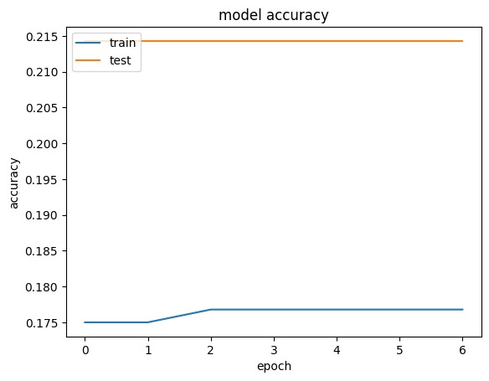
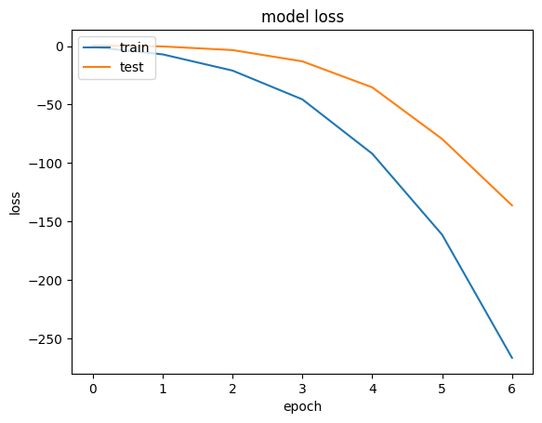
LSTM RNN Based Topic Model
Accuracy
loss
10/10 [==============================] - 4s 391ms/step - loss: -155.0823 - acc: 0.2367 Loss:-155.082 Accuracy: 0.237

Slide 24
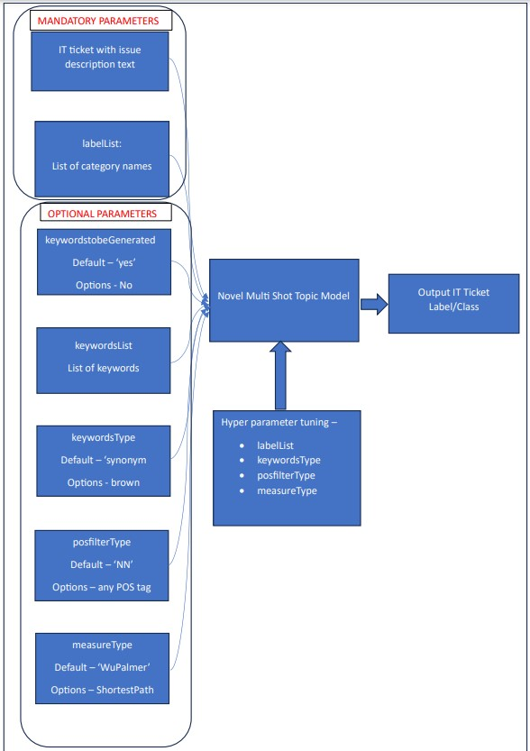
Multi Shot Topic Model

Slide 25
Model Foundations
WordNet is the lexical database i.e. dictionary for the English language, specifically designed for natural language processing.
Synset is a special kind of a simple interface that is present in NLTK to look up words in WordNet. Synset instances are the groupings of synonymous words that express the same concept. Some of the words have only one Synset and some have several.
Hypernyms: More abstract terms, Hyponyms: More specific terms. Both come to picture as Synsets are organized in a structure similar to that of an inheritance tree. This tree can be traced all the way up to a root hypernym. Hypernyms provide a way to categorize and group words based on their similarity to each other.
Shortest Path - One of the core metrics used to calculate similarity is the shortest path the distance between the two Synsets and their common hypernym.
WuPalmer similarity measure calculates relatedness by considering the depths of the two synsets in the WordNet taxonomies, along with the depth of the LCS (Least Common Subsumer).
2*depth(LCS)/[depth(S1)+depth(S2)]
The score can be 0 < score <= 1. The score can never be zero because the depth of the LCS is never zero (the depth of the root of taxonomy is one). It calculates the similarity based on how similar the word senses are and where the Synsets occur relative to each other in the hypernym tree.

Slide 26
multiShot Model
multiShotWordnetModel(text, labelList, keywordstobeGenerated='Yes', keywordsList=[], keywordsType='synonym', posfilterType='NN', measureType='WuPalmer’)
Parameters:
Text (Mandatory parameter) : IT ticket text
labelList (Mandatory parameter) : List of category names
keywordstobeGenerated (Optional parameter) : Yes/No, default: ‘Yes’
keywordsList (Optional parameter) : List of keywords, default: []
keywordsType (Optional parameter) : word type supported by the corpus like wordnet corpus supports synonym/hypernym/brown, default: synonym
posfilterType (Optional parameter) : Parts Of Speech type to be considered like NN, default: NN
measureType (Optional parameter) : Measure type supported by corpus like WuPalmer or ShortestPath default: ‘WuPalmer’

Slide 27
multiShot Model Code
def multiShotWordnetModel(text, labelList, keywordstobeGenerated='Yes', keywordsList=[], keywordsType='synonym', posfilterType='NN', measureType='WuPalmer'):
if not text and not labelList:
print("Input Text and List of Label/Category names required")
return()
else:
if(keywordstobeGenerated=='Yes'):
topics = getKeywords(labelList,keywordsType)
else:
topics = labelList
if(measureType=='WuPalmer'):
if(posfilterType=='NN'):
return(WordnetWUP_labelscore(text,topics))
if(measureType=='ShortestPath'):
if(posfilterType=='NN'):
return(WordnetShortestPath_labelscore(text,topics))

Slide 28
WuPalmer (WUP) Score Algorithm
Feed Input as the each row of dataframe text column & list of topic words per label
Declare resulting variables – highest net average WUP Score & corresponding label
Tokenize the input row of sentence to words.
Set label as 0
Loop through list of topic word string per label:
Declare counter & total as zero
Loop through each word in topic word string
Declare count, average & sum as zero
Loop through each word in sentence:
Check if wordnet sysnets exists for the word and wordnet sysnets exists for the topic word
Check if the sysnets are NOUNS
Find the WUP Score between the word and topic word
Add the WUP Score value to sum
Increment count
If count = 0 set average as 0 else calculate average as sum/count
Total = total + average
Increment counter
If counter =0 set net average WUP score as 0 else calculate net average as total/counter
Increment label
If net average greater than highest net average then set highest net average as net average and set label corresponding
Finally return highest net average and corresponding label

Slide 29
Shortest Path Score Algorithm
Feed Input as the each row of dataframe text column & list of topic words per label
Declare resulting variables – lowest net average shortest path & corresponding label
Tokenize the input row of sentence to words.
Set label as 0
Loop through list of topic word string per label:
Declare counter & total as zero
Loop through each word in topic word string
Declare count, average & sum as zero
Loop through each word in sentence:
Check if wordnet sysnets exists for the word and wordnet sysnets exists for the topic word
Check if the sysnets are NOUNS
Find the shortest path between the word and topic word
Add the shortest path value to sum
Increment count
If count = 0 set average as 0 else calculate average as sum/count
Total = total + average
Increment counter
If counter =0 set net average shortest path as 0 else calculate net average as total/counter
Increment label
If net average less than lowest net average then set lowest net average as net average and set label corresponding
Finally return lowest net average and corresponding label

Slide 30
Shortest Path & WU-PALMER Scores based evaluation using different keyword extraction techniques on multi shot topic model
Model | Shortest Path Accuracy | Shortest Path NN POS Accuracy | WU-PALMER Accuracy | WU-PALMER NN POS Accuracy
Raw | 0.232 | 0.291 | 0.257 | 0.306
Synonyms | 0.202 | 0.214 | 0.198 | 0.214
Word Count | 0.219 | 0.297 | 0.261 | 0.312
TF-IDF | 0.202 | 0.226 | 0.213 | 0.204
KeyBERT | 0.208 | 0.271 | 0.313 | 0.372
YAKE | 0.221 | 0.293 | 0.290 | 0.358

Slide 31
Limitations and Future Work
Knowledge of domain very critical – expert user provided topic names generally helps improve model accuracy. A domain related corpus creation will certainly improve model performance.
User input text cleaning is complex since domain specific words should be handled carefully
English POS and synonyms help but domain specific similar words would be better
Generic models cannot provide high accuracy but it is a good starting point
Keyword generation is crucial. The novel keyword generator is a good starting point leveraging synonyms, brown words, hypernyms, hyponyms to generate similar words for each topic.
Novel model helps to bucket documents using shortest path and WuPalmer score.
The novel keyword generator performs comparable to raw input keywords across the models
The novel multi-Shot TM model performs comparable to other TM models.

Slide 32
REFERENCES
Tunstall, L., Reimers, N., Jo, U. E. S., Bates, L., Korat, D., Wasserblat, M., & Pereg, O. (2022). Efficient Few-Shot Learning Without Prompts (Version 1). arXiv. https://doi.org/10.48550/ARXIV.2209.11055
Halder, K., Akbik, A., Krapac, J., & Vollgraf, R. (2020). Task-Aware Representation of Sentences for Generic Text Classification. In Proceedings of the 28th International Conference on Computational Linguistics. Proceedings of the 28th International Conference on Computational Linguistics. International Committee on Computational Linguistics. https://doi.org/10.18653/v1/2020.coling-main.285
Grootendorst, M. (2022). BERTopic: Neural topic modeling with a class-based TF-IDF procedure (Version 1). arXiv. https://doi.org/10.48550/ARXIV.2203.05794
Grootendorst, M. (2021). MaartenGr/KeyBERT: BibTeX (v0.1.3). Zenodo. https://doi.org/10.5281/ZENODO.4461265
Campos, R., Mangaravite, V., Pasquali, A., Jorge, A., Nunes, C., & Jatowt, A. (2020). YAKE! Keyword extraction from single documents using multiple local features. In Information Sciences (Vol. 509, pp. 257–289). Elsevier BV. https://doi.org/10.1016/j.ins.2019.09.013
Watanabe, K., & Baturo, A. (2023). Seeded Sequential LDA: A Semi-Supervised Algorithm for Topic-Specific Analysis of Sentences. In Social Science Computer Review (Vol. 42, Issue 1, pp. 224–248). SAGE Publications. https://doi.org/10.1177/08944393231178605
Soysal, O. A., & Serdar Guzel, M. (2020). An Introduction to Zero-Shot Learning: An Essential Review. In 2020 International Congress on Human-Computer Interaction, Optimization and Robotic Applications (HORA). 2020 International Congress on Human-Computer Interaction, Optimization and Robotic Applications (HORA). IEEE. https://doi.org/10.1109/hora49412.2020.9152859
Wang, M., & Hu, F. (2021). The Application of NLTK Library for Python Natural Language Processing in Corpus Research. In Theory and Practice in Language Studies (Vol. 11, Issue 9, pp. 1041–1049). Academy Publication. https://doi.org/10.17507/tpls.1109.09
Courtney Corley and Rada Mihalcea. 2005. Measuring the semantic similarity of texts. In Proceedings of the ACL Workshop on Empirical Modeling of Semantic Equivalence and Entailment (EMSEE '05). Association for Computational Linguistics, USA, 13–18.
Röder, M., Both, A., & Hinneburg, A. (2015). Exploring the Space of Topic Coherence Measures. In Proceedings of the Eighth ACM International Conference on Web Search and Data Mining. WSDM 2015: Eighth ACM International Conference on Web Search and Data Mining. ACM. https://doi.org/10.1145/2684822.2685324

Slide 33
REFERENCES
Alessandro Zangari, Matteo Marcuzzo, Michele Schiavinato, Andrea Gasparetto, Andrea Albarelli, Ticket automation: An insight into current research with applications to multi-level classification scenarios, Expert Systems with Applications, Volume 225, 2023
Gabriele Papadia, Massimo Pacella, Massimiliano Perrone, and Vincenzo Giliberti. A comparison of different topic modeling methods through a real case study of italian customer care. Algorithms, 16(2):94, February 2023.
Schopf, T., Braun, D., & Matthes, F. (2022). Evaluating Unsupervised Text Classification: Zero-shot and Similarity-based Approaches. In Proceedings of the 2022 6th International Conference on Natural Language Processing and Information Retrieval. NLPIR 2022: 2022 6th International Conference on Natural Language Processing and Information Retrieval. ACM. https://doi.org/10.1145/3582768.3582795
Murshed, B. A. H., Mallappa, S., Abawajy, J., Saif, M. A. N., Al-ariki, H. D. E., & Abdulwahab, H. M. (2022). Short text topic modelling approaches in the context of big data: taxonomy, survey, and analysis. In Artificial Intelligence Review (Vol. 56, Issue 6, pp. 5133–5260). Springer Science and Business Media LLC. https://doi.org/10.1007/s10462-022-10254-w
C. Pidej and S. Thaicharoen, "Bilingual IT Service Desk Ticket Classification Using Language Model Pre-training Techniques," 2021 16th International Joint Symposium on Artificial Intelligence and Natural Language Processing (iSAI-NLP), Ayutthaya, Thailand, 2021, pp. 1-6, doi: 10.1109/iSAI-NLP54397.2021.9678179.
Zicari P., Folino G., Guarascio M., Pontieri L. Discovering accurate deep learning based predictive models for automatic customer support ticket classification. Proceedings of the 36th annual acm symposium on applied computing, Association for Computing Machinery, New York, NY, USA (2021), pp. 1098-1101
Al-Hawari F., Barham H., A machine learning based help desk system for IT service management
Journal of King Saud University - Computer and Information Sciences, 33 (6) (2021), pp. 702-718, 10.1016/j.jksuci.2019.04.001
A Kishaloy Task-Halder et al, Aware Representation of Sentences for Generic Text Classification, roceedings of the 28th International Conference on Computational Linguistics, 2020
Jacob Devlin, Ming-Wei Chang, Kenton Lee, and Kristina Toutanova. BERT: Pre-training of deep bidirectional transformers for language understanding. 2018.
Koehler, Jana, et al. "Towards intelligent process support for customer service desks: Extracting problem descriptions from noisy and multi-lingual texts." Business Process Management Workshops: BPM 2017 International Workshops, Barcelona, Spain, September 10-11, 2017, Revised Papers 15. Springer International Publishing, 2018.

