Slide 1
ELF BINARY INFECTION ATTACKS FOR PERSISTENCE AND HEURISTIC DETECTION.
Chad C. Delecia

Slide 2


ABOUT ME
Pentest and Offensive Security R&D
Contributor to VX-Underground Black Mass Volume 2 and tmp.0ut Volume 2 hacker journals.
Twitter:@sad0pr
Email: sad0p@protonmail.com
Github: github.com/sad0p

Slide 3
AGENDA
Background information on ELF infection and ELF format.
Infection algorithms.
Leveraging infection tooling for persistence.
Heuristic detection of infected ELF binaries.
Leveraging tooling for heuristic detection of infected ELF binaries.

Slide 4
WHAT ARE ELF BINARIES ?
ELF stands for Executable and Linkable Format.
Used for holding code and data for executables, libraries/shared objects (.so) object files (.o), kernel modules (.ko) and even the Linux Kernel itself.
Often embedded in firmware images.
Supports wide variety of CPU architectures.
Mostly prevalent in UNIX environments.

Slide 5
WHAT IS ELF BINARY INFECTION ?
Conceived by Silvio Cesar and published in his paper "UNIX ELF Parasites and Virus" on Oct, 1998.
Idea is to patch the target binary and "reroute" execution to the inserted parasite (payload) while conforming to the ELF specification.
Use infection algorithms to confirm to the ELF specification.
Not abiding to the ELF specification leads to no-execution or improper execution / crash.

Slide 6
ELF BINARY INFECTION FOR PERSISTENCE.
Instead of modifying configurations for persistence we can backdoor ELF binaries on the system to persist.
UNIX commands such as ls, cat, test can be targeted, frequent execution by user and scripts and at virtually all privilege levels, our parasite can run at those privileges.

Slide 7
BENEFITS OF ELF BINARY INFECTION FOR PERSISTENCE VERSUS TRADITIONAL PLAINTEXT CONFIGURATION MODIFICATION
Mostly an increase in covertness.
Relatively hard to accidentally find or root out binary infections compared to configuration based modifications.
IR Analyst or System Admin will look for well-known and established Linux persistence mechanism (cronjob entries, .authorized_keys, .bashrc, /etc/passwd, etc).

Slide 8
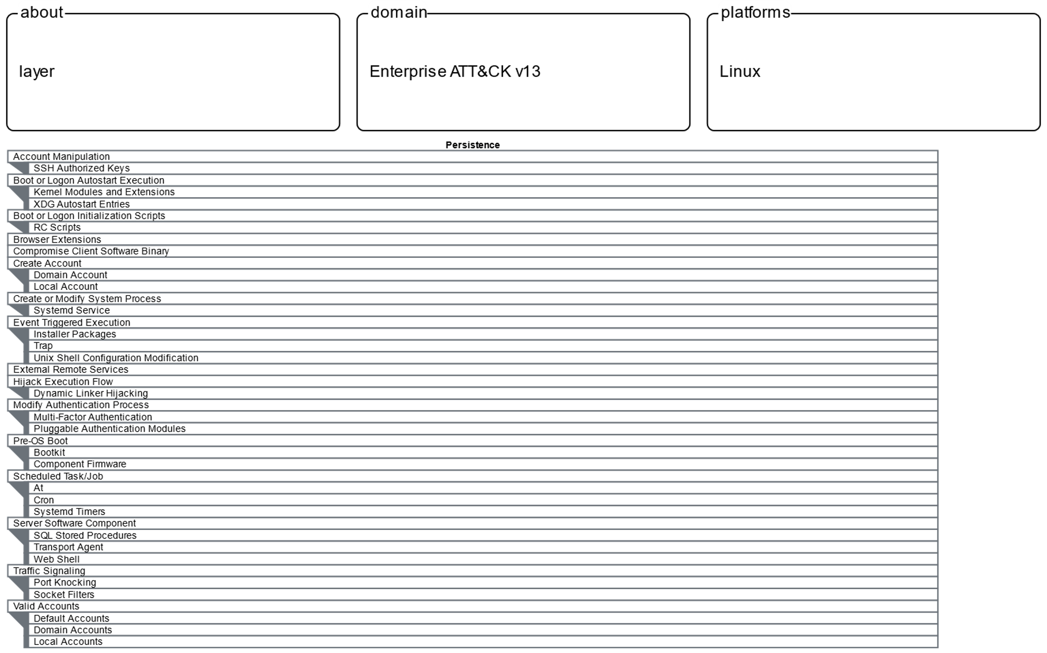
BENEFITS OF ELF BINARY INFECTION FOR PERSISTENCE VERSUS TRADITIONAL PLAINTEXT CONFIGURATION MODIFICATION (CONTINUED).

Slide 9
LINUX IS OPEN SOURCE, WHY NOT RECOMPILE ?
Recompilation presents new challenges, especially in more complicated software.
Need for source code and dependencies.
Does your backdoor version of the application on the surface behave like other versions present and past.
Would the modified application link properly with the existing dependencies on the host ?
Run the risk of breaking software across the system if interoperability requirements aren't satisfied.
Overall recompilation doesn't scale too well.

Slide 10
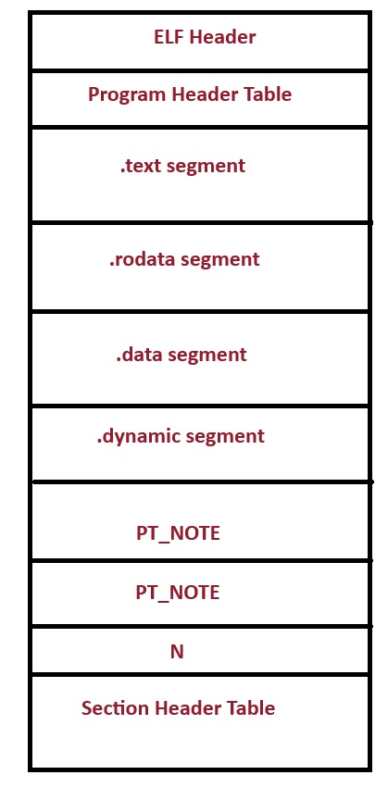
ELF BINARY FORMAT OVERVIEW (ELF HEADER)
ELF Header – First 4 bytes contains ELF magic numbers.
Stores the program's entry-point, tells the kernel where code execution in the binary should start (nice target for infection algorithms).
Contains file offsets for finding structures in the ELF binary, such as the Program Header Table and Section Header Table and how many entries are in those structures.
Other data specifying architecture requirements.

Slide 11
ELF BINARY FORMAT OVERVIEW CONTINUED (PROGRAM HEADER TABLE).
An array of entries describing segments in the binary.
Each program header entry, contains fields for file offsets, virtual address, memory permission, etc.
We can locate executable segments to insert code or create new segments entries to store code with the appropriate infection algorithms.
Must be careful to stay within the ELF specification, segments are used for program loading and the kernel strictly adheres to the ELF specification.

Slide 12
ELF BINARY FORMAT OVERVIEW CONTINUED(SEGMENTS).
.text segment – R-X perm, contains executable code.
.rodata segment – READ ONLY perm, used for the storage of string literals.
.dynamic segment – Has R-W perm. Present in dynamically linked binaries and utilized by the dynamic linker (ld-linux.so).
PT_NOTE segment – Contains vendor specific information to help the operate system determine if it can load or run the ELF binary (think BSD ELF on Linux vice versa).
.data segment – Has R-W permissions. Used for the storage of global variables.

Slide 13
ELF BINARY FORMAT OVERVIEW CONTINUED(SECTION HEADER TABLE).
Often confused with segments, they are not the same.
Not important for program execution, but vital in linking ELF objects (ET_REL) during the compilation and linking process.
Used by binary analysis tools such as debuggers, disassemblers and decompilers (vector for obfuscation).
Describe areas within a given segment, .init, .fini and .text sections are all within the text segment.
GCC & GNU Linker by default place section header table at the end of the binary (we can abuse this for embedding payloads).

Slide 14
ELF BINARY INFECTION ALGORITHMS
Allows for insertion of code into the binary while adhering to ELF specifications.
Enables execution to flow to our code (insertion is not enough) by modifying the OEP (Original Entry Point), function pointers, relocation records, function trampolines and many more.
Keeps original binary functionality seemingly intact (user or other applications are unaware of any modification), no crashes.
Text Segment Padding, Reverse Text Segment Padding, PT_NOTE to PT_LOAD, and Data Segment Infection (maybe embedded, NX-bit changed the game), DT_NEEDED (permanent LD_PRELOAD) and Relocation Poisoning / Hijacking are notable file (on disk) infection algorithms (there are others).
Memory infection techniques (very stealthy) also exists.

Slide 15
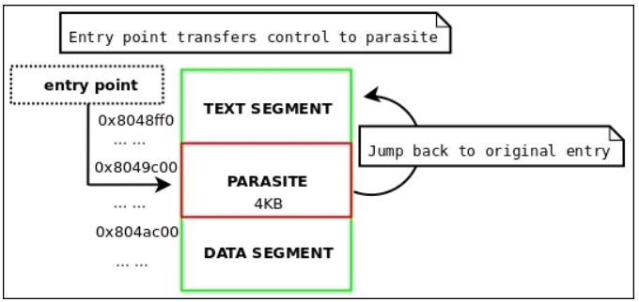
ELF BINARY INFECTION ALGORITHMS (TEXT SEGMENT PADDING)
Takes advantage of the fact there will be a page of memory (4096 bytes) between the text and data segment in memory.
The additional space can be used to host a parasite/payload.
64-bit systems are capable of larger pages and a theoretical 0x200000 (2MB) infection is possible when configured for HUGE PAGES.
Systems hosting databases might have this enabled (Linux Kernel HugePages configuration), but in X86_64 Linux Kernel still defaults to 32-bit page size (4096 bytes).
Note, 4096 bytes is the maximum potential space, in most cases there has been less space available.
In theory workarounds exists (discussion for another time, maybe blog post).
Diagram from Linux Binary Analysis by Ryan Oneil (elfmaster)

Slide 16
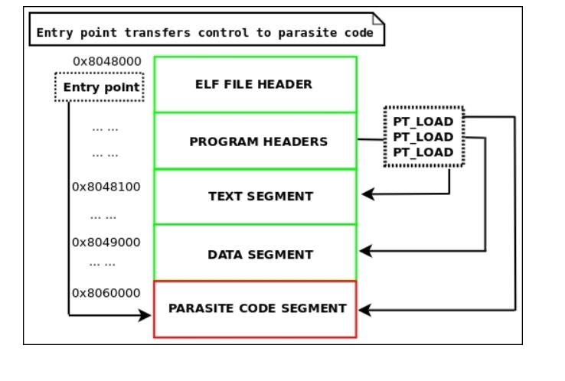
ELF BINARY INFECTION ALGORITHMS (PT_NOTE TO PT_LOAD)
Converts PT_NOTE segment to a PT_LOAD segment to store our parasite.
Segments with PT_LOAD are essential for loading, so the ELF loader (kernel) will automatically try to load this segment.
No space constraints.
Easy to implement and very popular.
Also EASY to detect, there will be two segments of type PT_LOAD with executable permission (screams malware to an informed analyst).
Diagram from Linux Binary Analysis by Ryan Oneil (elfmaster)

Slide 17
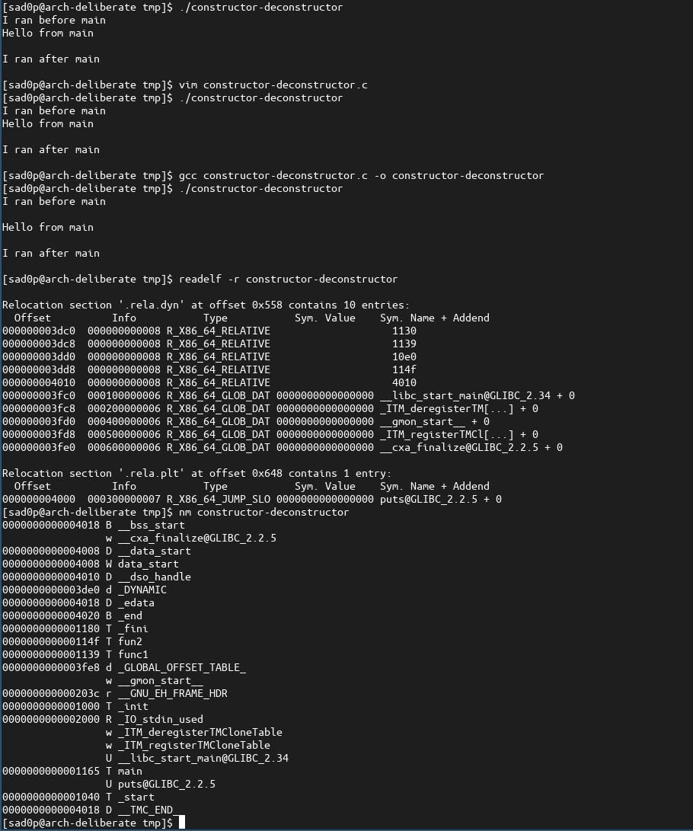
ELF BINARY INFECTION ALGORITHMS (RELATIVE RELOCATION POISONING/HIJACKING)
Modern ELF binaries implement constructor and destructor routines by writing to .init_array and .fini_array at run time using the dynamic linker through RELATIVE RELOCATIONS.
Older implementation of this functionality just relied on the .init_array and .fini_array contents.
Remanence of the old implementation are still present (useful for detection).
Can be used to divert execution to our inserted payloads (no need to modify OEP).
We can leverage this to use executable file infection algorithms on shared objects (libraries).

Slide 18
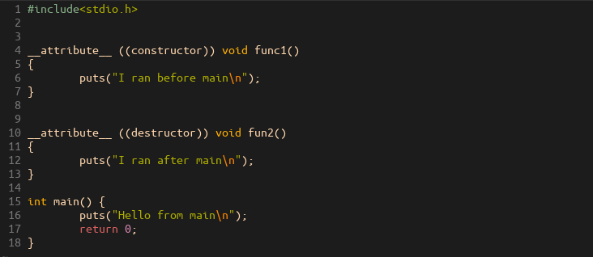
ELF BINARY INFECTION ALGORITHMS (RELATIVE RELOCATION POISONING/HIJACKING CONT.)

Slide 19
ELF BINARY INFECTION TOOLING - DOZER
ELF binary injector I wrote in Golang.
Allows for payload injection into target executable.
Supports Text Segment Padding, PT_NOTE_TO_PT_LOAD and Relative Relocation Poisoning / hijacking.
X86 and X86_64 ELF binaries of type ET_DYN (dynamically linked and static-pie binaries) and ET_EXEC (non-pie static).
Handles execution context preservation and restoration.
User only need to provide a self-contained position independent payload.

Slide 20
DOZER PAYLOAD DEVELOPMENT - CONSTRAINTS
Can't be compiled against LIBC, must write your own libc functions (-nostdlib).
Also must write your own system call wrappers.
String storage is tricky, traditional C programs store string literals in .rodata (we are only interested in .text segment).
Utilize stack strings, they are embedded in the .text segment and pushed onto the stack for use.
If you don't plan on handling preservation and restoration of the original application context be sure the end and start of your payload does not interfere with the stack.
GCC: __attribute__ ((naked)) void your_pay_load_start() {…}
Disable stack canary protection (-fno-stack-protector).
Must be position independent (-fPIC).
Suggest disabling GCC optimization passes (-O0), can create hard to track down bugs when the parasite/payload executes within the target.

Slide 21
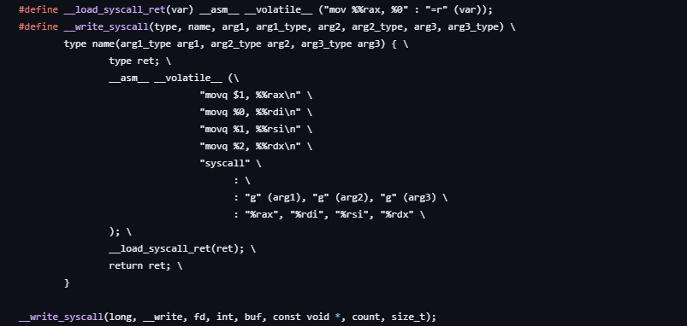
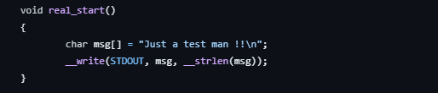
DOZER PAYLOAD DEVELOPMENT – SYSCALL WRAPPER EXAMPLE

Slide 22
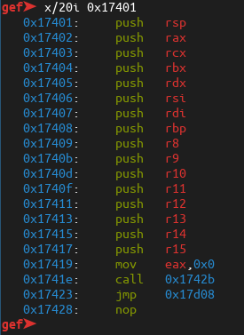
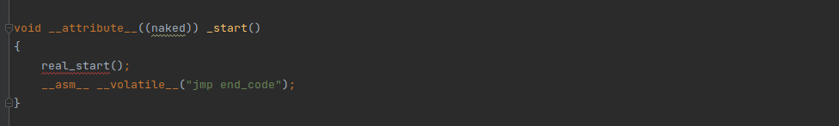
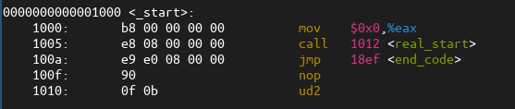
DOZER PAYLOAD DEVELOPMENT – OMIT GCC PROLOGUE
First function to be executed in payload.
Assembly produced for void __attribute__((naked)) _start()
Dozer preservation stub

Slide 23
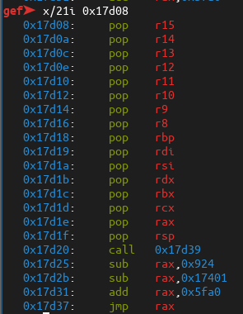
DOZER PAYLOAD DEVELOPMENT – ENDING PAYLOAD EXECUTION
Outside of d0zer instrumentation, the payload would crash with SIGILL (Illegal Instruction).
d0zer stack restoration stub
Return execution to native code
d0zer instrumented payload

Slide 24
DEMO 1 – D0ZER WITH WEBSHELL PERSISTENCE PAYLOAD

Slide 25
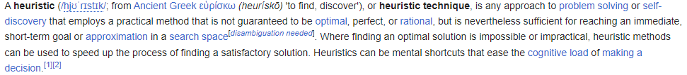
HEURISTIC BASED DETECTION OF INFECTED ELF BINARIES
Definition of heuristics courtesy of Wikipedia.
Heuristics (context of ELF binary infection) - A set of rules that describes common characteristics of infected ELF binaries, in terms of the ELF structure and META data, that we can apply to ELF binaries to determine if it is infected or worth an analyst attention.
Provides a line of defense when signature based (often sample specific) detections fail or are absent.
Heuristics discussed are in no way exhaustive.

Slide 26
HEURISTIC DETECTION OF EMBEDDED PAYLOADS
Here an embedded payload is defined as data or code appended to the end of the binary, after the section header table (often for malicious intent).
ELF binaries can function just fine when data doesn't overwrite or alter position of critical structures, code or meta data.
The size of an ELF binary pre-infection can be calculated from the ELF Header through three fields, e_shoff, e_shnum and e_shentsize.
We can use an equation for a binary that has a section header table at the end of the file: FileSize = e_shoff + (e_shnum * e_shentsize)
Binaries produced by Go compiler-linker have their section header table in the "middle", this equation won't work.

Slide 27
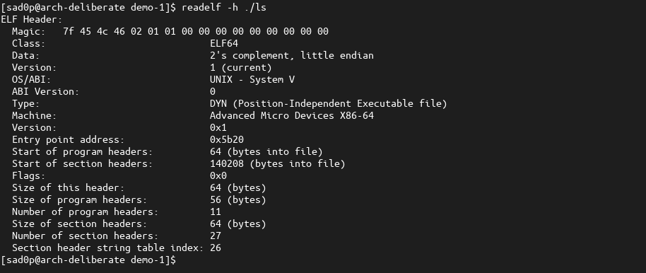

HEURISTIC DETECTION OF EMBEDDED PAYLOADS - UNINFECTED BINARY GCC-GNU LINKER
e_shoff
e_shentsize
e_shnum

Slide 28
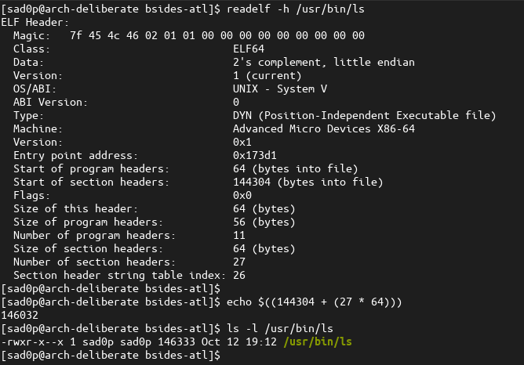
HEURISTIC DETECTION OF EMBEDDED PAYLOADS – INFECTED GCC & GNU LINKER PRODUCED ELF BINARY

Slide 29
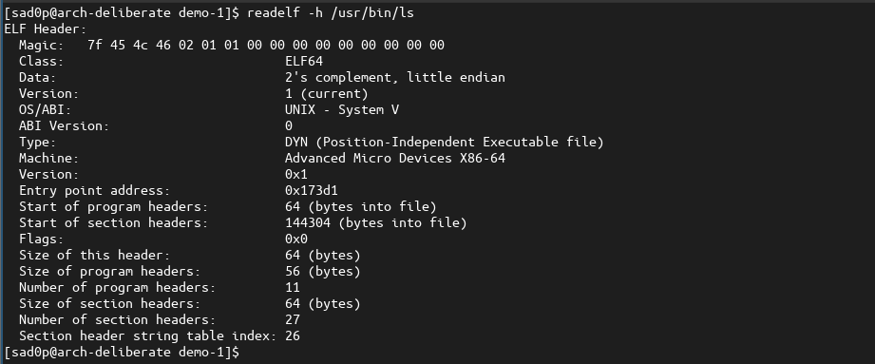

HEURISTIC DETECTION OF ENTRY POINT MODIFICATION
Most binaries that are not infected have entry-points that are the start of the .text section.
Entry point of 0x173d1.
.text section starts at 0x4040 and ends at 0x173c2.
Entry point is not in the range of the .text section, this binary more than likely had its entry point modified.

Slide 30
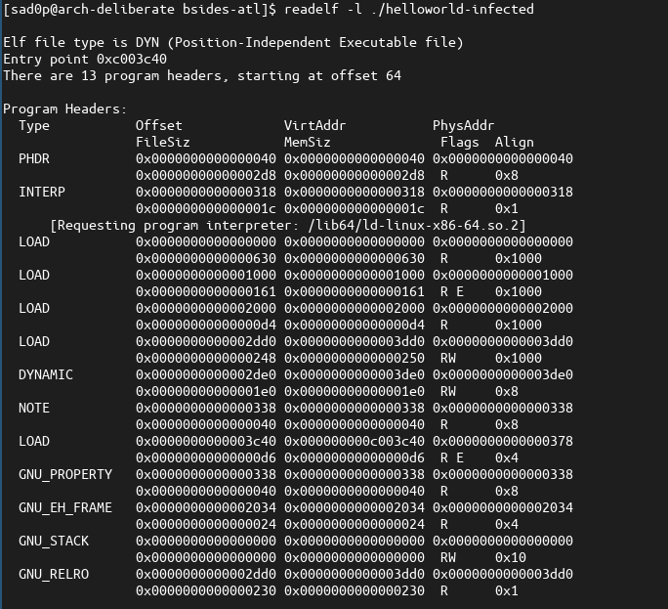
HEURISTIC DETECTION OF PT_NOTE_TO_LOAD
Multiple PT_LOAD segments with Executable permission.

Slide 31
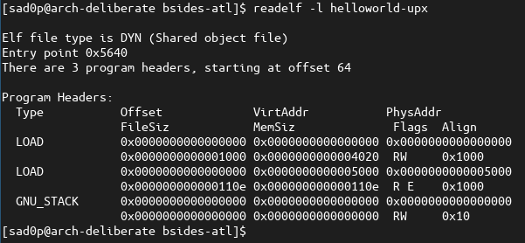
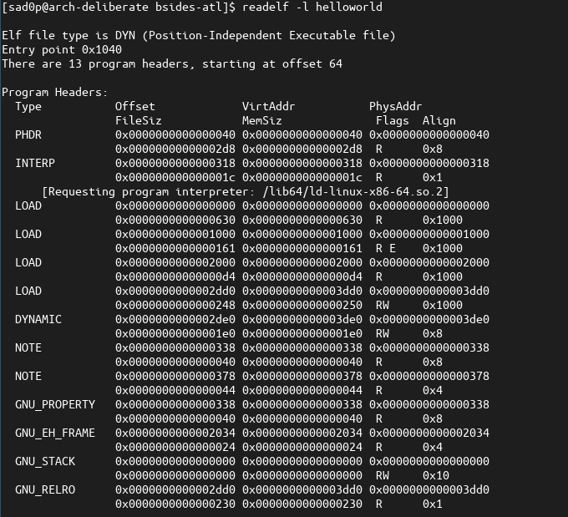
HEURISTIC DETECTION OF UPX PACKED BINARIES
Threat actors can use UPX to bypass signature detection.
Modern ELF binaries utilize SCOP (Separate Code Partitioning) that result to four PT_LOAD segments.
SCOP reduce the attack surface for ROP gadgets.
UPX packed binary above only has two PT_LOAD segments.

Slide 32
HEURISTIC DETECTION – OTHER THINGS TO NOTE
RWX permissions.
Error messages from readelf or GDB (but the binary runs).
Missing section header tables (can be legitimate).

Slide 33
ELFDOC – POC HEURISTIC DETECTION ENGINE FOR ELF BINARIES
Written in C++.
Can detect embedded payloads, entry-point modification, missing section header table, PT_NOTE_TO_PT_LOAD infection.

Slide 34
Demo 2 - ELF Doc

Slide 35
QUESTIONS ?
Resources:
github.com/sad0p/d0zer
github.com/sad0p/elfdoc
hxxp://tmp.0ut
github.com/elfmaster
hxxps://a.co/d/jfynVjc (Linux Binary Analysis Amazon link)
hxxps://tinyurl.com/38fmtrr7 (Black Mass Volume 2 by VXUG)
hxxps://tinyurl.com/3bdf3w84 (Silvio Cesar Unix Parasites and Virus)
hxxps://refspecs.linuxfoundation.org/elf/elf.pdf
hxxps://github.com/tmpout/awesome-elf

