Slide 1
Django Application Framework
Build Sophisticated application using python
No compromise

Slide 2
Break
Backup images etc.

Slide 3
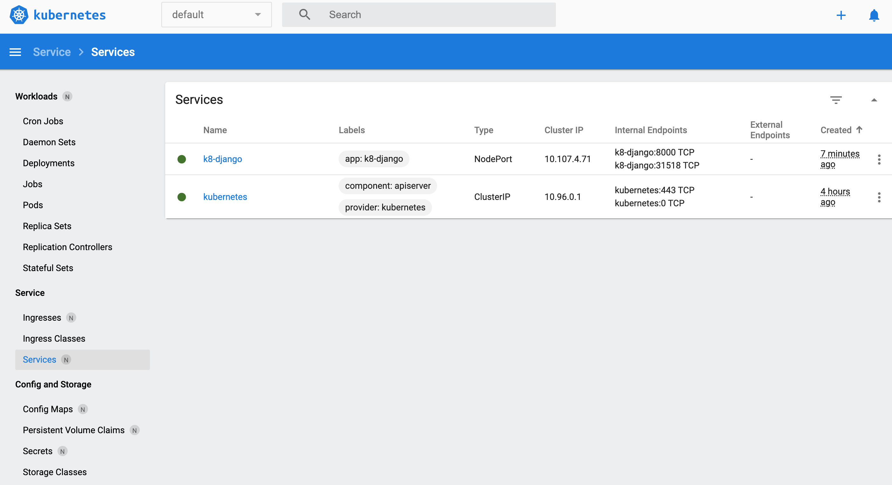
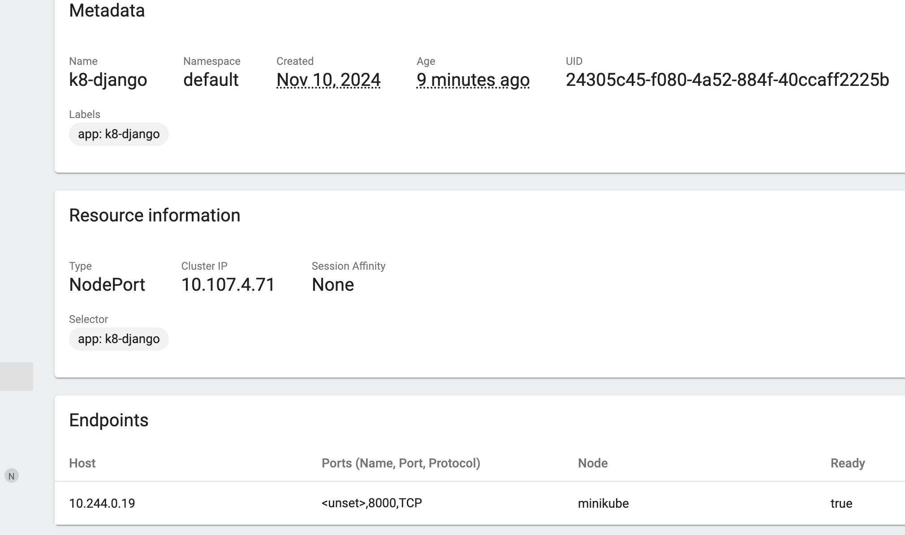
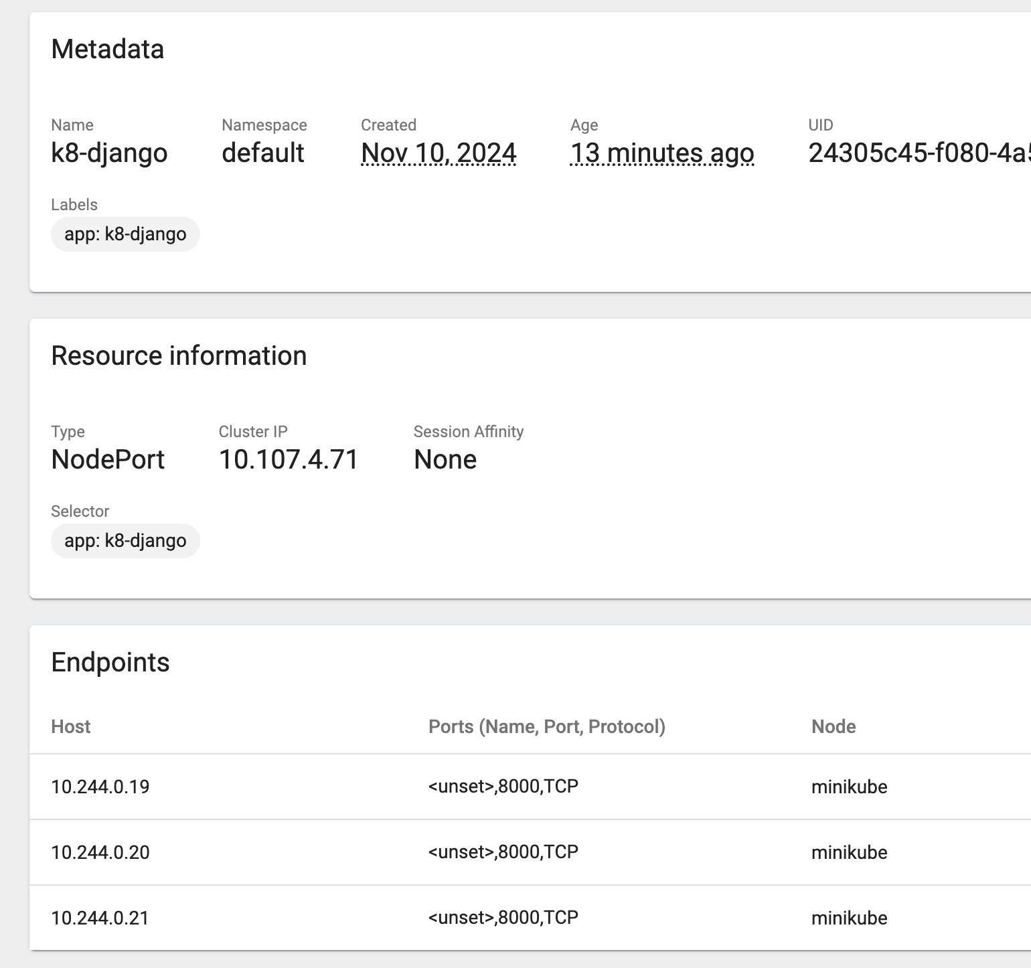
Increase replicas:
kubectl edit deployments.app/${MKSERVICE}
…
replicas: 3
…
You can change it in dashboard as well!!
Your deployment is shown - click
Three replicas
Your deployment is shown - click
ONE instance
kubectl edit deployments.app/${MKSERVICE}
Changes with replicas

