Slide 1


Artificial Intelligence
Machine Learning,
Data Science
Artificial Neural Networks
Sada Narayanappa

Slide 2
Introduction
NOTATIONS

Slide 3


Binary Classification
size
Price of the House
Zip code
price
price
#bedrooms
Size of the house

Slide 4
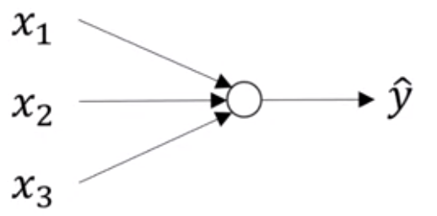
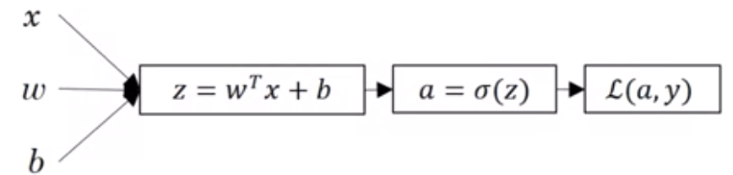
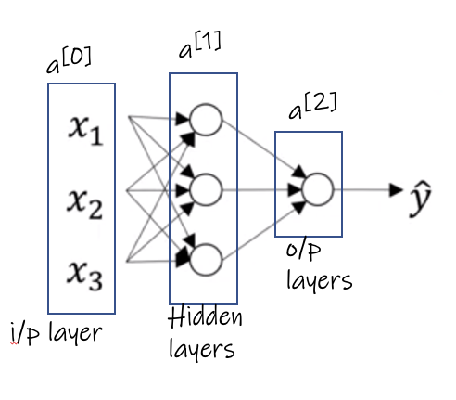
Logistic Regression and Neural Networks

Slide 5
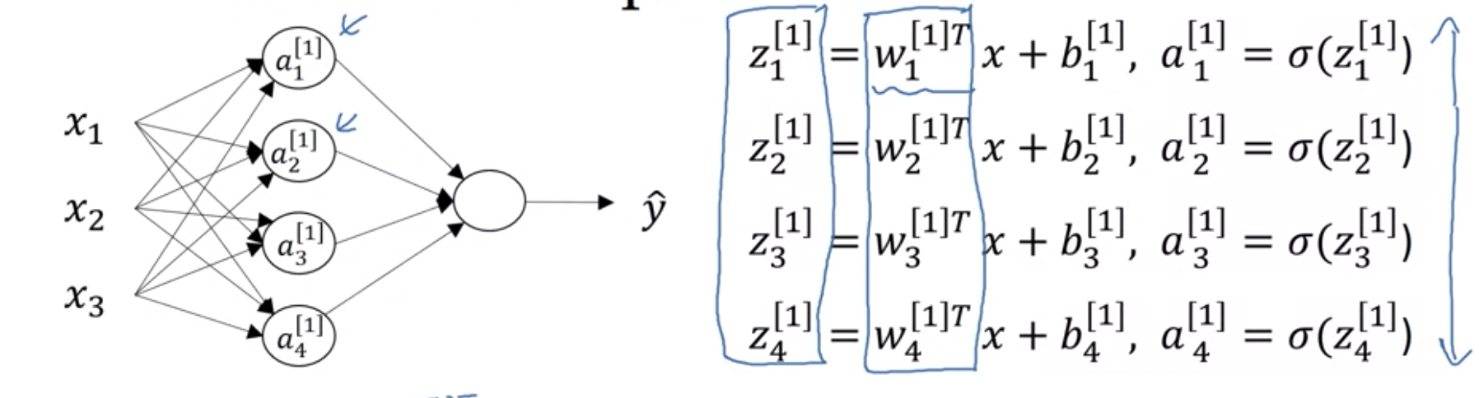
Computing Weights

Slide 6
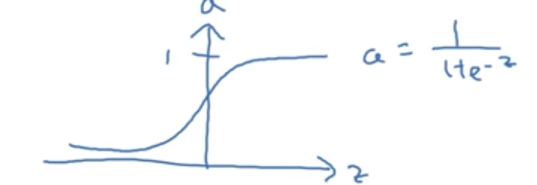
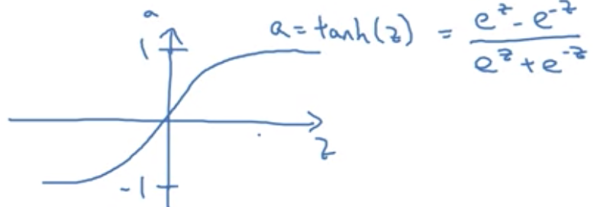
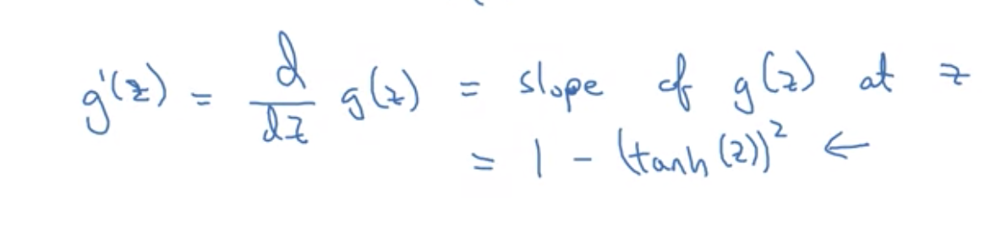
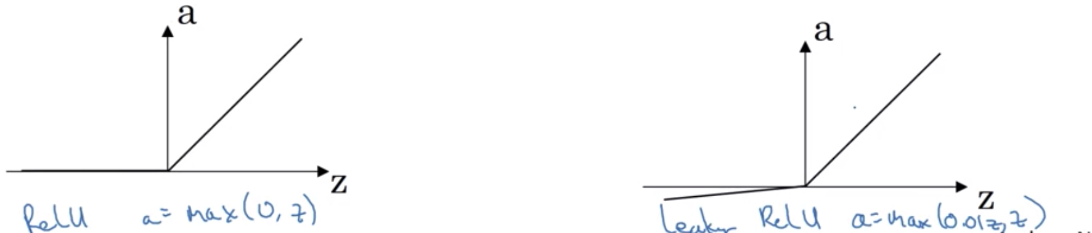
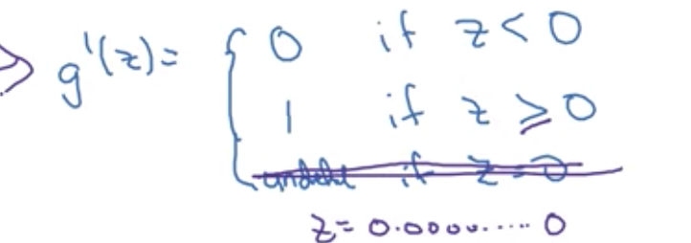
Activation Functions

Slide 7
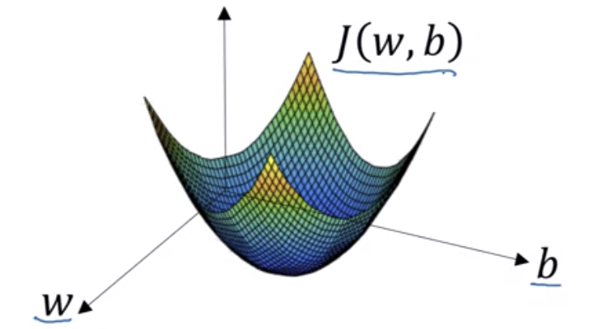
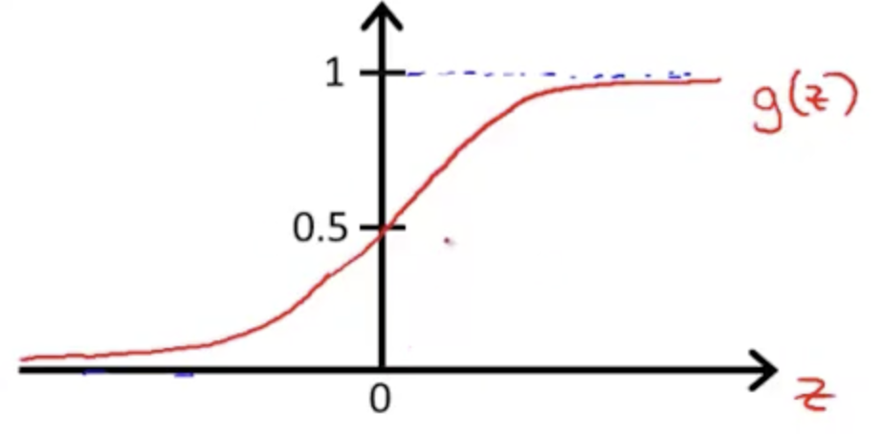
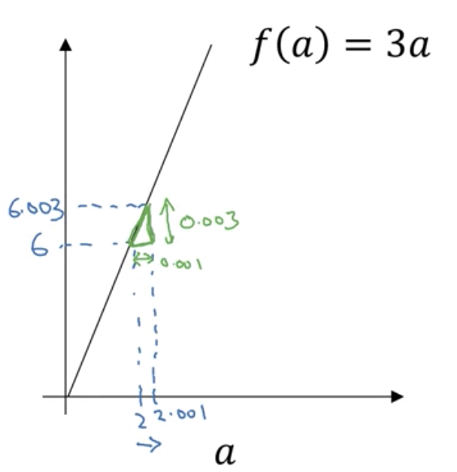

Slide 8
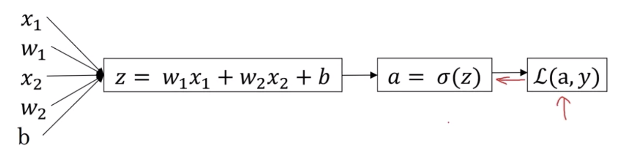
u = b c
v = a + u
J = 3 v

Slide 9
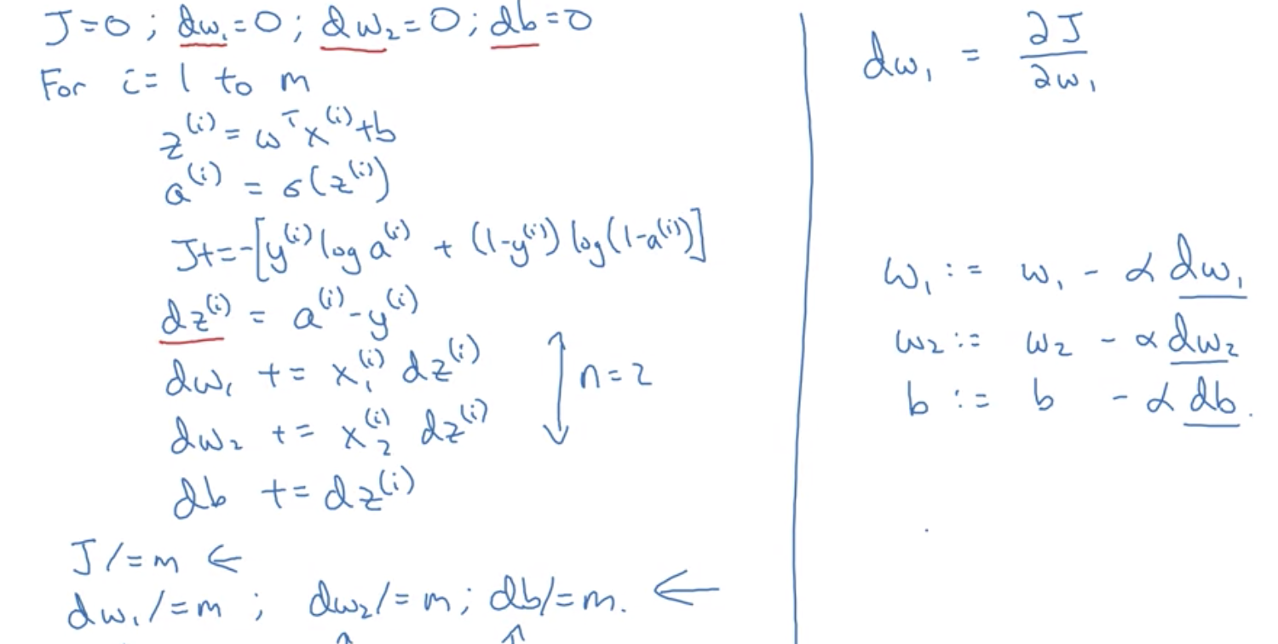
Gradient Descent with Adjust weights

Slide 10
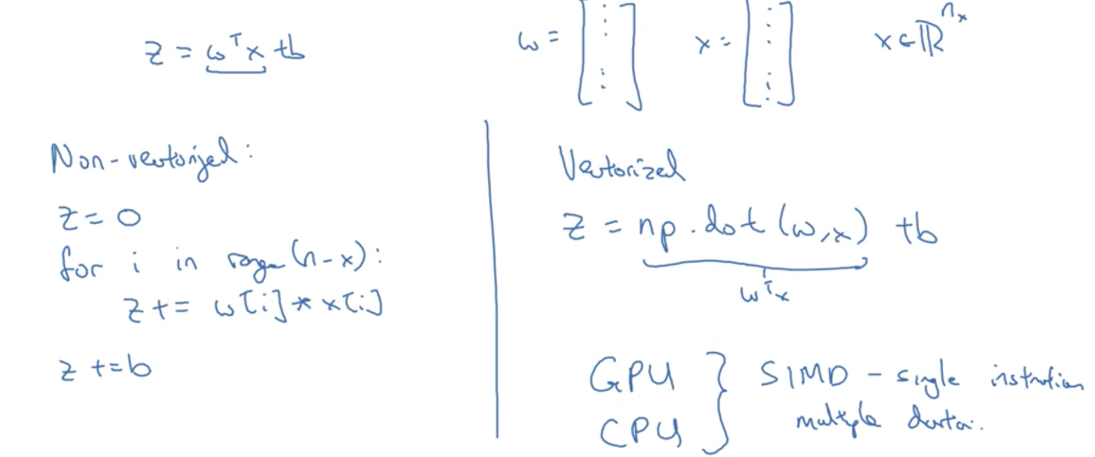
Vectorization

Slide 11
Sequence Models
Recurrent Neural network

Slide 12
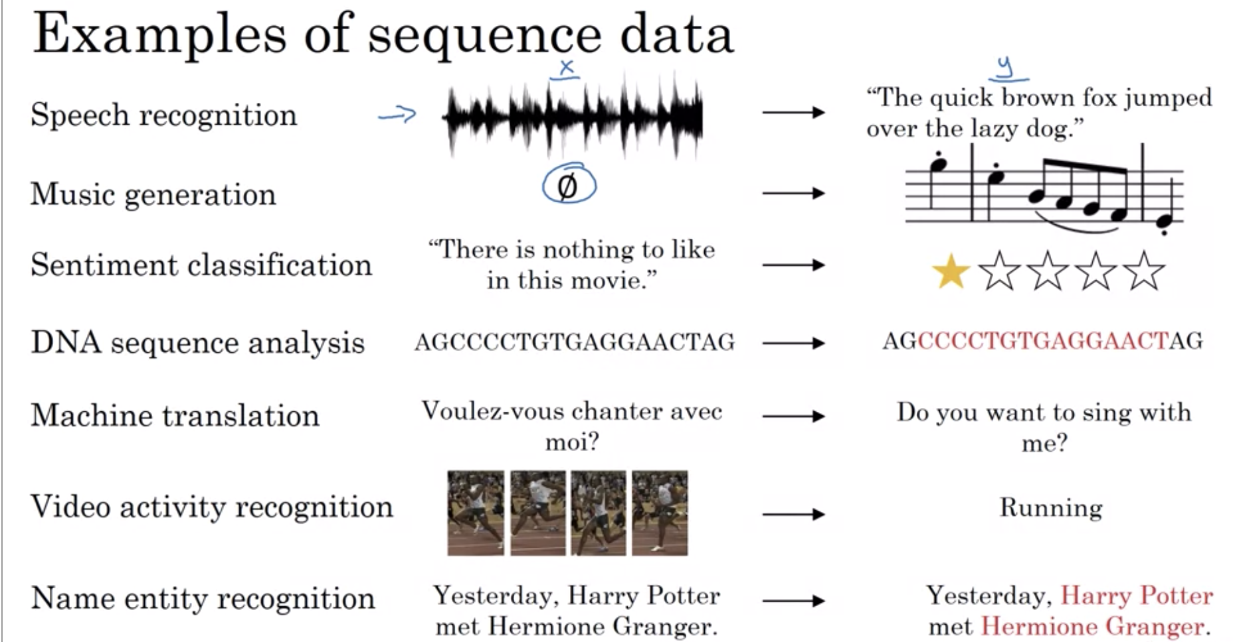
Sequence Models Example
Sequence Models
Many – Many
1 – Many
Many – 1
1 – 1

