Slide 2
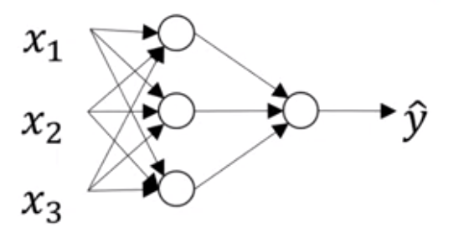
.
a^{[0]}
a^{[1]}
a^{[2]}
o/p
layers
Hidden
layers
i/p layer

Slide 3
Null-Hyp
True
(No effect)
State of the world
Null-Hyp
False
(There is effect)
Correct (could not reject) | Wrong Type I Error
Wrong Type II Error | Correct (Rejected)
Could not
Reject - no
Stat significance
(Retain)
Decision
Experiments
Results showed
Effect
To Reject

Slide 4

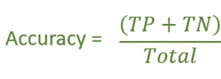



State of the world
True
False
Precision
TP
FP
True
Predicted
FN
TN
False
Recall =
Sensitivity
True +ve Rate
TPR
= FPR
False +ve Rate
= Specificity
1 - FPR

Slide 5
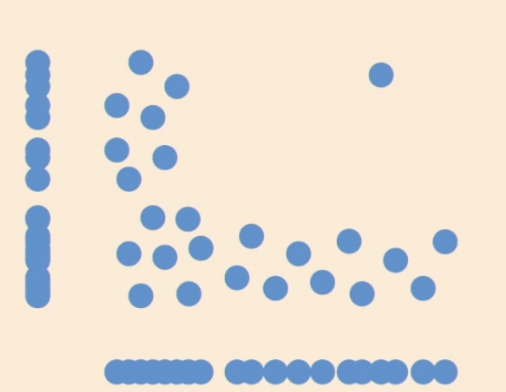
To next layer
10
20
Features
1
2
Batch-size
Time steps
X1 X2
10
20
30
…
80
90
t1 t2 y
[1 10] [2 20] 3
[2 20] [3 30] 4
…
t1
1
10
t1
2
20
History = 2

Slide 6
X1 X2
10
20
30
…
80
90
t1 t2 y
[1 10] [2 20] 3
[2 20] [3 30] 4
…
To next layer
History = 2
Batch = 1
10
20
Features
1
2
Batch-size
Time steps
t1
1
10
t2
2
20
To next layer
10
20
X1 X2
10
20
30
…
80
90
[[1, 10] [2, 20], [3
[2, 20] [3, 30], 4
[3, 30] [4, 40]] 5]
…
Features
1
2
Batch-size
History = 2
Bath = 3
Time steps
t1
[1, 10]
[2,20]
[3,30]
t2
[2,20]
[3,30]
[4, 40]

