Slide 1

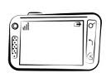

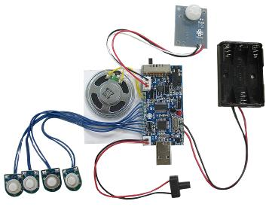
Sensor Design
PF meter
Inhaler
Environmental Sensors

Slide 2



Public
Environmental
Data
Temperature/
Humidity/Wind …
Location / time
Environment/
Health conditions
Data Collection
Data Analytics
Data Models
Algorithms
Health Alerts
Patient Mobile
sensors
PF meter
Inhaler
Doctors
Researchers
Educators
Environmental
Sensors

Slide 3
Sensors
Inhaler Usage
Public Environmental Data
Smart Phone
Interface
PF Meter Usage
Environment sensors
Statistical Analysis
(Exploratory/Confirmatory)
Visualization
(Charts & GIS)
Database
Algorithms
NLP
Machine Learning

Slide 4
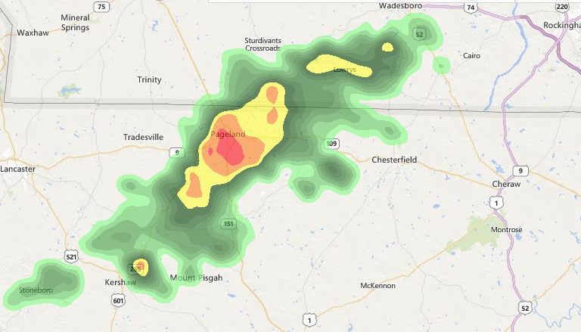

Start - Patient1 Trajectory
Time: 4/1/2014: 1:00 – 1:30PM
Start Of Patient2 Trajectory

Slide 5
Public Environmental Data
Base MAP/ Environmental Tiles
(GIS)
Smart and Connected Health Alert System
alerts
location., medication etc.
Users
(Patients/Doctors)

Slide 6
UI (CLIENT)
Web
Browser
Environmental
Data
C R O S S C U T T I N G *
User Interface
S
E
C
U
R
I
T
Y
C
O
N
F
I
G
U
R
A
T
I
O
N
L
O
G
G
I
N
G
Data Acquisition (web services)
Algorithms
Prediction/Inferences/Data synthesizer
Data Store
Archive
PostGres
Hadoop

Slide 7
Deployment
Two almost identical systems will be deployed (Min specs)
O.S.: Linux REDHAT 6.x, 64 bit
CPU: Dual Intel® Xeon® E5-2620 2.00GHz,
Memory: 64GB
Storage: 2TB (preferably 1TB with SSD)
Installed Frameworks
(See notes for install locations)
Java/JDK 7.x
Python – Anaconda
Ipython
Tomcat
Apache
Open SSL/SSH
All utilities (ex. wget etc.)
Open Ports:
80, 8000-9999, ssh
Web/
Application Server
Web/
Application Server
Presentation
Presentation
Business
Business
Data
Data
Development
Production
Network
SSH/VPN
Internet

Slide 8

Android Architecture
Receive PFM Usage service
Receive Inhaler Usage service
Receive Inhaler Usage service
Send Patient inputs
To
server
Display status

Slide 9
Client UI
Tomcat + Apache Server
Web Services
Predictions
DB

