Slide 1
LOC
Closest Weather 1
Closest Weather 2
Closest Weather 3
Distance to
Time difference
Score
Environmental data
1
2
1
1
2 Dp, Apn, Dn, Sp, Sn
1
2 Dp, Apn, Dn, Sp, Sn
1
1
1
1
1 Dp, Apn, Dn, Sp, Sn
1
1 Dp, Apn, Dn, Sp, Sn
Innocent until proven guilty
^Precision = B/A
Recall = B/(A+D)
C/A ➔ (Low)
A= Invalid points
D
(OK)
P= Valid points
S
Precision =Q/P
Recall = Q/(P+S)
P/R ➔ (Low)
B = Good Invalid
(True +ves)
C= Incorrect Invalid Points
False + ves
(BAD) – These are valid points
Q = Good valid
(True -ves)
R= Incorrect valid Points
False –ves
(BAD)
Accuracy = (B+ Q)/(A+D+P+S)

Slide 2
H………………………A………………………H…………… A SA H H H H
….p, lllllll eeee

Slide 3
A
(Positive)
B
(Negatives)
Total population : 14
+ve case P1= Precision = A’/(A’ + B’’)
R1= Recall = A’/A
-ve Case
P2 = Precision = B’/(A’’+B’)
R2 = Recall = B’/B
Decrease B” and Increase A’
We want => High P1
Actual
T F
Identified
as
Negatives
T
TP
FP
A’’
False Negatives (FN)
B’ – True Negatives
(TN)
Predicted
F
FP
TN
Identified
As
Positives
A’ –
True Positive
(TP)
B’’ – False Positives
(FP)

Slide 4
X, y, Bad/Good, x^2 + Y^2
---- --------------------------------
2, 3, G, 13
3,1, g , 10
1,2, B, 5

Slide 5
LOC.txt
kdkl;jfsdjl; sdjflksdjklfjsl
Dsfjklsdjlj lk sdj;lkfkl; jdkl
Jsjkdsfjskl jlk sd;fjlskdj kldsjfl
Invalid Points.txt
2 Invalid
3. Invalid
2. Valid
Invalid
Valid
HashTable
Key Value
==== ====
Valid
Invalid
1 Invalid
LOC.txt
kdkl;jfsdjl; sdjflksdjklfjsl - Marked Invalid
Dsfjklsdjlj lk sdj;lkfkl; jdkl – No changes
Jsjkdsfjskl jlk sd;fjlskdj kldsjfl - Invalid

Slide 6
APP Package
APP Package
Service
Mobile UI App
STOP IT
Display On Map
LOC.txt

Slide 7
Service
1. Wake up every 10 minutes
2. Check if SCHAS App is running
3. If Not start it unless the battery is less than 20%
Mobile UI App
Display On Map

Slide 8
Distance(1,2) – calculate it
b. Distance(2,3)
c. Time difference (1,2)
d. Time Difference (2,3)
S12 = Speed(1,2) = s12 = a/c
S23 = Speed(2,3) = s23 = b/d
A = Angle (1,2,3)
1 kjdfjdsjfjsdlkjfkl j sdjfklsjd kljfdsk
2 jdkflsdkj kjsk jklsdjfklsj
1 jsfdkljsdkljfjs kjsdjfjslkfjsljfsl
For Display
----------------
1 kjdfjdsjfjsdlkjfkl j sdjfklsjd kljfdsk sdjfkj slkdf
2, a, b, c, d, s12, s23, A, hjhj, +89
1 jsfdkljsdkljfjs kjsdjfjslkfjsljfsl
For predictions
----------------
2, a, b, c, d, s12, s23, A, dujsflkjsdklf j sdjflksj
a. Distance(1,2) – calculate it
b. Distance(2,3)
c. Time difference (1,2)
d. Time Difference (2,3)
S12 = Speed(1,2) = s12 = a/c
S23 = Speed(2,3) = s23 = b/d
A = Angle (1,2,3)
1 kjdfjdsjfjsdlkjfkl j sdjfklsjd kljfdsk
1 jdkflsdkj kjsk jklsdjfklsj
1 jsfdkljsdkljfjs kjsdjfjslkfjsljfsl
For Display
----------------
1 kjdfjdsjfjsdlkjfkl j sdjfklsjd kljfdsk sdjfkj slkdf
1, a, b, c, d, s12, s23, A, dujsflkjsdklf j sdjflksj
1 jsfdkljsdkljfjs kjsdjfjslkfjsljfsl
For predictions
----------------
1, a, b, c, d, s12, s23, A, dujsflkjsdklf j sdjflksj
1
A
3
100 point
80 20
100 point
80 20
2
1
A
3
2
1
1
1
1
1
A
3
2

Slide 9
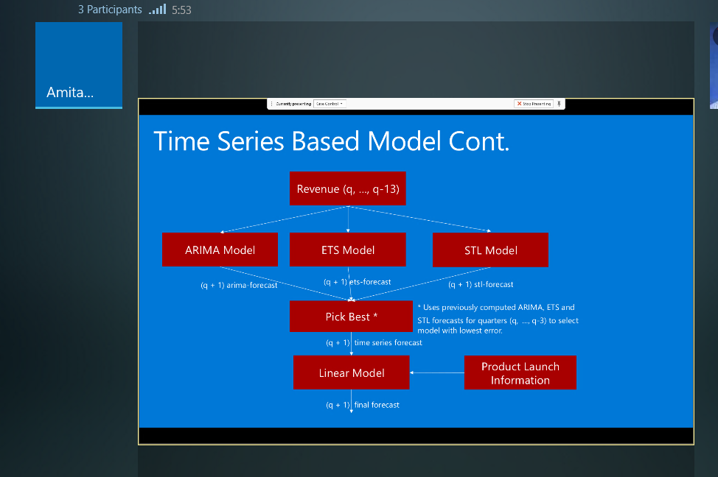

Slide 10
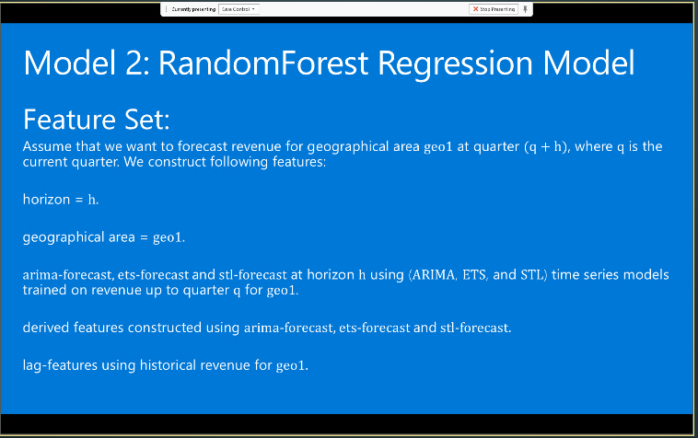

Slide 11
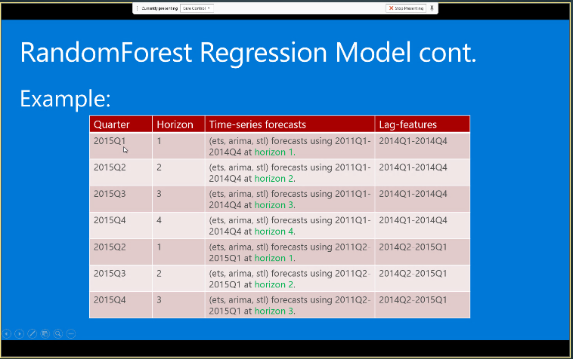

Slide 12
A
User
Time1
Event1
B
User
Time2
Event2
How can you say Event 1 most likely causing Event2
A = User, time1 , time1 + minimum (time11, 1hour)
FROM A JOIN

Slide 14
UAEStations stationid recorddate recordtime pm10 no2 o3 co so2 pm2_5 temperature lat lon humidity .
LOC id Stored_at Measured_at Weatherchecked . . .
LOC_Weather id lat lon measured_at pm10 no2 o3 co so2 pm2_5 temperature humidity weather_lat weather_lon weather_recorddate weather_recordtime weather_stationid score
This table captures all the
Users location information
UAE Stations:
Data is updated from UAE
environmental services
This table captures all the
Weather information;
This is computed from UAE
stations Data

