Slide 1


Generative AI (LLM, Gen AI)
General sketch of Generative AI

Slide 2

What is Gen AI anyway
Generative AI is encompass wide range:
Content generation – images/text
Content curation/summarization
Q&A
Search and Identify
Rationalize and Reason
Compose style
Application:
Sales & Marketing
Proposal Generation
Content Search
How does it look for users
send Queries
Some User Interface
Use
Response

Slide 3
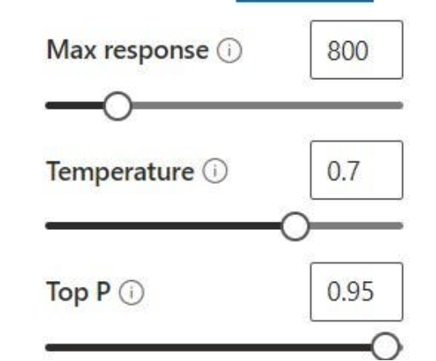
Bit more technicalities
Context Window
Output
Classify the following:
This is great.
Sentiment:
Inferencing
Classify the following:
This is great.
Sentiment: positive
Model
Prompt
Completion
User
RAG – Retrieval Augmented Generation
One shot/multi shot leaning
Prompt Engineering
Temperature, top K, top P

Slide 4
General Gen-AI life cycle
Choose
Assess the Scope & Define the specific Use-case
Best path
Model, Metric, Design
Prompting
Data
Engineering
Vectorizing
Efficient Retrievals
Evaluate
GLUE
Super GLUE
HELM Holistic Evaluation of Lang. models
MMLU
Massive Multi Lang. Understanding)
ROUGE, BLUE
Full scale Integration
Application
Augmentation
Model deployment
Evaluation
Continuous learning
Fine Tuning PEFT,
RLHF
RAG
One shot/Few Shot learning
Prompt Engineering
Prompt Tuning
Parametric efficient fine tuning
LoRA (Low rank order Adaptation)
Choice of vectorization (https://huggingface.co/spaces/mteb/leaderboard)
Chunking Strategies
Model Selection (https://artificialanalysis.ai/)
Bench Marks (https://deepgram.com/learn/superglue-llm-benchmark-explained)

Slide 5
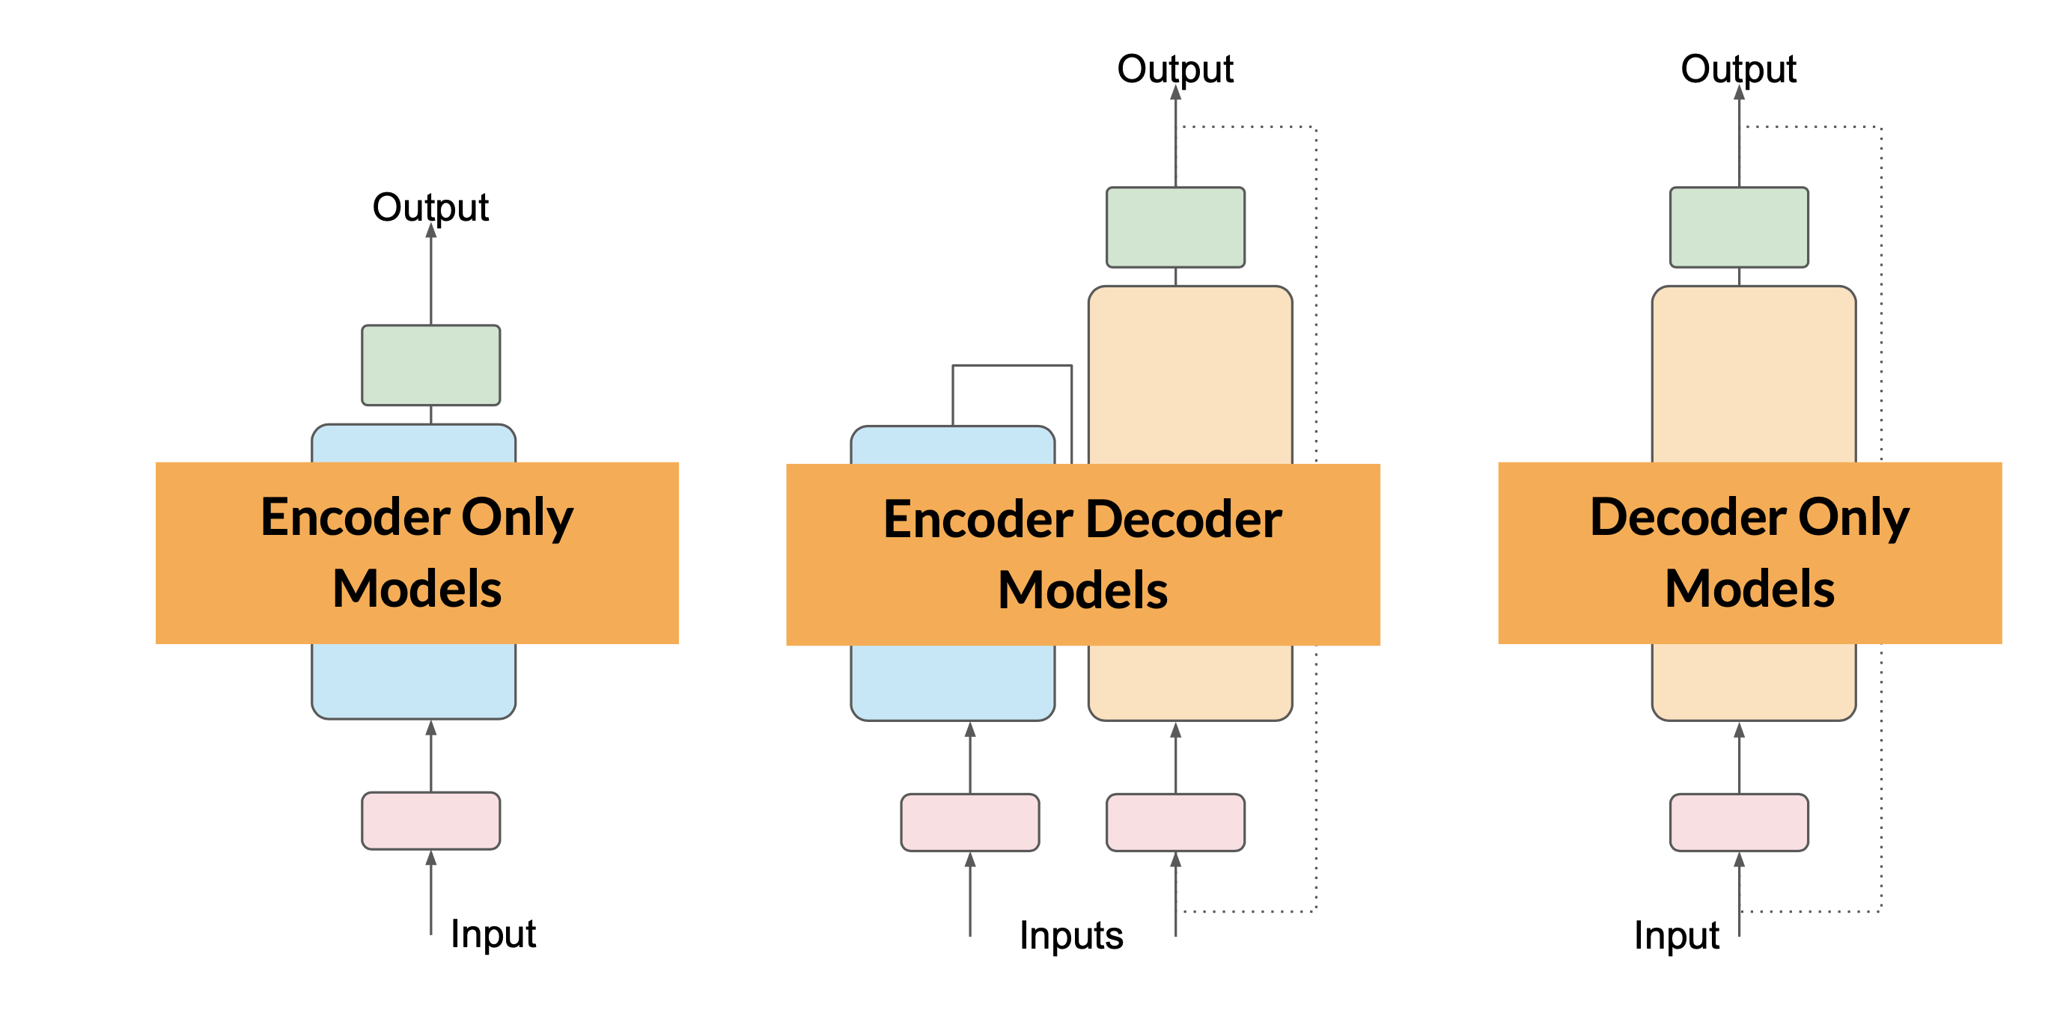
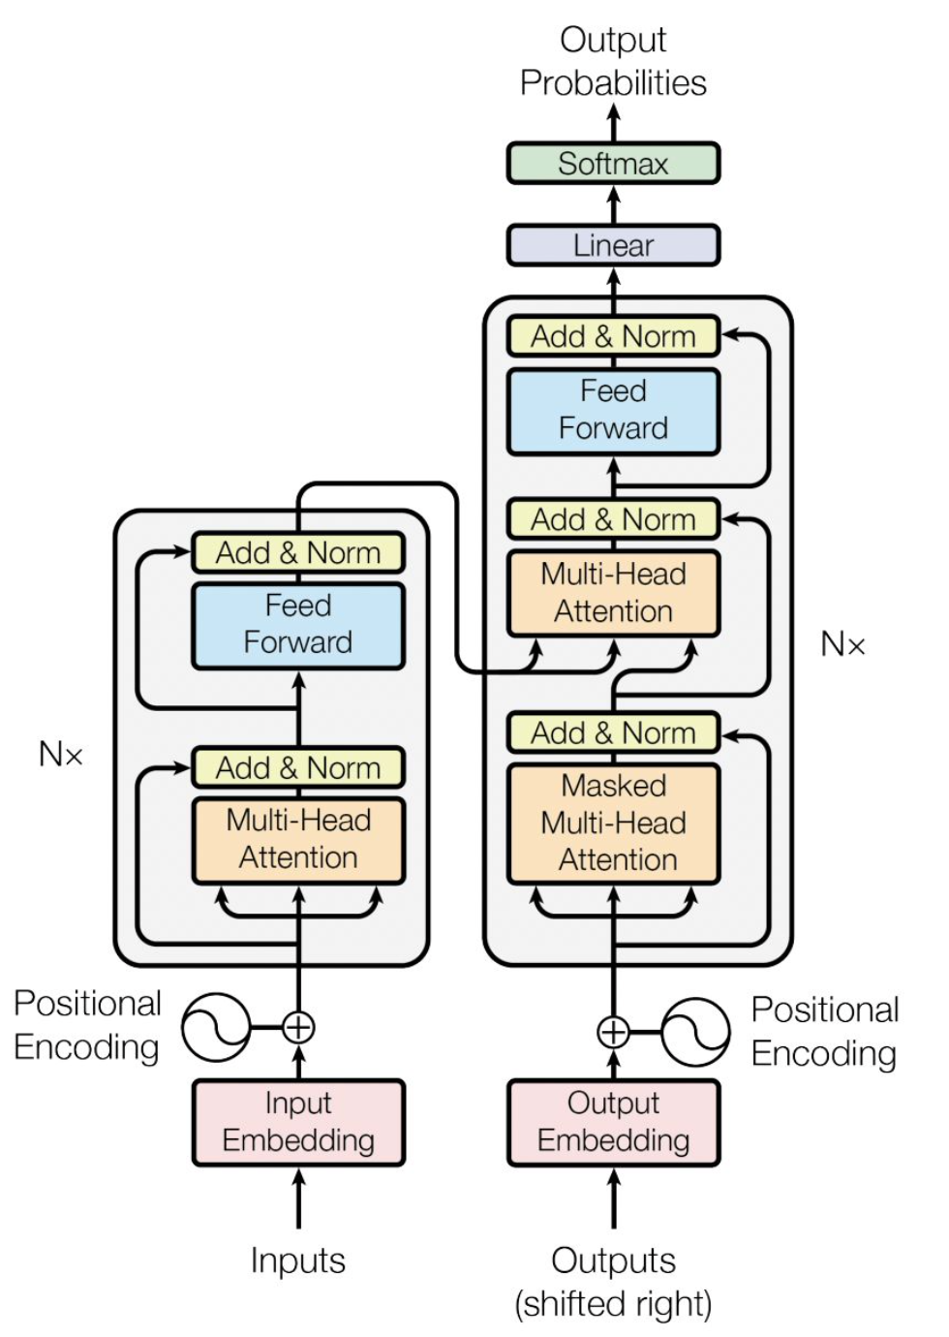
Technicalities
Neural networks
Transformers
Attention mechanism
Classification
Sentiment analysis
NERs
Ex: BART Trained using masking
Seq-to-Seq
Translation
Text Summarization
Ex: BERT Train: Span Corruption
Generation
Text Generation
Reasoning
Ex: GPT, BLOOM
Full Lang. Modelling

Slide 6
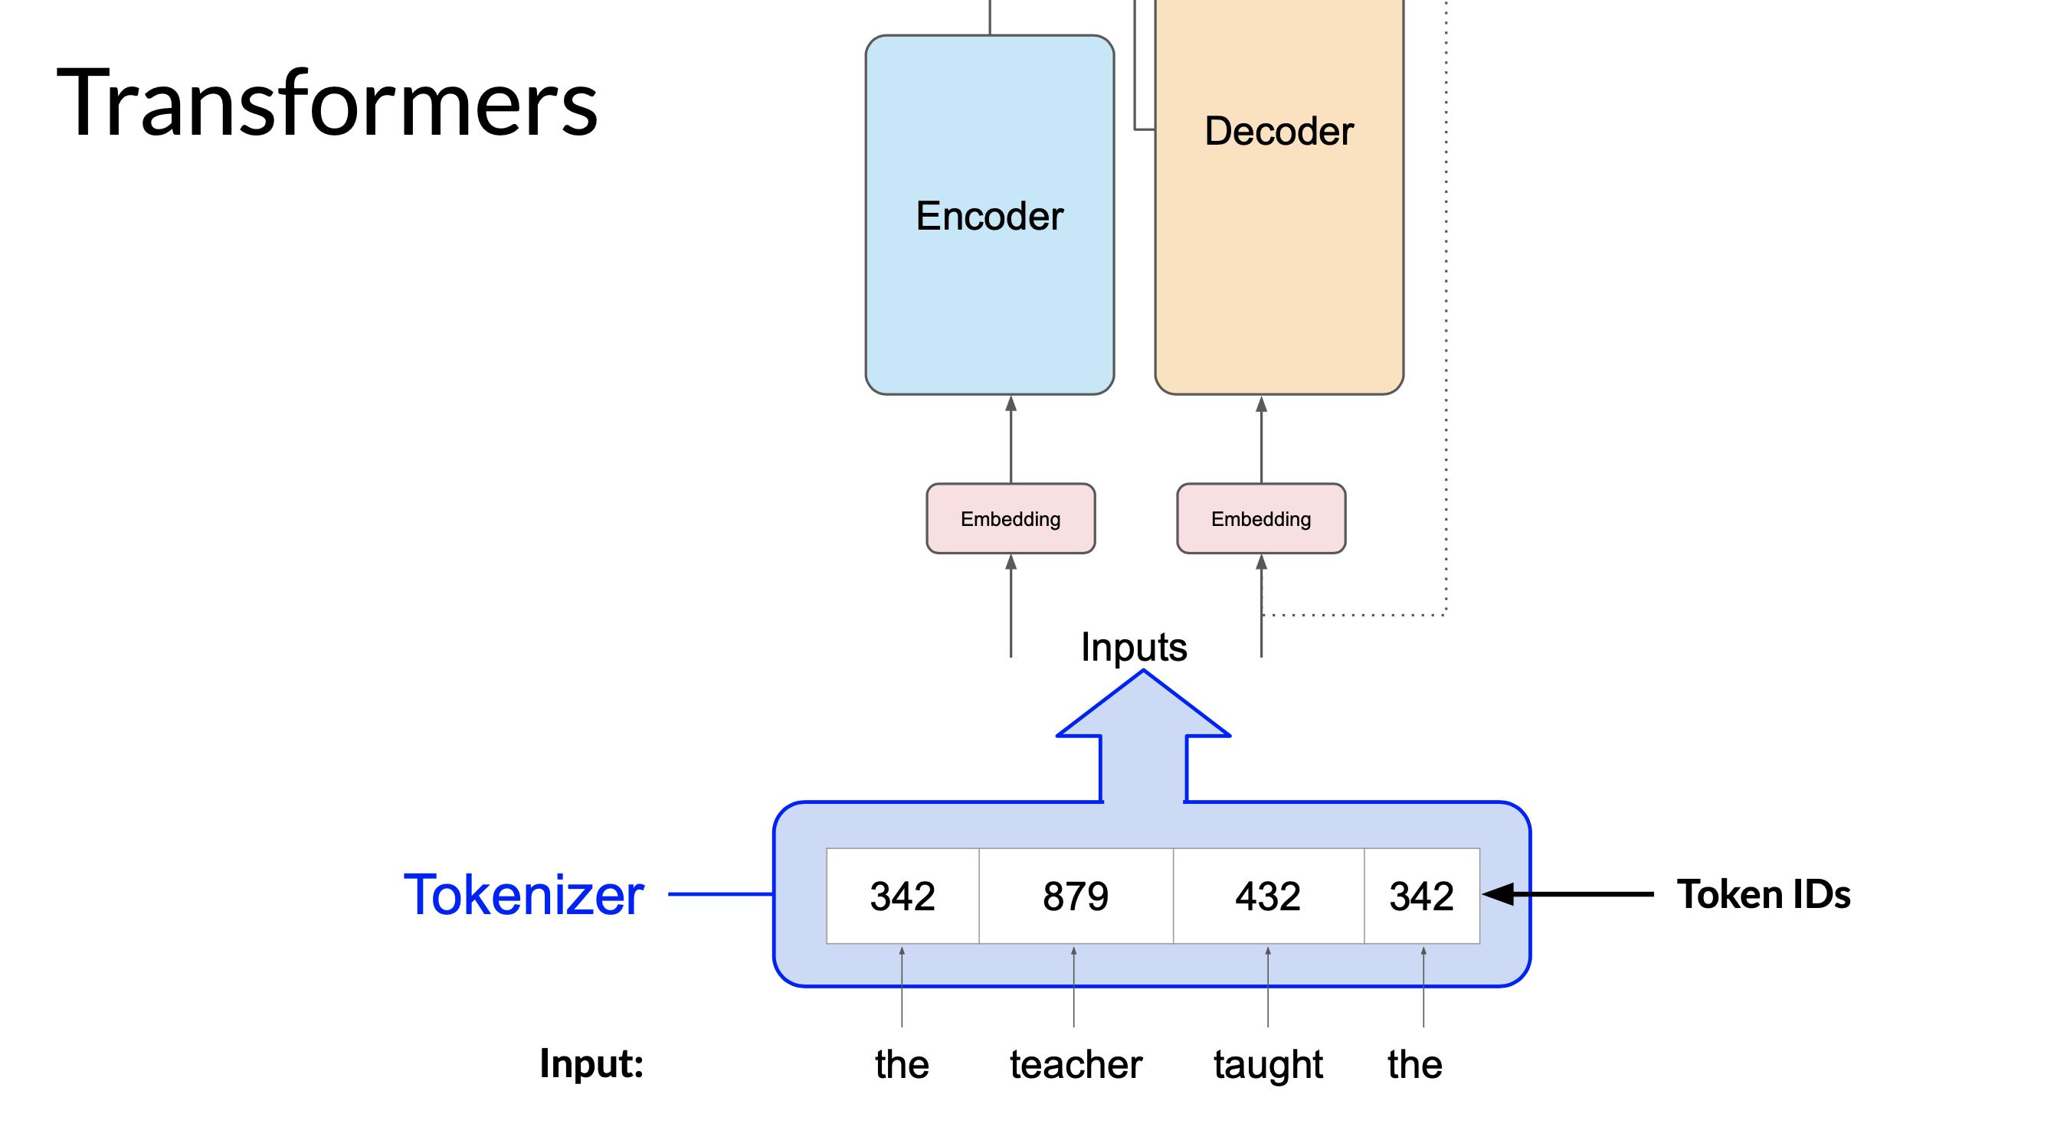
Bit more Technicalities
Attention mechanism

