Slide 1
Sales Insights Of Atliq Hardware
ANALYZINF Sales Data and Finding the Causes of Decline

Slide 2
Problem Statement
Atliq Brands is operating in many many cities of India for four years. They were performing well but now after four years they saw a decline in over all revenue wanted to analyze the sales and find any factors that could be helpful in better decisions of managers.

Slide 3
The Dataset
Dataset contains five files
Transactions table
Transactions table is the main (fact) table and other tables are dimension to the table.
Customers table
Customers table contains customer code, customer name and customer type.
Products table
Products table contains product code, product type.
Markets table
Markets Table has zone, markets code and market name columns.
Date table
Date table consists dates of transactions, year, month etc.

Slide 4
The Dataset
Customers
Customer code
Customer name
Customer type
E-commerce
Brick & Mortar

Slide 5
The Dataset
Markets
Zone
Market Name
Market code
North
Central
South
North
Ahmedabad, Delhi NCR, Kanpur, Lucknow, Patna, Surat
Central
Mumbai, Bhopal, Nagpur
South
Chennai, Hyderabad, Kochi, Bengaluru, Bhubaneshwar

Slide 6
The Dataset
Products
Product code
Customer type
Distribution
Own

Slide 7
Methodology
ETL ( Extract, Transform and Load)
Extract
Transform
Clean (renaming, duplicates and null removal) and transform data (Calculated columns, change data type, and basic measures).
Load into Power BI

Slide 8
Methodology
Dashboard and Reporting
Build necessary visuals
Combine to make dashboard

Slide 9
Dashboard
Dashboard and Reporting
Build necessary visuals
Combine to make dashboard

Slide 10
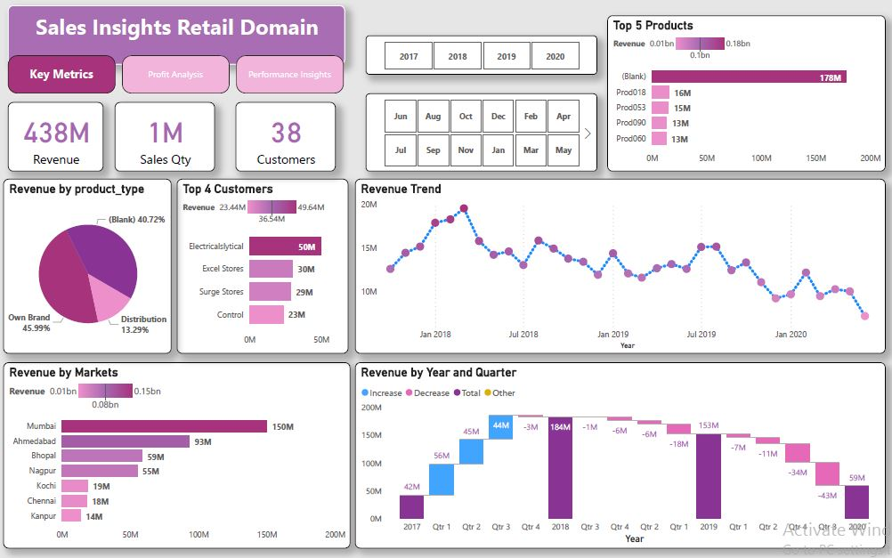
Dashboard (Key Metrics)

Slide 11
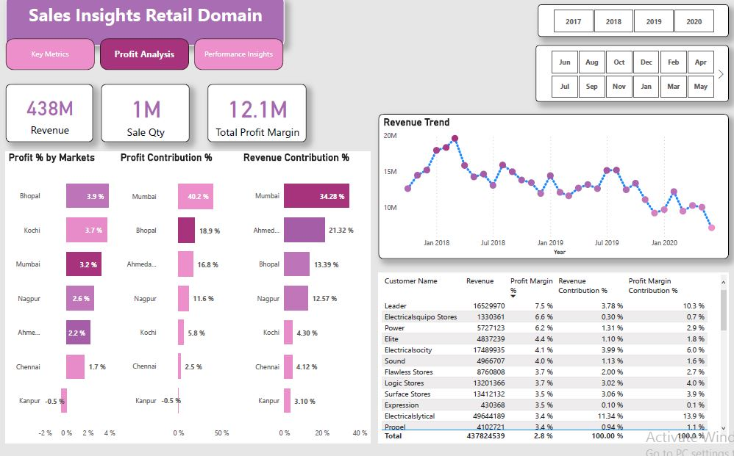
Dashboard (Profit Analysis)

Slide 12
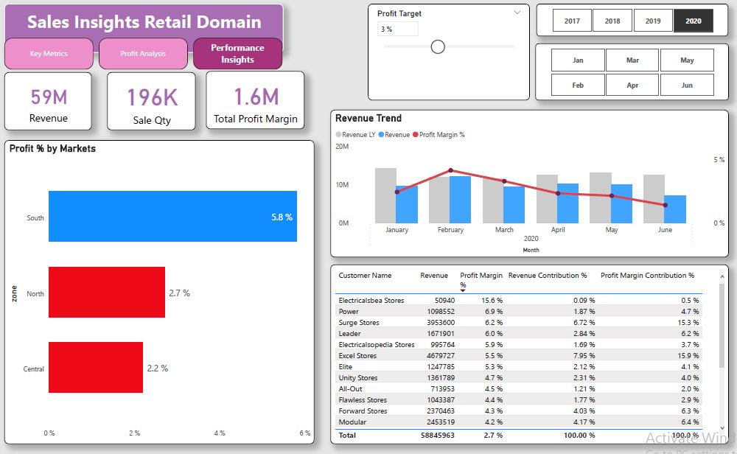
Dashboard (Performance Insights)

