Slide 1
PYTHON • MYSQL • POWER BI
Customer Shopping Behavior
Turning transaction data into a retention strategy
Sadab Ahamad
Chandigarh, India

Slide 2
OVERVIEW
What we'll cover
01
The Dataset
3,900 transactions, 18 features, one cleaning challenge
02
The Pipeline
Python for prep, MySQL for analysis, Power BI to present
03
Key Findings
Who spends, who stays, and where discounts are doing too much work
04
Recommendations
Five concrete moves for the business

Slide 3
THE DATASET
3,900 transactions, four categories
3,900
18
4
37
customer records
data columns
product categories
missing ratings, imputed
Categories covered
Clothing
Accessories
Footwear
Outerwear
Fields span customer demographics, purchase details, and shopping behavior — including discounts, subscriptions, review ratings, and shipping type.

Slide 4
THE PIPELINE
Three tools, three jobs
Python
MySQL
Power BI
Clean & Prepare
Query & Analyze
Visualize & Present
→
→
Missing values, snake_case columns, age & frequency features
10 structured business questions against the cleaned data
Interactive dashboard for non-technical stakeholders

Slide 5
STEP 1 · PYTHON
Cleaning before counting
Missing ratings
37 blank Review Rating values filled with each product category's median — not a single global average.
Column standardization
All 18 columns renamed to snake_case for clean SQL compatibility.
Feature engineering
New age_group and purchase_frequency_days columns built for segmentation.
Consistency check
discount_applied vs. promo_code_used compared — near-duplicate signal, one dropped.

Slide 6
STEP 2 · MYSQL FINDINGS
Revenue is broad-based, not concentrated
Revenue by Age Group ($)
Revenue by Gender ($)
Takeaway
Age-group revenue is nearly flat — segmenting by behavior (subscriber status, discount use) will outperform segmenting by age.
Sample output from shared dataset — verify against your own query run.

Slide 7
STEP 2 · MYSQL FINDINGS
Loyal, but not subscribed
Customer Segments
27%
$59.49 vs $59.87
of customers are subscribers
avg. spend: subscribers vs. non-subscribers
Takeaway
3,116 customers are already Loyal, but subscribers spend the same per order as everyone else — subscription today is a label, not an incentive. Attaching a real perk to it is the single highest-leverage fix in this dataset.
Sample output from shared dataset — verify against your own query run.

Slide 8
STEP 2 · MYSQL FINDINGS
Some products only sell on discount
839
customers used a discount and still spent above the $59.76 average
Takeaway
Hats and sneakers are discounted on ~half of all purchases. Worth testing a full-price window to see if demand holds.
Sample output from shared dataset — verify against your own query run.

Slide 9
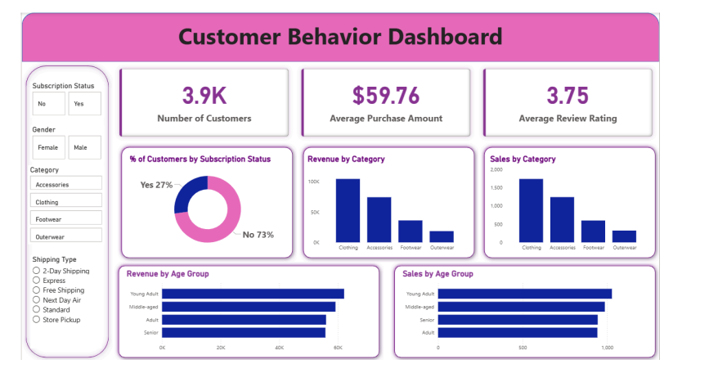
STEP 3 · POWER BI
One dashboard, every cut of the data
Filterable by subscription status, gender, category, and shipping type — no SQL required.

Slide 10
RECOMMENDATIONS
Five moves for the business
1
2
3
Give subscription an incentive
Audit discount-dependent products
Move Returning → Loyal
Attach a real perk so it drives spend, not just labels loyalty.
Test full price on hats, sneakers & coats to see if demand holds.
Target the 701 Returning customers with a lightweight loyalty nudge.
4
5
Lean into Express shipping
Segment by behavior, not age
Express spenders already pay more — promote it more aggressively.
Age-based revenue is flat; discount/subscriber behavior isn't.

Slide 11
Thank you
Questions & discussion welcome
Sadab Ahamad · Chandigarh, India

