Slide 1
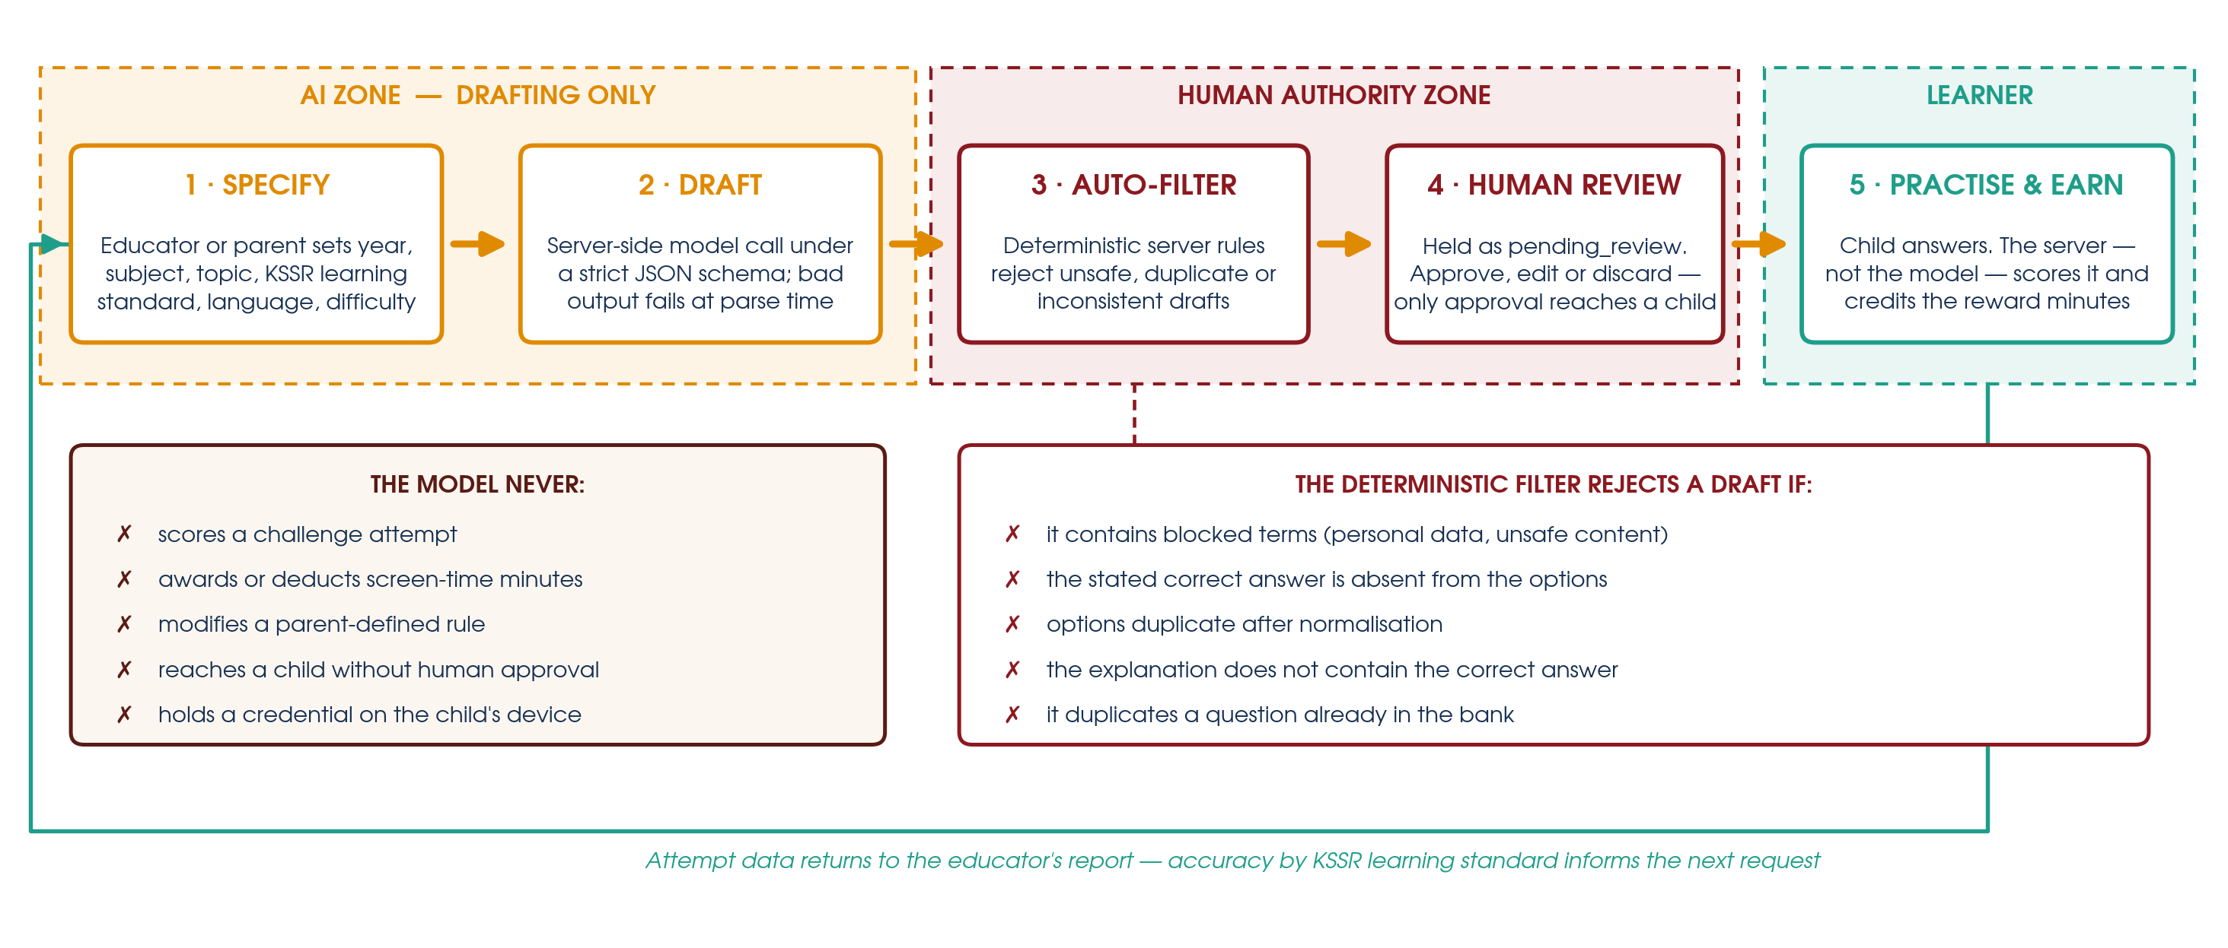
Learn2Unlock
Human–AI Synergy for Converting Children's Screen Time into KSSR Practice
Adnan Mashrur Sadad¹ · Siti Nur Khadijah Aishah Ibrahim¹
¹ Malaysia-Japan International Institute of Technology, Universiti Teknologi Malaysia · adnanmashrursadad@gmail.com
Parental controls restrict screen time; they rarely teach through it. Learn2Unlock makes device access something a child earns by answering questions aligned to the Malaysian KSSR curriculum. A generative model drafts those questions — but authority stays human. Every draft passes a deterministic server filter, then explicit educator approval, before a child ever sees it, and the model can never score an attempt or award a single minute.
THE PROBLEM
OBJECTIVES
NOVELTY
Parental control tools respond to children's device use almost entirely with restriction — timers, blocklists, bedtime cut-offs. Restriction is adversarial by design: it makes the adult an obstacle, produces daily negotiation, and teaches the child nothing.
Answer-to-unlock apps exist, but three problems keep them marginal:
▪ Content mismatch — generic banks that rarely map to KSSR
▪ Authoring burden — adults must write every question by hand
▪ Trust gap — where AI generates, it does so unsupervised
▪ Make device access an outcome earned through curriculum-aligned practice, not granted or withheld arbitrarily.
▪ Cut the question-authoring effort demanded of parents and teachers by an order of magnitude.
▪ Guarantee architecturally that the model cannot score an attempt, alter a rule or award screen time.
▪ Cover KSSR Years 1–6 in four subjects, every item traceable to a learning-standard code.
▪ Report accuracy by learning standard, so practice data feeds back into what is taught next.
Existing applications place AI either fully in control of the learning loop or entirely outside it. Learn2Unlock takes a third position:
the model holds drafting authority only, and that boundary is enforced in code rather than in policy.
Generated questions enter as pending_review and stay invisible to the child until an adult approves them. Scoring, reward calculation and rule enforcement run in deterministic server-side paths the model cannot reach.
The novelty is not the reward loop — it is the placement of the human gate, and the fact that it cannot be bypassed.
HOW THE SYNERGY WORKS
SYSTEM ARCHITECTURE
PROTOTYPE: BUILT AND RUNNING
PARENT APP
Expo / React Native
Defines every rule. Approves, edits or rejects every question before a child sees it.
API SERVER
Node.js · SQLite · Zod
Scores attempts, credits reward minutes, enforces caps, runs the deterministic safety filter.
CHILD APP
Expo / React Native
Attempts challenges and requests time. Holds no credential for the model.
3
deployable units:
parent app, child app, API
4
KSSR subjects seeded
across Years 1–6
5
deterministic rules that
reject a draft pre-review
0
minutes the model can
award — by architecture
Both flows run end to end against the persistent API, with an automated test suite and project-wide type checking. Findings at this stage are technical, not behavioural — an eight-week pilot with Malaysian families will measure engagement, household conflict, approval and edit rates for AI drafts, usability and trust.
IMPACT
IN THE CLASSROOM
CONCLUSION
▪ Minutes once spent negotiating become retrieval practice on the exact standards the school assesses.
▪ The child decides when to attempt a challenge — the reward is earned, not granted.
▪ One teacher's approved bank serves many families at no extra authoring cost.
▪ Generate against one learning standard at a time — the report is only as good as the tagging.
▪ Keep mixed difficulty in each release, so the weakest learner still passes and the strongest is stretched.
▪ Treat the rejection log as diagnostic: many rejects usually means a standard phrased too broadly.
Generative AI can enter children's educational technology without asking anyone to trust an unsupervised model.
Confine the model to drafting, filter its output deterministically, and require a human decision before anything reaches a child. AI supplies scale; the educator supplies judgement.

