Slide 1
Global AI Content Impact
• • •
Analysis of 10 Countries and 10 Industries (2020–2025)
Corrected edition — figures verified against the source dataset

Slide 2
Overview
This dataset explores the influence of AI-generated content across various industries.
Dataset at a Glance
Metric | Value | Notes
Total records | 200 | Country × Industry × Year
Countries | 10 | USA, Germany, France, UK, China, Japan, India, Australia, Canada, South Korea
Industries | 10 | Media, Legal, Automotive, Gaming, Retail, Education, Healthcare, Marketing, Manufacturing, Finance
Years covered | 2020–2025 | 6-year period; sampling is uneven — not every country × industry × year combination is present
This caveat matters: several charts later in the deck compare countries or industries with very small sample sizes (sometimes 1–3 records). Single-year, single-country figures should be read as illustrative, not as stable long-run trends.
2

Slide 3
Project Objective
The dataset captures 7 key numerical metrics:
AI Adoption Rate, AI-Generated Content Volume, Job Loss Due to AI, Revenue Increase Due to AI, Human-AI Collaboration Rate, Consumer Trust in AI, and Market Share of AI Companies.
The charts in this report cover every dimension of the dataset and are organized into four analytical sections:
1
Section 1 — Industry and Country Adoption Patterns
2
Section 2 — Economic Impact: Jobs and Revenue
3
Section 3 — Technology Ecosystem: Tools, Content and Market
4
Section 4 — Trust, Collaboration and Relationships
3

Slide 4
Industry and Country
Adoption Patterns
AI adoption by industry (The Illusion of Averages)

Slide 5
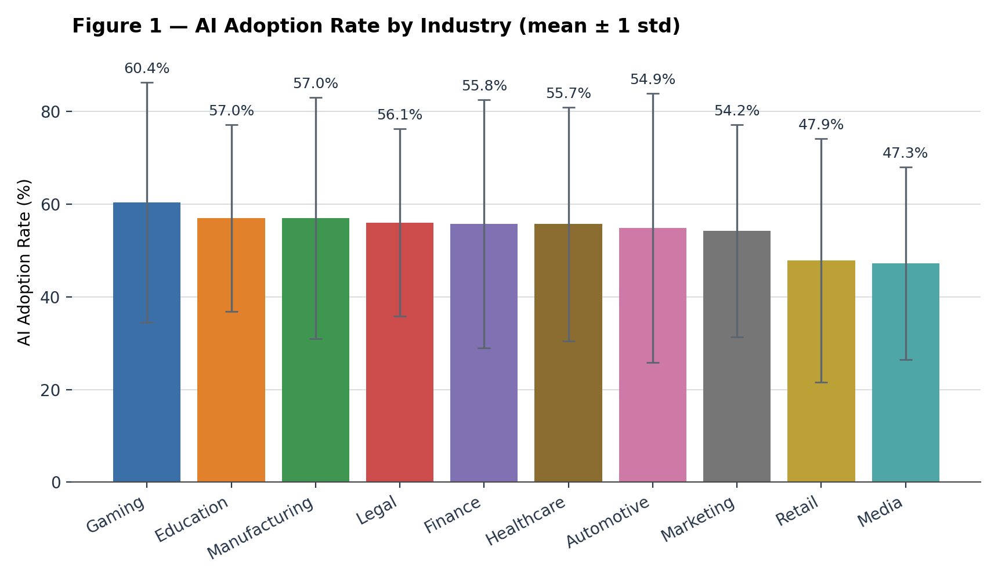
AI Adoption Rate by Industry
This bar chart shows the average AI Adoption Rate (%) for each of the 10 industries, computed across all countries and years in the dataset.
The error bars show one standard deviation — and they're almost as tall as the bars themselves. That's a first sign that industry-level averages hide a lot of underlying variation, which the next few slides dig into.
5

Slide 6
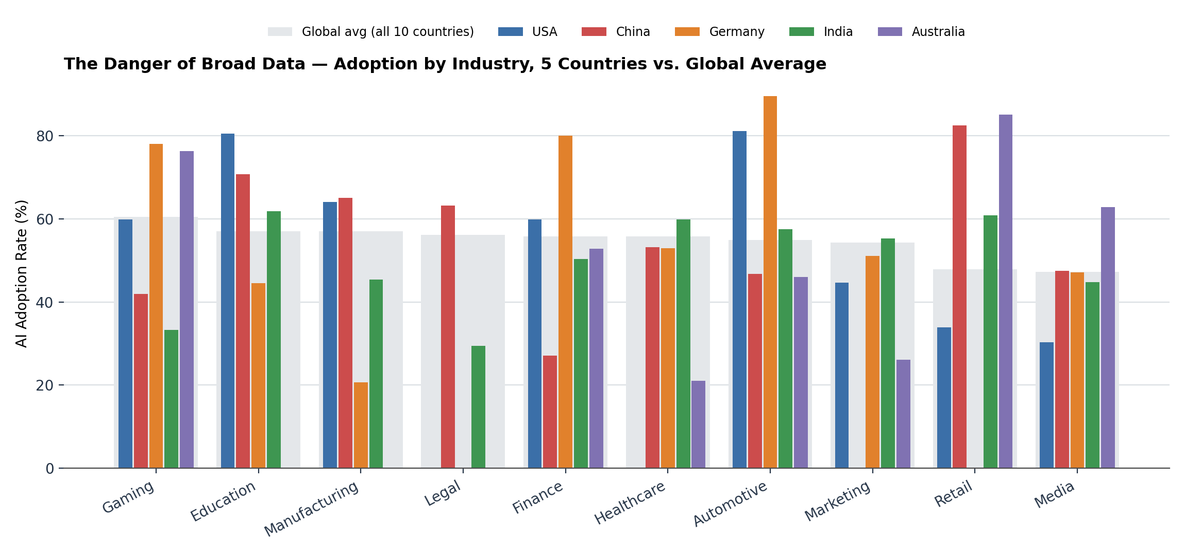
The Danger of Broad Data
Broad industry averages hide dramatic regional differences.
6

Slide 7
What Is the Illusion?
The Paradigm Shift: "Which industry adopts AI most?" is the wrong question.
The Right Question: "Which country-regulation combination within an industry drives adoption?"
63%
29%
As the chart shows, adoption within a single industry can swing far more than the difference between industry averages. In Legal services, for example, average AI adoption is 63% in China but just 29% in India — a 34-point spread inside one industry, wider than the entire 13-point gap between the highest- and lowest-adopting industries overall (Gaming at 60% vs. Media at 47%). Asking “which industry adopts AI most” is the wrong question; the right one is how country-level factors and regulation drive adoption.
China — Legal AI adoption
India — Legal AI adoption
Same industry. Same year range. A 34-point gap.
7

Slide 8
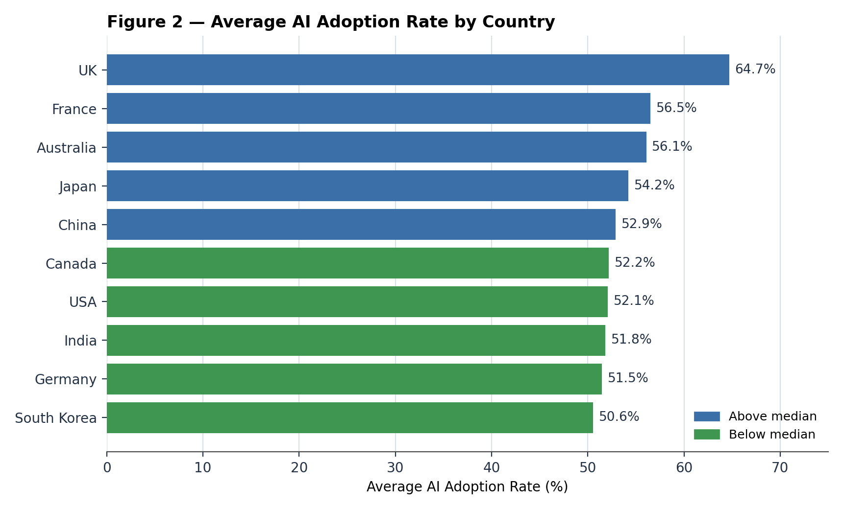
Average AI Adoption Rate by Country
Leading Adopters: the UK leads (~64.7%), well ahead of the rest of the field.
Strict Regulation's Effect: China (52.9%) and South Korea (50.6%) are among the lowest, consistent with stricter sector rules.
The Real Gap: the spread across all 10 countries is about 14 percentage points (64.7% to 50.6%) — real, but modest compared with the industry-level swings on the previous slides.
8

Slide 9
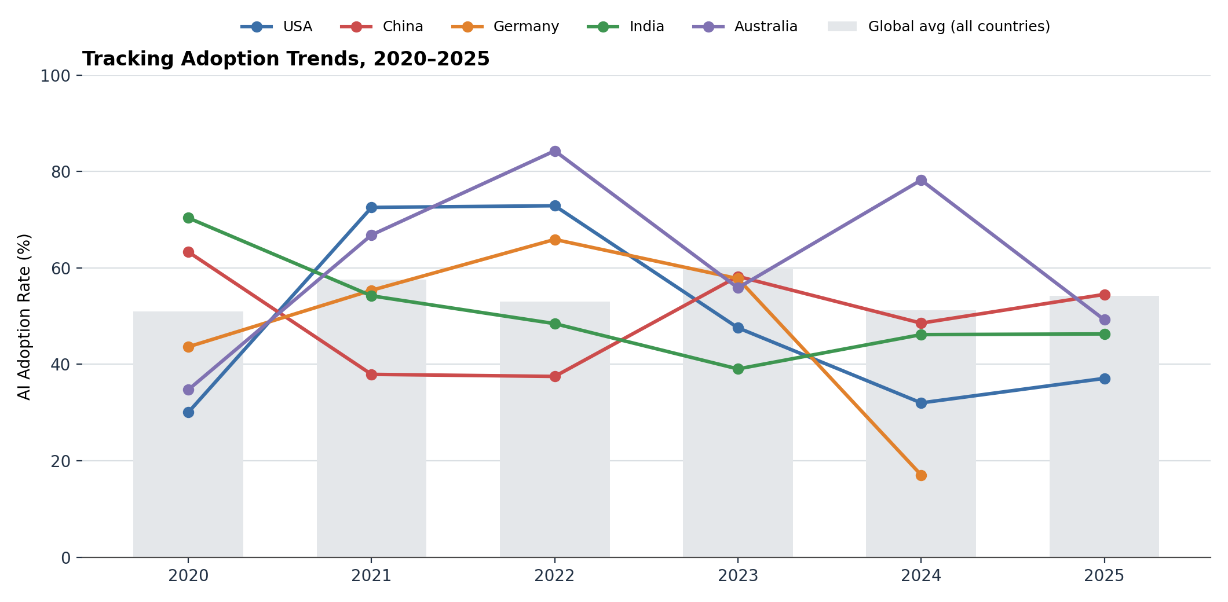
Tracking Adoption Trends Over 6 Years
The global adoption landscape is volatile — none of the five countries shows one clean, steady trend.
India fell the most: from a 2020 high of 70% to 46% by 2025 (–24 pts), the steepest net decline of the five.
China and Germany swing rather than trend: China ranged from 37% (2021–22) to 63% (2020) before settling near 55%; Germany peaked at 66% in 2022 then fell to 17% by 2024, its last recorded year (no 2025 data in the sample).
Read with caution: each country-year point is often just 1–5 records, so year-to-year jumps are noisy, not clean policy signals.
9

Slide 10
Key Takeaway: The Adoption Myth
Geography Alone Is a Weak Predictor: national averages mask sizable sector-level differences.
The Reality: AI adoption varies more within industries — and within countries year to year — than industry averages alone suggest.
Conclusion: country policy, regulation status, infrastructure, and ordinary sampling noise all matter as much as the industry label itself.
10

Slide 11
Economic Impact
‘Jobs and Revenue’
The Universal Risk of Job Loss

Slide 12
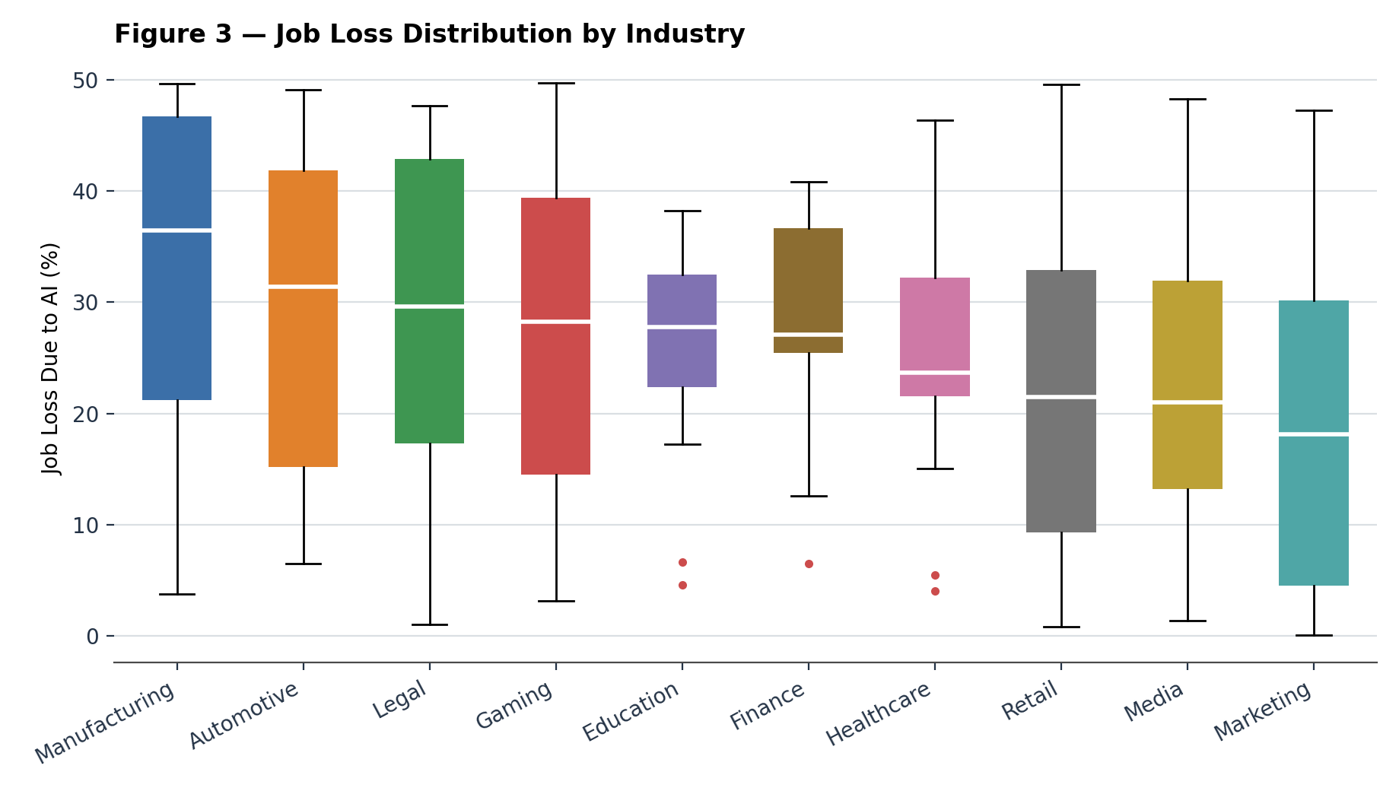
Job Loss Distribution by Industry
Most Affected: Manufacturing has the highest median job loss (36%), followed by Automotive (31%) and Legal (30%) — industries with high potential for task automation.
Least Affected: Marketing (18%) and Retail (22%) see the least displacement, as AI tends to augment rather than replace work there.
Wide Spread: every industry's 25th-to-75th-percentile range spans at least ~20 points, so the average understates how unevenly displacement actually lands.
12

Slide 13
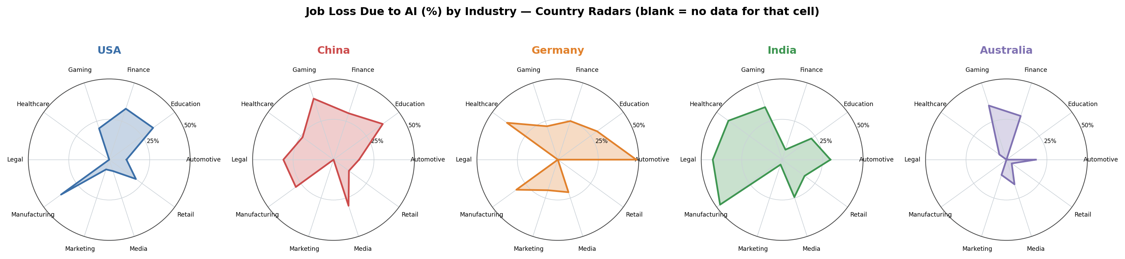
The Shape of Displacement: Country Perspectives
Job loss patterns are shaped by national economies, not a single global rule. India shows massive spikes in Manufacturing (47%) and Legal (43%); Germany's biggest displacement is in Automotive (48%).
13

Slide 14
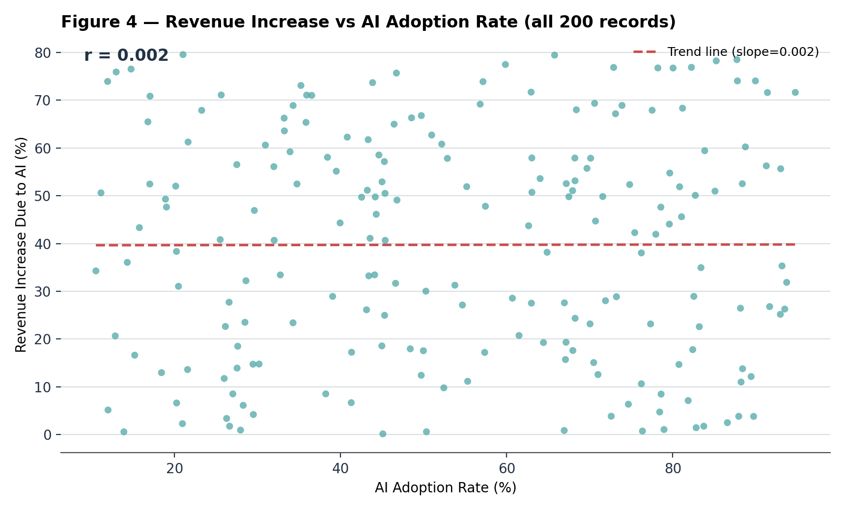
The Revenue Myth: Does More AI Equal More Money?
The Assumption: broad AI adoption automatically drives higher revenue.
The Reality: there is essentially zero correlation (r ≈ 0.00, precisely +0.002) between raw AI adoption rates and revenue increases, across all 200 records.
High revenue gains appear at every level of adoption, from single digits to the mid-90s.
14

Slide 15
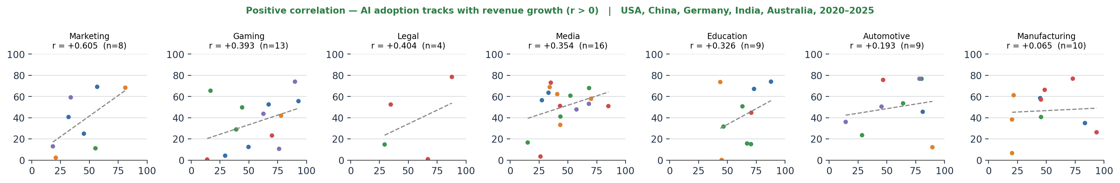
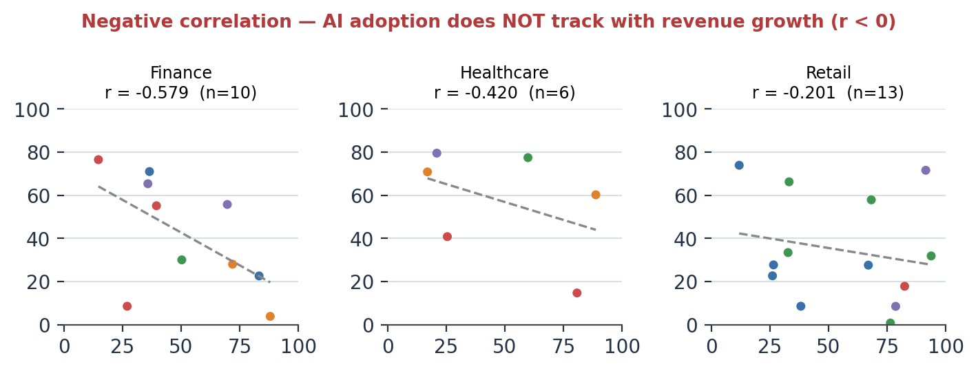
Revenue Realities: Sector-Specific Correlations
Correlation between AI Adoption Rate and Revenue Increase, within USA, China, Germany, India, Australia (2020–2025)
Paradoxically, in Finance (r = –0.579) and Healthcare (r = –0.42), higher AI adoption is linked to lower revenue growth within this five-country sample — while Marketing (r = +0.605) and Legal (r = +0.404) show the opposite pattern.
15

Slide 16
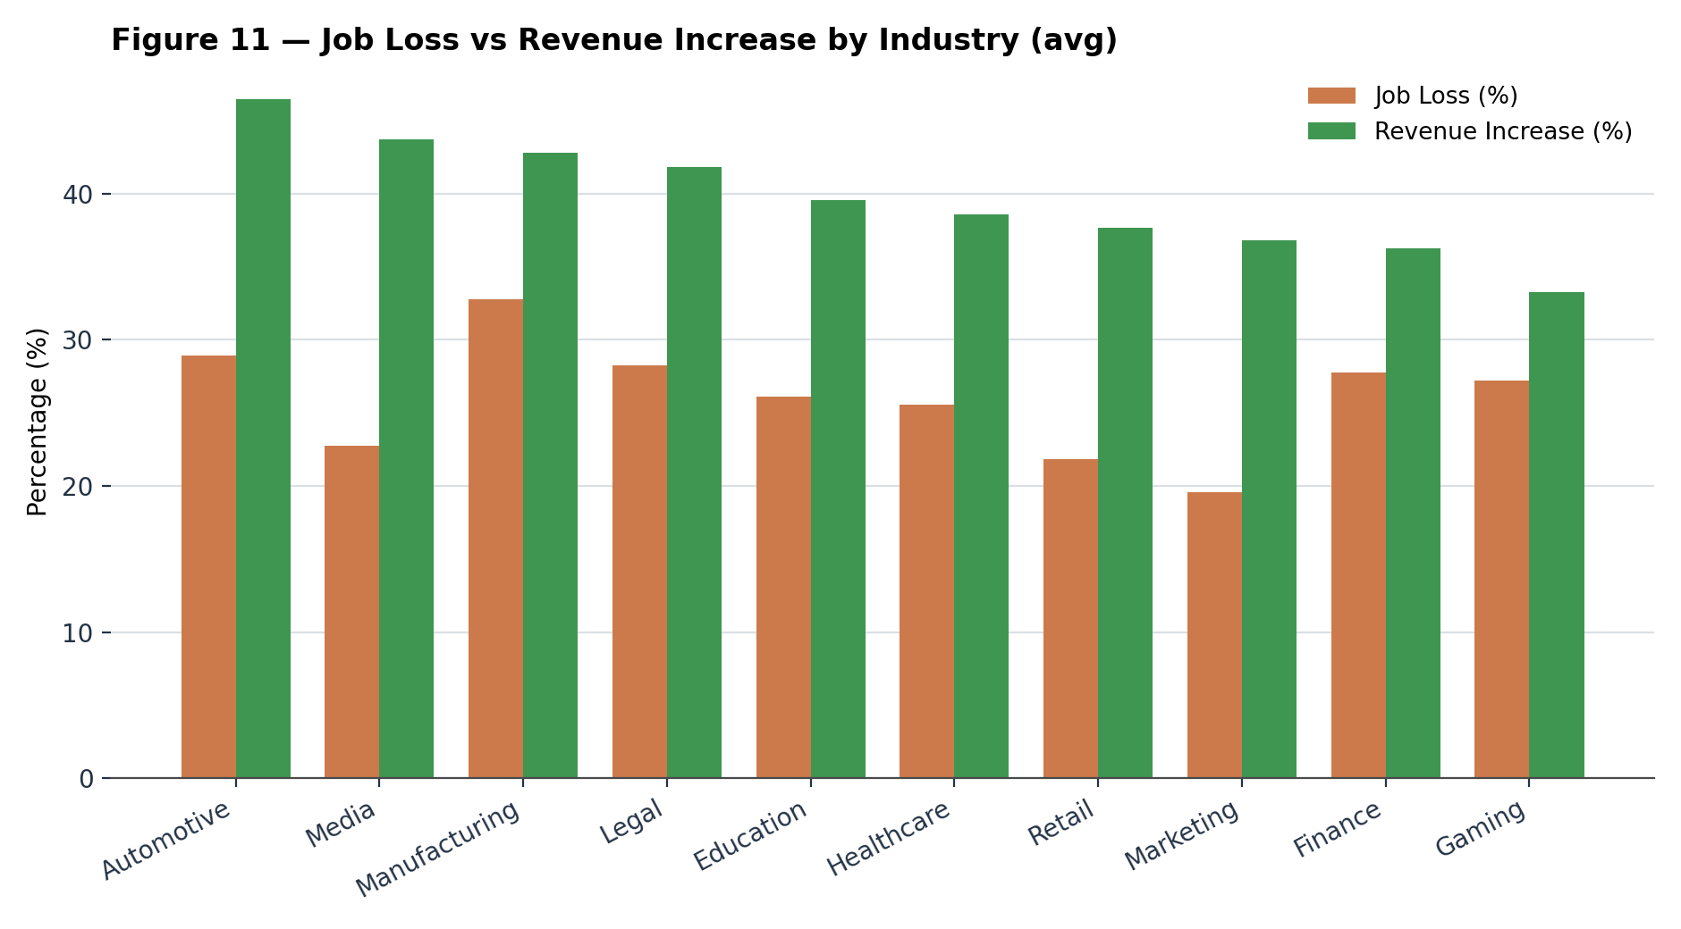
The Economic Trade-Off: Job Loss vs. Revenue
Best Trade-off: Media pairs strong revenue gains (44%) with comparatively low job loss (23%) — AI mostly augments rather than replaces here.
Profitable but Disruptive: Automotive has the highest average revenue (46%) but above-average job loss (29%); Legal is similar (42% revenue, 28% job loss).
Highest Displacement: Manufacturing has the highest job loss of any sector (33%), with only mid-pack revenue (43%).
Weakest Sector: Gaming combines the lowest average revenue (33%) with above-average job loss (27%) — the least favorable trade-off in the dataset.
16

Slide 17
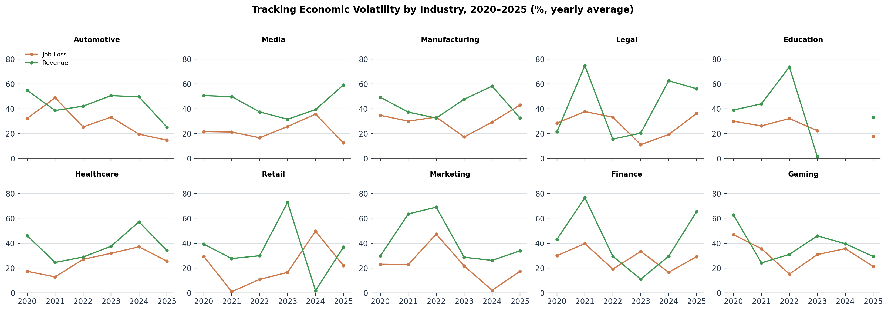
Tracking Economic Volatility by Industry (2020–2025)
Both job loss and revenue swing substantially year to year within every industry — there is no steady trend either way for most sectors, which is why single-year snapshots can be misleading if read as long-run averages.
17

Slide 18
Key Takeaway: “Quality Over Quantity”
Adoption ≠ Revenue: racing to raise AI adoption rates does not guarantee financial success (r ≈ 0.00 overall).
Targeted Value: sector-specific patterns (Marketing, Legal) suggest that deployment on well-matched, high-value tasks matters more than raw adoption breadth.
Policy Imperative: reskilling should be prioritized for the highest-job-loss sectors — Manufacturing, Automotive, and Legal — where displacement is greatest.
18

Slide 19
The Technology Ecosystem
& Dominant Tools

Slide 20
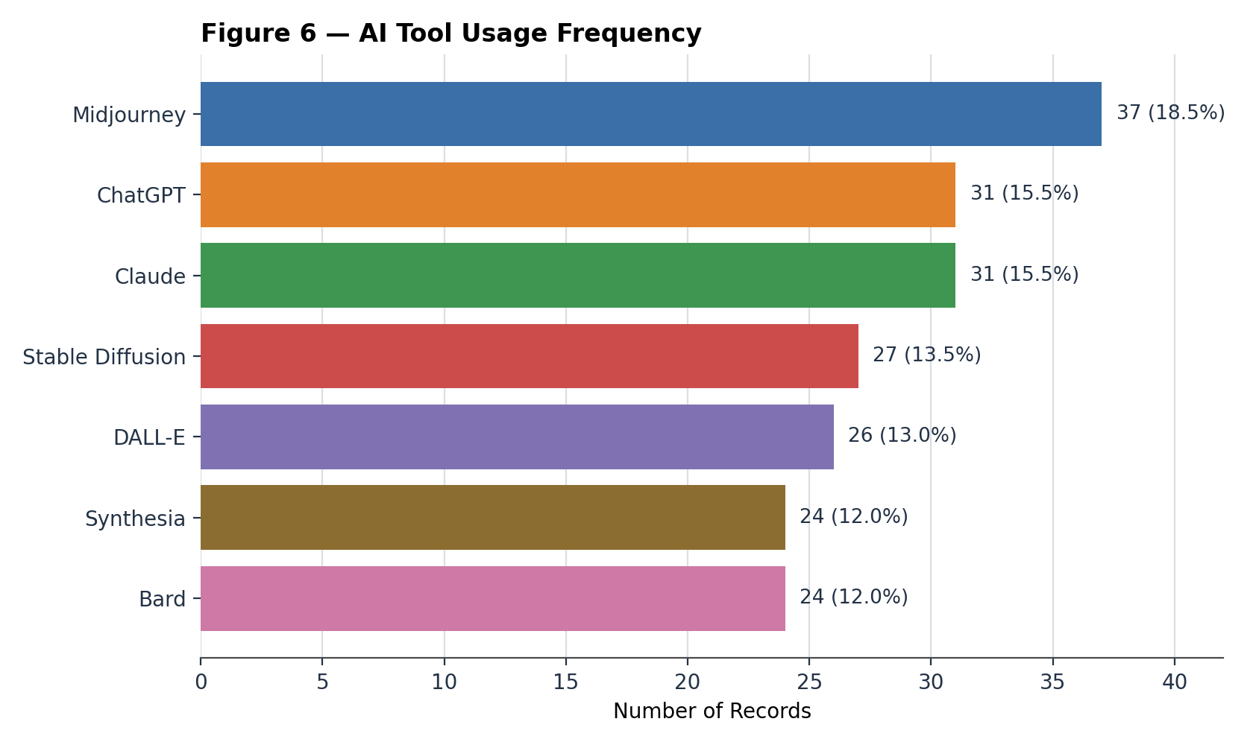
Technology Ecosystem — The Dominance of Visual AI
Visual AI Leads: image-generation tools — Midjourney, DALL-E, and Stable Diffusion — together account for 45% of all primary tool usage.
Top Tool: Midjourney ranks #1 overall (18.5% of records), followed by ChatGPT and Claude, tied at 15.5% each.
The Rest: Stable Diffusion (13.5%), DALL-E (13.0%), and Bard and Synthesia (12.0% each) round out the field — no tool outside Midjourney dominates.
20

Slide 21
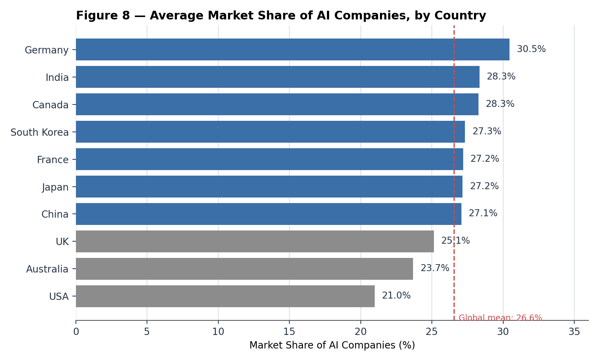
Global AI Market Share: A Distributed Ecosystem
The Leader: Germany leads market share (~30.5%), followed closely by India and Canada (~28.3% each).
The Lowest: the USA has the lowest share (~21.0%), consistent with acting primarily as an AI user rather than a creator; Australia (23.7%) and the UK (25.1%) are also below the 26.6% global mean.
A Real but Modest Spread: the range across all 10 countries is about 9.5 percentage points (30.5% to 21.0%) — meaningful, but far narrower than the spreads seen in adoption or job loss.
21

Slide 22
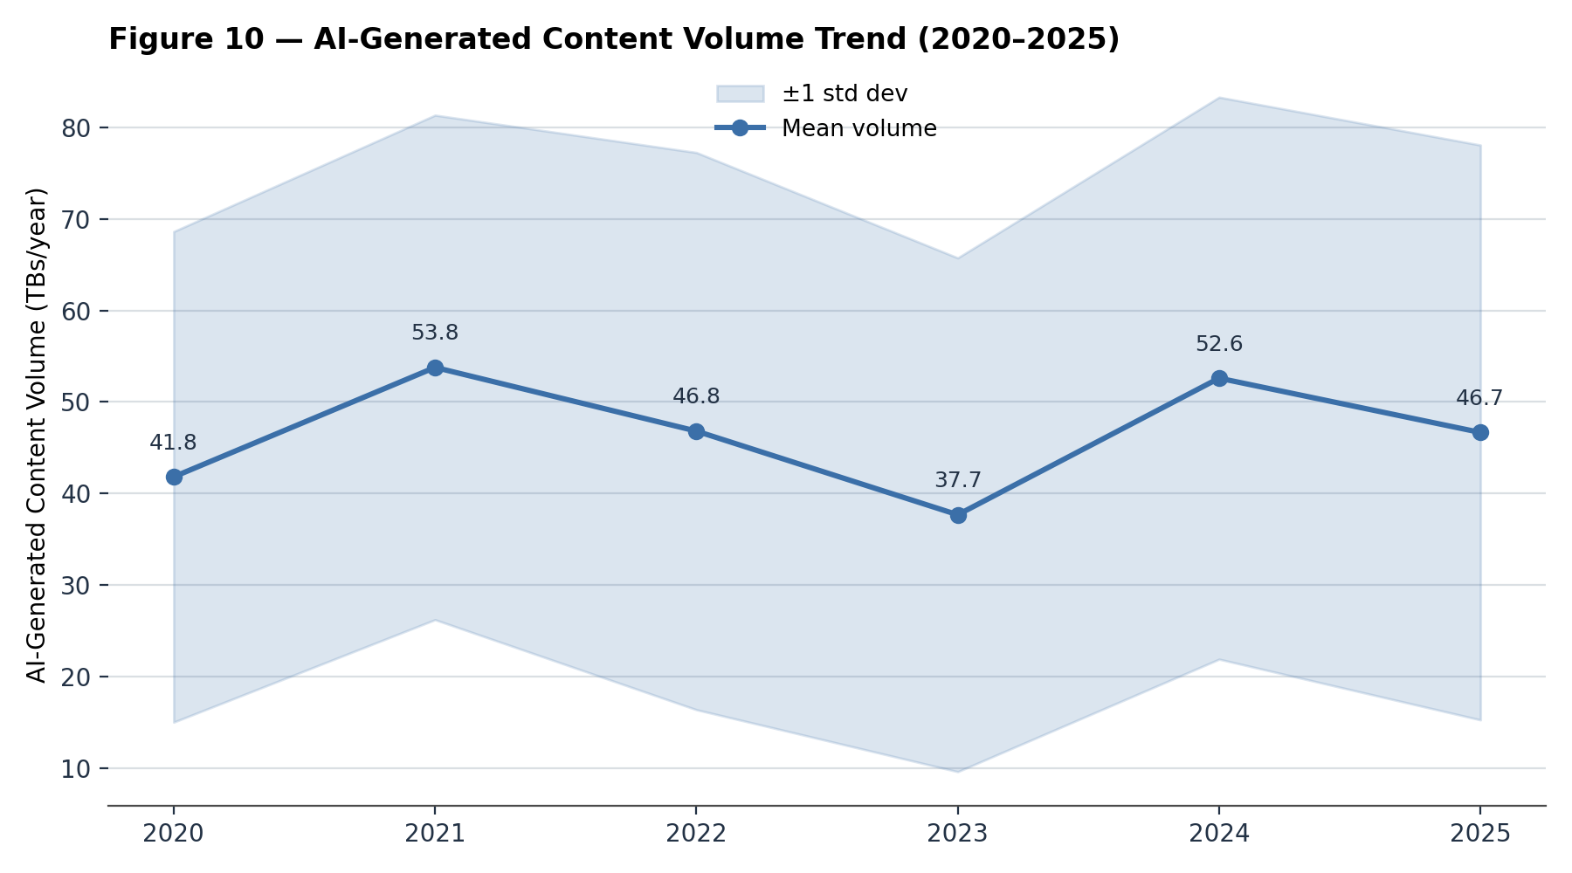
Content Volume Trends (2020–2025): The Surprising Plateau
No Exponential Growth: contrary to expectations, there is no clear upward trend in AI-generated content volume over the 6 years.
The Averages: volume fluctuates between 38–54 terabytes per year, with no consistent direction.
Massive Variance: the standard deviation is huge (±27–31 TB) — volume is driven more by specific industry needs than by the passage of time.
22

Slide 23
Trust, Collaboration
and Relationships
The Regulation Paradox

Slide 24
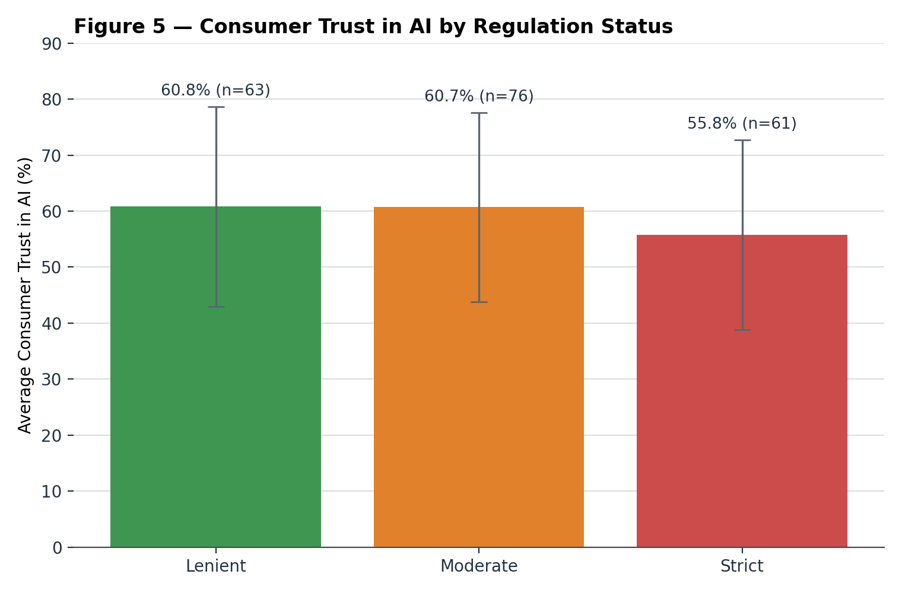
Trust & Collaboration — The Trust Paradox
The Paradox: lenient (60.8%) and moderate (60.7%) regulation correspond to higher consumer trust than strict regulation.
Strict Rules, Lower Trust: environments with strict AI regulation show the lowest average trust (55.8%).
The “Signaling” Effect: strict regulation may inadvertently signal that AI is risky, suppressing trust — though with ~17-point std. deviations in every group, individual cases vary widely.
24

Slide 25
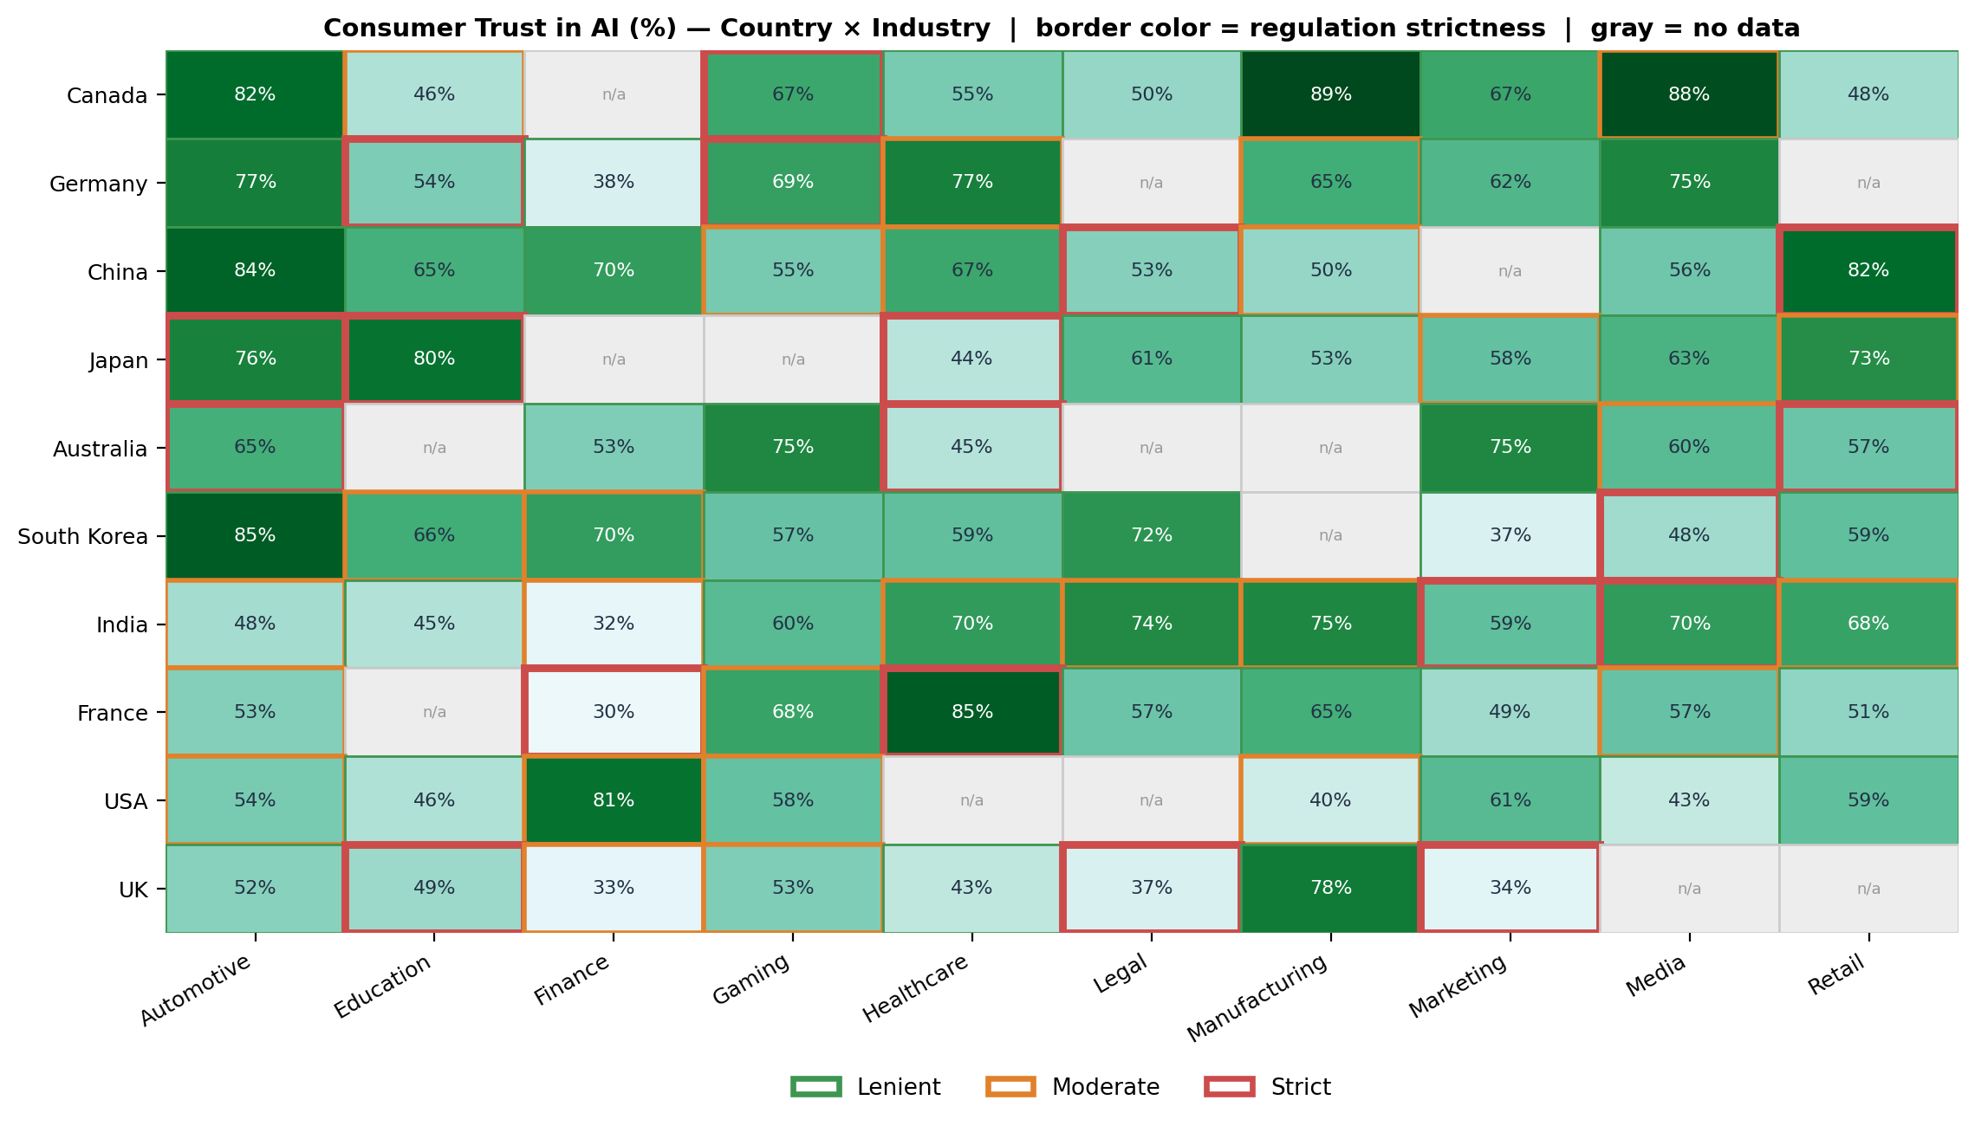
The Granular View of Trust: Strict Borders vs. Low Trust
Darker cells = higher trust. Border color/thickness = regulation strictness. France's Finance sector (strict) shows just 30% trust; Canada's Manufacturing (lenient) shows 89% — though exceptions exist, e.g. China's Automotive (lenient) still shows 84% trust.
25

Slide 26
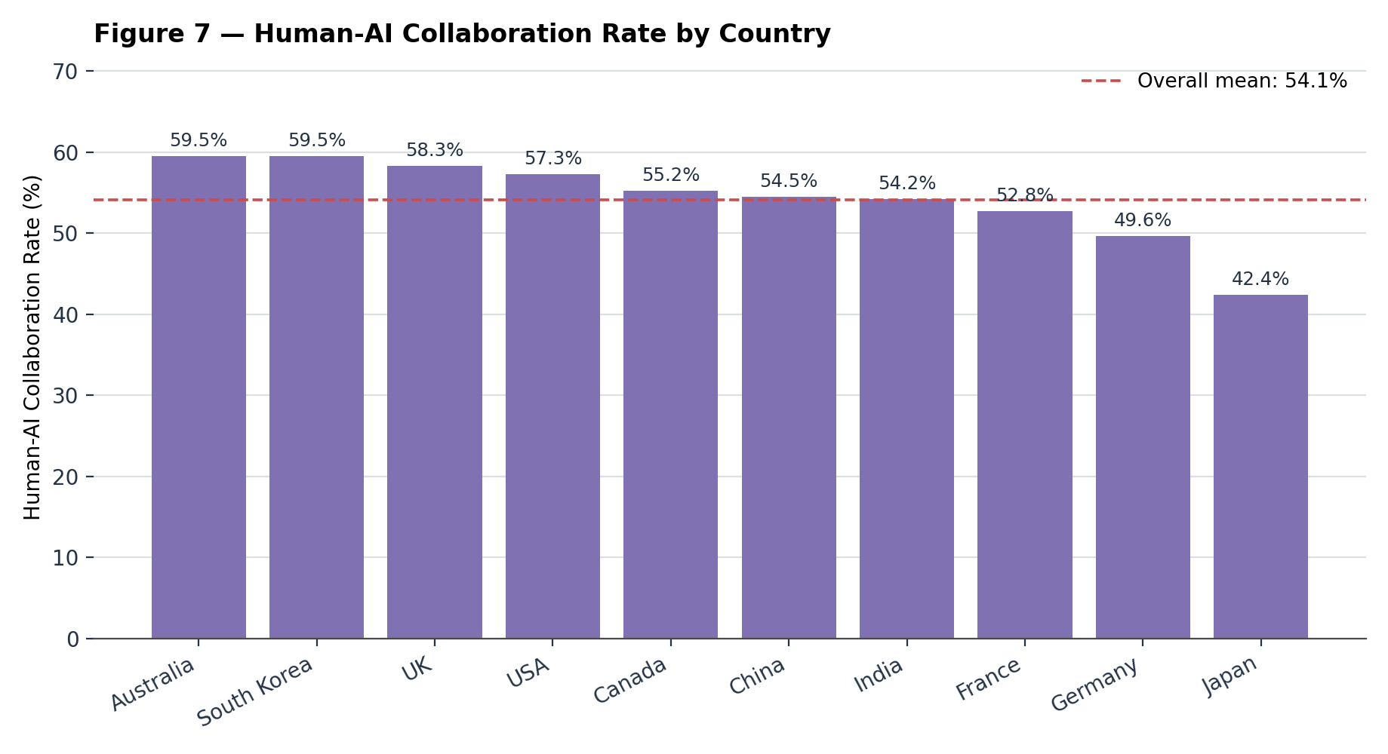
Human-AI Collaboration: A Real, Wide Gap
Not a Narrow Gap: countries span about 17 percentage points in collaboration rate — wider than the gaps seen in market share or overall adoption.
The Extremes: Australia and South Korea lead (~59.5% each); Japan is the clear outlier at the bottom (~42.4%), well below Germany (49.6%), the next-lowest.
The Reality: technology limits alone don't explain this — national culture and policy still visibly shape how collaborative vs. autonomous AI use is, given how wide this spread is.
26

Slide 27
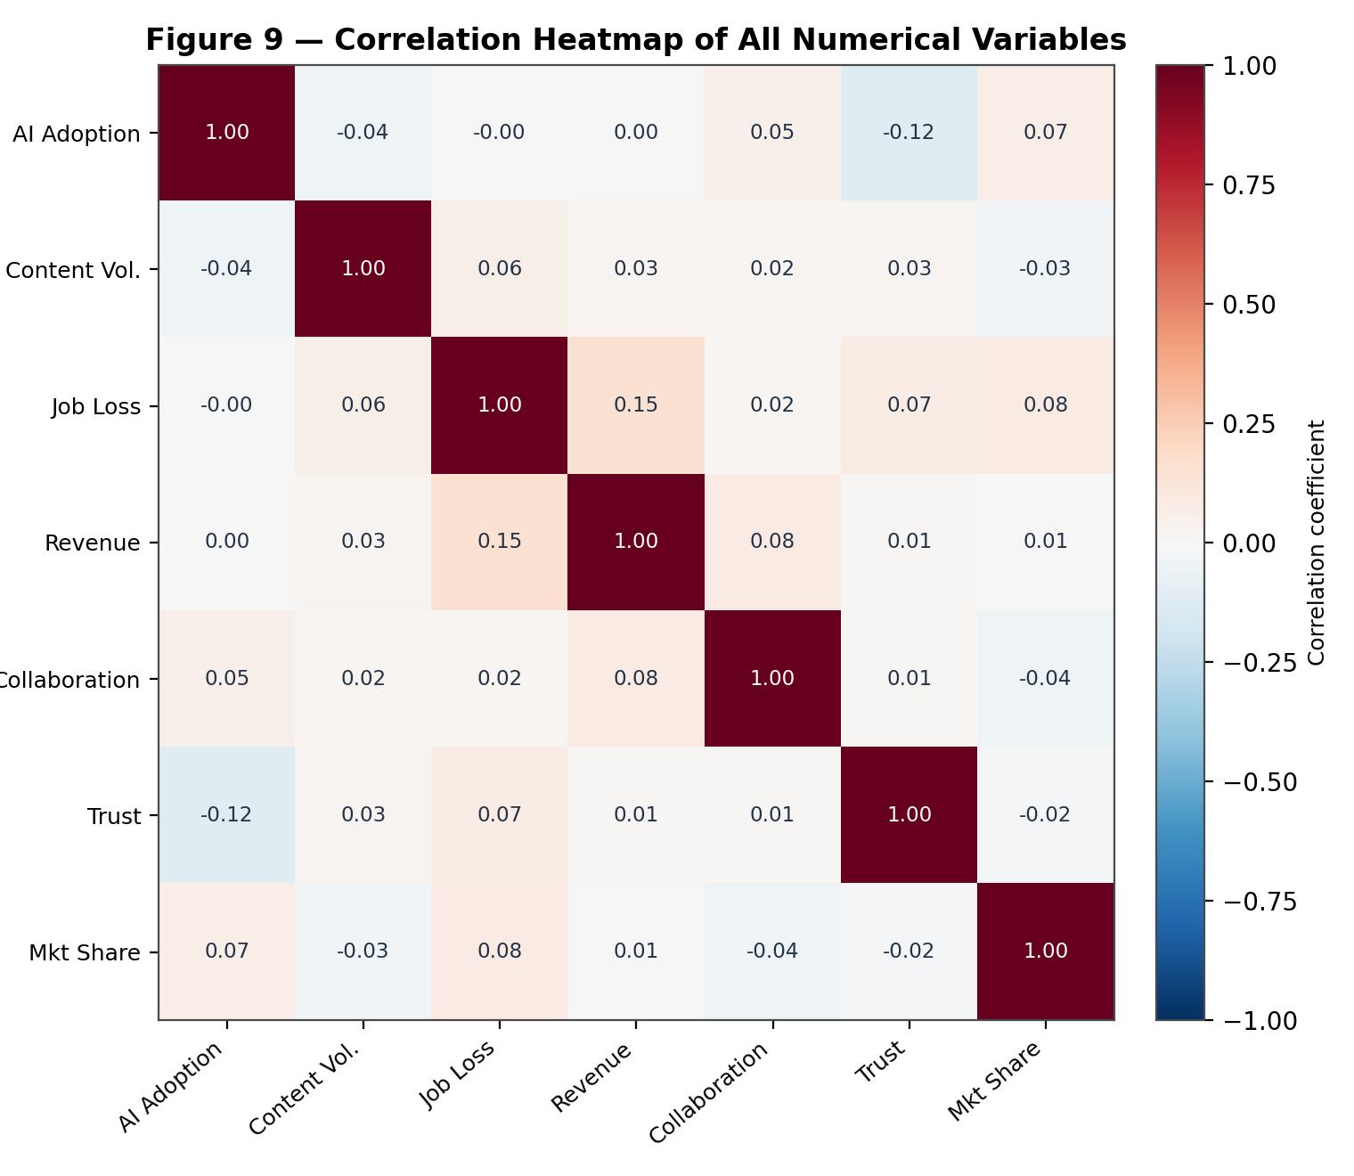
The Quality vs. Quantity Dilemma
Adoption ≠ Trust: there is a weak negative correlation (r = –0.12) between adoption rates and consumer trust.
The Clearest Case: the UK combines the highest average adoption (64.7%) with the lowest average trust (50.1%) of any country; Germany sits at the opposite extreme — below-average adoption (51.5%) with the highest trust (65.0%).
No Magic Lever: all 7 metrics in this dataset are nearly independent (most correlations under |0.15|) — you cannot optimize revenue or trust simply by forcing higher AI adoption.
27

Slide 28
Final Conclusions & Strategic Imperatives
Averages Are Illusions: AI adoption and impact vary far more within industries and within countries year-to-year than headline averages suggest.
The Revenue Myth: broad adoption does not guarantee revenue (r ≈ 0.00 overall); sector-specific, strategic deployment is what correlates with gains.
Job Loss Is Uneven but Widespread: displacement is highest in Manufacturing, Automotive, and Legal — prioritize reskilling there first.
28

