Slide 1
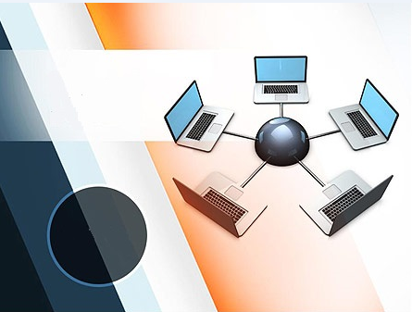
Topologies

Slide 2
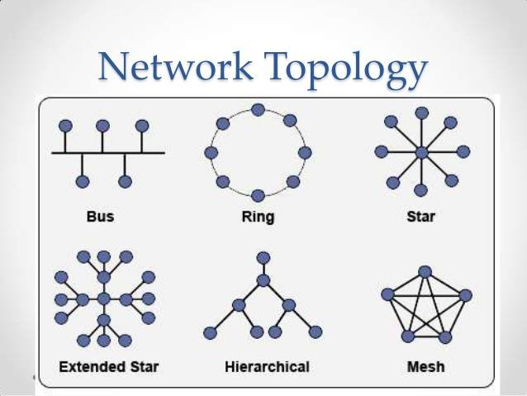
Topology
Definition:
“The way how the devices on a network are arranged and comminicate with each other is called Topology”.

Slide 3
Types:
Topology
Ring Topology
Tree Topology
Bus Topology
Star Topology
Mesh Topology

Slide 4
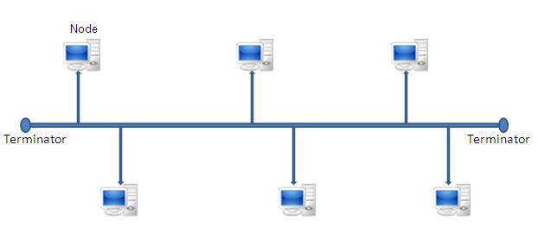
Bus Topology
In this network topology, all computers or nodes are connected to a common communication medium. This medium is often a central wire known as bus.
The terminators are used at the end of a bus to absorb signals.
Used with Local Area Network.

Slide 5

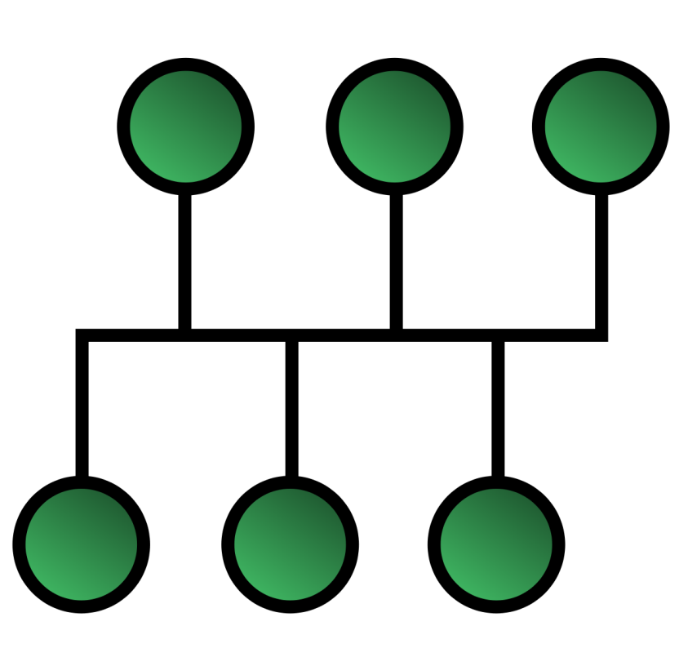
Advantages:
Requires small cable length.
Less expensive
If one node fails, it does not affect the network.
Disadvantages:
Bus topology is not good for large networks.
Number of devices affects its efficiency.

Slide 6
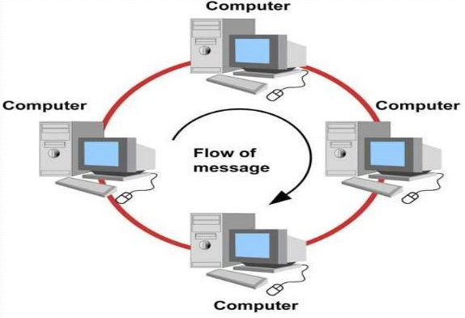
Ring Topology
Definition:
In this topology, each computer is connected to the next computer with the last one connected to the first. Thus, a ring of computer is formed.
Working:
Flow of data is in clock-wise direction.
Token ring is used in this network. A node can only access the network if it has token ring.
Token ring is like a ticket which transfers from computer to computer

Slide 7
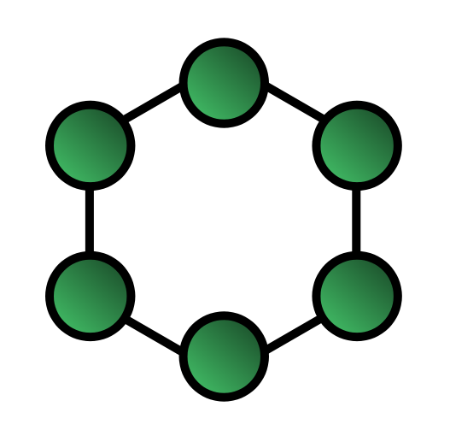
Advantages:
Not much expensive
Equal access of computer nodes.
Disadvantages:
Failure of one node, can causes affect on network
Adding or removing computers affect whole network

Slide 8

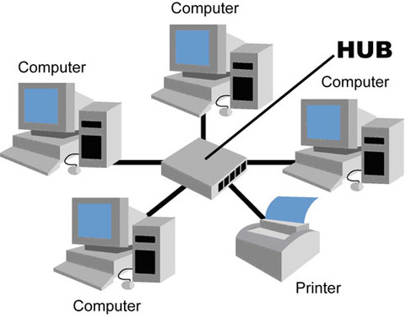
Star Topology
Definition:
All computers in star topology are connected with central device called hub. Star topology is mostly used in client-server network.

Slide 9

WORKING OF STAR TOPOLOGY:
Transmission through a central point.
One PC send data to the central device (hub)and this way computer connected with one another.
Computer is not directly connected with one another
The main communication source is “HUB”.

Slide 10
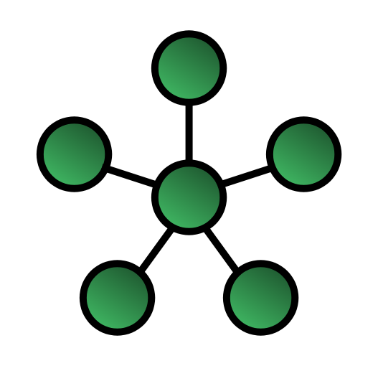
Advantages:
Easy to connect new nodes
Failure of one node
As compared to Bus topology it gives much better performance
Disadvantages:
Length of cable
Hub fails
More expensive

Slide 11

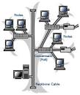
Tree Topology
Definition:
It combines the characteristic of bus and star topology. It consists of different groups of computers attached in a star topology.
Working:

Slide 12
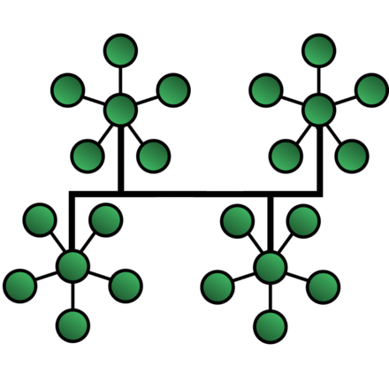
Advantages:
It provides point-to-point wiring.
It is supported by several hardware and software vendors.
Disadvantages:
Cable length is limited.
If backbone line breaks, entire segment goes down.
Difficult to configure.

Slide 13
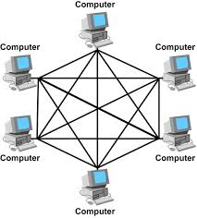
Mesh Topology
Definition:
In this topology, every device in the network is physically connected to every other device in the network.
Different paths.
Wide area use.
Working:
All computer nodes have equal access to the network. There is no server in this network.

Slide 14

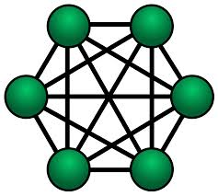
Advantages:
Manages high amounts of traffic
failure of a device
Adding additional devices
Disadvantages:
Costly
maintaining is difficult
Less desirable option

Slide 15
Types of mesh topology
It occurs when every node has a circuit connecting it to every other node in a network
Full-mesh topology
Partial-mesh topology
Full-mesh topology
It occurs when every nodehas a circuit connecting it to every other node in a network
Partial-mesh topology
In this topology, some nodes are organized in a full mesh scheme but others are only connected to one or two in the network

Slide 16
Thank You !

