Slide 1
Future directions in computer science research
John Hopcroft
Department of Computer Science
Cornell University

Slide 2
Time of change
The information age is a revolution that is changing all aspects of our lives.
Those individuals, institutions, and nations who recognize this change and position themselves for the future will benefit enormously.

Slide 3
Computer Science is changing
Early years
Programming languages
Compilers
Operating systems
Algorithms
Data bases
Emphasis on making computers useful

Slide 4
Computer Science is changing
The future years
Tracking the flow of ideas in scientific literature
Tracking evolution of communities in social networks
Extracting information from unstructured data
sources
Processing massive data sets and streams
Extracting signals from noise
Dealing with high dimensional data and dimension
reduction
The field will become much more application oriented

Slide 5
Computer Science is changing
Drivers of change
Merging of computing and communication
The wealth of data available in digital form
Networked devices and sensors

Slide 6
Implications for Theoretical Computer Science
Need to develop theory to support the new directions
Update computer science education

Slide 7
Theory to support new directions
Large graphs
Spectral analysis
High dimensions and dimension reduction
Clustering
Collaborative filtering
Extracting signal from noise
Sparse vectors
Learning theory

Slide 8
Sparse vectors
There are a number of situations where sparse vectors are important.
Tracking the flow of ideas in scientific literature
Biological applications
Signal processing

Slide 9
Sparse vectors in biology
plants
Phenotype
Observables
Outward manifestation
Genotype
Internal code

Slide 10
Digitization of medical records
Doctor – needs my entire medical record
Insurance company – needs my last doctor
visit, not my entire medical record
Researcher – needs statistical information but
no identifiable individual information
Relevant research – zero knowledge proofs, differential privacy

Slide 11
A zero knowledge proof of a statement is a proof that the statement is true without providing you any other information.

Slide 12
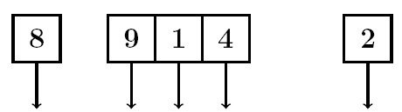
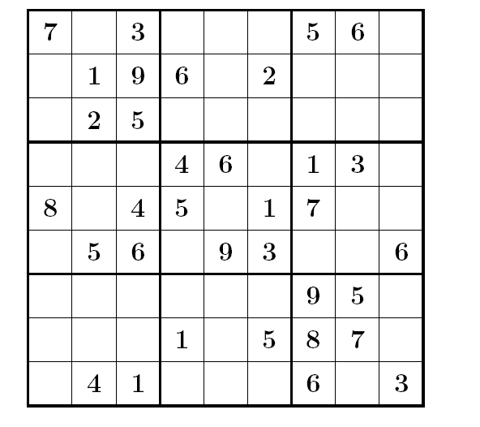

Slide 13
Zero knowledge proof
Graph 3-colorability
Problem is NP-hard - No polynomial time algorithm unless P=NP

Slide 14
Zero knowledge proof

Slide 15
Digitization of medical records is not the only system
Car and road – gps – privacy
Supply chains
Transportation systems

Slide 16
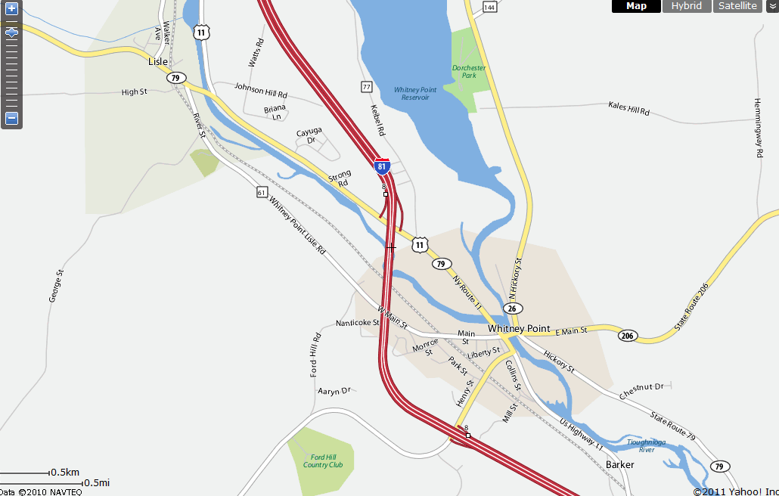

Slide 17
In the past, sociologists could study groups of a few thousand individuals.
Today, with social networks, we can study interaction among hundreds of millions of individuals.
One important activity is how communities form and evolve.

Slide 18
Future work
Consider communities with more external edges than internal edges
Find small communities
Track communities over time
Develop appropriate definitions for communities
Understand the structure of different types of social networks

Slide 19
Our view of a community
Colleagues at Cornell
Classmates
TCS
Me
More connections outside than inside
Family and friends

Slide 20
Structure of communities
How many communities is a person in?
Small, medium, large?
How many seed points are needed to uniquely specify a community a person is in?
Which seeds are good seeds?
Etc.

Slide 21
What types of communities are there?
How do communities evolve over time?
Are all social networks similar?

Slide 22
Are the underlying graphs for social networks similar or do we need different algorithms for different types of networks?
G(1000,1/2) and G(1000,1/4) are similar, one is just denser than the other.
G(2000,1/2) and G(1000,1/2) are similar, one is just larger than the other.

Slide 23
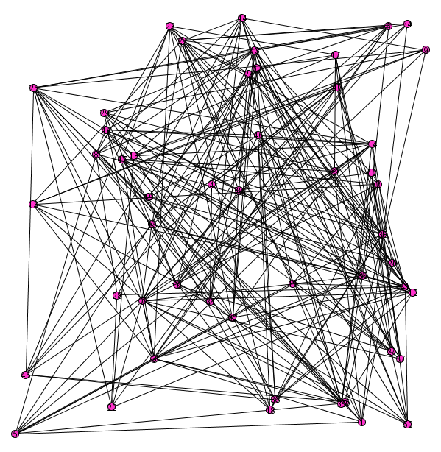
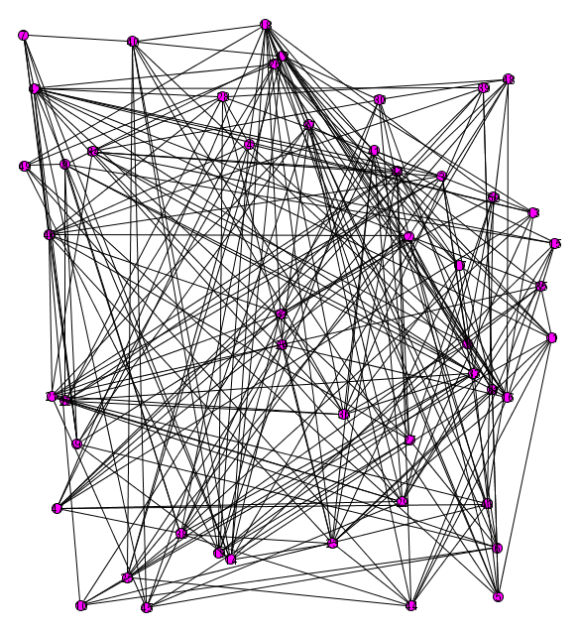

Slide 24
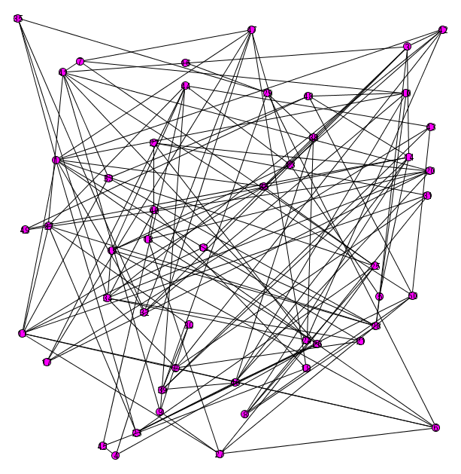
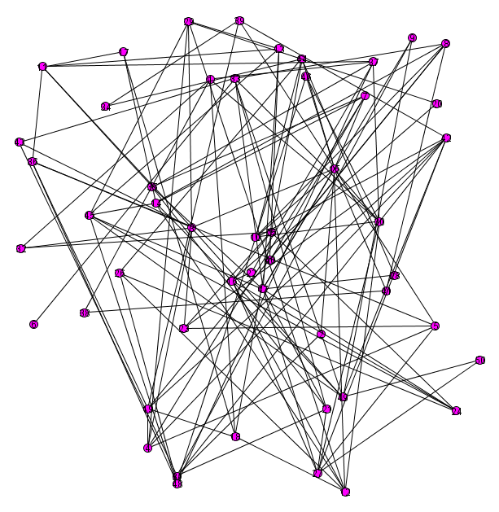

Slide 25
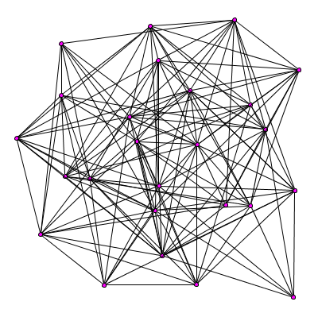

Slide 26
Two G(n,p) graphs are similar even though they have only 50% of edges in common.
What do we mean mathematically when we say two graphs are similar?

Slide 27
Theory of Large Graphs
Large graphs with billions of vertices
Exact edges present not critical
Invariant to small changes in definition
Must be able to prove basic theorems

Slide 28
Erdös-Renyi
n vertices
each of n² potential edges is present with independent probability
N
n
p^{n} (1-p)^{N-n}
number of vertices
vertex degree
binomial degree distribution

Slide 29
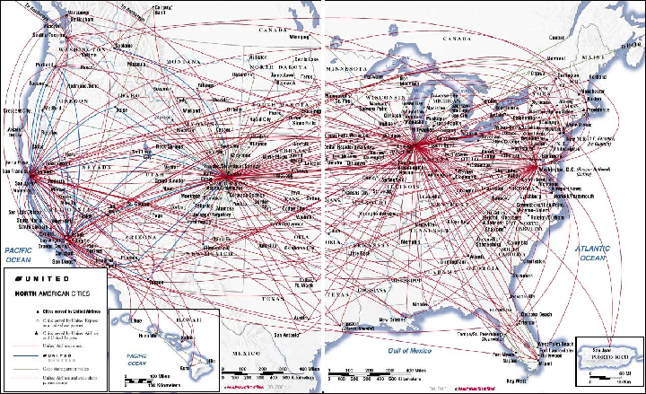

Slide 30
Generative models for graphs
Vertices and edges added at each unit of
time
Rule to determine where to place edges
Uniform probability
Preferential attachment - gives rise to power law degree distributions

Slide 31
Preferential attachment gives rise to the power law degree distribution common in many graphs.
Number
of
vertices
Vertex degree

Slide 32
Protein interactions
2730 proteins in data base
3602 interactions between proteins
Only 899 proteins in components. Where are the 1851 missing proteins?
Science 1999 July 30; 285:751-753

Slide 33
Protein interactions
2730 proteins in data base
3602 interactions between proteins
Science 1999 July 30; 285:751-753

Slide 34
Science Base
What do we mean by science base?
Example: High dimensions

Slide 35
High dimension is fundamentally different from 2 or 3 dimensional space

Slide 36
High dimensional data is inherently unstable.
Given n random points in d-dimensional space, essentially all n² distances are equal.

Slide 37
High Dimensions
Intuition from two and three dimensions is not valid for high dimensions.
Volume of cube is one in all dimensions.
Volume of sphere goes to zero.

Slide 38
Gaussian distribution
Probability mass concentrated between dotted lines

Slide 39
Gaussian in high dimensions

Slide 40
Two Gaussians

Slide 43
Distance between two random points from same Gaussian
Points on thin annulus of radius
Approximate by a sphere of radius
Average distance between two points is
(Place one point at N. Pole, the other point at random. Almost
surely, the second point will be near the equator.)

Slide 46
Expected distance between points from two Gaussians separated by δ

Slide 47
Can separate points from two Gaussians if

Slide 48
Dimension reduction
Project points onto subspace containing centers of Gaussians.
Reduce dimension from d to k, the number of Gaussians

Slide 49
Centers retain separation
Average distance between points reduced
by

Slide 50
Can separate Gaussians provided
> some constant involving k and γ independent of the dimension

Slide 51
We have just seen what a science base for high dimensional data might look like.
For what other areas do we need a science base?

Slide 52
Ranking is important
Restaurants, movies, books, web pages
Multi-billion dollar industry
Collaborative filtering
When a customer buys a product, what else is he
or she likely to buy?
Dimension reduction
Extracting information from large data sources
Social networks

Slide 53
This is an exciting time for computer science.
There is a wealth of data in digital format, information from sensors, and social networks to explore.
It is important to develop the science base to support these activities.

Slide 54
Remember that institutions, nations, and individuals who position themselves for the future will benefit immensely.
Thank You!

