Slide 1
Type Script

Slide 2
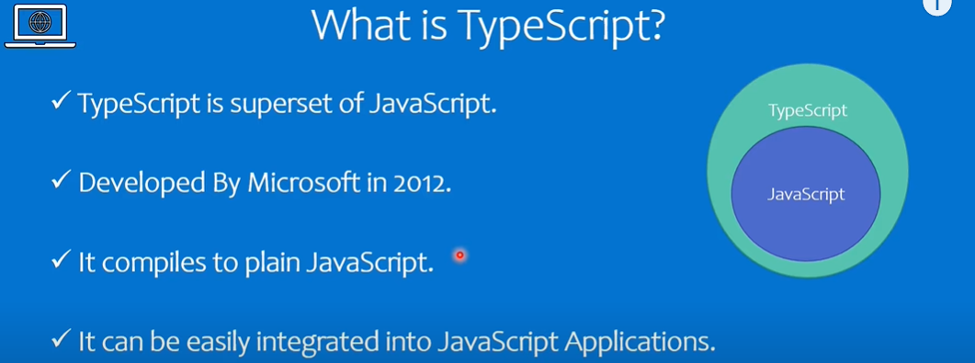

Slide 3
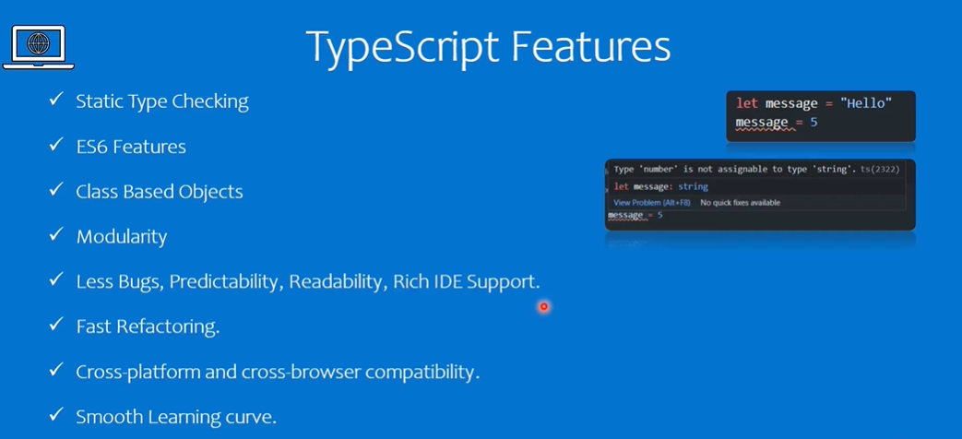

Slide 4
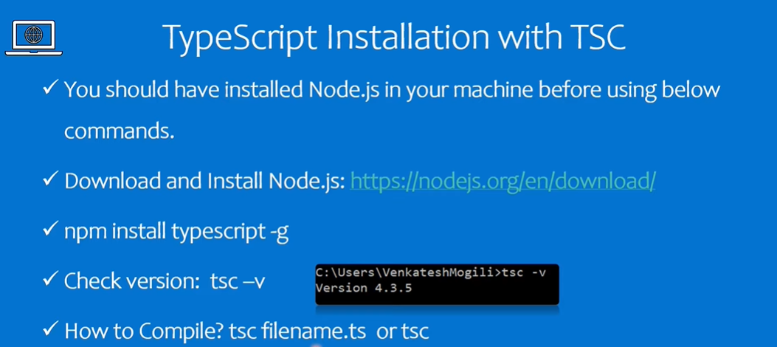

Slide 5
Steps:
npm install typescript –g
tsc -v

Slide 6
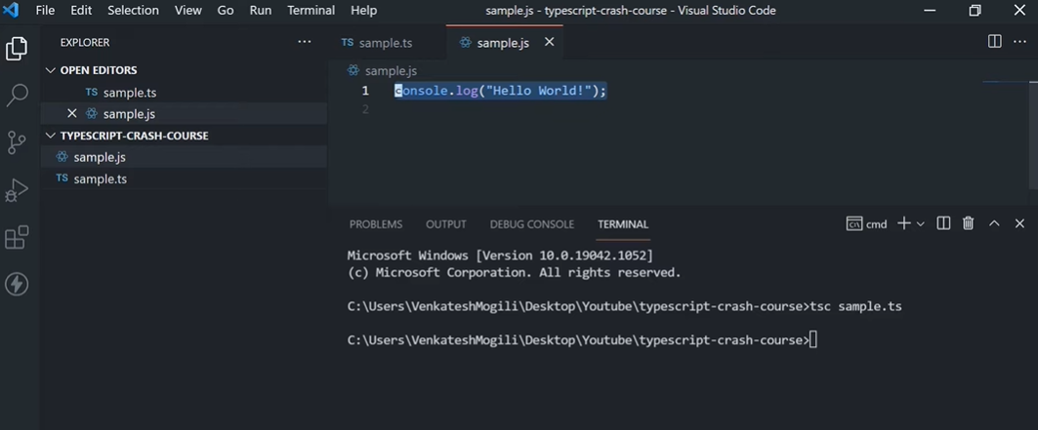

Slide 7
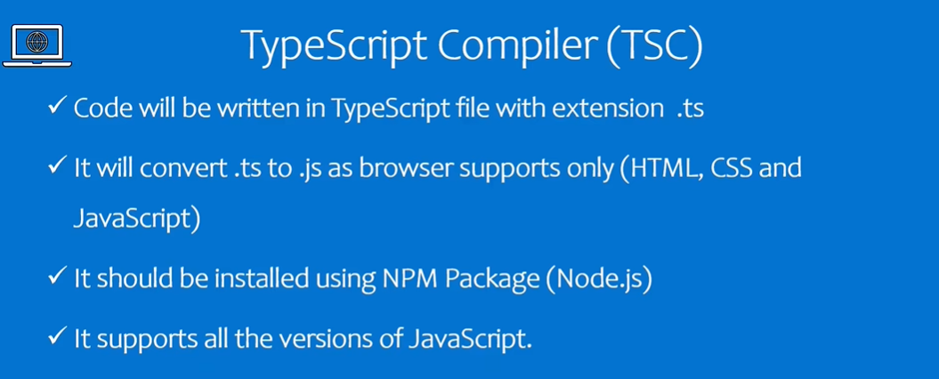

Slide 8
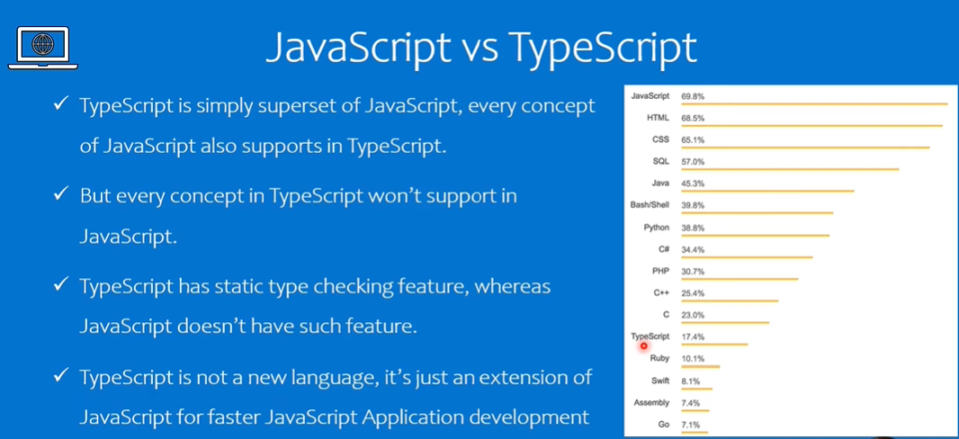


Slide 9
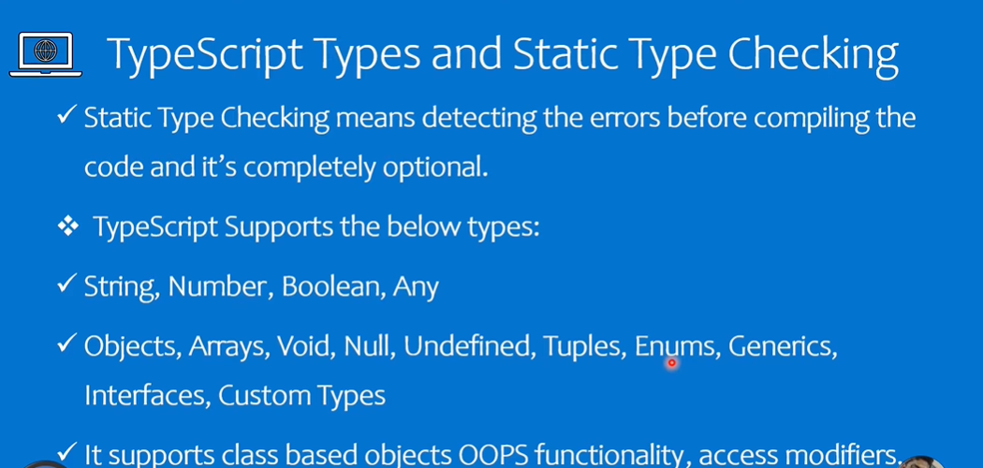

Slide 10
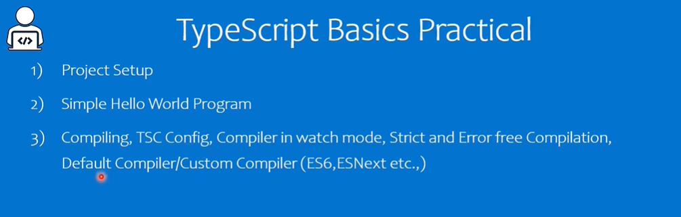

Slide 11
Steps:
tsc sample.ts
console.log(‘Hello’);
let message = ‘Hello’;
sample.js file is created
var message = ‘Hello’;
So to convert var to let use this commands, tsc --init
Open tsconfig.json and change “target” : “es6”
Run in terminal , tsc
tsc –watch
Let message = “hello”;
Let hello = 5;
Hello = “hello”; //Error, to overcome add “noEmitOnError” : true

Slide 12
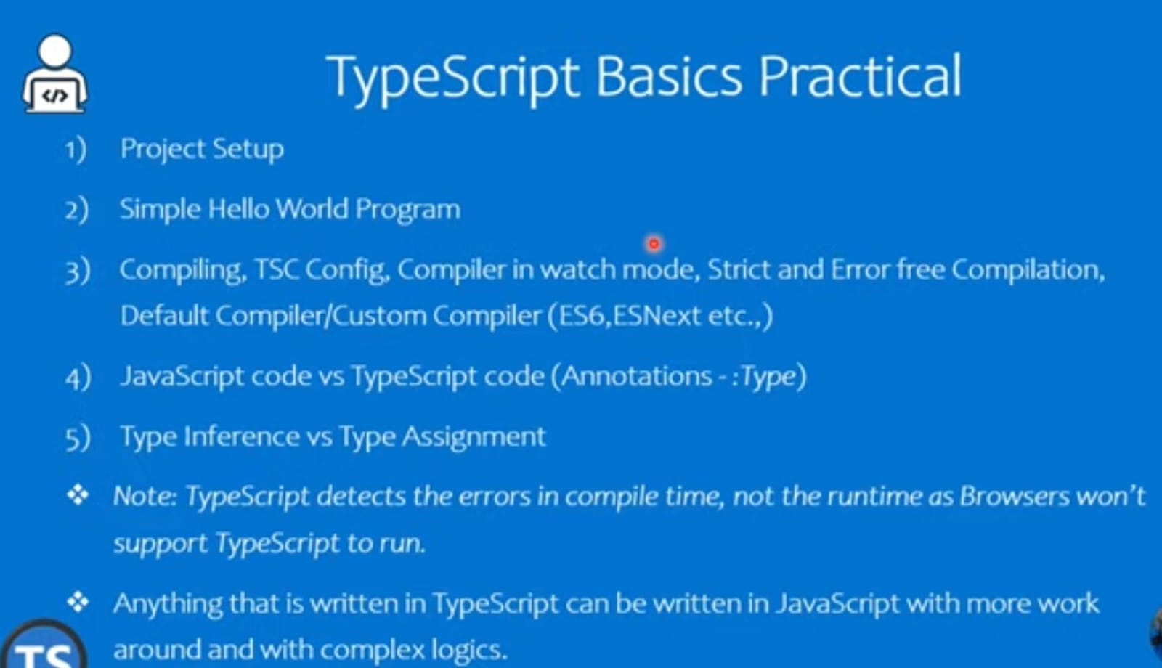

Slide 13
npx tsc –init (tsconfig.json) will be created which includes
target: es2016
module: commonjs
"experimentalDecorators": true,
strict: true
esModuleInterop: true
skipLibCheck: true
forceConsistentCasingInFileNames: true

Slide 14
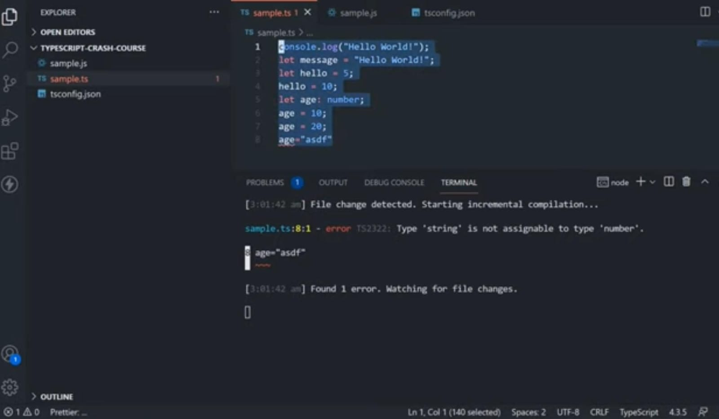

Slide 15
//CLASSES
class Persons {
private firstName: string;
private lastName: string;
constructor(firstName: string, lastName: string) {
this.firstName = firstName;
this.lastName = lastName;
}
getFullName(): string {
return `${this.firstName} ${this.lastName}`;
}
}
let person1 = new Persons('John', 'Doe');
console.log(person1.getFullName()); // Output: John Doe

Slide 16
Interfaces
Defines a contract for how an object should be structured. It describes the properties and methods that an object must have, without providing an implementation. This allows you to enforce a specific shape for objects used in your code.

Slide 17
Interfaces
interface Student {
id: number;
name: string;
age: number;
grade: string;
}
function displayStudent(student: Student) {
console.log(`ID: ${student.id}, Name: ${student.name}, Age: ${student.age}, Grade: ${student.grade}`);
}
const student: Student = {
id: 1,
name: 'Alice',
age: 20,
grade: 'A'
};
displayStudent(student);

Slide 18
Generics
Generics in TypeScript allow you to create reusable components that can work with a variety of data types while maintaining type safety. They enable you to create functions, classes, and interfaces that can work with any data type.
In simple, it will let you write code that works with different types without knowing those types in advance.

Slide 19
function reverseArray<T>(array: T[]): T[] {
return array.reverse();
}
const numbers = [1, 2, 3, 4, 5];
const reversedNumbers = reverseArray(numbers);
console.log(reversedNumbers);
const strings = ['a', 'b', 'c'];
const reversedStrings = reverseArray(strings);
console.log(reversedStrings);
the reverseArray function is a generic function with type parameter T. It takes an array of type T and returns an array of type T. The function uses the reverse method to reverse the array.

Slide 20
Decorators
Decorators is like a wrapper that you can put around functions or methods to add extra behavior without changing their code directly. It's a way to modify or extend the functionality of functions or methods in a flexible and reusable manner.
"experimentalDecorators": true,
"target": "es2016",

