Slide 1
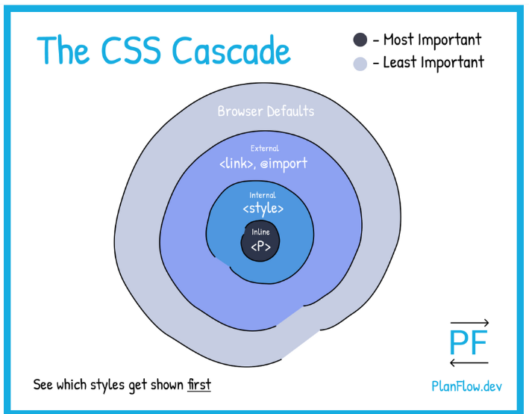
WHAT THE CASCADE IS
The CSS specificity ‘engine’, or what is commonly known as the ‘cascade’, is what determines which CSS style declarations ‘win’, or in other words, which style declarations are more likely to get shown than other style declarations within an overall HTML page structure.
As we can see in the drawing above, it is the ‘inline’ style that holds the most power and gets shown if competing with the style declarations at the other levels of the cascade.
The above cascade example shows us how the cascade decides what style declarations are more important at the high level (outside of a CSS file).

Slide 2
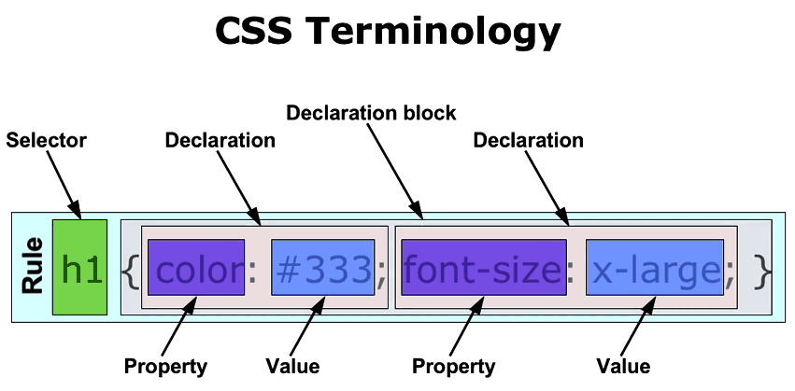

Slide 3
<!DOCTYPE html>
<title>Example</title>
<style>
div#css-section {
border:1px dotted red;
padding: 20px;
}
</style>
<div id="css-section">
This lucky div has ID...
</div>
<div>
This poor div has no ID...
</div>

Slide 4
IDs vs Classes
Given classes and IDs are very similar, you may be wondering which one to use. This depends on the situation.
When to use classes
You should use classes when your style needs to be applied multiple times on the same page. For example, you might have many <h1> elements that need the same style applied.
When to use IDs
You should use IDs if only one element on the page should have the style applied, and/or you need a unique identifier for that element.

Slide 5
CSS Codes
<! CSS code on List elements> <html> <head> </head> <body> <ul style = "list-style-type:circle;"> <li>Maths</li> <li>Social Science</li> <li>Physics</li> </ul> <ul style = "list-style-type:square;"> <li>Maths</li> <li>Social Science</li> <li>Physics</li> </ul> | <ol style = "list-style-type:decimal;"> <li>Maths</li> <li>Social Science</li> <li>Physics</li> </ol> <ol style = "list-style-type:lower-alpha;"> <li>Maths</li> <li>Social Science</li> <li>Physics</li> </ol> <ol style = "list-style-type:lower-roman;"> <li>Maths</li> <li>Social Science</li> <li>Physics</li> </ol> </body> </html>

Slide 6
CSS Code Using Z-Index
CSS gives you opportunity to create layers of various divisions. The CSS layers refer to applying the z-index property to elements that overlap with each other. The z-index property is used along with the position property to create an effect of layers. You can specify which element should come on top and which element should come at bottom. A z-index property can help you to create more complex webpage layouts. <html> <head> </head> <body> <div style = "background-color:red; width:300px; height:100px; position:relative; top:10px; left:80px; z-index:2"> </div> | <div style = "background-color:yellow; width:300px; height:100px; position:relative; top:-60px; left:35px; z-index:1;"> </div> <div style = "background-color:green; width:300px; height:100px; position:relative; top:-220px; left:120px; z-index:3;"> </div> </body> </html>

Slide 7
CSS Borders Color Change
<html> <head> <style type = "text/css"> p.example1 { border:1px solid; border-bottom-color:#009900; /* Green */ border-top-color:#FF0000; /* Red */ border-left-color:#330000; /* Black */ border-right-color:#0000CC; /* Blue */ } p.example2 { border:1px solid; border-color:#009900; /* Green */ } </style> </head> | <body> <p class = "example1"> This example is showing all borders in different colors. </p> <p class = "example2"> This example is showing all borders in green color only. </p> </body> </html>

Slide 8
Text Effects
<html> <head> <style> h1 { text-shadow: 2px 2px; } h2 { text-shadow: 2px 2px red; } h3 { text-shadow: 2px 2px 5px red; } h4 { color: white; text-shadow: 2px 2px 4px #000000; } h5 { text-shadow: 0 0 3px #FF0000; } h6 { text-shadow: 0 0 3px #FF0000, 0 0 5px #0000FF; } | p { color: white; text-shadow: 1px 1px 2px black, 0 0 25px blue, 0 0 5px darkblue; } </style> </head> <body> <h1>CVR College of Engineering</h1> <h2>CVR College of Engineering</h2> <h3>CVR College of Engineering</h3> <h4>CVR College of Engineering</h4> <h5>CVR College of Engineering</h5> <h6>CVR College of Engineering</h6> <p>CVR College of Engineering</p> </body> </html>

Slide 9
Background Image and Color Change
<html>
<head>
<style>
body {
background-image: url("sample.jpg");
background-color: red;
}
</style>
</head>
<body>
<h1>Hello World!</h1>
</body>
<html>

Slide 10
External CSS
<!DOCTYPE html> <html> <head> <link rel="stylesheet" href="mystyle.css"> </head> <body> <h1>This is a heading</h1> <p>This is a paragraph.</p> </body> </html>

Slide 11
mystyle.css
body { background-color:red; } h1 { color:green; margin-left: 20px; }

Slide 12
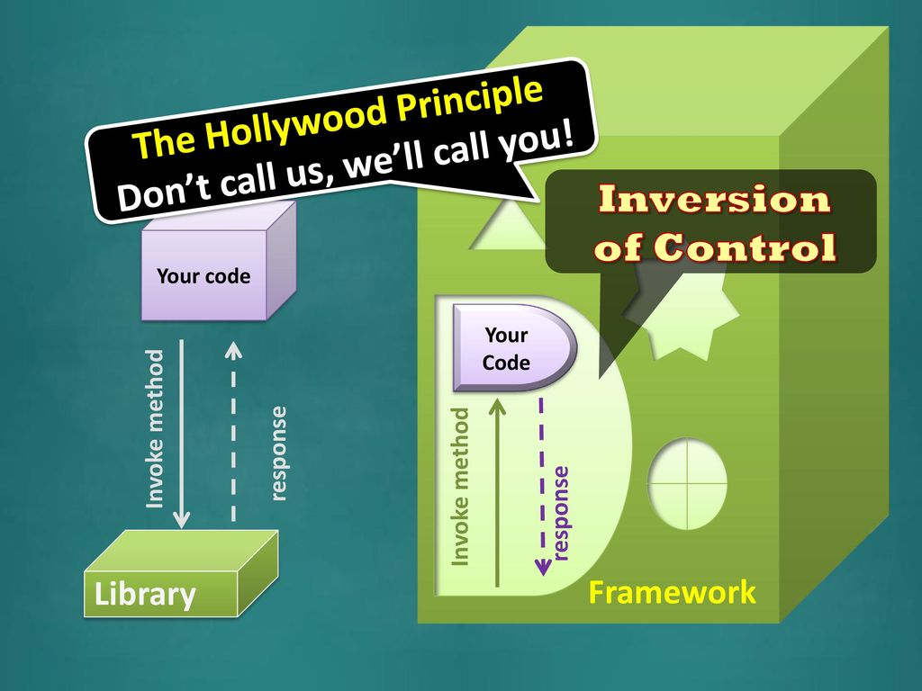
Introduction to Bootstrap

Slide 13
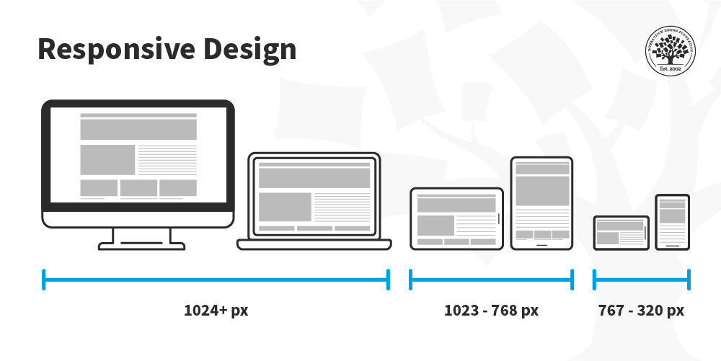

Slide 14
The CSS framework in front-end development is called Bootstrap.
It is free, open-source, and is mainly designed to develop mobile applications in the front end.
The CSS and JavaScript templates are used for typing, buttons, navigation, and other interacting components.
The framework is faster and popular now for developing mobile websites. It is written in CSS, HTML, Less, Sass, and JavaScript.
However, the framework is actually heavy due to CSS and HTML files.

Slide 15
What is Bootstrap?
let’s first know what exactly are front-end frameworks.
In a nutshell, it is an application interface that is also very popularly called a website interface such that whatever the end-user experiences and sees is allowed to be used inside the application.
It consists of an HTML code which is responsible for providing a structure, Cascading style sheets that are used to visually format the website, and JavaScript code which is used to allow dynamic elements such as slideshows, expanding the menu, calculators, etc
The framework in itself is nothing but a platform, a foundation, or a base upon which pre-built software solutions are present, which is the web interface in our case.

Slide 16
Bootstrap is currently the most popular front-end framework, which the developers created at Twitter.
The main purpose of this utility was to build a tool that helps in the development of website-related applications fast, easy, convenient and more responsive.
It also made sure that the consistency of the code and the code quality is also not compromised. It also became easier to maintain a framework whose further development was very easy.

Slide 17
1. CSS files: It consists of global settings and is used to define, by making use of multiple complementary classes, the look of the prominent HTML items such as lists, texts, tables, form elements, and images.
2. JS files: These Js files consist of ready to use a plugin for the most famous Jquery library and also allows for enriching created interface along with dynamic elements quicker than ever. The important ones among them are models, carousel sliders, expandable lists, dynamic tabs, tooltips, or accordions.
Each component consists of the HTML structure, some form of JavaScript code, and CSS declarations. They extend the functionality of existing elements related to the interface, including an autocomplete function for input fields.

Slide 18
What can you do with Bootstrap?
Some common uses of bootstrap are:
Layout creation as its responsive CSS adjusts to tablets, phones, and desktops, with modern first styles primarily being part of this framework.
The support community is very huge so chatting among a league of developers at IRC, Blog, and Expo to having a look at other people’s findings are some of the activities that can be done.
It is also compatible with maximum modern browsers such as Firefox, Chrome, Internet Explorer, Opera, and Safari.

Slide 19
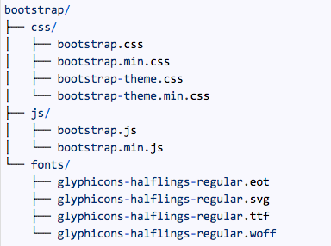
First Bootstrap File
<!DOCTYPE html>
<html lang="en">
<head>
<meta charset="utf-8">
<title>Bootstrap Article</title>
<meta name="viewport"content="width=device-width,initial-scale=1">
<link rel="stylesheet"type="text/css"href="~/Bootstrap-Files/css/bootstrap.min.css">
</head>
<body>
<h1>Welcome to Bootstrap Article</h1>
<script src="~/Bootstrap-Files/js/bootstrap.min.js"></script>
</body>
</html>

Slide 20
<!DOCTYPE html>
<html lang="en">
<head>
<title>Bootstrap Example</title>
<meta charset="utf-8">
<meta name="viewport" content="width=device-width, initial-scale=1">
<link rel="stylesheet" href="https://maxcdn.bootstrapcdn.com/bootstrap/3.4.1/css/bootstrap.min.css">
<script src="https://ajax.googleapis.com/ajax/libs/jquery/3.6.1/jquery.min.js"></script>
<script src="https://maxcdn.bootstrapcdn.com/bootstrap/3.4.1/js/bootstrap.min.js"></script>
</head>
<body>

Slide 21
<div class="container">
<h2>Hover Rows</h2>
<p>The .table-hover class enables a hover state on table rows:</p>
<table class="table table-hover">
<thead>
<tr>
<th>Firstname</th>
<th>Lastname</th>
<th>Email</th>
</tr>
</thead>
<tbody>
<tr>
<td>John</td>
<td>Doe</td>
<td>john@example.com</td>
</tr>
<tr>
<td>Mary</td>
<td>Moe</td>
<td>mary@example.com</td> </tr>
</tbody> </ table> </div> </body> </html>

