Slide 1
JavaScript ES6
In this session , we will learn about JavaScript ES6 with the help of examples.
JavaScript ES6 (also known as ECMAScript 2015 or ECMAScript 6) is the newer version of JavaScript that was introduced in 2015.
ECMAScript is the standard that JavaScript programming language uses.
ECMAScript provides the specification on how JavaScript programming language should work.

Slide 2
A Simple Javascript Hello World Program
<html>
<head>
<title>Java Script Hello World</title>
<body>
<script>
document.write("Hello World");
</script>
</body>
</head>
</html>

Slide 3
JavaScript let
JavaScript let is used to declare variables. Previously, variables were declared using the var keyword.
The variables declared using let are block-scoped. This means they are only accessible within a particular block.
The difference between let and var is in the scope of the variables they create: Variables declared by let are only available inside the block where they're defined. Variables declared by var are available throughout the function in which they're declared.

Slide 4
// variable declared using let
let name = 'Sara';
{
// can be accessed only inside
let name = 'Peter';
console.log(name); // Peter
}
console.log(name); // Sara

Slide 5
JavaScript const
The const statement is used to declare constants in JavaScript.
The const keyword was introduced in ES6 (2015).
Variables defined with const cannot be Redeclared.
Variables defined with const cannot be Reassigned.
Variables defined with const have Block Scope.

Slide 6
<!DOCTYPE html>
<html>
<body>
<h2>JavaScript const</h2>
<p id="demo"></p>
<script>
try {
const PI = 3.141592653589793;
PI = 3.14;
}
catch (err) { document.getElementById("demo").innerHTML = err; }
</script>
</body>
</html>

Slide 7
JavaScript Arrow Function(“fat arrow” )
In the ES6 version, you can use arrow functions to create function expressions. For example,
This function
// function expression
let x = function(x, y) {
return x * y;
}
can be written as
// function expression using arrow function
let x = (x, y) => x * y;
let sum = (a, b) => {
let result = a + b;
return result;
}
let result1 = sum(5,7);
console.log(result1); // 12

Slide 8
JavaScript ES6 Classes
JavaScript class is used to create an object. Class is similar to a constructor function.
class Person {
constructor(name) {
this.name = name;
}
}
Keyword class is used to create a class. The properties are assigned in a constructor function.

Slide 9
Now you can create an object. For example,
class Person {
constructor(name) {
this.name = name;
}
}
const person1 = new Person('John');
console.log(person1.name); // John

Slide 10
Default Parameter Values
In the ES6 version, you can pass default values in the function parameters. For example,
function sum(x, y = 5) {
// take sum the value of y is 5 if not passed
console.log(x + y);
}
sum(5); // 10
sum(5, 15); // 20
Note: In the above example, if we don't pass the parameter for y, it will take 5 by default.

Slide 11
The template literal has made it easier to include variables inside a string. For example, before you had to do:
const first_name = "Jack";
const last_name = "Sparrow";
console.log('Hello ' + first_name + ' ' + last_name);
This can be achieved using template literal by:
const first_name = "Jack";
const last_name = "Sparrow";
console.log(`Hello ${first_name} ${last_name}`);
Note : Use Backtick in console.log

Slide 12
JavaScript Destructuring
The destructuring syntax makes it easier to assign values to a new variable. For example,
// before you would do something like this
const person = {
name: 'Sara',
age: 25,
gender: 'female'
}
let name = person.name;
let age = person.age;
let gender = person.gender;
console.log(name); // Sara
console.log(age); // 25
console.log(gender); // female

Slide 13
Using ES6 Destructuring syntax, the above code can be written as:
const person = {
name: 'Sara',
age: 25,
gender: 'female'
}
let { name, age, gender } = person;
console.log(name); // Sara
console.log(age); // 25
console.log(gender); // female

Slide 14
Export and Import modules in ES6
Step 1: Create one js file called contact. Add the contents to that file are given by
// export
export default function contact(name, age) {
console.log(`The name is ${name}. And age is ${age}.`);
}
Step 2: import the above file to the new js file by using this
import contact from './contact.js';
contact('Sara', 25);
// The name is Sara. And age is 25

Slide 15
JavaScript Rest Parameter and Spread Operator
We can use the rest parameter to represent an indefinite number of arguments as an array. For example,
function show(a, b, ...args) {
console.log(a); // one
console.log(b); // two
console.log(args); // ["three", "four", "five", "six","seven"]
}
show('one', 'two', 'three', 'four', 'five', 'six','seven’)
O/P:
one
two
(5) ['three', 'four', 'five', 'six', 'seven’]
Note: You pass the remaining arguments using ... syntax. Hence, the name rest parameter.

Slide 16
You use the spread syntax ... to copy the items into a single array. For example,
let arr1 = ['one', 'two'];
let arr2 = [...arr1, 'three', 'four', 'five'];
console.log(arr2); // ["one", "two", "three", "four", "five"]

Slide 17
With most primitives, the value is always exactly equal to other primitives with an equivalent value.
const a = 10;
const b = 10;
Console.log(a == b); // Outputs True
Console.log (a === b); // Outputs True
const str1 = 'abc';
const str2 = 'abc';
Console.log(str1 == str2); // Outputs True
Console.log(str1 === str2); // Outputs True
Note: === is called Strict equality means it never true for if one is +0 and one is -0.

Slide 18
However, object data types are never equal to other object types; they each have their own identity.
let obj1 = { 'id': 1 };
let obj2 = { 'id': 1 };
Cosnole.log(obj1 == obj2); // Outputs False
Console.log(obj1 === obj2); // Outputs False

Slide 19
ES6 Symbols
Starting with ES6, symbols were added to the primitives group. Like all other primitives, they are immutable(unchanging over time) and have no methods of their own.
The original purpose of symbols was to provide globally unique values that were kept private and for internal use only. However, in the final implementation of this primitive type, symbols ended up not being private, but they did keep their value uniqueness.

Slide 20
let symbol1 = Symbol('1');
let symbol2 = Symbol('2');
console.log(symbol1 == symbol2); // Outputs False
console.log(symbol1 === symbol2); // Outputs False
Note: You may be wondering why the Symbol() function doesn’t use the new keyword to create a new symbol. You wouldn’t write const symbol = new Symbol() because Symbol() is a function, not a constructor.

Slide 21

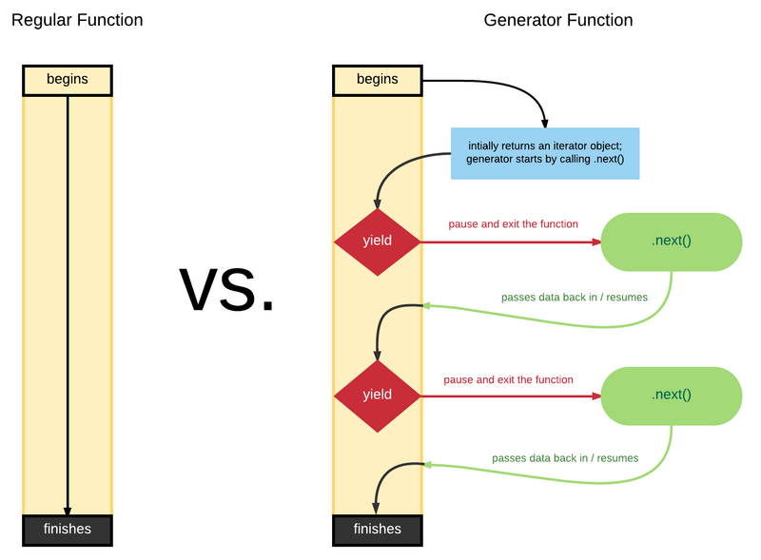

ES6 Generators
ES6 means Generator in simple terms.
Generator is designed for asynchrony, normal functions must be executed as soon as they enter, and Generator can be paused several times to give up control.

Slide 22
ES6 Generator Keywords
Learn the grammar or keywords of Generator, which you need to know function*, yield, next
Three basic concepts.
function* Is used to declare a function as a generator function, which is one more than a normal function declaration*.
*The location can be either next to the function keyword or next to the function name, depending on your preference.
Yield: The yield keyword can only appear in a generator function, but the generator can also have no yield keyword, and the function will pause when it encounters yield and throw out the result of the expression that follows it.
next: Returns control of the code to the generator function.

Slide 23
In the following syntax, we are showing the valid way of defining the generator function:
function* mygenfun() // Valid
{
yield 1;
yield 2;
...
...
}

Slide 24
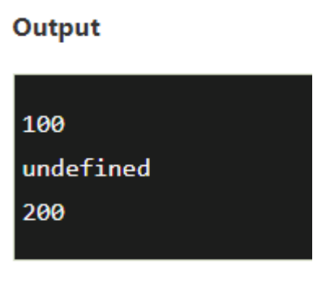
function* gen()
{
yield 100;
yield;
yield 200;
}
// Calling the Generator Function
var mygen = gen();
console.log(mygen.next().value); //O/P is 100 because it refers to the first yield
console.log(mygen.next().value); //O/P is undefined because it refers to the second yield as there is no value
console.log(mygen.next().value); //O/P is 200 because it refers to the third yield as it contains value as 200

Slide 25
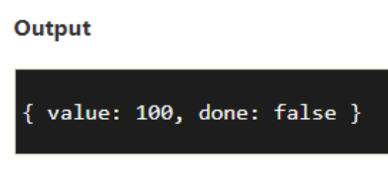
The result of the next() method is always an object having two properties:
value: It is the yielded value.
done: It is a Boolean value which gives true if the function code has finished. Otherwise, it gives false.
function* show() {
yield 100;
}
var gen = show(); //here 'gen' is a generator object
console.log(gen.next()); // { value: 100, done: false }

Slide 26
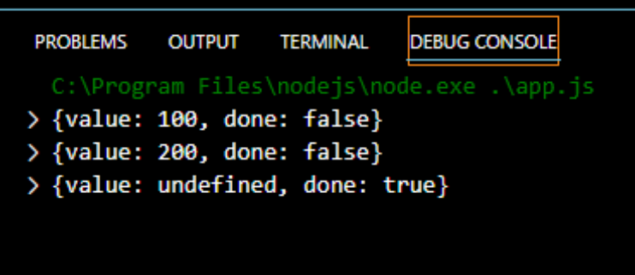
function* show() {
yield 100;
yield 200;
}
var gen = show(); //here 'gen' is a generator object
console.log(gen.next()); // { value: 100, done: false }
console.log(gen.next()); // { value: 200, done: false }
console.log( gen.next() );// {value: undefined, done:true}

Slide 27
The yield (x + 1) is what sends out value 6. The second next(12) call sends 12 to that waiting yield (x + 1) expression, so y is set to 12 * 2, value 24. Then the subsequent yield (y / 3) (yield (24 / 3)) is what sends out the value 8. The third next(13) call sends 13 to that waiting yield (y / 3) expression, making z set to 13.
Finally, return (x + y + z) is return (5 + 24 + 13), or 42 being returned out as the last value.
function *foo(x) {
var y = 2 * (yield (x + 1));
var z = yield (y / 3);
return (x + y + z);
}
var it = foo( 5 );
// note: not sending anything into `next()` here
console.log( it.next() ); // { value:6, done:false }
console.log( it.next( 12 ) ); // { value:8, done:false }
console.log( it.next( 13 ) ); // { value:42, done:true }

Slide 28
"use strict"
function* vowels() {
// here the asterisk marks this as a generator
yield 'A'; O/P: A E I O U
yield 'E';
yield 'I';
yield 'O';
yield 'U';
}
for(let alpha of vowels()) {
console.log(alpha);
}

Slide 29
function* generator(txt) {
console.log(txt); // 2
let result01 = yield "I m a step";
console.log(result01); // 4
// return;
}
let g = generator(' who are you? ');
console.log (' dialog begins ~~'); // 1
let step01 = g.next();
console.log(step01.value);// 3
g.next (' tips are welcome ');
console.log (' end of conversation ~~'); // 5
dialog begins ~~
who are you?
I m a step
tips are welcome
end of conversation ~~

Slide 30
Closure
A closure in JavaScript is a function that remembers the variables from the scope in which it was created, even after that scope has finished executing.
In simpler terms, a closure allows an inner function to access variables from its outer function, even if the outer function has already returned.

Slide 31
JavaScript runs code sequentially in top-down order. However, there are some cases that code runs (or must run) after something else happens and also not sequentially. This is called asynchronous programming.
Callbacks make sure that a function is not going to run before a task is completed but will run right after the task has completed. It helps us develop asynchronous JavaScript code and keeps us safe from problems and errors.
In JavaScript, the way to create a callback function is to pass it as a parameter to another function, and then to call it back right after something has happened or some task is completed.

Slide 32
What is a Promise?
A promise in JavaScript is similar to a promise in real life. When we make a promise in real life, it is a guarantee that we are going to do something in the future.
Because promises can only be made for the future.
A promise has 2 possible outcomes: it will either be kept when the time comes, or it won’t.
This is also the same for promises in JavaScript.
When we define a promise in JavaScript, it will be resolved when the time comes, or it will get rejected.

Slide 33
Promises in JavaScript
First of all, a Promise is an object. There are 3 states of the Promise object:
Pending: Initial State, before the Promise succeeds or fails
Resolved: Completed Promise
Rejected: Failed Promise

Slide 34
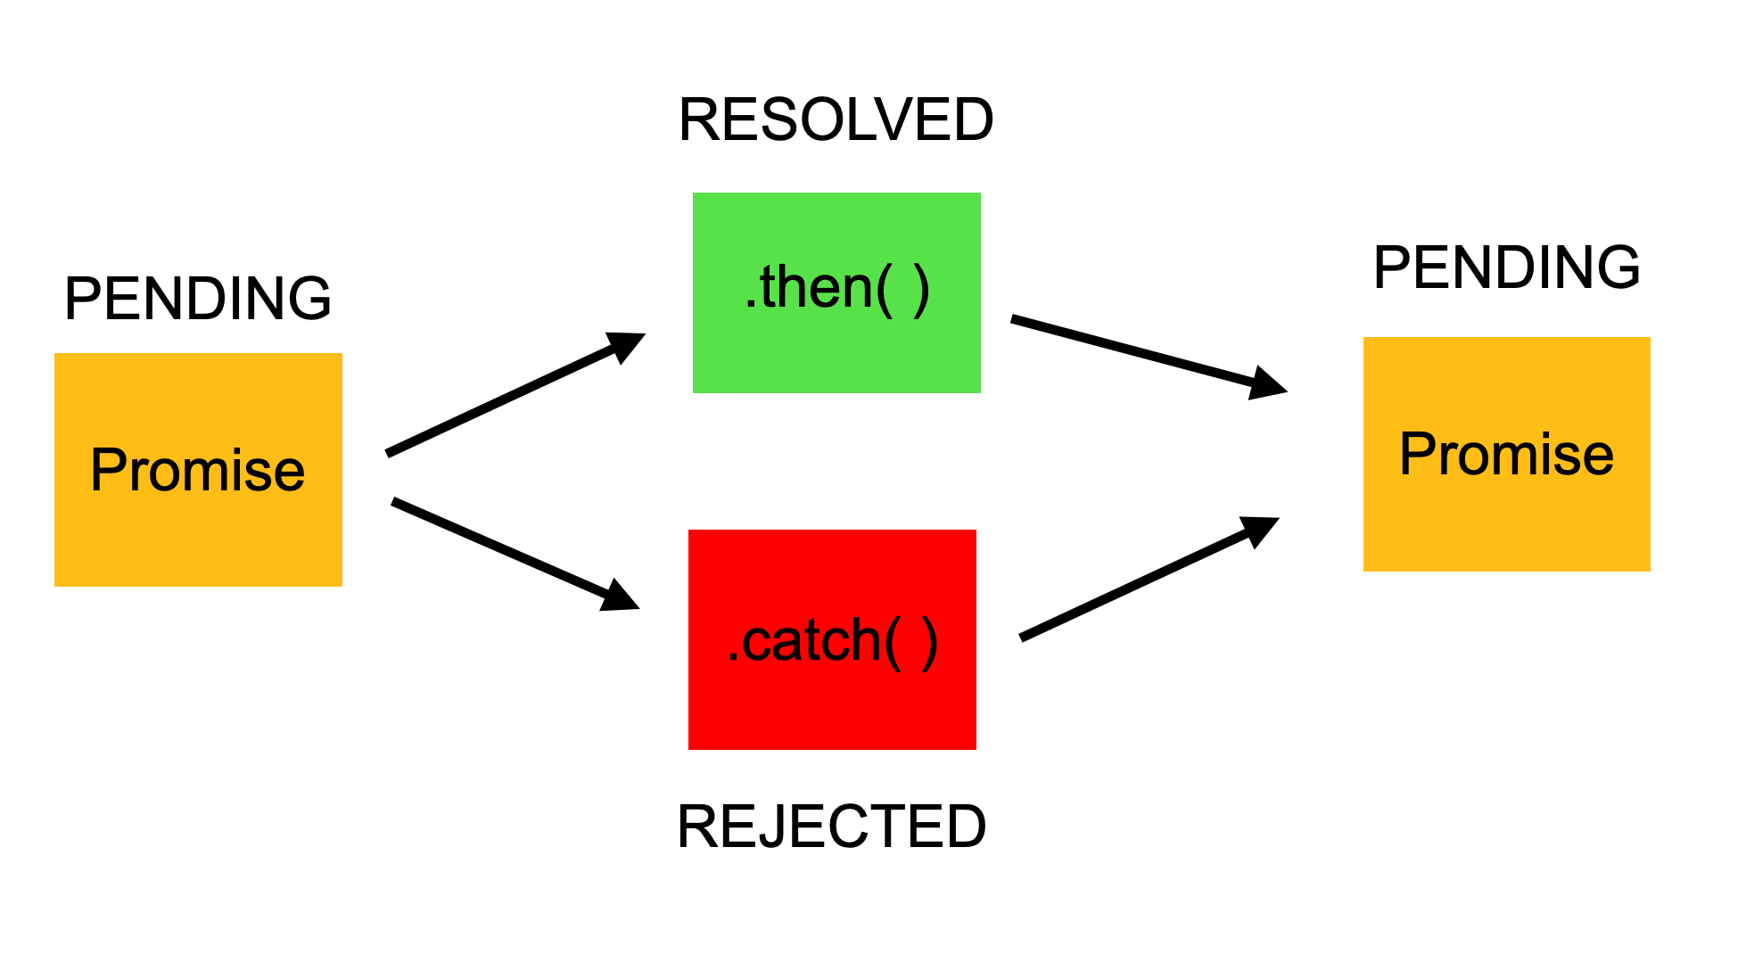

Slide 35
What is the difference between Callbacks and Promises?
The main difference between Callback Functions and Promises is that we attach a callback to a Promise rather than passing it.
So, we still use callback functions with Promises, but in a different way (chaining).
This is one of the greatest advantages of using Promises.
What is Chaining?
A common need is to execute two or more asynchronous operations back- to-back, where each subsequent operation starts when the previous operation succeeds, with the result from the previous step. We accomplish this by creating a promise chain.

Slide 36
Promise Methods
The Promise methods are used to handle the rejection or resolution of the Promise object. Let's understand the brief description of Promise methods.
.then()
This method invokes when a Promise is either fulfilled or rejected. This method can be chained for handling the rejection or fulfillment of the Promise. It takes two functional arguments for resolved and rejected. The first one gets invoked when the Promise is fulfilled, and the second one (which is optional) gets invoked when the Promise is rejected.

Slide 37
.catch()
It is a great way to handle failures and rejections. It takes only one functional argument for handling the errors.
.resolve()
It returns a new Promise object, which is resolved with the given value. If the value has a .then() method, then the returned Promise will follow that .then() method adopts its eventual state; otherwise, the returned Promise will be fulfilled with value.
.reject()
It returns a rejected Promise object with the given value.
.all()
It takes an array of Promises as an argument. This method returns a resolved Promise that fulfills when all of the Promises which are passed as an iterable have been fulfilled.

Slide 38
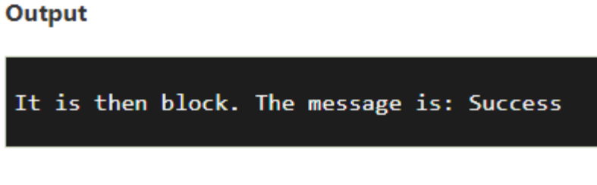
Syntax: const/let Promise = new Promise((resolve,reject) => {....});
let Promise = new Promise((resolve, reject)=>{
let a = 3;
if(a==3){
resolve('Success');
}
else{
reject('Failed');
}
})
Promise.then((message)=>{
console.log("It is then block. The message is: ?+ message)
}).catch((message)=>{
console.log("It is Catch block. The message is: ?+ message)
})

Slide 39
let p = new Promise((resolve, reject) => {
setTimeout(() => {
resolve(10);
}, 3 * 100);
});
p.then((result) => {
console.log(result);
return result * 2;
}).then((result) => {
console.log(result);
return result * 3;
});

Slide 40
XHR -- XMLHttpRequest
A JavaScript object for interacting with servers.
Enables asynchronous data transfer between browser and server.
Key Features:
Supports HTTP methods: GET, POST, PUT, DELETE, etc.
Can handle text, JSON, XML, and other response formats.
Works in asynchronous or synchronous modes.
Allows custom HTTP headers and response handling.

Slide 41
Basic Workflow:
Create an XMLHttpRequest object.
Open a connection using open(method, URL, async).
Send the request with send(data).
Handle the response using onreadystatechange or onload.
let xhr = new XMLHttpRequest();
xhr.open('GET', 'https://jsonplaceholder.typicode.com/posts', true);
xhr.onload = function () {
if (xhr.status === 200) {
console.log(JSON.parse(xhr.responseText));
}
};
xhr.send();

