Slide 1
Lecture
HTML
Markup Languages

Slide 2
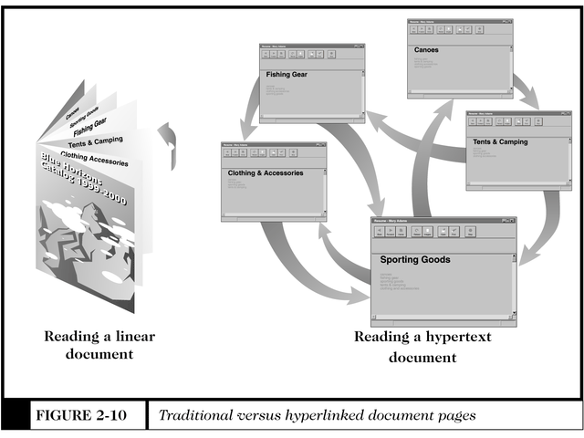
Traditional vs. Hyperlinked Document Pages
Markup Languages
Source: Schneider and Perry

Slide 3

Markup Languages and the Web
Standard Generalized Markup Language (SGML) SGML is a system for defining markup languages. A system for organizing and tagging elements of a document.
HTML is one example of a markup language. Each markup language defined in SGML is called an SGML application.
What's Special about SGML?
  its emphasis on descriptive rather than procedural markup;
  its document type concept; and
  its independence of any one system for representing the script in which a text is written.
  Regulated ISO standard since 1986
  Nonproprietary
  Supports user-defined tags
Markup Languages

Slide 4
Markup Languages and the Web
Hypertext Markup Language (HTML)
  Based on SGML
  Easier to learn and support
  Supports commonly used text markup features
    Headings, title bars, bullets, lines, lists
    Precise graphic positioning, tables, and frames
  Standard language for Web pages
Extensible Markup Language (XML)
  Descendant of SGML
  Defines which data to display, instead of how a page is displayed
  Describes a page’s actual content, unlike HTML
  Data-tracking capability
Markup Languages

Slide 5
XML & HTML
XML was designed to describe data and to focus on what data is.
HTML was designed to display data and to focus on how data looks.
Markup Languages

Slide 6
Hypertext & HTML
Hypertext Markup Language (HTML) is the language for specifying the content of Web pages
  hypertext refers to the fact that Web pages are more than just text
    can contain multimedia, provide links for jumping within & beyond
  markup refers to the fact that it works by augmenting text with special symbols (tags) that identify structure and content type
Markup Languages

Slide 7
Hypertext & HTML
HTML is an evolving standard (as new technology/tools are added)
  HTML 1 (Berners-Lee, 1989): very basic, limited integration of multimedia
    in 1993, Mosaic added many new features (e.g., integrated images)
  HTML 2.0 (IETF, 1994): tried to standardize these & other features, but late
    in 1994-96, Netscape & IE added many new, divergent features
  HTML 3.2 (W3C, 1996): attempted to unify into a single standard
    but didn't address newer technologies like Java applets & streaming video
  HTML 4.0 (W3C, 1997): current standard
    attempts to map out future directions for HTML, not just react to vendors
Markup Languages

Slide 8
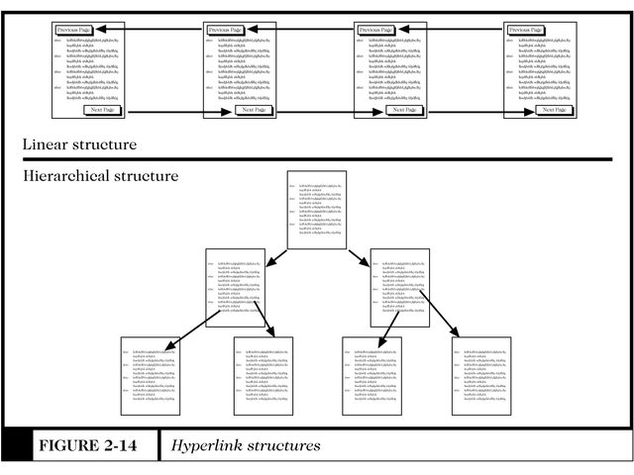
Hyperlink Structures
Source: Schneider and Perry
Markup Languages

Slide 9
Programming in HTML
Basic HTML: Outline
HTML describes layout and content of the page, content may include multimedia and scripts or small programs, dialogs and forms
HTML Tags & elements
HTML Text formatting
HTML Links
HTML Frames
HTML Tables
HTML Lists
HTML Forms
HTML Images
HTML Back Ground.
Markup Languages

Slide 10
HTML Advanced Features
HTML layout
HTML Fonts
HTML Styles
HTML Head
HTML Meta
HTML URLs
HTML Scripts
HTML Web Server
Markup Languages

Slide 11
HTML
Tags & elements
Tags
  <HTML>
  <body>
  <h1> to <h6>
  <p>
  <br>
  <hr>
  <!..>
Markup Languages

Slide 12
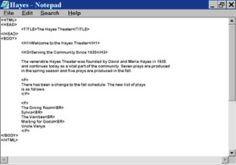
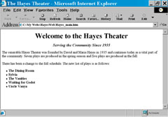
Programming in HTML
Type tags into a text file (Notepad)
HTML editor
HTML code must be saved with .html extension/ Explorer interpret tags to make the page layout
Markup Languages

Slide 13
Tags vs. Elements
HTML specifies a set of tags that identify structure and content type
  tags are enclosed in < >
    <img src="image.gif"> specifies an image
  most tags come in pairs, marking a beginning and ending
    <title> and </title> enclose the title of a page
    HTML Tags not case-sensitive
    Lower-case tags recommended
    HTML Tags may contain attributes
Can nest tags
Tags cannot overlap
Markup Languages

Slide 14
Tags vs. Elements
An HTML element is an object enclosed by a pair of tags
    <title>My Home Page</title> is a TITLE element
    <b>This text appears bold.</b> is a BOLD element
    <p>Part of this text is <b>bold</b>.</p>
        is a PARAGRAPH element that contains a BOLD element
HTML document is a collection of elements (text/media with context)
Markup Languages

Slide 15
Structural Elements
an HTML document has two main structural elements
  HEAD contains setup information for the browser & the Web page
    e.g., the title for the browser window, style definitions, JavaScript code, …
  BODY contains the actual content to be displayed in the Web page
Add content between
<BODY> … </BODY>
Text Structure Tags
  Headings
  Paragraphs
  Lists
  Images
Markup Languages

Slide 16
HTML: Document Tags
<HTML> … </HTML>
  Beginning and end of every HTML document
<HEAD> … </HEAD>
  Contains information about the document including the title that is to appear in the title bar
<TITLE> … </TITLE>
  Causes the page title to be displayed in the title bar
<BODY> … </BODY>
  All content for the page is placed between these tags
Markup Languages

Slide 17
A Very Simple HTML Program
Open text editor, create a file and save it with an extension .htm
Simple HTML program
  <HTML>
  <HEAD>
  <TITLE> This is a title </TITLE>
  </HEAD>
  <BODY>
  <H1> This is an heading </H1>
  <P>Hello World Wide Web </P>
  </BODY>
  </HTML>
Markup Languages

Slide 18
HTML Text Tags:
Heading Tags
Heading Tags (levels 1-6)
  <H1> Largest Heading </H1>
  <H2> Major Subdivision </H2>
  <H3> Minor Subheading </H3>
  <P> Regular Text </P>
  <H4> </H4>
  <H5> </H5>
  <H6> </H6>
  <H1>Theatre Schedule</H1>
Markup Languages

Slide 19
Example
<HTML>
  <HEAD>
  <TITLE>Joe’s Home Page</TITLE>
  </HEAD>
  <BODY>
  <H1>Welcome to Joe’s Home Page</H1>
  …Blah-Blah-Blah
  </BODY>
  <HTML>
Markup Languages

Slide 20
HTML Text Tags: Paragraph Tag
<P> … </P>
Blank line inserted before the start of the paragraph
One space between adjacent words regardless of the number of spaces in the source
Extra spaces and lines are ignored
<P>Learning HTML is a lot of fun!</P>
Markup Languages

Slide 21
Alignment
Align headings and text with the ALIGN command
left, center, and right justify a heading
  <H1 ALIGN=LEFT>Joe’s home page</H1>
  <H1 ALIGN=CENTER>Joe’s home page</H1>
  <H1 ALIGN=RIGHT>Joe’s home page</H1>
left, center, and right justify a paragraph
  <P ALIGN=LEFT>imagine a BIG paragraph in here</P>
  <P ALIGN=CENTER> imagine a BIG paragraph in here </P>
  <P ALIGN=RIGHT> imagine a BIG paragraph in here </P>
note that the </P> is used here to end the paragraph and turn off the alignment
Markup Languages

Slide 22
HTML Text Tags:
Line Break Tag & Dividing Lines
<BR>
Forces a new line
<P>Learning HTML is a lot of <BR>fun!</P>
Dividing lines for separating sections of page
<HR> will insert a standard line in your page
other options include size, width, alignment, and no bevel
  <HR SIZE=25 WIDTH=150 ALIGN=CENTER NOSHADE>
Markup Languages

Slide 23
HTML Formatting
Text Formatting Tags
  <b>
  <big>
  <em>
  <I>
  <small>
  <strong>
  <sub>
  <ins>
  <del>
Markup Languages

Slide 24
HTML Formatting Tags
Italics
<I> … </I>
Boldface
<B> … </B>
Underline
<U>…</U>
Typewriter
<TT>…</TT>
Strikeout
<S>…</S>
Center
<CENTER> … </CENTER>
Browser dependent
Emphasis Tag
  <EM> … </EM>
  Usually displays italics
Strong emphasis Tag
  <STRONG> … <STRONG>
  Usually displays boldface
Comment Tag
  <! …>
Markup Languages

Slide 25
Other Text Tags
<BLOCKQUOTE> </BLOCKQUOTE>
  Indented text
Preformatted Text
  <PRE></PRE>
  Text is formatted exactly as typed
  Can be used for simple tables
  Can be used as a substitute for tabs
Markup Languages

Slide 26
HTML LISTS
An unordered List
An ordered List
Definition List
Nested List
Tags
  <ul>- Define an unordered list
  <ol>- Define an ordered list
  <li> - Define a list item
  <dl>- Define a definition list.
  <dt> - Define a definition term
  <dd>- Define a definition description
Markup Languages

Slide 27
Creating Lists
Unordered Lists: Unordered (bulleted) lists <UL> can use a disc, circle, or square
  <h4>An Unordered List:</h4>
  <ul>
  <li>Coffee</li>
  <li>Tea</li>
  <li>Milk</li>
  </ul>
Output:
  An Unordered List:
    Coffee
    Tea
    Milk
Markup Languages

Slide 28
Ordered Lists
Ordered (numbered) lists <OL> can use numbers (1), capital letters (A), lowercase letters (a), or Roman numerals (i)
  <OL TYPE=1 START=5>
  <LI>first line
  <LI>second line ...
  </OL>
  <UL TYPE=circle>
  <LI>first line ...
  </UL>
All lists use <LI> to specify a new line
Progarm
<ol>
  <li>Coffee</li>
  <li>Milk</li>
</ol>
Output
  Coffee
  Milk
Additional
  <ol type="A">
  <ol type="a">
  <ol type="I">
  <ol type="i">
Markup Languages

Slide 29
Nested Lists
<h4>A nested List:</h4>
<ul>
<li>Coffee</li>
<li>Tea
<ul>
<li>Black tea</li>
<li>Green tea</li>
</ul>
</li>
<li>Milk</li>
</ul>
A nested List:
  Coffee
  Tea
    Black tea
    Green tea
  Milk
Markup Languages

Slide 30
Definition Lists
<h4>A Definition List:</h4>
<dl>
<dt>Coffee</dt>
<dd>Black hot drink</dd>
<dt>Milk</dt>
<dd>White cold drink</dd>
</dl>
A Definition List:
Coffee
        Black hot drink
Milk
        White cold drink
Markup Languages

Slide 31
Fonts
Font Size
Base font size (default=3, range = 1-7; 1=smallest, 7=largest)
  <BASEFONT SIZE=5>
Font size
  <FONT SIZE=3> sets font size to 3
Relative font size
  <FONT SIZE=+1> increases font size by 1
  <FONT SIZE=-2> decreases font size by 2
  <big>… </big> increase the size of the font
  <small>… </small> decrease the size of the font
  Note: if elements are nested, the order of opening/closing is important!
  (must be LIFO)
Markup Languages

Slide 32
HTML
LINKS
Tag <a>
Markup Languages

Slide 33
HTML Link Tag
Link to
  Other sites
  Between your own pages
  To e-mail
<A HREF=“name”>hypertext</A>
<A HREF=“http://www.kodak.com”>Kodak</A>
<A HREF=“john/johnpage.html”>John’s Page</A>
<A HREF=“mailto:johnsmith@practice.com”>John’s mail</A>
<A HREF=“file:///C:\web\john\johnpage.html”>John’s Page</A>
Markup Languages

Slide 34
Text Hyperlinks
Text links
use <A HREF=“…”> to link to another HTML page
HREF points to new page
text between <A…> and </A> will be highlighted as a link, e.g., “click here for syllabus” below will be highlighted
  <A HREF=“http://cis519dhm.bus.umich.edu”>
  click here for syllabus
  </A>
Markup Languages

Slide 35
Linking within one document
<p> <a href="#C4">
See also Chapter 4. </a> </p>
<p> <h2>Chapter 1</h2>
<p>This chapter explains ba bla bla</p>
<h2>Chapter 2</h2> <p>This chapter explains ba bla bla</p>
<h2>Chapter 3</h2> <p>This chapter explains ba bla bla</p>
<a name="C4"><h2>Chapter 4</h2></a> <p>This chapter explains ba bla bla</p>
<h2>Chapter 5</h2> <p>This chapter explains ba bla bla</p>
See also Chapter 4.
Chapter 1
This chapter explains ba bla bla
Chapter 2
This chapter explains ba bla bla
Chapter 3
This chapter explains ba bla bla
Chapter 4
This chapter explains ba bla bla
Chapter 5
This chapter explains ba bla bla
Markup Languages

Slide 36
Link to a mail
<p> This is a mail link:
<a href="mailto:someone@
microsoft.com?subject=Hello%20again">
Send Mail</a> </p>
<p>
<b>Note:</b> Spaces between words should be replaced by %20 to <b>ensure</b> that the browser will display your text properly.
</p>
This is a mail link: Send Mail
Note: Spaces between words should be replaced by %20 to ensure that the browser will display your text properly.
Markup Languages

Slide 37
HTML Images
<img> Defines an image
Attributes:SRC, ALT, HEIGHT, WIDTH, ALIGN, HSPACE ,VSPACE
<map> Defines an image map
<area> Defines an area inside an image map
Markup Languages

Slide 38
Image File Formats
Acceptable image formats vary by browser
Generally acceptable formats are
  GIF
    Graphics Interchange Format
    Use for graphics
  JPG
    Joint Photographic Experts Group
    Use for photographs
  PNG
    Portable Network Graphics
    Expected to replace GIF
Markup Languages

Slide 39
Image File Formats (cont’d)
Transparency
  All bitmapped graphics are rectangular by nature.
  Parts of a GIF image can be made transparent.
  Transparency in layered in flat images.
Interlacing
  Downloading in a series of passes.
  With each pass, the image becomes clearer.
  Useful for slow Internet connections.
Animation
  A sequence of frames.
  All frames saved as a single animated GIF file.
Markup Languages

Slide 40


HTML Image Tag
<p> An image:
<img src="constr4.gif"
width="144" height="50">
</p>
<p> A moving image:
<img src="hackanm.gif"
width="48" height="48">
</p>
An image:
A moving image:
Markup Languages

Slide 41


Inserting Image from Other Location
<p> An image from another folder:
<img src="/images/netscape.gif"
width="33" height="32">
</p>
<p> An image from W3Schools:
<img src="http://www.w3schools.com/images/ie.gif" width="73" height="68">
</p>
An image from another folder:
An image from W3Schools:
Markup Languages

Slide 42
ALT Attribute & Sizing Graphics and borders
Sometimes graphics may not be shown.
The ALT attribute of the IMG tag specifies an alternate text display for non-graphic browsers
<IMG SRC=“JoesPicture.gif” ALT=“[Picture of Joe and his dog.]”>
WIDTH and HEIGHT specify graphic size in pixels
  <IMG SRC=“MyPicture.gif” WIDTH=150 HEIGHT=200>
BORDER specifies width of border in pixels
  <IMG SRC=“MyPicture.gif” BORDER=14>
Markup Languages

Slide 43
ALIGN Attribute & HSPACE
The attribute HSPACE provides some horizontal padding around the text so that the text and image do not butt up against each other.
<IMAGE SRC=“image” HSPACE=20 This is the descriptive text>
Also the attributes VSPACE and SPACE
Used to specify the relation of text to the image.
<IMG SRC=“image” ALIGN=“direction”>
  Default is bottom
Attribute values: top, middle, bottom, right, left
Markup Languages

Slide 44
HTML Back Ground
Attribute of Body Tag
  bgcolor
Types of Background:
  a background color and a text color that makes the text on the page easy to read.
    <body bgcolor="#d0d0d0">
  a background color and a text color that makes the text on the page difficult to read.
    <body bgcolor="#ffffff" text="yellow">
Markup Languages

Slide 45
Background Color / Graphics
Backgrounds can be added to each document, but are not readable on all browsers.
Attributes of <BODY>
BGCOLOR=”code” Specify color for background of the screen
BACKGROUND=”path/file” Tiles the graphic in the file to fit the screen
<BODY BGCOLOR=”green”>
<BODY BGCOLOR=”#00FF00”>
<BODY BACKGROUND=” BrickWall.gif”>
black is “000000” (i.e., no color)
white is “ffffff”
Markup Languages

Slide 46
Creating Tables
<TABLE BORDER> starts table including a border
<CAPTION ALIGN=top> add title at top
<TR> starts a new table row
<TH> adds the headers for a table
<TD> adds the data for a table
<table> Defines a table
<caption>Defines a table caption
<colgroup>Defines groups of table columns
<col>Defines the attribute values for one or more columns in a table
<thead>Defines a table head
<tbody>Defines a table body
<tfoot>Defines a table footer
see next page for example format
Markup Languages

Slide 47
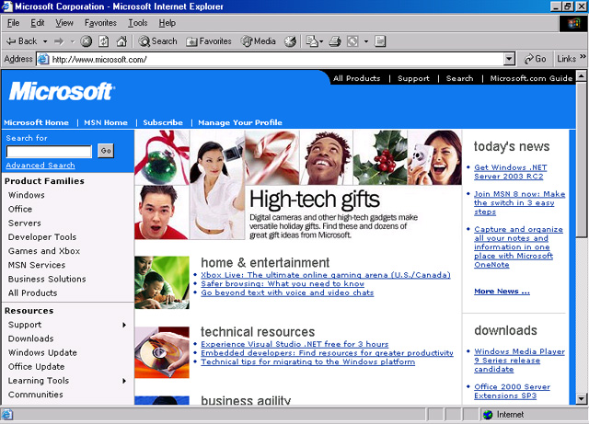
Example: Tables
Markup Languages

Slide 48
Table example
Tables (continued)
  <TABLE BORDER>
  <CAPTION ALIGN=top>Joe’s Resume</CAPTION>
  <TR>
  <TH>Year</TH><TH>Company</TH><TH>Position</TH>
  </TR>
  <TR>
  <TD>1995</TD><TD>Microsoft</TD><TD>Manager</TD>
  </TR>
  <TR>
  <TD>1994</TD><TD>Microsoft</TD><TD>Programmer</TD>
  </TR>
  </TABLE>
Markup Languages

Slide 49
HTML FRAMES
<frameset> Defines a set of frames
<frame> Defines a sub window (a frame)
<noframes> Defines a noframe section for browsers that do not handle frames
<iframe> Defines an inline sub window (frame)
Markup Languages

Slide 50
Advanced HTML: Frames
Header
Frames
divides screen into sections
allows one section to control another
often used with a fixed header, menu, and body
Menu
Body
Markup Languages

Slide 51
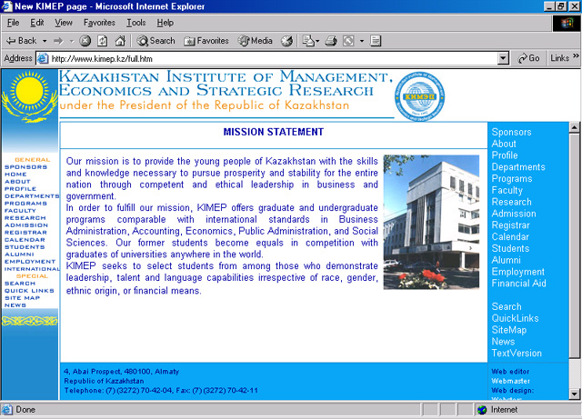
Example: Framed Page
Markup Languages

Slide 52
<html>
<frameset cols="25%,40%,25%, 10%">
<frame src="tryhtml_frame_a.htm">
<frame src="tryhtml_frame_b.htm">
<frame src="tryhtml_frame_c.htm">
<frame src ="tryhtml_frame_d.htm">
</frameset>
</html>
Markup Languages

Slide 53
Vertical frames
<html>
<frameset cols="25%,40%,25%, 10%">
<frame src="tryhtml_frame_a.htm">
<frame src="tryhtml_frame_b.htm">
<frame src="tryhtml_frame_c.htm">
<frame src ="tryhtml_frame_d.htm">
</frameset>
How to have Horizontal Frames?
/html>
Markup Languages

Slide 54
Mixed Frames
<html>
<frameset rows="50%,50%">
<frame src="tryhtml_frame_a.htm">
<frameset cols="25%,75%">
<frame src="tryhtml_frame_b.htm">
<frame src="tryhtml_frame_c.htm">
</frameset>
</frameset>
</html>
Markup Languages

Slide 55
Advanced HTML: Frames
Used to display more that one HTML document in the same browser window.
Setting up frames
  Create an extra HTML file
  <frameset> & <noframes> (noframes optional)
  Attributes = rows OR cols
  example:
  <frameset cols=“25%, 75%”>
  <frame src=“frame1.htm>
  <frame src=“frame2.htm>
  </frameset>
  <noframes>
  <body>Frames Reqd!</body>
  </noframes>
Markup Languages

Slide 56
HTML Forms
<form>Defines a form for user input
<input>Defines an input field
<textarea>Defines a text-area (a multi-line text input control)
<label> Defines a label to a control
<fieldset>Defines a fieldset
<legend>Defines a caption for a fieldset
<select>Defines a selectable list (a drop-down box)
<optgroup>Defines an option group
<option>Defines an option in the drop-down box
<button>Defines a push button
Markup Languages

Slide 57
Text Fields
<html> <body> <form>
First name: <input type="text" name="firstname">
<br> Last name: <input type="text" name="lastname">
</form>
</body>
</html>
<form>
Username:
<input type="text" name="user">
<br>
Password:
<input type="password" name="password">
</form>
Markup Languages

Slide 58
Advanced HTML: Forms
Forms can provide input for dynamic content
  CGI, MOD, ASP (coming soon…)
Form tags
  <form action=“run.cgi”> … </form>
Input tags
  type, name and value fields
    type = type of input (checkbox, radio, text)
    name = name of the input field
    value = default value
Also: <textarea>, <select>, <button>
Submit
  <input type=Submit value="Submit">
Markup Languages

Slide 59
Tables for Layout
Potential Uses:
  Advanced Text Layout
    Vertical spacing
      However, height attribute not official HTML 3.2
    Multiple columns of Text
      Using 2 cols
    Sophisticated Table Borders
      Using “table-within-a-table”
  Making your page the same at all resolutions and on all browsers
Experiment with no border tables and alignment, cell-padding and cell-spacing
Markup Languages

Slide 60
Advanced HTML: Inserting Scripts
…
</head>
<body>
…
<script language="JavaScript"> document.write("Hello World!")
</script>
…
</body>
</html>
Markup Languages

