Slide 1
Sudoku Game
Python Coding with GUI
Developed By:
Sadaqat Rasool

Slide 2
Outline
Introduction:
Sudoku game
Features of game
Purpose:
Game development
Problem solving
Algorithm design
Algorithm analysis
Time complexity
Space complexity
Results

Slide 3
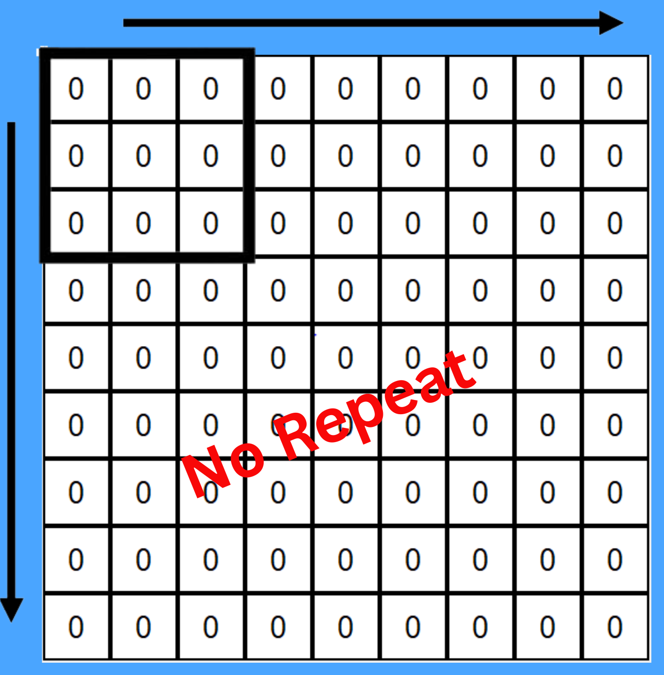
Introduction
Sudoku puzzle
9*9 grid
Game rules
No repeat in row
No repeat in column
No repeat in 3*3 sub grid

Slide 4
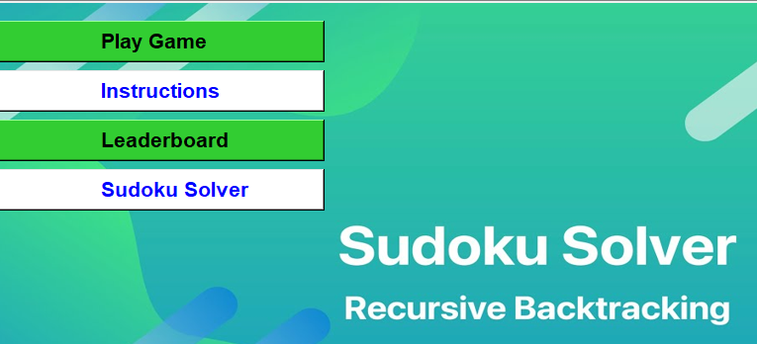
Introduction
Game’s Features
Play game
Sudoku Solver
Leaderboard
Instructions

Slide 5
Purpose
Step towards Game Development
Problem solving
Backtracking
Completeness
Flexibility

Slide 6
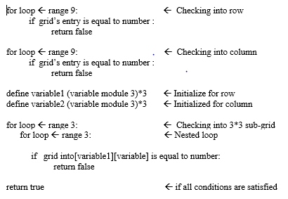
Algorithm Design
Function
Any grid
Row and column
Number
Check validation
Row
Column
Sub grid by 3*3

Slide 7
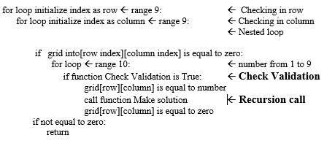
Algorithm Design
Function
Puzzle grid
Solved grid
Initialize global value
Using loops for iterating
Check validation
Numbers 1 to 9
Valid / Non valid
Recursion call

Slide 8
Algorithm Analysis
Space Complexity
Depends size of grid
Typically, 9*9 (81 cells)
O(n^2)
Puzzle grid
Solved grid
O(1)
Lists
Variables

Slide 9
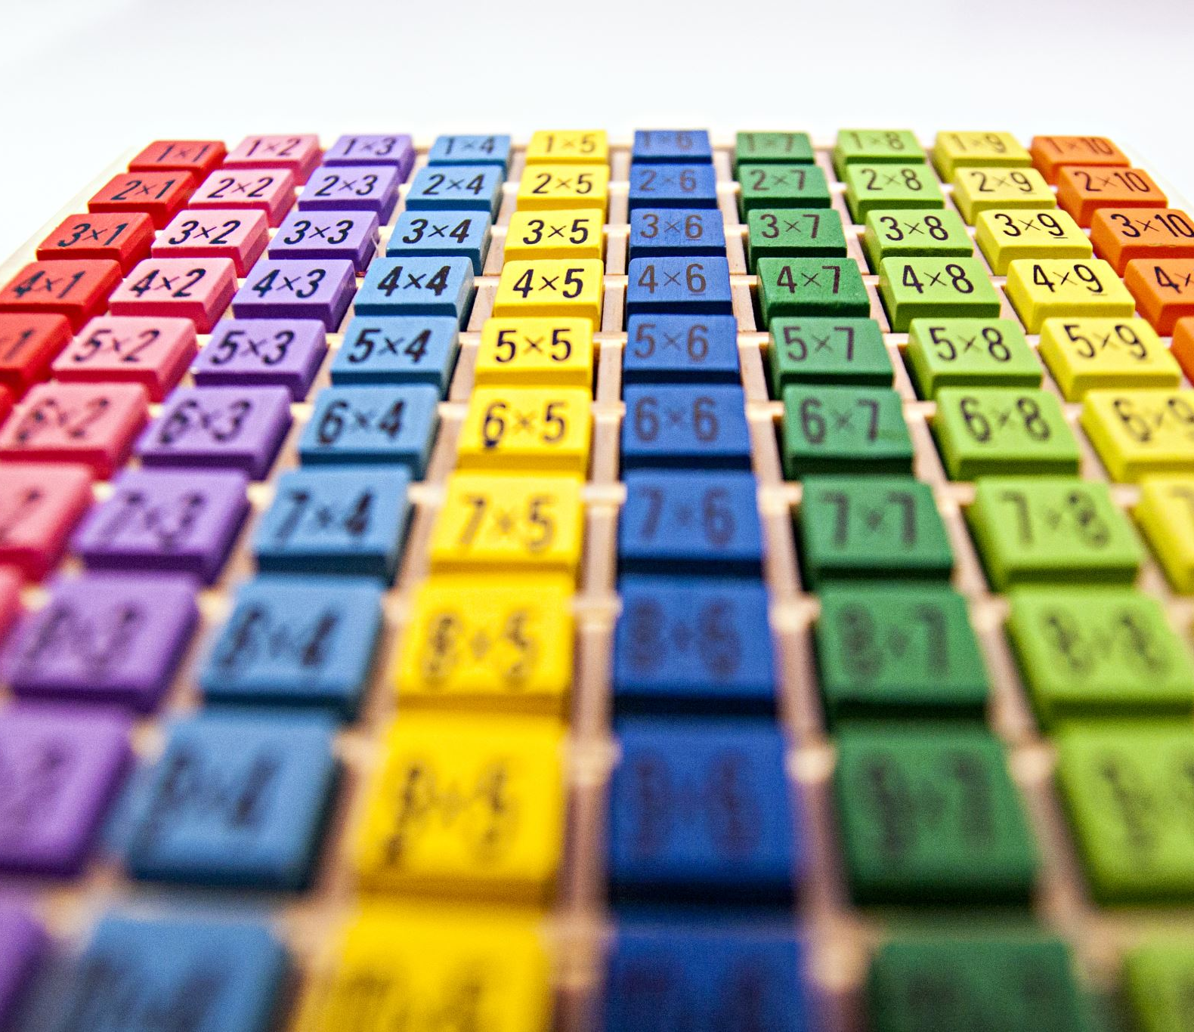
Algorithm analysis
Time Complexity:
O(n^2)
Exponential in most cases
Depends on puzzle
Efficient due to backtracking
Same for both scenarios

Slide 10
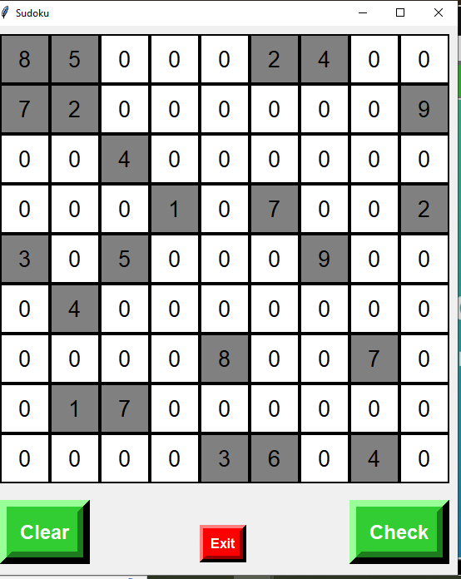
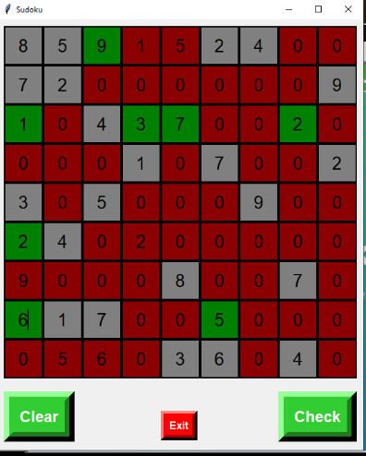
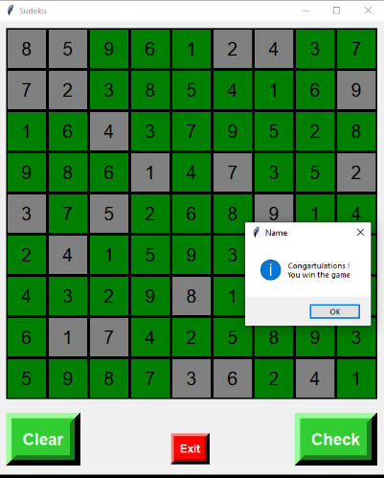
Algorithm Execution
Play Game
Make engaging GUI to play game
Validate entry

Slide 11
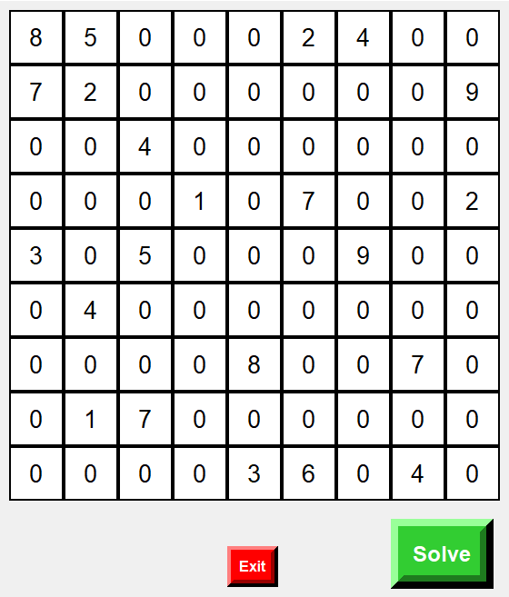
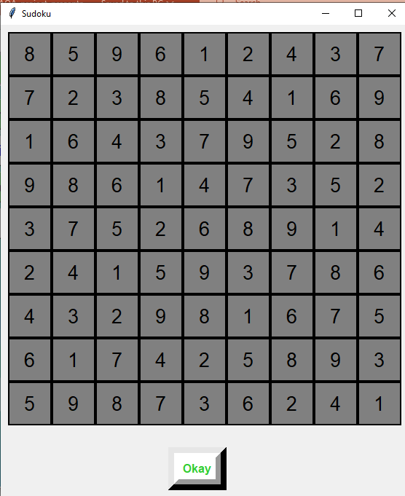
Algorithm Execution
Sudoku solver:
Input valid puzzle
Output as Solved puzzle

Slide 12
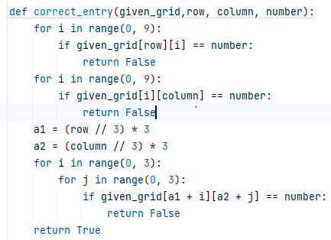
Algorithm sample code
Validate Function

Slide 13
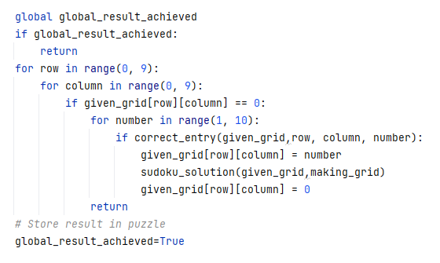
Algorithm sample code
Solved grid maker

Slide 14
Conclusion
Backtracking technique ensures accurate results
Applicable in puzzle-solving games
Steps towards Game → Development
Integrating the Sudoku solver into a game framework
Implementing game mechanics like timer
Incorporating features like leaderboard

Slide 15


