Slide 1

Grand Mobile Shop

Slide 2
Requirements
Main requirement is control a inventory.
Customer Manage.

Slide 3
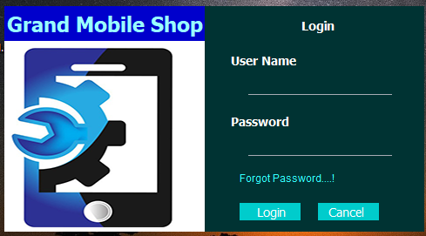

Login Interface
Incorrect Login

Slide 4
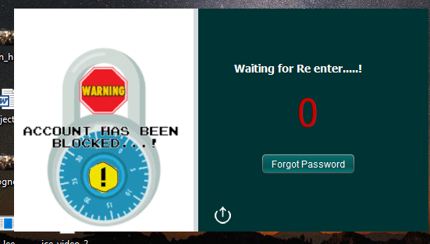
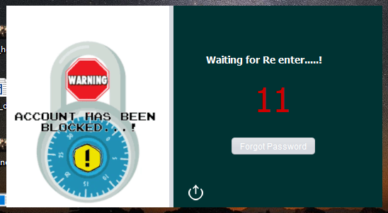
Block State

Slide 5
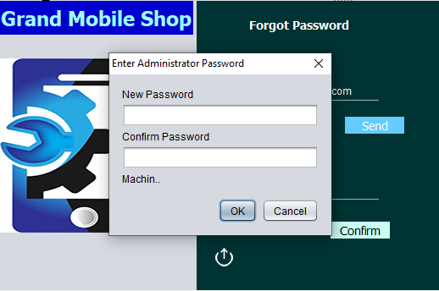
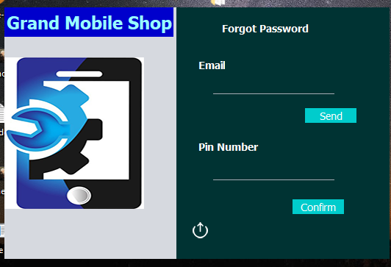
Forgot Password Interface

Slide 6
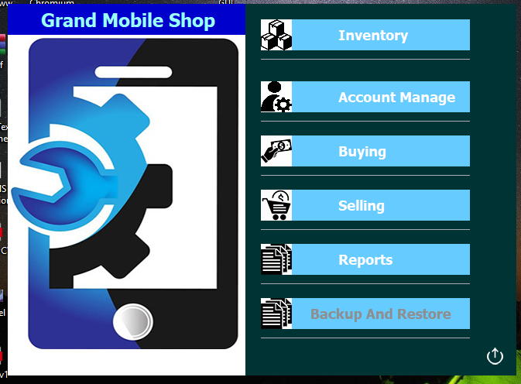
Main Menu

Slide 7

Login Interface
Incorrect Login
2. Correct Login

Slide 8

Main Menu

Slide 9
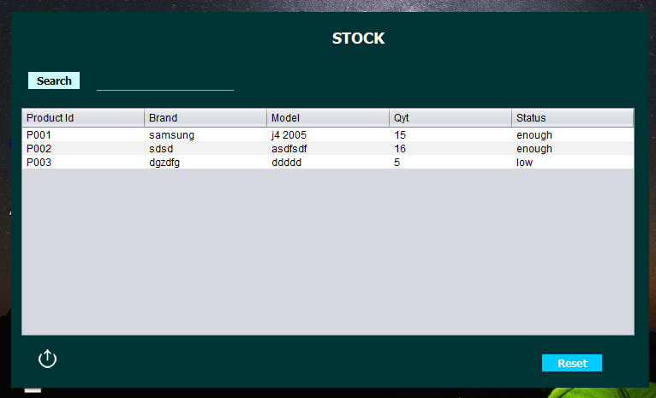
Stock

Slide 10
Main Menu

Slide 11
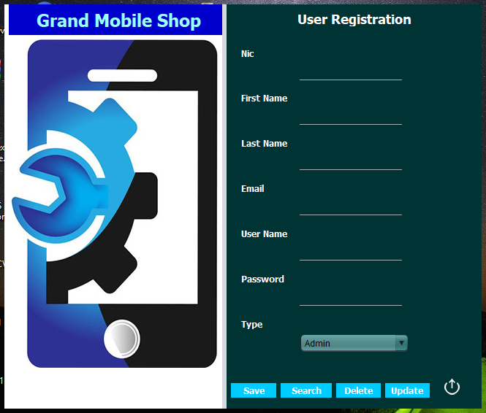
Account Manage

Slide 12
Main Menu

Slide 13
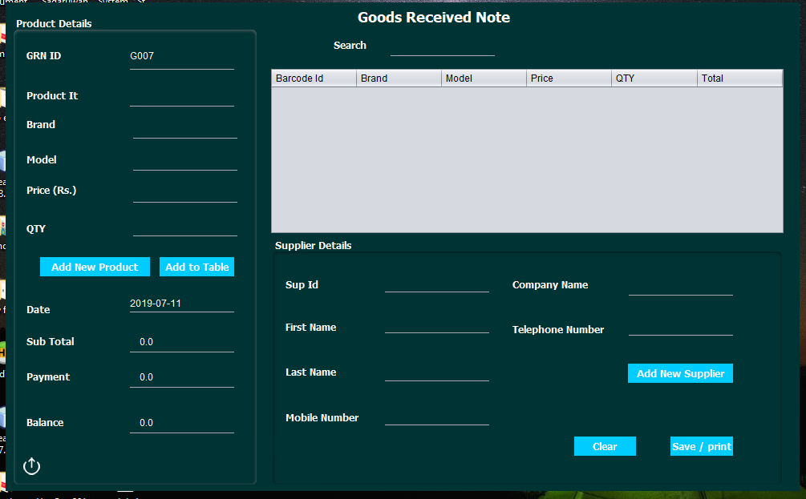

GRN
Press

Slide 14
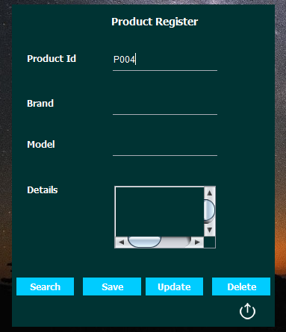
Add New Product

Slide 15
GRN
Press

Slide 16
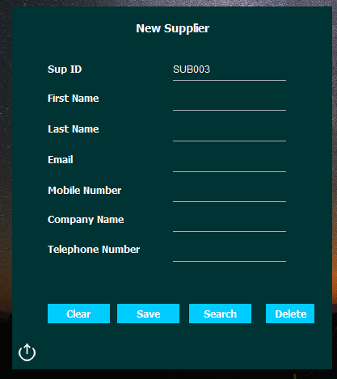
Add New Supplier

Slide 17
Main Menu

Slide 18
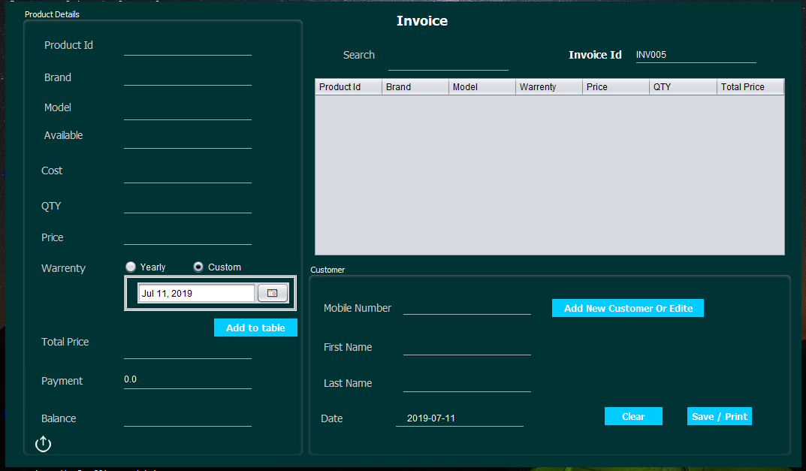
Invoice
Press

Slide 19
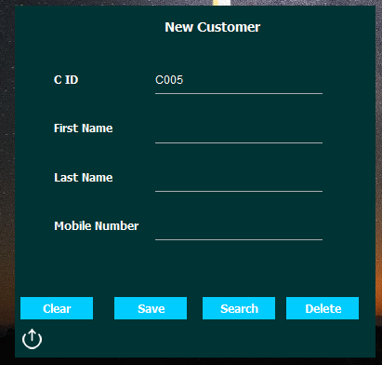
Add New Customer

Slide 20
Main Menu

Slide 21
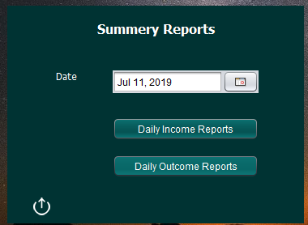
Reports Interface

Slide 22
Thank You…!

