Slide 1
N. Rizk
COSC 2430 : Data Structures
College of Natural and Applied Sciences
Department of Computer Science
University of Houston

Slide 2
Sorting Outline
Iterative sorting algorithms (comparison based)
Selection Sort
Bubble Sort
Insertion Sort
Recursive sorting algorithms (comparison based)
Merge Sort
Quick Sort
2

Slide 3
Why Study Sorting?
When an input is sorted, many problems become easy (e.g. searching, min, max, k-th smallest)
Sorting has a variety of interesting algorithmic solutions that embody many ideas
Comparison vs non-comparison based
Iterative
Recursive
Divide-and-conquer
Best/worst/average-case bounds
Randomized algorithms
3

Slide 4
Applications of Sorting
Uniqueness testing
Deleting duplicates
Prioritizing events
Frequency counting
Reconstructing the original order
Set intersection/union
Finding a target pair x, y such that x+y = z
Efficient searching
4

Slide 5
Bubble Sort: Idea
Given an array of n items
Compare pair of adjacent items
Swap if the items are out of order
Repeat until the end of array
The largest item will be at the last position
Reduce n by 1 and go to Step 1
Analogy
Large item is like “bubble” that floats to the end of the array

Slide 6
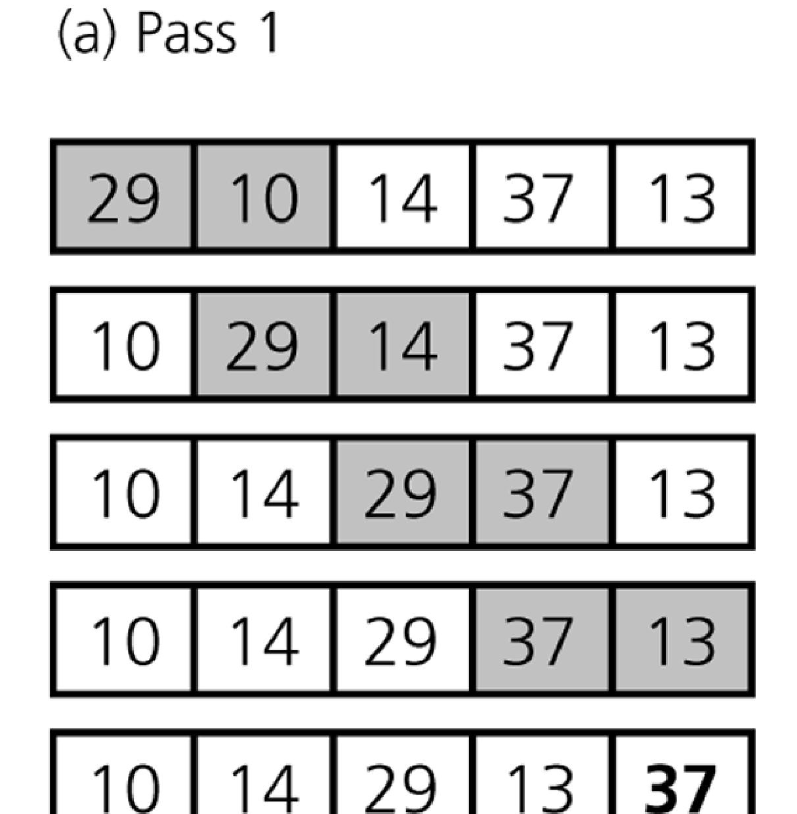
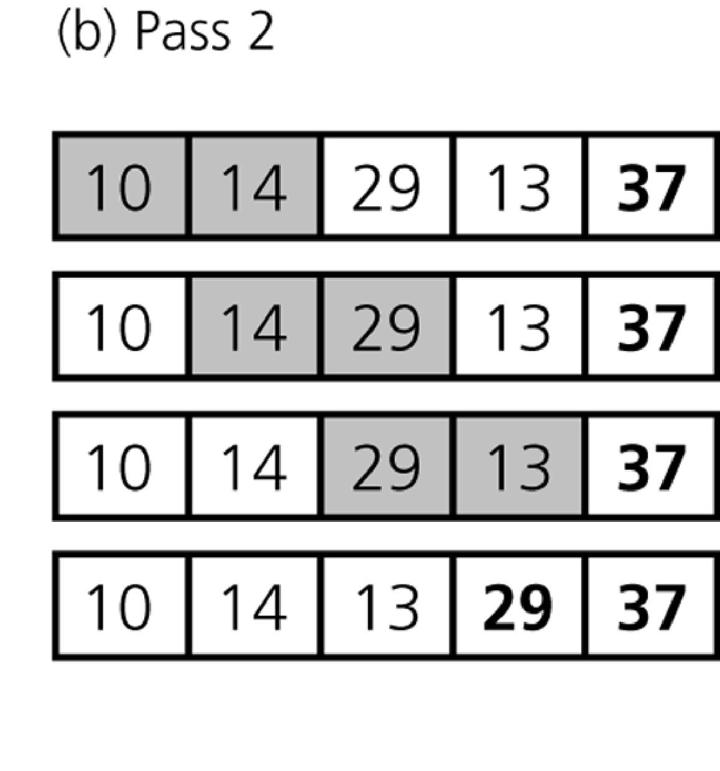
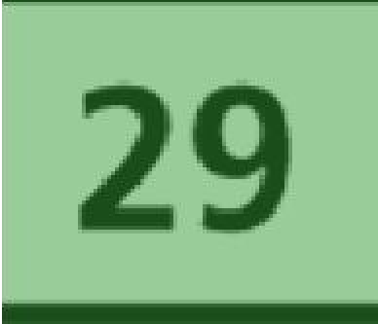
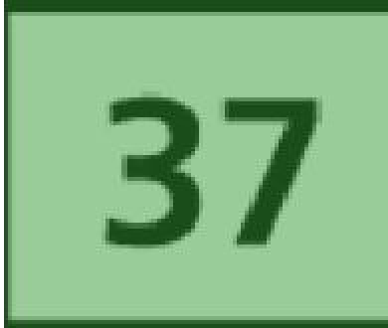
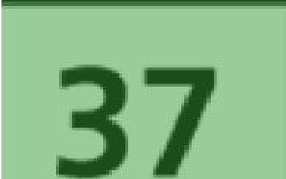


Bubble Sort: Illustration
At the end of Pass 2, the second largest item 29 is at the second last position.
At the end of Pass 1, the largest item 37 is at the last position.
x
Sorted Item
x
Pair of items under comparison

Slide 7
Bubble Sort: Implementation
void bubbleSort(int a[], int n) { for (int i = n-1; i >= 1; i--) {
for (int j = 1; j <= i; j++) {
if (a[j-1] > a[j])
swap(a[j], a[j-1]);
Step 1: Compare
adjacent
pairs of numbers
}
}
Step 2: Swap if the items are out of order
}
29 10 14 37 13
http://visualgo.net/sorting?create=29,10,14,37,13&mode=Bubble

Slide 8
N-1 Iteration
1 2 3 4 5 6
42
35
12
77
5
101
1 2 3 4 5 6
35
12
42
5
77
101
1 2 3 4 5 6
N - 1
12
35
5
42
77
101
1 2 3 4 5 6
12
5
35
42
77
101
1 2 3 4 5 6
5
12
35
42
77
101

Slide 9
procedure Bubblesort(A isoftype in/out Arr_Type)
to_do, index isoftype Num
to_do <- N – 1
loop
exitif(to_do = 0)
index <- 1
loop
exitif(index > to_do)
if(A[index] > A[index + 1]) then
Swap(A[index], A[index + 1])
endif
index <- index + 1
endloop
to_do <- to_do - 1
endloop
endprocedure // Bubblesort
To do N-1 iterations
To bubble a value
Inner loop
Outer loop

Slide 10
Bubble Sort: Analysis
1 iteration of the inner loop (test and swap) requires time bounded by a constant c
Two nested loops
Outer loop: exactly n iterations
Inner loop:
when i=0, (n−1) iterations
when i=1, (n−2) iterations
…
when i=(n−1), 0 iterations
Total number of iterations = 0+1+…+(n−1) = n(n−1)/2
Total time = c n(n−1)/2 = O(n²)

Slide 11
Bubble Sort v2.0 : Early Termination
Bubble Sort is inefficient with a O(n²) time complexity
However, it has an interesting property
Given the following array, how many times will the inner loop swap a pair of item?
3 | 6 | 11 | 25 | 39
Idea
If we go through the inner loop with no swapping
➔ the array is sorted
➔ can stop early!

Slide 12
Bubble Sort v2.0: Implementation
void bubbleSort2(int a[], int n) { for (int i = n-1; i >= 1; i--) {
bool is_sorted = true;
for (int j = 1; j <= i; j++) {
Assume the array is sorted before the inner loop
if (a[j-1] > a[j]) {
swap(a[j], a[j-1]); is_sorted = false;
Any swapping will invalidate the assumption
}
} // end of inner loop if (is_sorted) return;
If the flag
}
remains true after the inner loop ➔ sorted!
}

Slide 13
Bubble Sort v2.0: Analysis
Worst-case
Input is in descending order
Running time remains the same: O(n²)
Best-case
Input is already in ascending order
The algorithm returns after a single outer iteration
Running time: O(n)

Slide 14
Selection Sort: Idea
Given an array of n items
Find the largest item x, in the range of [0…n−1]
Swap x with the (n−1)^{th} item
Reduce n by 1 and go to Step 1
14

Slide 15
Selection Sort: Illustration
29 | 10 | 14 | 37 | 13
37 is the largest, swap it with the last element, i.e. 13.
Q: How to find the largest?
29 | 10 | 14 | 13 | 37
x
Unsorted items
13 | 10 | 14 | 29 | 37
x
Largest item for current iteration
13 | 10 | 14 | 29 | 37
x
Sorted items
10 | 13 | 14 | 29 | 37
Sorted!
We can also find the smallest and put it the front instead http://visualgo.net/sorting?create=29,10,14,37,13&mode=Selection
15

Slide 16
Selection Sort: Implementation
void selectionSort(int a[], int n) { for (int i = n-1; i >= 1; i--) {
int maxIdx = i;
for (int j = 0; j < i; j++) if (a[j] >= a[maxIdx])
maxIdx = j;
// swap routine is in STL <algorithm> swap(a[i], a[maxIdx]);
}
}
Step 1: Search for
maximum element
Step 2: Swap
maximum element with the last item i
16

Slide 17
Selection Sort: Analysis
void selectionSort(int a[], int n) { for (int i = n-1; i >= 1; i--) {
int maxIdx = i;
for (int j = 0; j < i; j++) if (a[j] >= a[maxIdx])
maxIdx = j;
// swap routine is in STL <algori swap(a[i], a[maxIdx]);
}
}
Number of times executed
n−1
n−1
(n−1)+(n−2)+…+1
= n(n−1)/2
thm>
n−1
Total
= c₁(n−1) +
c₂*n*(n−1)/2
= O(n²)
c₁ and c₂ are cost of statements in outer and inner blocks
17

Slide 18
Selection Sort -- Analysis
In general, we compare keys and move items (or exchange items) in a sorting algorithm (which uses key comparisons).
➔ So, to analyze a sorting algorithm we should count the number of key comparisons and the number of moves.
Ignoring other operations does not affect our final result.
In selection Sort function, the outer for loop executes n-1 times.
We invoke swap function once at each iteration.
➔ Total Swaps: n-1
➔ Total Moves: 3*(n-1) (Each swap has three moves)

Slide 19
Selection Sort – Analysis (cont.)
The inner for loop executes the size of the unsorted part minus 1 (from 1 to n-1), and in each iteration we make one key comparison.
➔ # of key comparisons = 1+2+...+n-1 = n*(n-1)/2
➔ So, Selection sort is O(n²)
The best case, the worst case, and the average case of the selection sort algorithm are same. ➔ all of them are O(n²)
This means that the behavior of the selection sort algorithm does not depend on the initial organization of data.
Since O(n²) grows so rapidly, the selection sort algorithm is appropriate only for small n.
Although the selection sort algorithm requires O(n²) key comparisons, it only requires O(n) moves.
A selection sort could be a good choice if data moves are costly but key comparisons are not costly (short keys, long records).

Slide 20
Comparison of N, logN and N²
N O(LogN) O(N²)
16 4 256
64 6 4K
256 8 64K
1,024 10 1M
16,384 14 256M
131,072 17 16G
262,144 18 6.87E+10
524,288 19 2.74E+11
1,048,576 20 1.09E+12
1,073,741,824 30 1.15E+18

Slide 21
Insertion Sort: Idea
Similar to how most people arrange a hand of poker cards
Start with one card in your hand
Pick the next card and insert it into its proper sorted order
Repeat previous step for all cards
1st card: 10♠
10♠
2nd card: 5♠
150♠
3rd card: K♠
5♠
10♠
K♠
… … … …

Slide 22
Insertion Sort: Illustration
Start | 40 | 13 | 20 | 8
Iteration 1 | 13 | 40 | 20 | 8
Iteration 2 | 13 | 20 | 40 | 8
Iteration 3 8 |  | 13 | 20 | 40
x
Sorted
x
Unsorted
x
Unsorted
To be inserted
http://visualgo.net/sorting?create=40,13,20,8&mode=Insertion

Slide 23
Insertion Sort: Implementation
void insertionSort(int a[], int n) { for (int i = 1; i < n; i++) {
int next = a[i]; int j;
next is the
item to be
inserted
for (j = i-1; j >= 0 && a[j] > next; j--) a[j+1] = a[j];
Shift sorted
a[j+1] = next;
items to make
}
place for next
}
Insert next to
the correct location
29 | 10 | 14 | 37 | 13
http://visualgo.net/sorting?create=29,10,14,37,13&mode=Insertion

Slide 24
Insertion Sort: Analysis
Outer-loop executes (n−1) times
Number of times inner-loop is executed depends on the input
Best-case: the array is already sorted and (a[j] > next) is always false
No shifting of data is necessary
Worst-case: the array is reversely sorted and (a[j] > next) is always true
Insertion always occur at the front
Therefore, the best-case time is O(n)
And the worst-case time is O(n²)

Slide 25
Insertion Sort – Analysis
Running time depends on not only the size of the array but also the contents of the array.
Best-case: ➔ O(n)
Array is already sorted in ascending order.
Inner loop will not be executed.
The number of moves: 2*(n-1) ➔ O(n)
The number of key comparisons: (n-1) ➔ O(n)
Worst-case: ➔ O(n²)
Array is in reverse order:
Inner loop is executed i-1 times, for i = 2,3, …, n
The number of moves: 2*(n-1)+(1+2+...+n-1)= 2*(n-1)+ n*(n-1)/2 ➔ O(n²)
The number of key comparisons: (1+2+...+n-1)= n*(n-1)/2 ➔ O(n²)
Average-case: ➔ O(n²)
We have to look at all possible initial data organizations.
So, Insertion Sort is O(n²)

Slide 26
Merge Sort: Idea
Suppose we only know how to merge two sorted sets of elements into one
Merge {1, 5, 9} with {2, 11} ➔ {1, 2, 5, 9, 11}
Question
Where do we get the two sorted sets in the first place?
Idea (use merge to sort n items)
Merge each pair of elements into sets of 2
Merge each pair of sets of 2 into sets of 4
Repeat previous step for sets of 4 …
Final step: merge 2 sets of n/2 elements to obtain a fully sorted set

Slide 27
Divide-and-Conquer Method
A powerful problem solving technique
Divide-and-conquer method solves problem in the following steps
Divide step
Divide the large problem into smaller problems
Recursively solve the smaller problems
Conquer step
Combine the results of the smaller problems to produce the result of the larger problem

Slide 28
Divide and Conquer: Merge Sort
Merge Sort is a divide-and-conquer sorting algorithm
Divide step
Divide the array into two (equal) halves
Recursively sort the two halves
Conquer step
Merge the two halves to form a sorted array

Slide 29
Merge Sort: Illustration
7 | 2 | 6 | 3 | 8 | 4 | 5
Divide into
7 | 2 | 6 | 3
8 4 5
two halves
Recursively sort the halves
Merge them
Question
How should we sort the halves in the 2nd step?
2 | 3 | 6 | 7
4 | 5 | 8
2 | 3 | 4 | 5 | 6 | 7 | 8

Slide 30
Merge Sort: Implementation
void mergeSort(int a[], int low, int high) {
if (low < high) {
int mid = (low+high) / 2;
Merge sort on
a[low...high]
mergeSort(a, low , mid ); mergeSort(a, mid+1, high);
Divide a[ ] into two
halves and recursively
sort them
merge(a, low, mid, high);
}
}
Conquer: merge the
Function to merge a[low…mid] and
two sorted halves
a[mid+1…high] into a[low…high]
Note
mergeSort() is a recursive function
low >= high is the base case, i.e. there is 0 or 1 item

Slide 31
Merge Sort: Example
mergeSort(a[low…mid]) mergeSort(a[mid+1…high]) merge(a[low..mid],
a[mid+1..high])
38 16 27 39 12 27
38 16 27
39 12 27
38 16
27
39 12
27
Divide Phase Recursive call to mergeSort()
38
16
39
12
16 38
12 39
Conquer Phase
Merge steps
16 27 38
12 27 39
12 16 27 27 38 39
http://visualgo.net/sorting?create=38,16,27,39,12,27&mode=Merge

Slide 32
Merge Sort: Merge
a[0..2]
a[3..5] b[0..5]
2 | 4 | 5
3 | 7 | 8
2 | 4 | 5
3 | 7 | 8
2
2 | 4 | 5
3 | 7 | 8
2 | 3
2 | 4 | 5
3 | 7 | 8
2 | 3 | 4
2 | 4 | 5
3 | 7 | 8
2 | 3 | 4 | 5
x
Unmerged items
Items used for comparison
Merged items
2 | 4 | 5
3 | 7 | 8
2 | 3 | 4 | 5 | 7 | 8
x
Two sorted halves to be merged
Merged result in a temporary array
x

Slide 33
Merge Sort: Merge Implementation
PS: C++ STL <algorithm> has merge subroutine too
void merge(int a[], int low, int mid, int high) {
int n = high-low+1; int* b = new int[n];
b is a
temporary
int left=low, right=mid+1, bIdx=0;
array to store
result
while (left <= mid && right <= high) { if (a[left] <= a[right])
b[bIdx++] = a[left++]; else
Normal Merging
Where both
halves have
b[bIdx++] = a[right++];
unmerged items
}
// continue on next slide

Slide 34
Merge Sort: Merge Implementation
// continued from previous slide
while (left <= mid) b[bIdx++] = a[left++]; while (right <= high) b[bIdx++] = a[right++];
for (int k = 0; k < n; k++) a[low+k] = b[k];
Merged result are copied back into a[]
Remaining
items are
copied into
b[]
delete [] b;
}
Remember to free allocated memory
Question
Why do we need a temporary array b[]?

Slide 35
Merge Sort: Analysis
In mergeSort(), the bulk of work is done in the merge step
For merge(a, low, mid, high)
Let total items = k = (high − low + 1)
Number of comparisons ≤ k − 1
Number of moves from original array to temporary array = k
Number of moves from temporary array back to original array = k
In total, number of operations ≤ 3k − 1 = O(k)
The important question is
How many times is merge() called?

Slide 36
Merge Sort: Analysis
Level 0:
Level 0:
1 call to mergeSort
mergeSort n items
n
Level 1:
mergeSort n/2 items
Level 1:
2 calls to mergeSort
n/2
n/2
Level 2:
mergeSort n/2² items
Level 2:
2² calls to mergeSort
n/2²
n/2²
n/2²
n/2²
…
…
…
Level (lg n): mergeSort 1 item
Level (lg n):
2^{lg n}(= n) calls to mergeSort
1 1
. . .
1 1
n/(2^{k}) = 1 ➔ n = 2^{k} ➔ k = lg n

Slide 37
Merge Sort: Analysis
Level 0: 0 call to merge()
Level 1: 1 calls to merge() with n/2 items in each half, O(1 x 2 x n/2) = O(n) time
Level 2: 2 calls to merge() with n/2² items in each half, O(2 x 2 x n/2²) = O(n) time
Level 3: 2² calls to merge() with n/2³ items in each half, O(2² x 2 x n/2³) = O(n) time
…
Level (lg n): 2^{lg(n) − 1}(= n/2) calls to merge() with n/2^{lg(n)} (= 1) item in each half, O(n) time
Total time complexity = O(n lg(n))
Optimal comparison-based sorting method

Slide 38
Merge Sort: Pros and Cons
Pros
The performance is guaranteed, i.e. unaffected by original ordering of the input
Suitable for extremely large number of inputs
Can operate on the input portion by portion
Cons
Not easy to implement
Requires additional storage during merging operation
O(n) extra memory storage needed

Slide 39
Quick Sort: Idea
Quick Sort is a divide-and-conquer algorithm
Divide step
Choose an item p (known as pivot) and partition the items of a[i...j] into two parts
Items that are smaller than p
Items that are greater than or equal to p
Recursively sort the two parts
Conquer step
Do nothing!
In comparison, Merge Sort spends most of the time in conquer step but very little time in divide step

Slide 40
Quick Sort: Divide Step Example
Pivot
Choose first element as pivot
19
27 38 12 39 27 16
Pivot
Partition a[] about the pivot 27
12 16 27
39 27 38
Pivot
Recursively sort the two parts
12
16 27 27
38
39
Notice anything special about the position of pivot in the final sorted items?

Slide 41
Quick Sort: Implementation
void quickSort(int a[], int low, int high) {
if (low < high) {
Partition
int pivotIdx = partition(a, low, high)
;
a[low...high]
and return the
quickSort(a, low, pivotIdx-1); quickSort(a, pivotIdx+1, high);
index of the
pivot item
}
Recursively sort
the two portions
}
partition() splits a[low...high] into two portions
a[low ... pivot–1] and a[pivot+1 ... high]
Pivot item does not participate in any further sorting

Slide 42
Quick Sort: Partition Algorithm
To partition a[i...j], we choose a[i] as the pivot p
Why choose a[i]? Are there other choices?
The remaining items (i.e. a[i+1...j]) are divided into 3 regions
S1 = a[i+1...m] where items < p
S2 = a[m+1...k-1] where item ≥ p
Unknown (unprocessed) = a[k...j], where items are yet to be assigned to S1 or S2
p | < p | ≥p | ?
i
m
k
Unknown
j
S1
S2

Slide 43
Quick Sort: Partition Algorithm
Initially, regions S1 and S2 are empty
All items excluding p are in the unknown region
For each item a[k] in the unknown region
Compare a[k] with p
If a[k] >= p, put it into S2
Otherwise, put a[k] into S1
p ?
i
k
j
Unknown

Slide 44
Quick Sort: Partition Algorithm
Case 1: if a[k] >= p
S1 S2
If a[k]=y ≥ p,
p | < p | x ≥p | y ?
i
m
k
j
S1
S2
Increment k
p | < p | x ≥ p y | ?
i
m
k
j
Case 2: if a[k] < p
If a[k]=y < p

Slide 45
Quick Sort: Partition Implementation
PS: C++ STL <algorithm> has partition subroutine too
int partition(int a[], int i, int j) { int p = a[i];
p is the pivot
int m = i;
S1 and S2 empty
initially
for (int k = i+1; k <= j; k++) {
if (a[k] < p) { m++;
swap(a[k], a[m]);
}
else {
}
Go through each
element in unknown
Case 2
region
Case 1: Do nothing!
}
swap(a[i], a[m]); return m;
Swap pivot with a[m]
}
m is the index of pivot

Slide 46

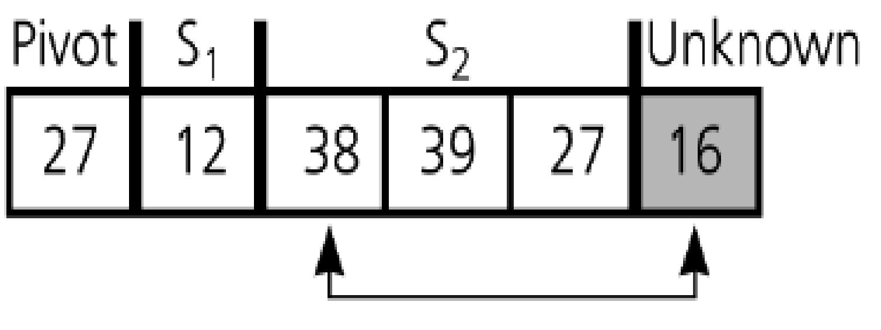

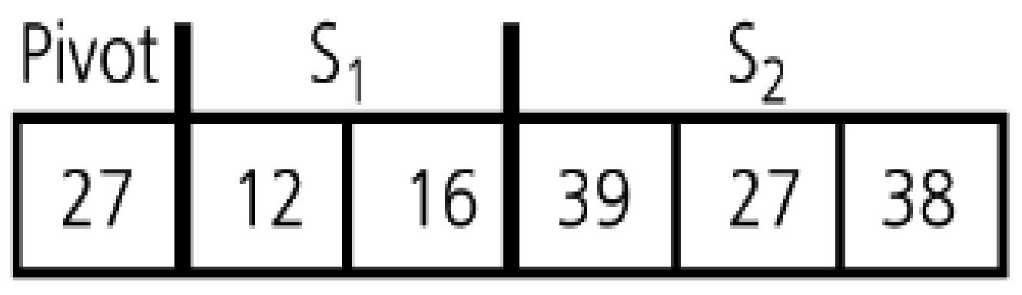
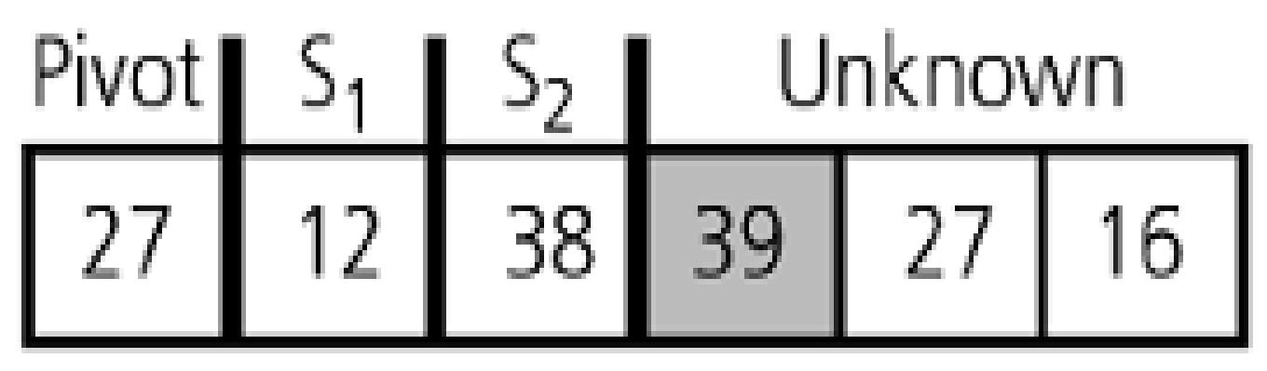
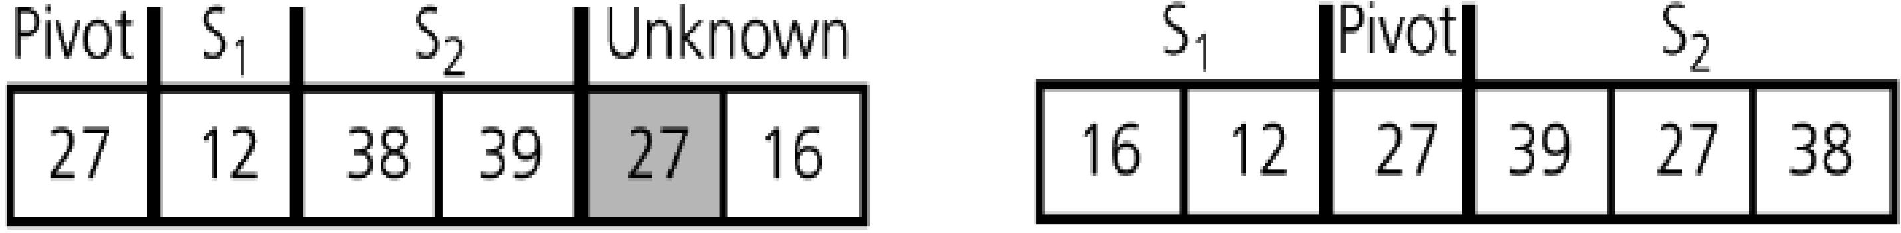
Quick Sort: Partition Example
http://visualgo.net/sorting?create=27,38,12,39,27,16&mode=Quick

Slide 47
Quick Sort: Partition Analysis
There is only a single for-loop
Number of iterations = number of items, n, in the unknown region
n = high − low
Complexity is O(n)
Similar to Merge Sort, the complexity is then dependent on the number of times partition() is called

Slide 48
Quick Sort: Worst Case Analysis
When the array is already in ascending order
5 18 23 39 44 57
19
p = a[i]
S2 = a[m+1...j]
S1 = a[i+1...m]
empty when m = i
What is the pivot index returned by partition()?
What is the effect of swap(a, i, m)?
S1 is empty, while S2 contains every item except the pivot

Slide 49
Quick Sort: Worst Case Analysis
n
1 n-1
Total no. of levels
= n
1 n-2
……
As each partition takes linear time, the algorithm in its worst case has n levels and hence it takes time n+(n-1)+...+1 = O(n²)
1 1
contains the pivot only!

Slide 50
Quicksort – Analysis
Worst Case: (assume that we are selecting the first element as pivot)
The pivot divides the list of size n into two sublists of sizes 0 and n-1.
The number of key comparisons
= n-1 + n-2 + ... + 1
= n²/2 – n/2 ➔ O(n²)
The number of swaps =
= n-1 + n-1 + n-2 + ... + 1
swaps outside of the for loop swaps inside of the for loop
= n²/2 + n/2 - 1 ➔ O(n²)
So, Quicksort is O(n²) in worst case

Slide 51
Quick Sort: Best/Average Case Analysis
Best case occurs when partition always splits the array into two equal halves
Depth of recursion is log n
Each level takes n or fewer comparisons, so the time complexity is O(n log n)
In practice, worst case is rare, and on the average we get some good splits and some bad ones (details in COSC2320)
Average time is also O(n log n)

Slide 52
Lower Bound: Comparison-Based Sort
It is known that
All comparison-based sorting algorithms have a complexity lower bound of n log n
Therefore, any comparison-based sorting algorithm with worst-case complexity O(n log n) is optimal

Slide 53
Sorting Algorithms: Summary
 | Worst Case | Best Case | In-place? | Stable?
Selection Sort | O(n²) | O(n²) | Yes | No
Insertion Sort | O(n²) | O(n) | Yes | Yes
Bubble Sort | O(n²) | O(n²) | Yes | Yes
Bubble Sort 2 | O(n²) | O(n) | Yes | Yes
Merge Sort | O(n lg n) | O(n lg n) | No | Yes
Quick Sort | O(n²) | O(n lg n) | Yes | No
Radix sort | O(dn) | O(dn) | No | yes
A sort algorithm is said to be an in-place sort If it requires only a constant amount (i.e. O(1)) of extra space during the sorting process
A sorting algorithm is stable if the relative order of elements with the same key
value is preserved by the algorithm (student list alphabetically , group list)

Slide 54
