Slide 1
N. Rizk
COSC 2430 : Data Structures
College of Natural and Applied Sciences
Department of Computer Science
University of Houston

Slide 2
Big O
Review

Slide 3
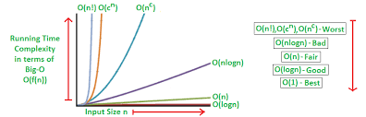
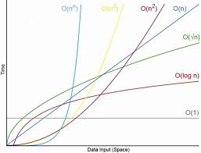
Logarithmic - log n
Linear - n
Quadratic - n^2
Polynomial - n^z, where z is some constant
Exponential - a^n, where a is some constant

Slide 4
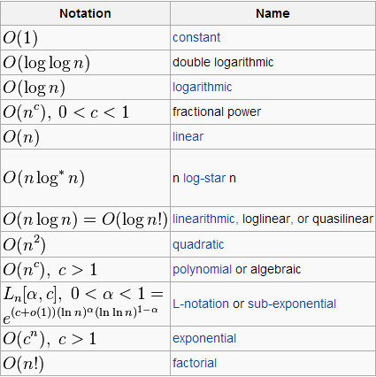

Slide 5
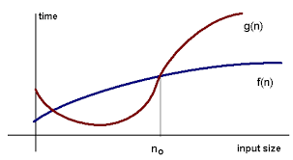
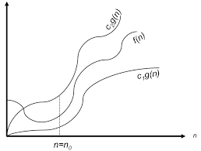
Big O
F(n)=2n+3
G(n)=10n
F(n)=2n+3
G(n)=7n
F(n)=2n+3 <G(n)=10n=O(n)

Slide 6
f(n)=2n+3 >g(n)=1+n=Ω(g(n))
1+n<=F(n)=2n+3<=5n=Θ(g(n))
1+n²<=f(n)=2n²+3+4<= 2n²+3n²+4n²
Θ(n²) is the exact asymptotic
10 n²logn <=f(n)=n²logn +n<= 10 n²logn
Θ(n²Logn)
1<=f(n)=n!<= n*n*n*..
1< 1*2*3…*n< n*n*n*..
Omega(1)<n!<O(1)

Slide 7
1<=f(n)=logn!<= log(n*n*n*..)
Log(1x1x1)< =1*2*3…*n< n*n*n*.. <= log n^{n}
1 =logn!< n*n*n*.. <= nlog n
Omega(1)<logn!<O(nlog n)

Slide 8
Best , worst , and average case analysis
1-linear search
2- Binary search Tree

Slide 9
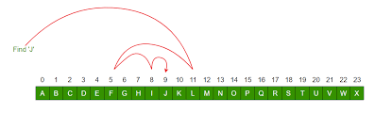
1-linear search
Best case if the key is found at first location
Best case time O(1) ➔ Θ(1)
Worst case if the key is found at the last index
Worst case time O(n)=➔ Θ(n)
Average case =all cases/nb of cases
=key can be anywhere n / n
= total nb of camparisons 1+2+…/n
=n(n+1)/2/n
=(n+1)/2 =O(n)

Slide 10
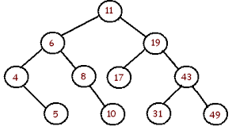
2-Binary search Tree
Height of this tree = log number of nodes n
Best case if the key is found at the root
Best case time O(1) (analysis of lower upper ..) ➔ Θ(1)
Worst case if the key is found at the leaf
Worst case time O(logn)
Worst case can be n if the tree is unbalanced min worst case logn
Worst case max worst case n
➔ Worst case = Height of this tree

Slide 11
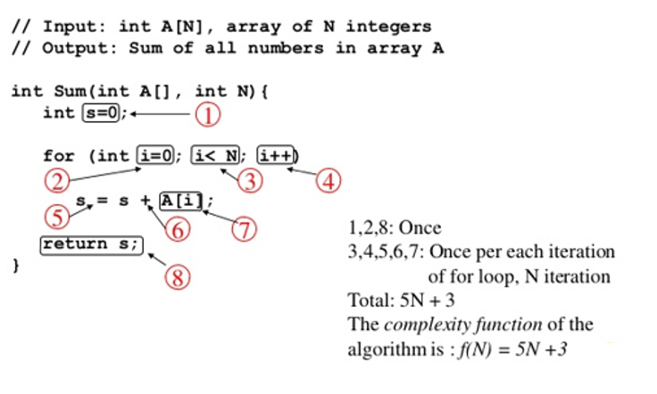
For loop Time complexity
O(N)

Slide 12

For loop Time complexity
O(N)
Nested for O(N)??
i+2
f(n)=5/2 n +3

Slide 13
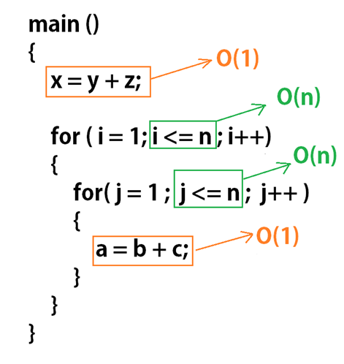
Nested for O(N²)?

Slide 14
Nested for O(N²)?
for(int i=0;i<n;i++)
for (int j=0;j< i; j++)
statement;
i | j | Nb of execution
0 | 0 | 0
1 | 0 | 1
2 | 0,1 | 2
3 | 0,1,2 | 3
 |  | n
Total nb of execution =1+2+3…+n =n(n+1)/2 === O(n²)

Slide 15
O(?)?
O(sqrt(n))
s=0;
for(int i=1;s<n;i++)
s=s+i;
i | s | Nb of execution
1 | 0+1=1 | 1
2 | 1+2=3 | 3
3 | 1+2+3=6 | 6
4 | 1+2+3+4=10 | 10
K? | 1+2+3+……+k | K(k+1)/2
Total nb of execution = k(k+1)/2 > n
k ² > n
k =sqrt(n)

Slide 16
O(?)?
O(logn)
for(int i=1;i<n;i=i*2)
statement;
i | Nb of execution
1 | 1
1*2=2 | 2
2*2 = 2 ² | 4
2 ² *2 = 2 ³ | 8
K? 2 ^{k} | 2 ^{k}
Total nb of execution = 2 ^{k} >= n
k ² > n
k ² = n
(apply log) k= log n
For n=8 ➔1,2,4,,,xx8 = 3 times
For n=10 ➔ 1,2,4,8xx10 =4 times
O(ceil(logn)
because log 8=3 and log 10=3.2 (should be4)

Slide 17
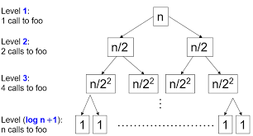
O(?)?
O(logn)
for(int i=n; i>=1;i=i/2)
statement;
i | Nb of execution
n | n/2
n-1 | (n-1)/2/2 = n/2 ²
 | n/ 2 ^{k}
Total nb of execution = n/2 ^{k} >= 1
n/2 ^{k} = 1
n =2 ^{k}
(apply log) k= log n

Slide 18
O(?)?
O(sqrt(n))
for(int i=0; i*i<n;i++)
statement;
i | Nb of execution
0 | 1
1 | 1
2 | 4
4
 | k ²
Total nb of execution
k ² = n
K= sqrt(n)

Slide 19
O(n)
O(?)?
for(int i=0; i<n;i++)
statement;
for(int j=0; j<n;j++)
statement;
i | j | Nb of execution
0 | 0 | 0
1 | 0 | 1
2 | 0 | 2…..n
0 | 1 | 1…..
0 | 2 | n
Total nb of execution= 2n

Slide 20
O(?)?
O(log log n)
//nested for
p=0;
for(int i=0; i<n;i=i*2)
p++;
➔p=logn
for(int j=1; j< p ;j=j*2)
statement;
===➔logp
Replace p with log n
for(int j=1; j< logn ;j=j*2)
statement;
===➔log logn

Slide 21
O(?)?
O(nlogn)
//nested for
for(int i=0; i<n;i=++)
for(int j=1; j< n ;j=j*2)
statement;
Executes n times
Executes n times
Executes nlog n times
Executes log n times
Executes nlog n times
Total nb of execution= n+ nlog n+ nlogn= 2nlogn + n
= 2nlogn

Slide 22
Summary
for loop
for(int i=0; i<n;i++) | O(n)
for(int i=0; i<n;i=i+2) | O(n) (executes n/2)
for(int i=n; i>1;i--) | O(n)
for(int i=1; i<n;i=i*2) | O(log ₂n)
for(int i=1; i<n;i=i*3) | O(log ₃n)
for(int i=n; i>1;i=i/2) | O(log ₂n)

Slide 23
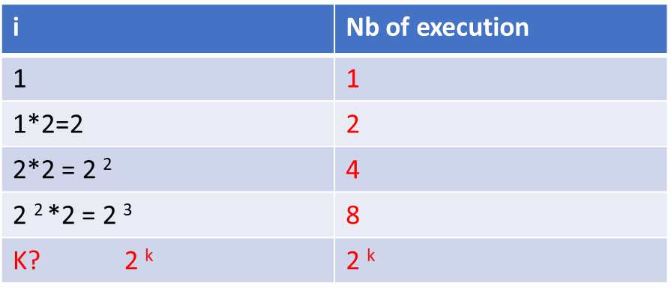
//while
int i=0;
While (i<n)
{ statement;
i++;}
Total nb of execution
2 ^{k} = b
K= log (b)

Slide 24
i | Nb of execution
n | n/2
n-1 | (n-1)/2/2 = n/2 ²
 | n/ 2 ^{k}
//while
int i=n;
While (i>1)
{ statement;
i=i/2;}
Total nb of execution = n/2 ^{k} >= 1
n/2 ^{k} = 1
n =2 ^{k}
(apply log) k= log n

Slide 25
i | k
1 | 1
2 | 1+1=2
3 | 2+2
 | 2+2+3 …
//while
int i=1;
Int k=1;
While (k<n)
{ statement;
k=k+I;
i=i++;}
Total nb of execution = 2+2+3+4++5+…+m
=1+(1+2+3…+m)
=1+ m(m+1)/2
~m² =k
(condition to stop k>n) m² = n
m=sqrt(n)

Slide 26
M =6 | N=3
6 | 3
3 | 3
M =5 | N=5
M=16 | N=2
//while &if
While (m!=<n)
{ If (m>n)
m=m-n;
else
n=n-m;}
Count the number of times
16 2
14 2
12 2
10 2
2
2
2 2
Min time O(1)
Max Time O(n) ~n/2

