Slide 1
N. Rizk
COSC 2430 : Data Structures
College of Natural and Applied Sciences
Department of Computer Science
University of Houston

Slide 2
Repetition versus Recursion
Void Recursive Functions.
Assume that we need to print n asterisks on a line and the value of n is known.
We can use either an iterative or a recursive solution as shown below.
// Iterative
void line(int n)
{
while (n >= 1)
{
cout << "*";
n−−;
}
return;
}
// Recursive
void line(int n)
{
if (n < 1)
{
return;
}
cout << "*";
line(n − 1);
}

Slide 3
Repetition versus Recursion
If we compare the two approaches, we see that a condition, implicit or explicit, is needed to return from the function.
In the iterative version, we reduce the value of the variable n one by one using the statement n−−; in the recursive version, we call the function again with a reduced parameter (n − 1).
In the repetitive version, the statement (cout << "*") is called n times, each time in one iteration in the loop.
In the recursive version, the same statement is executed once in each call to the function.

Slide 4
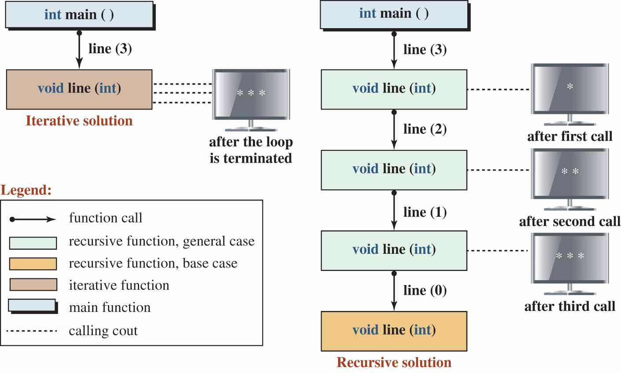
Repetition versus Recursion
In the repetitive version, we have only one function call; in the recursive version, we have n − 1 function calls.
Iterative versus recursive call of a void function
Access the text alternative for slide images.

Slide 5
Repetition versus Recursion
Value-Returning Recursive Functions.
Assume that we need to find the sum of all numbers from 0 to n.
We can write two functions, one iterative and one recursive.
The functions, however, are not void functions; each needs to return the value of the sum.
We show two functions side by side to see the difference between the iterative version and the recursive version.
Again, we use the while loop that makes the comparison easier.

Slide 6
Repetition versus Recursion Part 6
// Iterative
int sum(int n)
{
int result = 0;
while (n >= 0)
{
result += n;
n−−;
}
return result;
}
// Recursive
int sum(int n)
{
if (n <= 0)
{
return 0;
}
return sum(n − 1) + n;
}

Slide 7
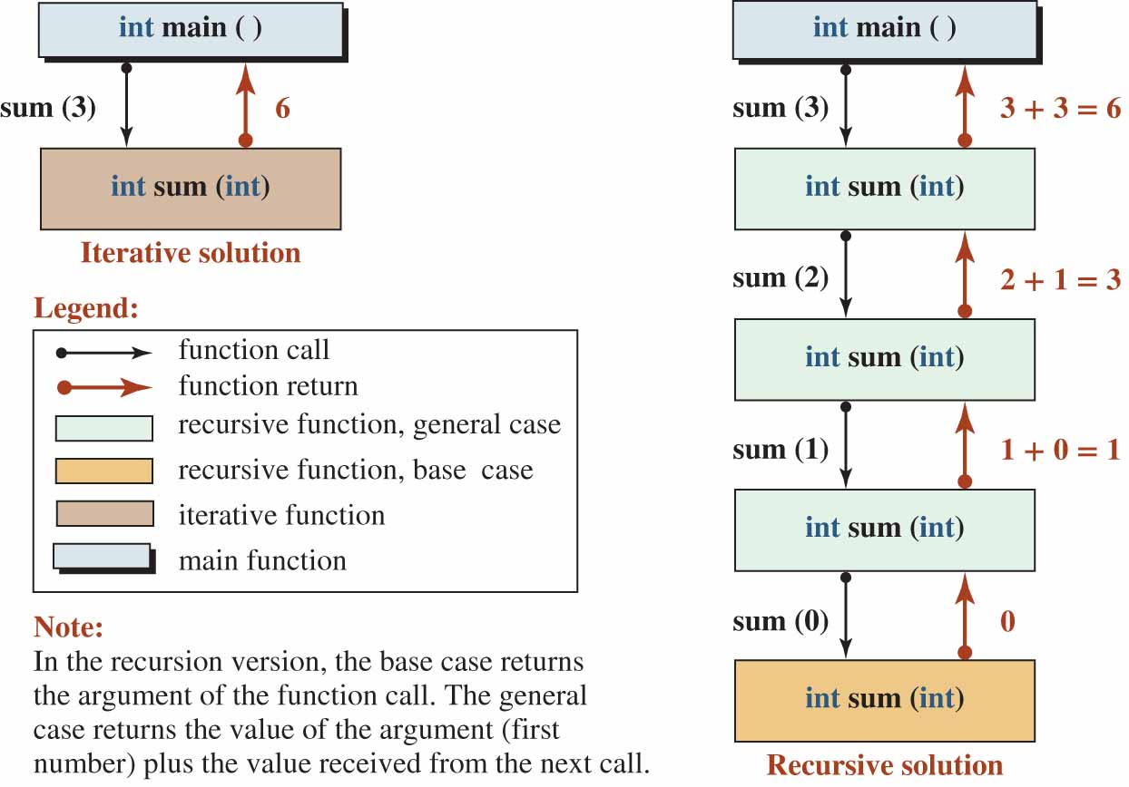
Repetition versus Recursion Part 7
In both cases we are summing the numbers backward, from n to 0.
Figure 17.2 symbolically shows the behavior of each function.
Figure 17.2 Iterative versus recursive call
Access the text alternative for slide images.

Slide 8
Repetition versus Recursion Part 8 (1)
Comparison.
When we compare the recursive line function (Figure 17.1) and the recursive sum function (Figure 17.2), we can deduce the difference between a void recursive function and a value-returning recursive function.
Void Recursive.
In the case of a void recursive function, general cases are continuously called until a base case is reached; the general case does not have to hold any information.
Value-Returning Recursive.
In the case of value-returning function, the general cases are called until the base case is reached.

Slide 9
Repetition versus Recursion Part 8 (2)
Each general case needs to hold some information (the value of n) until the call to the next step is returned.
The base case then returns the value of sum(0) to the previous general case, which returns the value of sum(1) to the previous general case, and so on.

Slide 10
Some Recursive Algorithms Part 1
In this section, we give some simple recursive algorithm.
Sum and Factorial.
We discussed how to solve the sum(n) problem recursively.
A sibling of the sum(n) function is the factorial(n) function (also called product).
In the sum function, we need to add numbers from n to 0; in the factorial function, we need to multiply numbers from n to 1.

Slide 11
Some Recursive Algorithms Part 2
// Sum
int sum(int n)
{
if (n <= 0)
{
return 0;
}
return sum(n − 1) + n;
}
// Factorial
int factorial(int n)
{
if (n =< 1)
{
return 1;
}
return factorial(n − 1) * n;
}

Slide 12
Some Recursive Algorithms
Note that sum(0) is 0, while factorial(1) is 1.
In the sum function, we use the addition operator; in the factorial function, we use the multiplication operator.
Note that in the sum function, sum(n − 1) is the value returned from the next call and in the factorial function, factorial(n − 1) is the value returned from the next call.
Program 17.1 tests the value of sum(n) and factorial(n) using the same value for n in each call.
We can see that the sum grows slowly, but the factorial grows rapidly.

Slide 13
Find the Sum and Factorial of an Integer
Testing recursive sum and factorial
1
2
3
4
5
6
7
8
9
10
11
12
13
14
15
16
17
18
19
20
/***************************************************************
* A program to find the sum and factorial of an integer *
***************************************************************/
#include <iostream>
using namespace std;
// Declaration of sum function
int sum (int n);
// Declaration of factorial function
int factorial (int n);
int main ( )
{
// Testing sum (0) and factorial (1)
cout << "sum (0) = " << sum (0) << endl ;
cout << "factorial (1) = " << factorial (1) << endl << endl;
// Testing sum (3) and factorial (3)
cout << "sum (3) = " << sum (3) << endl;
cout << "factorial (3) = " << factorial (3) << endl << endl;
// Testing sum (7) and factorial (7)

Slide 14
Find the Sum and Factorial of an Integer
Testing recursive sum and factorial
21
22
23
24
25
26
27
28
29
30
31
32
33
34
35
36
37
38
39
40
cout << "sum (7) = " << sum (7) << endl;
cout << "factorial (7) = " << factorial (7);
return 0;
}
// Recursive definition of sum (n)
int sum (int n)
{
if (n <= 0)
{
return 0;
}
return n + sum (n − 1);
}
// Recursive definition of factorial (n)
int factorial (int n)
{
if (n <= 1)
{
return 1;
}

Slide 15
Find the Sum and Factorial of an Integer
Testing recursive sum and factorial
41
42
return n * factorial (n − 1);
}
Run:
sum (0) = 0
factorial (1) = 1
sum (3) = 6
factorial (3) = 6
sum (7) = 28
factorial (7) = 5040

Slide 16
Some Recursive Algorithms
Greatest Common Divisor.
One function often needed in mathematics and computer science is the greatest common divisor, gcd, of two positive integers.
An integer y is a divisor of x if x % y = 0.
Two positive integers may have many common divisors, but only one greatest common divisor. Figure 17.3 shows that 12 and 140 have three common divisors, but only one gcd, which is 4.

Slide 17
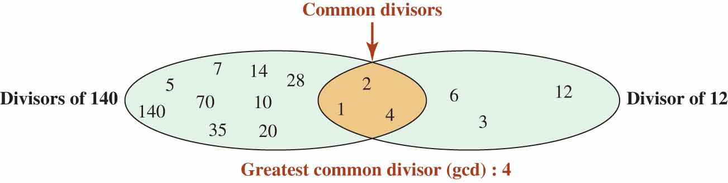
Some Recursive Algorithms
Greatest Common Divisor of 12 and 140
Access the text alternative for slide images.

Slide 18
Some Recursive Algorithms
Table 17.1 shows the base and general case of the Euclidean algorithm (that finds the greatest common divisor).
Euclidean algorithm
Base case | General case
gcd(x, 0) = x | gcd(x, y) = gcd(y, x % y)
Figure 17.4 shows how the recursive gcd function calls another version until it finds the greatest common divisor of its two arguments.

Slide 19
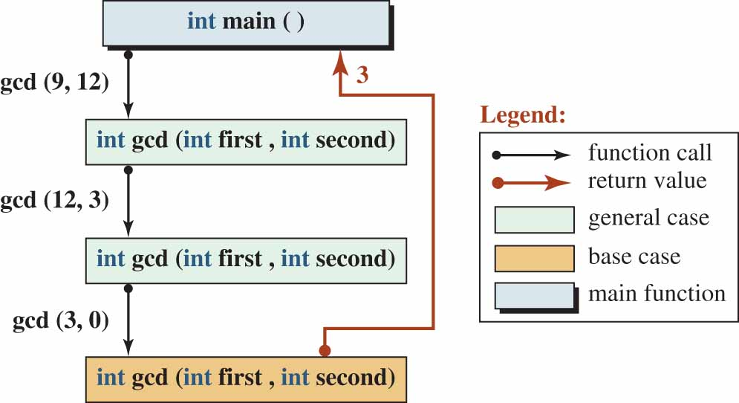
Some Recursive Algorithms
The recursive calls in gcd(9, 12)
Access the text alternative for slide images.

Slide 20
Program to Find Greatest Common Divisor
Greatest common divisor
1
2
3
4
5
6
7
8
9
10
11
12
13
14
15
16
17
18
19
20
/***************************************************************
* A program to find the greatest common divisor of some pairs *
***************************************************************/
#include <iostream>
using namespace std;
// Declaration of gcd function
int gcd (int first, int second);
int main ()
{
// Checking gcd of five pairs
cout << "gcd (8, 6) = " << gcd (8, 6) << endl;
cout << "gcd (9, 12) = " << gcd (9, 12) << endl;
cout << "gcd (7, 11) = " << gcd (7, 11) << endl;
cout << "gcd (21, 35) = " << gcd (21, 35) << endl;
cout << "gcd (140, 12) = " << gcd (140, 12);
return 0;
}
// Recursive definition of greatest common divisor

Slide 21
Program to Find Greatest Common Divisor
Greatest common divisor
21
22
23
24
25
26
27
28
29
30
31
int gcd (int first, int second)
{
if (second == 0)
{
return first;
}
else
{
return gcd (second, first % second);
}
}
Run:
gcd (8, 6) = 2
gcd (9, 12) = 3
gcd (7, 11) = 1
gcd (21, 35) = 7
gcd (140, 12) = 4

Slide 22
Some Recursive Algorithms
Fibonacci Numbers.
Fibonacci numbers are a series in which each number is the sum of the previous two numbers.
Unlike the previous recursive problem, this problem has two bases as shown in Table 17.2.
Table 17.2 Fibonacci number
Base case | General case
Fib(0) = 0, fib(1) = 1 | fib(n) = fib(n − 1) + fib(n − 2)

Slide 23
Some Recursive Algorithms Part 9
Figure 17.5 shows how we can calculate fib(4) using recursive calls.
Note that we cannot find the return value of fib(4) until we find the return value of fib(3) and fib(2).
We cannot find fib(3) until we find fib(2) and fib(1). We cannot find fib(2) until we find fib(1) and fib(0).
Finally we find the answer to fib(0) and fib(1), which are the base cases.

Slide 24
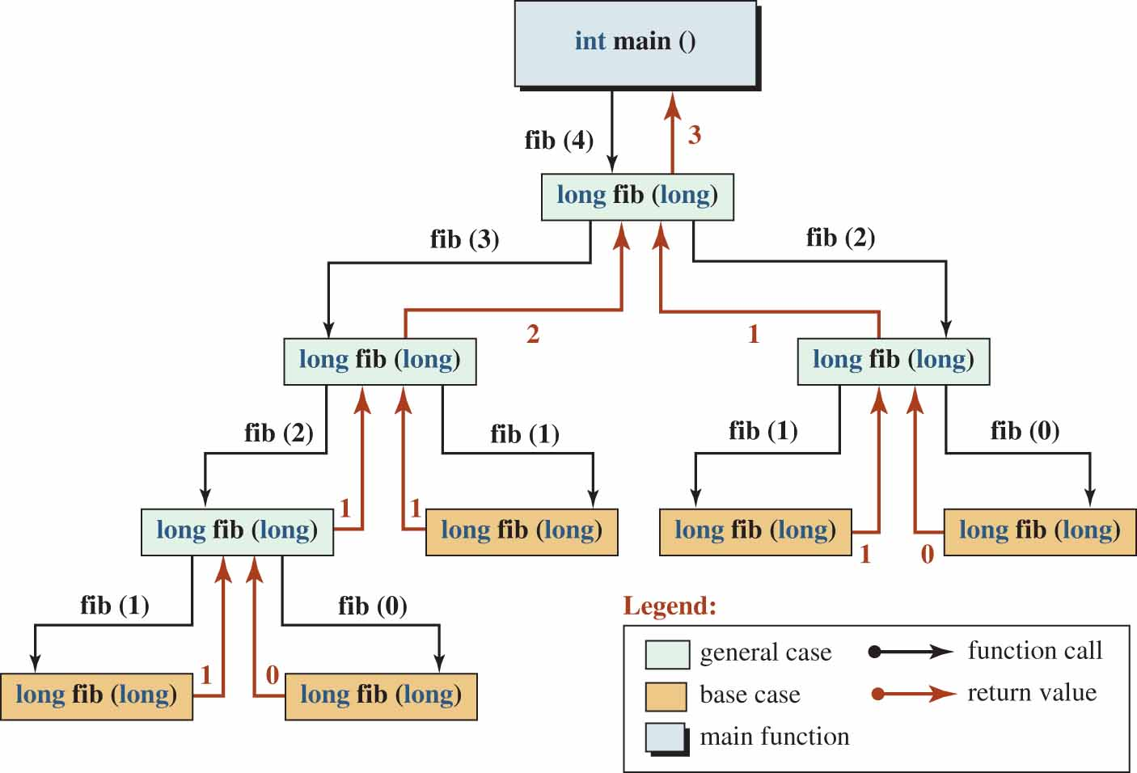
Some Recursive Algorithms
Recursive trace of Fibonacci number fib(4)

Slide 25
Recursive Solution to Fibonacci Number
Recursive solution to Fibonacci numbers
1
2
3
4
5
6
7
8
9
10
11
12
13
14
15
16
17
18
19
20
/***************************************************************
* A program to find the Fibonacci values *
***************************************************************/
#include <iostream>
using namespace std;
// Function declaration
long long fib (int n);
int main ( )
{
// Testing Fibonacci 0 to 10
cout << "Fibonacci numbers from 0 to 10" << endl;
for (int i = 0; i <= 10; i++)
{
cout << "fib (" << i << ") = " << fib(i) << endl;
}
cout << endl;
// Testing Fibonacci numbers of 35 and 36
cout << "Fibonacci numbers of 35 and 36" << endl;

Slide 26
Recursive Solution to Fibonacci Number
Recursive solution to Fibonacci numbers
21
22
23
24
25
26
27
28
29
30
31
32
33
34
35
36
cout << "fib (35) = " << fib(36) << endl;
cout << "fib (36) = " << fib(36) << endl;
return 0;
}
// Function Definition
long long fib (int n)
{
if (n == 0 || n ==1)
{
return n;
}
else
{
return (fib (n - 2) + fib (n - 1));
}
}

Slide 27
Recursive Solution to Fibonacci Number
Recursive solution to Fibonacci numbers
Run:
Fibonacci numbers from 0 to 10
fib (0) = 0
fib (1) = 1
fib (2) = 1
fib (3) = 2
fib (4) = 3
fib (5) = 5
fib (6) = 8
fib (7) = 13
fib (8) = 21
fib (9) = 34
fib (10) = 55
Fibonacci numbers from 35 to 37
fib (35) = 9227465
fib (36) = 14930352

Slide 28
Some Recursive Algorithms
Reversing A String.
Another problem that can be solved recursively is to reverse a string.
We can define the base and general case as shown below
The base and general case of string reverse
Base case | General case
if(length <= 1), return strg | return reverse(substr(1, length − 1)) + subtr(0, 1)

Slide 29
Some Recursive Algorithms
In other words, if the string is made of zero or one character, the reverse string is itself.
Otherwise, we need to find the reverse of the substring minus the first character and then concatenated it with the substring that holds only the first character.
Each general case calls another general case, passing the substring of the argument.
It holds the first character in a substring until the reversed string is returned. It then concatenates the two strings and returns the result to the calling function.

Slide 30
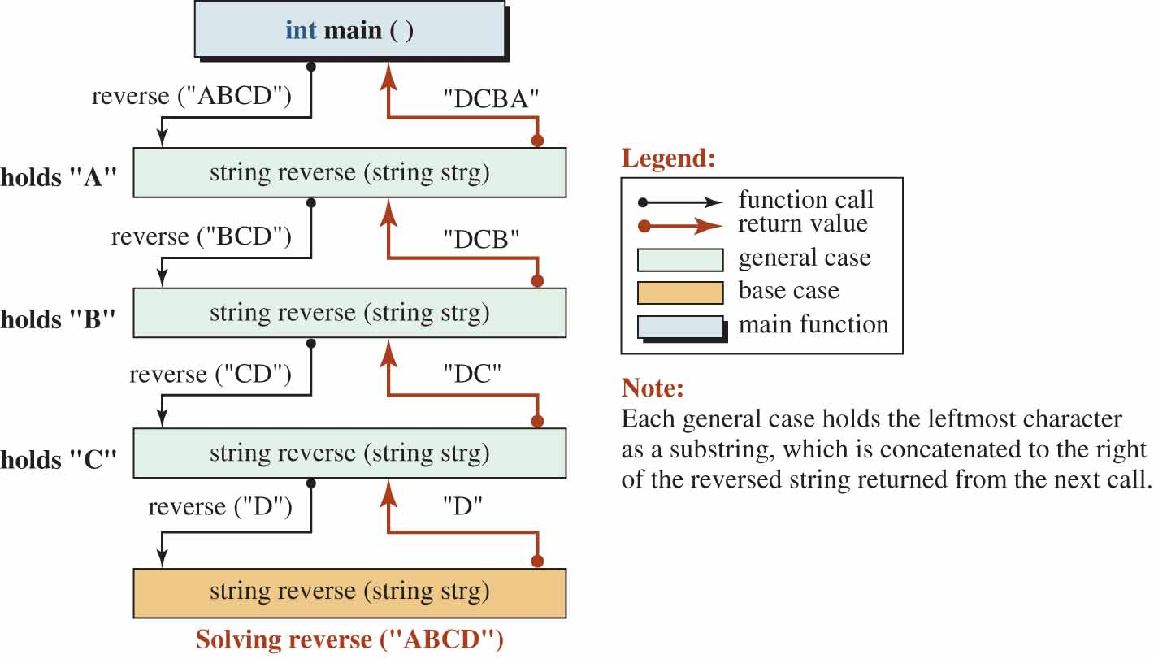
Some Recursive Algorithms
The steps involved in calling reverse("ABCD")

Slide 31
Program that Recursively Reverses a String
Recursively reversing a string
1
2
3
4
5
6
7
8
9
10
11
12
13
14
15
16
17
18
19
20
/***************************************************************
* A program that reverses a string recursively *
***************************************************************/
#include <iostream>
#include <string>
using namespace std;
// Declaration of recursive function
string reverse (string str);
int main ( )
{
// Calling reverse function using some strings
cout << "Reverse of ’ABCD’: " << reverse ("ABCD") << endl;
cout << "Reverse of ’Hello’: " << reverse ("Hello") << endl;
cout << "Reverse of ’Bye’: " << reverse ("Bye") << endl;
return 0;
}
// Definition of recursive function
string reverse (string str)

Slide 32
Program that Recursively Reverses a String
Recursively reversing a string
21
22
23
24
25
26
27
28
29
30
{
if (str.length () <= 1)
{
return str;
}
else
{
return reverse (str.substr (1, str.length() − 1)) + str.substr (0, 1);
}
}
Run:
Reverse of ’ABCD’: DCBA
Reverse of ’Hello’: olleH
Reverse of ’Bye’: eyB

Slide 33
Some Recursive Algorithms
Checking for Palindrome.
A string is a palindrome if reads the same forward and backward.
We can solve this problem using a recursive function called isPalidrome as shown in Table 17.4.
isPalindrom
Base cases | if (length <= 1), return true else if (strg [0] != strg [strg.size()−1]) return false
General case | return isPalindrome(strg.substr(1, strg.size() − 2));

Slide 34
Some Recursive Algorithms
The first base case is related to an empty string or a string with only one character, which is obviously a palindrome.
The second base case is related to the string in which the first character and the last character are different, which is obviously not a palindrome.
Figure 17.7 shows how we can use the base and general cases to find if a string is a palindrome.

Slide 35
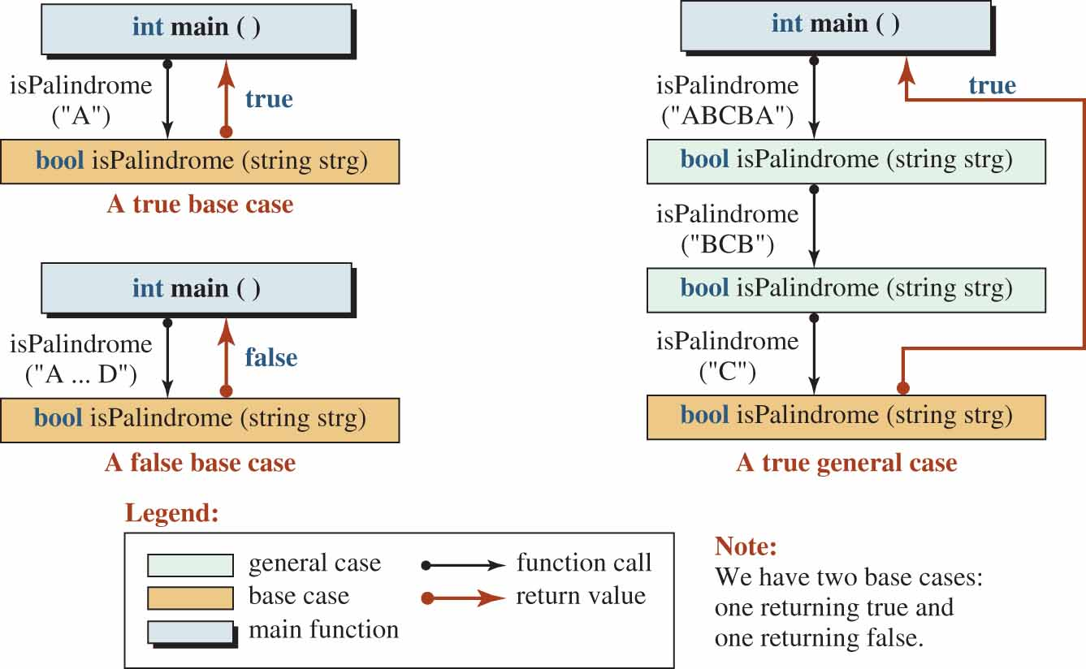
Some Recursive Algorithms
Cases of recursive isPalindrome function

Slide 36
Recursive isPalindrome Function Part 1
Using the recursive isPalindrome function
1
2
3
4
5
6
7
8
9
10
11
12
13
14
15
16
17
18
19
20
/***************************************************************
* A program that checks if a string is a palindrome *
***************************************************************/
#include <iostream>
#include <string>
using namespace std;
// Declaration of recursive function
bool isPalindrome (string strg);
int main ( )
{
// Instantiation of some strings
string strg1 ("");
string strg2 ("rotor");
string strg4 ("hello");
// Checking for palindromes
cout << boolalpha;
cout << "Is ’’ a palindrome? " << isPalindrome (strg1) << endl;
cout << "Is ’rotor’ a palindrome? " << isPalindrome (strg2) << endl;

Slide 37
Recursive isPalindrome Function
Using the recursive isPalindrome function
21
22
23
24
25
26
27
28
29
30
31
32
33
34
35
36
cout << "Is ’hello’ a palindrome? " << isPalindrome (strg3);
return 0;
}
// Definition of recursive function
bool isPalindrome(string strg)
{
if (strg.size () <= 1)
{
return true;
}
else if (strg[0] != strg [strg.size() − 1])
{
return false;
}
return isPalindrome (strg.substr (1, strg.size () − 2));
}
Run:
Is ’’ a palindrome? true // empty string
Is ’rotor’ a palindrome? true
Is ’hello’ a palindrome? false

Slide 38
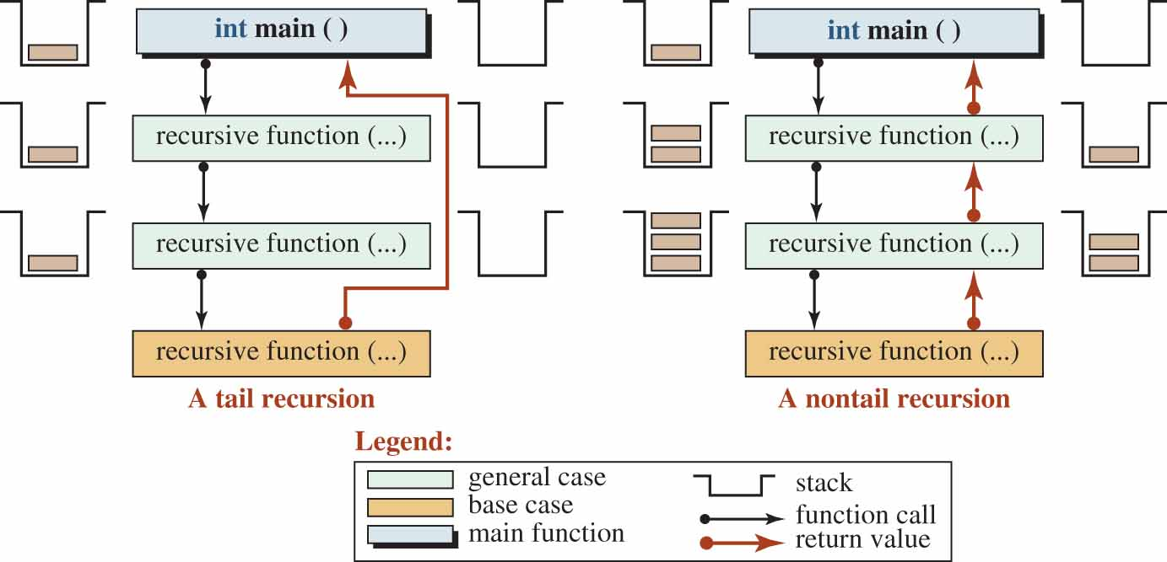
Tail and Non-tail Recursive Functions
We encountered two types of recursion in the examples that we discussed in the previous sections: tail recursion and non-tail recursion (Figure 17.8).
Figure 17.8 Difference between a tail and a non-tail function

Slide 39
Tail and Non-tail Recursive Functions
Tail Recursion.
In tail recursion, each general case terminates after calling the next general case or the base case.
In other words, the duty of the general case is just to call the next general function or the base function.
The duty of the base case is to return the result of the whole operation to the main function.
In tail recursion, the stack that holds the record of the next function call has only one record because when the next function is called, the current function terminates and its record is popped from the stack.
Note that if we design a void recursive function, it is a tail recursive function in which even the base case does not return anything to the main function.

Slide 40
Tail and Non-tail Recursive Functions
Non-Tail Recursion.
In non-tail recursion, the duty of a general-case call is not terminated until the next call returns.
The current function then combines the information it is holding with what is returned from the next call and passes it to the previous call.
The final information is returned to the main function by the first general case.
In non-tail recursion, the stack holds the record of the next recursive call until the call is returned.

Slide 41
Helper Functions
A recursive function can be inefficient. In particular, a non-tail recursive function can be inefficient for two reasons.
First, each general case needs to hold information until the result of the next call is returned.
In addition, the stack eventually holds many records, which can require a large amount of memory.
To improve efficiency, we can use a helper function.
A helper function is a tail recursive function with more parameters than the non-tail recursive function.
We can use a non-recursive function to call the helper function.

Slide 42
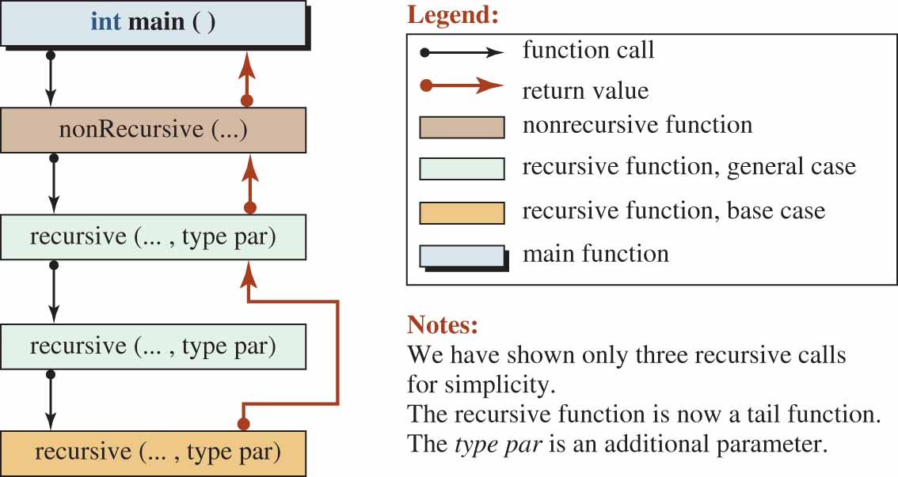
Helper Functions Part 2
Using a helper function to remove inefficiency

Slide 43
Helper Functions
The sum function is not a tail function.
We can create a tail recursive function as a helper function with an extra parameter (result) that holds the value of n that would otherwise be held as a variable.

Slide 44
Helper Function to Create a Tail Recursive
Using the helper function with the sum function
1
2
3
4
5
6
7
8
9
10
11
12
13
14
15
16
17
18
19
20
/*****************************************************************
* A program using a helping function to create a tail recursive *
* function that is more efficient than a non-tail function *
*****************************************************************/
#include <iostream>
using namespace std;
// Functions declaration
int sum (int n);
int sum (int n, int result);
int main ( )
{
// Calling the non-recursive function four times
cout << "Sum (0) = " << sum (0) << endl;
cout << "Sum (1) = " << sum (1) << endl;
cout << "Sum (3) = " << sum (3) << endl;
cout << "Sum (7) = " << sum (7);
return 0;
}

Slide 45
Helper Function to Create a Tail Recursive
Using the helper function with the sum function
21
22
23
24
25
26
27
28
29
30
31
32
33
34
// Non-recursive
int sum (int n)
{
return sum (n, 0);
}
// Recursive
int sum (int n, int result)
{
if (n == 0)
{
return result;
}
return sum (n − 1, n + result);
}
Run:
Sum(0) = 0
Sum(1) = 1
Sum(3) = 6
Sum(7) = 28

Slide 46
Helper Functions
As another example, let us redesign the isPalindrome function using a helper function.
Note that isPalindrome is already a tail recursive function, but redesigning it removes the inefficiency of creating a substring each time we call the function.

Slide 47
The isPalindrome with a Helper Function
The isPalindrome function with a helper function
1
2
3
4
5
6
7
8
9
10
11
12
13
14
15
16
17
18
19
20
/***************************************************************
* A program that check if a string is a palindrome by using *
* a helper function to avoid creating substring objects. *
***************************************************************/
#include <string>
#include <iostream>
using namespace std;
// Function declaration
bool isPalindrome (const string& strg);
bool isPalindrome (const string& strg, int left, int right);
int main ( )
{
// Checking if the strings are palindromes
cout << boolalpha;
cout << "Is ’rotor" a palindrome? " << isPalindrome ("rotor") << endl;
cout << "Is ’madam’ a palindrome? " << isPalindrome ("madam") << endl;
cout << "Is ’Hello’ a palindrome? "<< isPalindrome ("Hello");
return 0;

Slide 48
The isPalindrome with a Helper Function
The isPalindrome function with a helper function
21
22
23
24
25
26
27
28
29
30
31
32
33
34
35
36
37
38
39
}
// Function definition for non-recursive isPalindrome
bool isPalindrome(const string& strg)
{
return isPalindrome (strg, 0, strg.size () − 1);
}
// Function definition for helper recursive isPalindrome
bool isPalindrome(const string& strg, int left, int right)
{
if (right <= left)
{
return true;
}
else if (strg [left] != strg [right])
{
return false;
}
return isPalindrome (strg, left + 1 , right − 1);
}

Slide 49
The isPalindrome with a Helper Function Part 3
The isPalindrome function with a helper function
Run:
Is ’rotor’ a palindrome? true
Is ’madam’ a palindrome? true
Is ’hello’ a palindrome? false

Slide 50
RECURSIVE SORT AND SEARCH
In computer science we often need to sort a list and search a list.
When a list is sorted, the search can be very fast.

Slide 51
Quick Sort
Sorting means to rearrange the elements of a list (such as an array) so that the values are in sequence.
The sorting algorithm that we introduce in this section is called quicksort (a recursive algorithm).
This is a very fast and efficient algorithm that is used in most libraries.
The quicksort algorithm uses a non-recursive algorithm called partition that we discuss next.

Slide 52
Quick Sort Part 2
Partition Algorithm.
The partition algorithm rearranges an array around a pivot, one of the elements of the array, so that all elements larger than or equal to the pivot move after it and all elements smaller than the pivot move before it.
The pivot is normally selected as the first element.

Slide 53
Quick Sort Part 3
int partition(int arr[], int i, int j) // i and j are partition indexes
{
int p = i; // p is the pivot
while (i < j) // outer loop
{
while (arr [j] > arr[p]) // first inner loop
{
j--;
}
swap(arr[j], arr[p]);
p = j;
j--;
while (arr [i] < arr [p]) // second inner loop
{
i++;
}
swap(arr[i], arr [p]);
p = i;
i++;
}
return p;
}

Slide 54
Quick Sort Part 4
In each execution of the outer loop we do the following two sets of actions.
We move j to the left as long as arr [j] is larger than the arr [p]. We then swap the values of arr [j] and arr [p] and set p = j. Then we move j one more element to the left.
We move i to the right as long as arr [i] is smaller than the arr [p]. We then swap the values of arr [i] and arr [p] and set p = i. Then we move i one more element to the right.

Slide 55
Quick Sort Part 5
The pivot p is set to the first element, but it moves to its final position in the array.
Note that after the second iteration, i moves to the right of j and the outer loop terminates.
Example : an array of 10 elements and the changes that occur during two iterations of the outer loop.

Slide 56
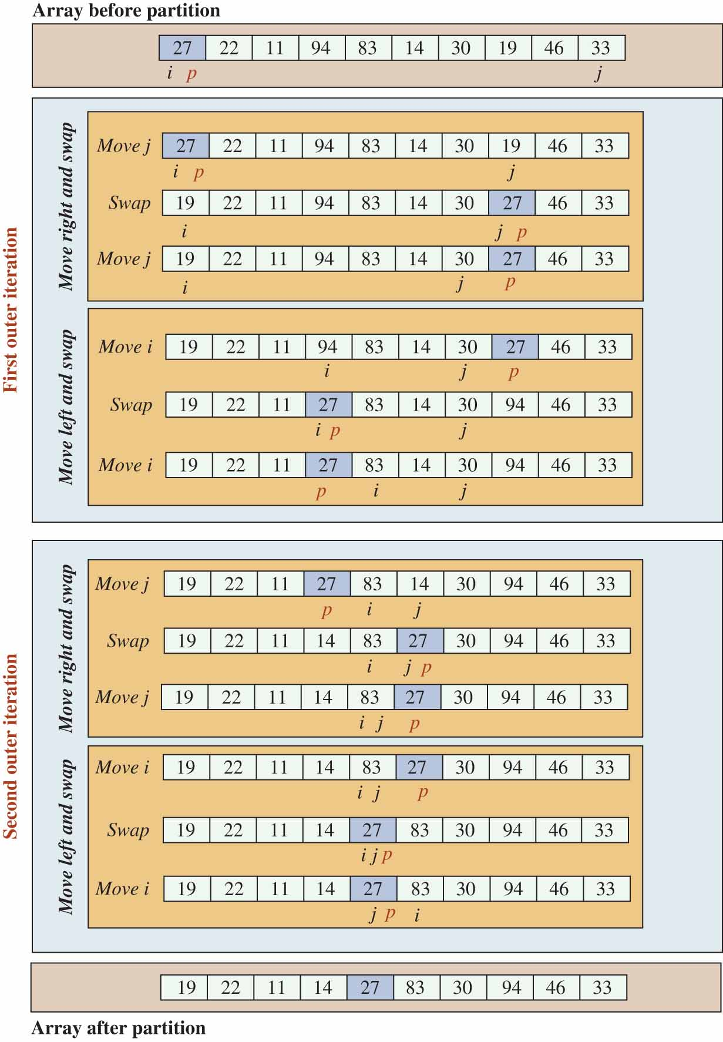
Quick Sort Part 6
Applying the partition algorithm on array
Access the text alternative for slide images.

Slide 57
Quick Sort Part 7
Applying the partition algorithm on array
Access the text alternative for slide images.

Slide 58
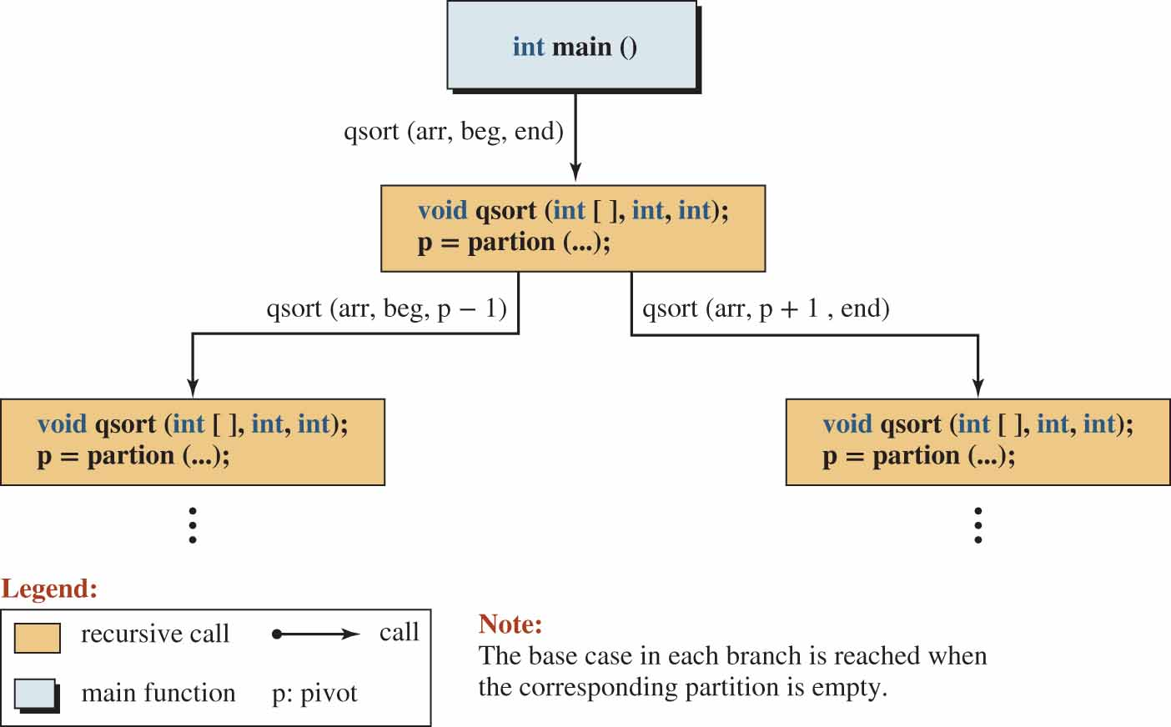
Quick Sort Part 8
Quick Sort Algorithm.
The quick sort algorithm is a void recursive algorithm.
It moves recursively down left and down right until it reaches an empty partition array.
The idea of quick sort algorithm

Slide 59
Quick Sort Program Part 1
Quick sort program
1
2
3
4
5
6
7
8
9
10
11
12
13
14
15
16
17
18
19
20
/****************************************************************
* A program that uses the quicksort algorithm to sort an array *
* by calling the partition algorithm recursively. *
****************************************************************/
#include <iostream>
using namespace std;
// Function declarations
void swap (int& x, int& y);
void print (int array[], int size);
int partition (int arr[], int beg, int end);
void quickSort (int arr[], int beg, int end);
int main ()
{
// Declaration of an unsorted array
int array [10] = {27, 22, 11, 94, 83, 14, 30, 19, 46, 33};
// Printing unsorted array
cout << "Original array: " << endl;
print (array, 10);

Slide 60
Quick Sort Program Part 2
Quick sort program
21
22
23
24
25
26
27
28
29
30
31
32
33
34
35
36
37
38
39
40
// Calling quickSort function
quickSort (array, 0, 9);
// Printing sorted array
cout << "Sorted array: " << endl;
print (array, 10);
return 0;
}
// Swap function
void swap (int& x, int& y)
{
int temp = x;
x = y;
y = temp;
}
// Print-array function
void print (int array[], int size) {
for (int i = 0; i < size; i++)
{
cout << array [i] << " ";

Slide 61
Quick Sort Program Part 3
Quick sort program
41
42
43
44
45
46
47
48
49
50
51
52
53
54
55
56
57
58
59
60
}
cout << endl;
}
// Partition function
int partition (int arr[], int beg, int end)
{
int p = beg ; // Initializing pivot
int i = beg; // Initializing i
int j = end; // Initializing j
while (i < j)
{
// Moving j to the left
while (arr [j] > arr[p] )
{
j--;
}
swap (arr[j], arr[p]);
p = j;
// Moving i to the right

Slide 62
Quick Sort Program Part 4
Quick sort program
61
62
63
64
65
66
67
68
69
70
71
72
73
74
75
76
77
78
79
80
while (arr [i] < arr [p] )
{
i++;
}
swap (arr[i], arr [p]);
p = i;
}
return p;
}
// Quick sort function
void quickSort (int arr[], int beg, int end)
{
if (beg >= end || beg < 0)
{
return;
}
int pivot = partition (arr, beg, end);
quickSort (arr, beg, pivot − 1);
quickSort (arr, pivot + 1, end);
}

Slide 63
Quick Sort Program Part 5
Quick sort program
Run:
Original array:
27 22 11 94 83 14 30 19 46 33
Sorted array:
11 14 19 22 27 30 33 46 83 94

Slide 64
Binary Search Part 1
We often need to search an array to find the location of a element.
It is much easier to search a sorted array than an unsorted array.
We know that when items are in order, we can find them much easier.
The binary search algorithm is designed to find a value in a sorted array.

Slide 65
Binary Search Part 2
The binary search starts by looking at the middle element. We can have three cases:
If the value is equal to the middle element, the search stops. The index has been found.
If the value is greater that the middle element, the search continues with the right half of the array.
If the value is greater that the middle element, the search continues with the right half of the array.

Slide 66
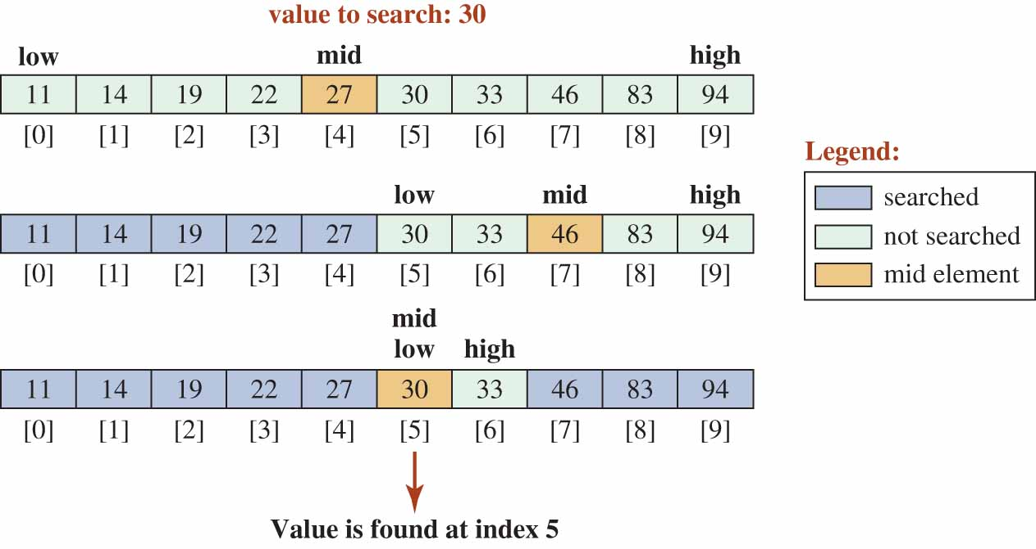
Binary Search Part 3
Figure shows an example of a binary search.
We search for the value 30 in a sorted array of 10 elements.
After three attempts, the index of the value, 5, is returned.
Example of a binary search

Slide 67
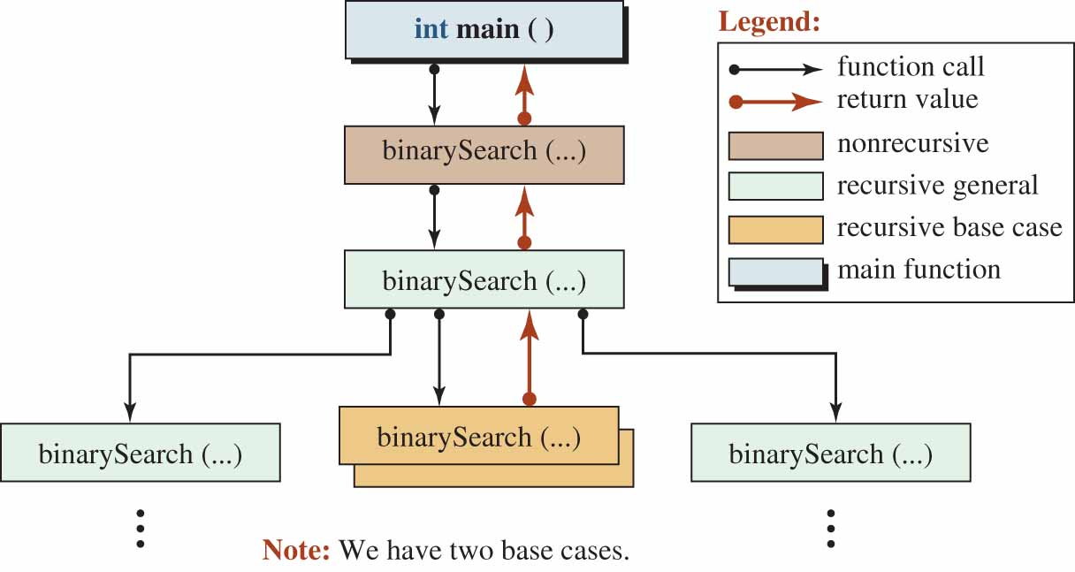
Binary Search Part 4
Recursive Binary Search.
Figure 17.13 shows the recursive binary search algorithm using a helper function.
Recursive binary search

Slide 68
Binary Search Part 5 (1)
We have two base cases. In the first, the value is not found and in the second, it is found.
In a traditional binary search an application calls the search function using the array name, the size, and the value to be found such as binarySearch(arr, size, value).
If the value is not the middle element, we need to call again, but the new call needs to search only the left or right part of the array.
If we want to search the left part, the array pointer does not need to be changed, but the size must be changed.

Slide 69
Binary Search Part 5 (2)
If we want to search the right part, we need to move the array pointer after the middle element and adjust the size.
It is convenient and more efficient to use a helper function that does not move the array pointer, but in each call uses a subpart of the array starting from low to high.
Program shows how to implement the recursive binary search using a helper function.

Slide 70
Recursive Binary Search Part 1
Recursive binary search
1
2
3
4
5
6
7
8
9
10
11
12
13
14
15
16
17
18
19
20
/***************************************************************
* A program that uses the recursive binary search to search *
* an array for a value *
***************************************************************/
#include <iostream>
using namespace std;
// Declaration of non-recursive and recursive search functions
int binarySearch (const int arr[], int size, int value);
int binarySearch (const int arr[], int low, int high, int value);
// Declaration of array to be searched
const int size = 10;
int array [size] = {11, 14, 19, 22, 27, 30, 33, 46, 63, 94};
int main ()
{
// Inputting the value to be found
int value;
cout << "Enter the value to be found: ";
cin >> value;

Slide 71
Recursive Binary Search Part 2
Recursive binary search
21
22
23
24
25
26
27
28
29
30
31
32
33
34
35
36
37
38
39
40
// Calling the non-recursive search function
int index = binarySearch (array, size, value);
if (index == −1)
{
cout << "The value is not in the array!";
}
else
{
cout << "The value was found at index: " << index;
}
return 0;
}
// Definition of non-recursive search function
int binarySearch (const int arr[], int size, int value)
{
int low = 0;
int high = size − 1;
return binarySearch (arr, low, high, value);
}
// Definition of recursive search function

Slide 72
Recursive Binary Search Part 3
Recursive binary search
41
42
43
44
45
46
47
48
49
50
51
52
53
54
55
56
57
58
59
60
int binarySearch (const int arr[], int low, int high, int value)
{
int mid = (low + high) / 2;
if (low > high)
{
return −1;
}
else if (value == arr [mid])
{
return mid;
}
else if (value < arr[mid])
{
return binarySearch (arr, low, mid − 1, value);
}
else
{
return binarySearch (arr, mid + 1, high, value);
}
}

Slide 73
Recursive Binary Search Part 4
Recursive binary search
Run:
Enter the value to be found: 11
The value was found at index: 0
Run:
Enter the value to be found: 27
The value was found at index: 4
Run:
Enter the value to be found: 94
The value was found at index: 9
Run:
Enter the value to be found: 10
The value is not in the array!
Run:
Enter the value to be found: 95
The value is not in the array!

Slide 74
PROGRAMS DESIGN
In this section, we develop recursive solutions to problems in which recursion gives a shorter and more elegant solution that iteration.
Finding if a number is a prime.

Slide 75
Prime Numbers Part 1
Mathematicians divide the positive integers into three groups:
Integer 1.
Primes.
Composites.
The integer 1 is neither prime nor composite.
A prime number is divisible by 1 and itself.
A composite number is divisible by 1, itself, and other integers.

Slide 76
Prime Numbers Part 2
Checking Primeness.
It is axiomatic that a number is prime if it is not divisible by any prime in the range (2 ... floor(sqrt(n)).
Example We can check the primeness of 97 using the above rule.
The floor(sqrt(97) = 9.
We need only to check all primes less than or equal 9, which are 2, 3, 5, and 7.
Since none of these integer divides 97, the integer 97 is a prime.

Slide 77
Prime Numbers Part 3
Checking Primeness.
It is axiomatic that a number is prime if it is not divisible by any prime in the range (2 ... floor(sqrt(n)).
Example
We can check the primeness of 301 using the above rule.
The floor(sqrt(301) = 17.
We need only to check all primes less than or equal 17, which are 2, 3, 5, 7, 11, 13, 17.
We found that the integer 7 divides 301 (301 / 7 = 43). This means that 301 is not a prime.

Slide 78
Prime Numbers Part 4 (1)
Recursive Function.
We can write a recursive function to find out if a number is prime by continuously check to see if the number is divisible by its prime divisors.
However, this implies that we have already created a list of prime divisors.
We can relax this condition and say we check if the given number is divisible by all numbers in the range 2 to floor(sqrt(number)).

Slide 79
Prime Numbers Part 4 (2)
bool isPrime(int div, int num)
{
if (num % div == 0)
{
return false;
}
else if (div >= floor(sqrt(num)))
{
return true;
}
return isPrime(div + 1, num);
}

Slide 80
Prime Numbers Part 5
Adding a Non-Recursive Function.
The previous recursive function does not correctly handle two special cases.
First, if num is 1, it incorrectly returns true.
Second, if num is 2, it incorrectly returns false.
These two cases cannot be included in the recursive function, but they can be tested in a non-recursive function as shown next slide.

Slide 81
Prime Numbers Part 6
bool isPrime(int num)
{
if (num <= 1)
{
return false;
}
else if (num == 2)
{
return true;
}
return isPrime(2, num);
}

Slide 82
Testing Primeness of an Integer Part 1
Testing the primeness of an integer
1
2
3
4
5
6
7
8
9
10
11
12
13
14
15
16
17
18
19
20
/***************************************************************
* A program to test the primeness of an integer *
***************************************************************/
#include <iostream>
#include <cmath>
using namespace std;
// Declaration of a non-recursive and a recursive function
bool isPrime (int num);
bool isPrime (int div, int num);
int main ( )
{
// Testing the primeness of some integers
cout << "Is 1 prime? " << boolalpha << isPrime(1) << endl;
cout << "Is 2 prime? " << boolalpha << isPrime(2) << endl;
cout << "Is 7 prime? " << boolalpha << isPrime(7) << endl;
cout << "Is 21 prime? " << boolalpha << isPrime(21) << endl;
cout << "Is 59 prime? " << boolalpha << isPrime(59) << endl;
cout << "Is 97 prime? " << boolalpha << isPrime(97) << endl;

Slide 83
Testing Primeness of an Integer Part 2
Testing the primeness of an integer
21
22
23
24
25
26
27
28
29
30
31
32
33
34
35
36
37
38
39
40
cout << "Is 301 prime? " << boolalpha << isPrime(301) << endl;
return 0;
}
// Definition of non-recursive function calling the recursive function
bool isPrime (int num)
{
if (num <= 1)
{
return false;
}
else if (num == 2)
{
return true;
}
return isPrime (2, num);
}
// Definition of the recursive (helper) function
bool isPrime (int div, int num)
{
if (num % div == 0)

Slide 84
Testing Primeness of an Integer Part 3
Testing the primeness of an integer
41
42
43
44
45
46
47
48
49
{
return false;
}
else if (div >= floor (sqrt (num)))
{
return true;
}
return isPrime (div + 1, num);
}
Run:
Is 1 prime? false
Is 2 prime? true
Is 7 prime? true
Is 21 prime? false
Is 59 prime? true
Is 97 prime? true
Is 301 prime? false

