Slide 1
N. Rizk
COSC 2430 : Data Structures
College of Natural and Applied Sciences
Department of Computer Science
University of Houston

Slide 2
& pointers
ARRAYS

Slide 3
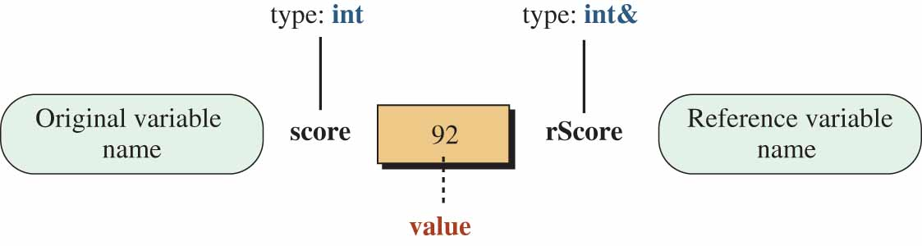
References
A reference is an alternative name for an object.
References have been added to C++ to simplify communication between entities such as functions.
A variable declared as type& is an alternative name for a variable declared as type.
we need to bind a reference variable to the original variable immediately
int score = 92; // Declaring and initializing score
int& rScore = score; // Declaring rScore and binding it to score
After the reference relationship is established, it cannot be changed.

Slide 4
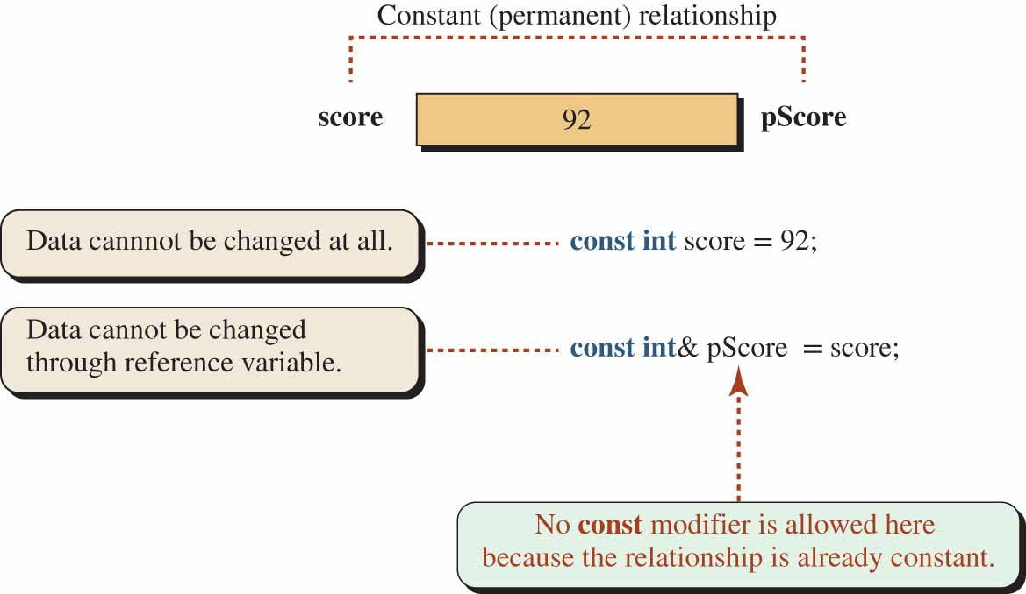
Preventing change in a reference relation
There is only one value in a reference relationship, but the value can be changed either through the original variable or any of the reference variables unless we use const modifiers.

Slide 5
Case | Data Variable | Reference variable | Status
1 | int name = value; | int& rName = name; | OK
2 | const int name = value; | int& rName = name; | Error
3 | int name = value; | const int& rName = name; | OK
4 | const int name = value; | const int& rName = name; | OK
1-There is no restriction to changing the value either through the original variable or through the reference variable.
2-Creates a compilation error because we try to bind a non-constant reference variable to a constant variable. Since the original variable is already constant, there is no way that we can change its value through the reference variable.
3-The data can be changed through the data variable, but we want to restrict it from being changed through the reference variable.
4-we want to create an original variable and a reference variable in a way that neither the original variable nor the reference variable can change the common value. This case has little application because the data variable and the reference variables can only be used to retrieve data, not to change them.

Slide 6
#include <iostream>
using namespace std;
int x_a=44;
int x_r=55;
int* returnByAddress()
{
return &x_a;
}
int& returnByReference()
{
return x_r;
}
int main() {
returnByReference() = 73; //possible
int x = 75;
// returnByAddress() = &x; //not a lvalue error
*returnByAddress() = 63; //possible
cout << "final value of x_a "<< x_a<<endl;
cout << "final value of x_r "<< x_r<<endl;
}
Returning a reference or the address of a local variable is returning garbage.

Slide 7
Returning a pointer or a reference =➔ return a reference to a pointer.
#include <iostream>
using namespace std;
double *& printa()
{ double a = 3.14;
static double *v = &a;
return v;}
double * wprinta()
{ double a = 3.14;
double *v = &a;
return v;}
double &printb()
{ double b = 11.77;
return b; //warning
}
double wprintb()
{ double b = 11.77;
return b;
}
int main() {
double Number = *printa();
cout << "Number: " << Number << endl;
Number = *w
printa();
cout << "Number: " << Number << endl;
Number = printb();
cout << "Number: " << Number << endl;
Number = wprintb();
cout << "Number: " << Number << endl;
}

Slide 8
#include <iostream>
using namespace std;
template <typename T>
class Array {private:
T *ptr;
int size;
public:
Array(T arr[], int s);
void print();};
template <typename T>
Array<T>::Array(T arr[], int s) {
ptr = new T[s];
size = s;
for(int i = 0; i < size; i++)
ptr[i] = arr[i];}
template <typename T>
void Array<T>::print() {
for (int i = 0; i < size; i++)
cout<<" "<<*(ptr + i);
cout<<endl;}
int main() {
int arr[5] = {1, 2, 3, 4, 5};
Array<int> a(arr, 5);
a.print();}
Array Class

Slide 9
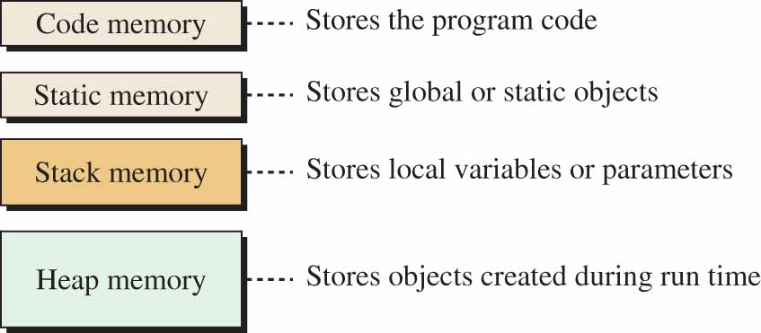
MEMORY MANAGEMENT

Slide 10
Heap Memory
Using heap memory to store a variable-size array
1
2
3
4
5
6
7
8
9
10
11
12
13
14
15
16
17
18
19
20
/***************************************************************
* The program shows how to create and access a variable-size *
* array in the heap and use pointers to access elements. *
***************************************************************/
#include <iostream>
using namespace std;
int main ( )
{
// Declaration of array size and the pointer in the stack
int size;
int* pArray;
// Validation of the size to be greater than zero
do
{
cout << "Enter the array size (larger than zero): ";
cin >> size;
} while (size <= 0);
// Creation of array in the heap
pArray = new int [size];

Slide 11
Heap Memory
Using heap memory to store a variable-size array
21
22
23
24
25
26
27
28
29
30
31
32
33
34
35
36
// Inputting the values of array
for (int i = 0; i < size ; i++)
{
cout << "Enter the value for element " << i << ": ";
cin >> *(pArray + i);
}
// Outputting the values of the array
cout << "The elements in the array are: " << endl;
for (int i = 0; i < size ; i++)
{
cout << *(pArray + i) << " ";
}
// Deleting the array in the heap
delete [ ] pArray;
return 0;
}

Slide 12
Heap Memory
Using heap memory to store a variable-size array
Run:
Enter the array size (larger than zero): 3
Enter the value for element 0: 6
Enter the value for element 1: 12
Enter the value for element 2: 5
The elements in the array are:
6 12 5

Slide 13
Two-Dimensional Array
A two-dimensional array is made of rows and columns.
We have three choices to create a two-dimensional array.
Using Only Stack Memory.
If both the row size and the column size are known before compilation, we can create the array totally in the stack as we have done before.

Slide 14
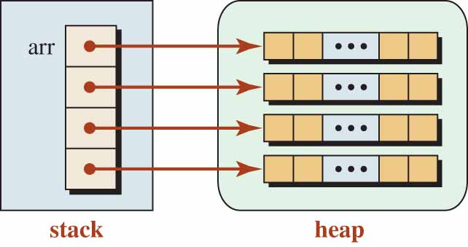
Two-Dimensional Array
Using Both Stack and Heap Memory.
If the row dimension is know before the compilation, we can create an array of pointers in the stack and then create each row in the heap.
An array in stack and another in the heap

Slide 15
Two-Dimensional Array
The following shows the code to create such an array.
int* arr [4]; // An array of four pointers to integers in stack
cin >> colNums;
for (int i = 0; i < 4 ; i++)
{
arr[i] = new int [colNums]; // an array of colNums in the heap
}
Using Only Heap Memory.
If neither of the dimensions are know before the compilation, we need to create the whole two-dimensional array in the heap as shown in Figure 9.28.

Slide 16
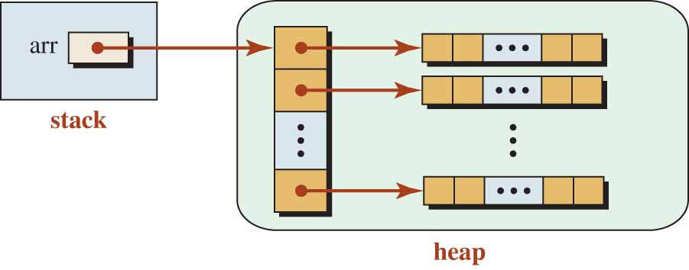
Two-Dimensional Array
A two-dimensional array totally in the heap
The following shows the code to create such an array.
cin >> rowNums;
cin >> colNums;
int** arr = new int* [rowNums];
for (int i = 0; i < n + 1 ; i++)
{
arr[i] = new int [colNums];
}

Slide 17
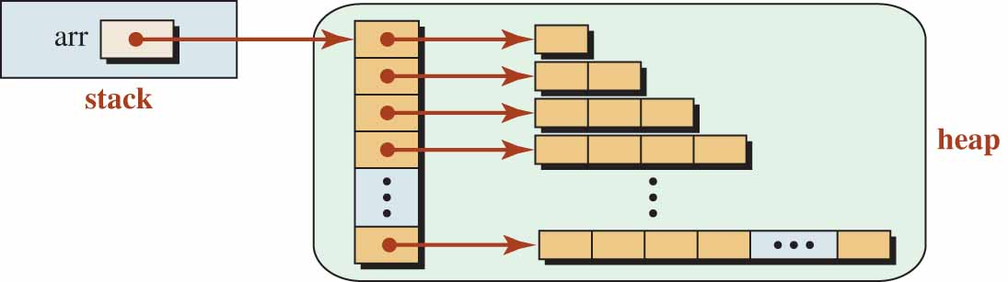
Two-Dimensional Array
Ragged Array.
We can create a two-dimensional array in which the number of elements in one row is different from the number of elements in another.
Ragged array

Slide 18
Two-Dimensional Array
Pascal's triangle determines the coefficients of a binomial expansion. When a binomial like (x + y) is raised to a positive integer power we have:
(x + y)^{n} = a₀ x^{n} + a₁ x^{n−1}y + a₂ x^{n−2}y² + ... + a_{n−1} x y^{n−1} + a_{n}y^{n}
The coefficient of each term (a₀, a₁, a₂, ... a_{n−1}, a_{n}) can be calculated using a triangle of n + 1 rows and n + 1 columns.
n = 0 | 1
n = 1 | 1 | 1
n = 2 | 1 | 2 | 1
n = 3 | 1 | 3 | 3 | 1
n = 4 | 1 | 4 | 6 | 4 | 1

Slide 19
Two-Dimensional Array
Finding the Pascal coefficients
1
2
3
4
5
6
7
8
9
10
11
12
13
14
15
16
17
18
19
20
/***************************************************************
* The program shows how to create Pascal coefficients using *
* a ragged array dynamically allocated on the heap. *
***************************************************************/
#include <iostream>
#include <iomanip>
using namespace std;
int main ( )
{
// Declaration
int maxPower = 10;
int n;
// Input validation
do
{
cout << "Enter the power of binomial : ";
cin >> n;
} while(n < 0 || n > maxPower);
// Allocate memory from heap

Slide 20
Two-Dimensional Array
Finding the Pascal coefficients
21
22
23
24
25
26
27
28
29
30
31
32
33
34
35
36
37
38
39
40
int** pascal = new int* [n + 1];
for (int i = 0; i < n + 1 ; i++)
{
pascal[i] = new int [i];
}
// Formation of the coefficient
for (int i = 0; i <= n ; i++)
{
for (int j = 0; j < i + 1; j++)
{
if (j == 0 || i == j)
{
pascal [i][j] = 1;
}
else
{
pascal [i][j] = pascal [i − 1] [j − 1] + pascal [i − 1][j];
}
}
}

Slide 21
Two-Dimensional Array
Finding the Pascal coefficients
41
42
43
44
45
46
47
48
49
50
51
52
53
54
55
56
// Print coefficients
cout << endl;
cout << "Coefficients for (x + y)^" << n << " are:";
for (int j = 0; j <= n ; j++)
{
cout << setw (5) << pascal [n][j] ;
}
cout << endl;
// Delete allocated memory
for (int i = 0; i < n + 1 ; i++)
{
delete [ ] pascal [i];
}
delete [ ] pascal;
return 0;
}
Run:
Enter the power of binomial : 5
Coefficients for (x + y)^5 are: 1 5 10 10 5 1

Slide 22
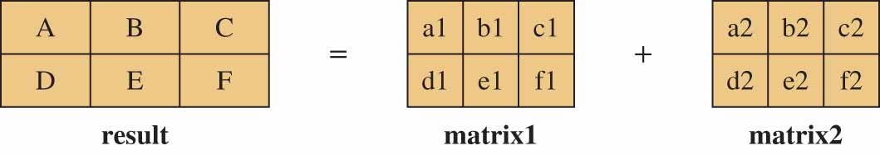
A Matrix Class
A matrix is a table of values in mathematics. In computer programming, we can simulate a matrix with a two-dimensional array.
Operation We define three operations on matrices: addition, subtraction, and multiplication. Division of matrixes is very complex and requires the inversion of matrices.
Addition We can add two matrices if the number of rows are the same and the number of columns are the same.
Adding two matrices

Slide 23
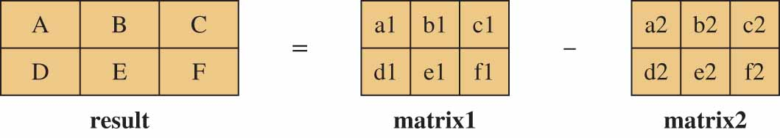
A Matrix Class
A = a1 + a2
...
F = f1 + f2
Subtraction Subtraction is the same as addition but the values of the corresponding cells are subtracted.
Subtracting two matrices
A = a1 - a2
...
F = f1 - f2

Slide 24
A Matrix Class
Multiplication
We can multiply two matrices if the number columns in the first matrix is the same as the number of rows in the second matrix (c1 == r2).
The result is a matrix with the number of rows equal r1 and the number of columns equal c2.

Slide 25
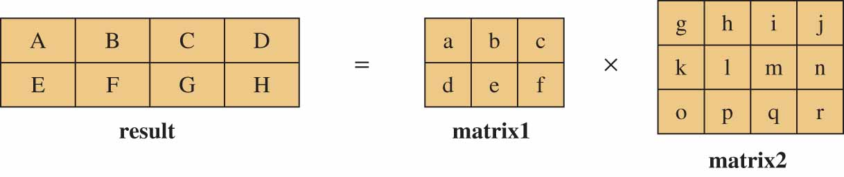
A Matrix Class
Multiplying two matrices
A = a * g + b * k + c * o
B = a * h + b * l + c * p
...
H = d * j + e * n + f * r
Code
Now we define the interface, implementation, and application files.

Slide 26
A Matrix Class
The interface file for the Matrix class
1
2
3
4
5
6
7
8
9
10
11
12
13
14
15
16
17
18
19
20
/*******************************************************************
* The interface file for the Matrix class. The only private data *
* members are the sizes of the matrix and the pointer that *
* points to the matrix in the heap. *
* The constructor creates a matrix in the heap and the destructor *
* deletes the allocated memory in the heap. *
* The setup member function fills the matrices randomly *
* We have addition, subtraction, multiplication, and print *
* member functions. *
*******************************************************************/
#include <iostream>
#ifndef MATRIX_H
#define MATRIX_H
#include <cmath>
#include <cstdlib>
#include <iomanip>
#include <cassert>
using namespace std;
// Matrix class definition

Slide 27
A Matrix Class
The interface file for the Matrix class
21
22
23
24
25
26
27
28
29
30
31
32
33
34
35
36
class Matrix
{
private:
int rowSize;
int colSize;
int** ptr;
public:
Matrix (int rowSize, int colSize);
~Matrix ();
void setup ();
void add (const Matrix& second, Matrix& result) const;
void subtract (const Matrix& second, Matrix& result) const;
void multiply (const Matrix& second, Matrix& result) const;
void print () const;
};
#endif

Slide 28
A Matrix Class
implementation file for the Matrix class
1
2
3
4
5
6
7
8
9
10
11
12
13
14
15
16
17
18
19
20
/***************************************************************
* We have implemented all member functions declared in the *
* interface file. *
* The implementation follows the description of operations *
* discussed before. *
***************************************************************/
#include "matrix.h"
// Constructor: creates a matrix in the heap
Matrix :: Matrix (int r, int c)
: rowSize (r), colSize (c)
{
ptr = new int* [rowSize];
for (int i = 0; i < rowSize; i++)
{
ptr [i] = new int [colSize];
}
}
// Destructor: deletes memory locations in the heap
Matrix :: ~Matrix ()

Slide 29
A Matrix Class
The implementation file for the Matrix class
21
22
23
24
25
26
27
28
29
30
31
32
33
34
35
36
37
38
39
40
{
for (int i = 0; i < rowSize ; i++)
{
delete [] ptr [i];
}
delete [] ptr;
}
// The setup fills the cells with random values between 1 and 5
void Matrix :: setup ()
{
for (int i = 0; i < rowSize; i++)
{
for (int j = 0; j < colSize ; j++)
{
ptr [i][j] = rand () % 5 + 1;
}
}
}
// The add function adds second to the host and creates result
void Matrix :: add (const Matrix& second, Matrix& result) const

Slide 30
A Matrix Class
The implementation file for the Matrix class
41
42
43
44
45
46
47
48
49
50
51
52
53
54
55
56
57
58
59
60
{
assert (second.rowSize == rowSize && second.colSize == colSize);
assert (result.rowSize == rowSize && result.colSize == colSize);
for (int i = 0; i < rowSize ; i++)
{
for (int j = 0; j < second.colSize; j++)
{
result.ptr[i][j] = ptr[i][j] + second.ptr[i][j];
}
}
}
// The subtract function subtracts second from host
void Matrix :: subtract (const Matrix& second, Matrix& result) const
{
assert (second.rowSize == rowSize && second.colSize == colSize);
assert (result.rowSize == rowSize && result.colSize == colSize);
for (int i = 0; i < rowSize ; i++)
{
for (int j = 0; j < second.colSize; j++)

Slide 31
Future Value of a Fixed Investment
The implementation file for the Matrix class
61
62
63
64
65
66
67
68
69
70
71
72
73
74
75
76
77
78
79
80
{
result.ptr[i][j] = ptr[i][j] − second.ptr[i][j];
}
}
}
// The multiply function multiplies second by host
void Matrix :: multiply (const Matrix& second, Matrix& result) const
{
assert (colSize == second.rowSize);
assert (result.rowSize = rowSize);
assert (result.colSize = second.colSize);
for (int i = 0; i < rowSize ; i++)
{
for (int j = 0; j < second.colSize; j++)
{
result.ptr[i][j] = 0;
for (int k = 0 ; k < colSize; k++)
{
result.ptr[i][j] += ptr[i][k] * second.ptr[k][j];
}

Slide 32
A Matrix Class
The implementation file for the Matrix class
81
82
83
84
85
86
87
88
89
90
91
92
93
94
95
96
}
}
}
// The print function prints the values of cells
void Matrix :: print () const
{
for (int i = 0 ; i < rowSize; i++)
{
for (int j = 0; j < colSize ; j++)
{
cout << setw (5) << ptr [i][j];
}
cout << endl;
}
cout << endl;
}

Slide 33
A Matrix Class
Application to test the Matrix class
1
2
3
4
5
6
7
8
9
10
11
12
13
14
15
16
17
18
19
20
/***************************************************************
* We create several matrix objects in the heap and we apply *
* some operations on them. *
***************************************************************/
#include "matrix.h"
int main ()
{
// Instantiation and setup of matrix1
cout << "matrix1" << endl;
Matrix matrix1 (3, 4);
matrix1.setup ();
matrix1.print();
// Instantiation and setup of matrix2
cout << "matrix2" << endl;
Matrix matrix2 (3, 4);
matrix2.setup ();
matrix2.print ();
// Instantiation and setup of matrix3
cout << "A new matrix3" << endl;

Slide 34
A Matrix Class
Application to test the Matrix class
21
22
23
24
25
26
27
28
29
30
31
32
33
34
35
36
37
38
39
40
Matrix matrix3 (4, 2);
matrix3.setup ();
matrix3.print ();
// Adding matrix2 to matrix1 and printing the resulting matrix
cout << "Result of matrix1 + matrix2" << endl;
Matrix addResult (3, 4);
matrix1.add (matrix2, addResult);
addResult.print ();
// Subtracting matrix2 from matrix1 and printing the resulting matrix
cout << " Result of matrix1 - matrix2" << endl;
Matrix subResult (3, 4);
matrix1.subtract (matrix2, subResult);
subResult.print ();
// Multiplying matrix1 and matrix3 and printing the resulting matrix
cout << "Result of matrix1 * matrix3"<< endl;
Matrix mulResult (3, 2);
matrix1.multiply (matrix3, mulResult);
mulResult.print();
return 0;
}

Slide 35
A Matrix Class
Application to test the Matrix class
Run:
matrix1
3 2 3 1
4 4 5 1
4 1 1 5
matrix2
4 3 1 3
3 5 1 5
4 5 1 4
matrix3
4 1
5 5
3 4
2 1

Slide 36
A Matrix Class
Application to test the Matrix class
Result of matrix1 + matrix2
7 5 4 4
7 9 6 6
8 6 2 9
Result of matrix1 − matrix2
−1 −1 2 −2
1 −1 4 −4
0 −4 0 1
Result of matrix1 * matrix3
33 26
53 45
34 18

Slide 37
Array-Based Lists
List
Collection of elements of same type
Length of a list
Number of elements in the list
Many operations may be performed on a list
Store a list in the computer’s memory
Using an array

Slide 38
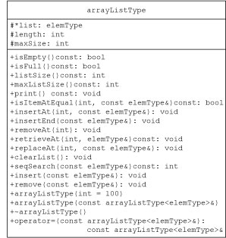
Array-Based Lists
Define class implementing list as an abstract data type (ADT)
UML class diagram of the class arrayListType

Slide 39
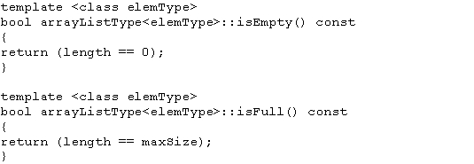
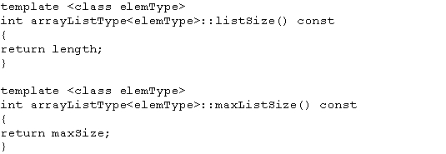
Array-Based Lists
Definitions of functions isEmpty, isFull, listSize and maxListSize

Slide 40
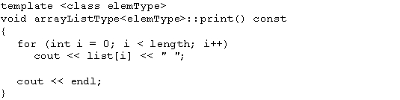
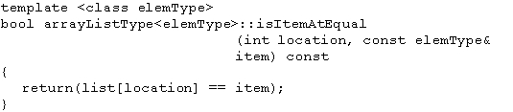
Array-Based Lists
Template print (outputs the elements of the list) and template isItemAtEqual

Slide 41
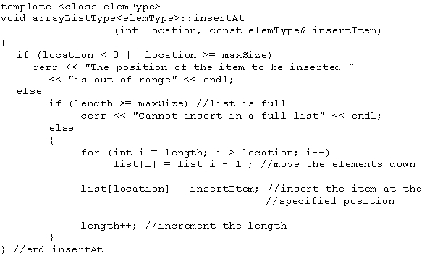
Array-Based Lists (cont’d.)
Template insertAt

Slide 42
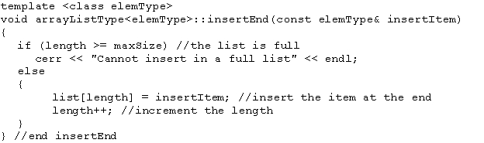
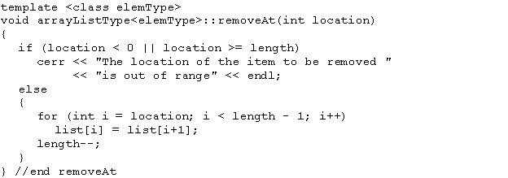
Array-Based Lists (cont’d.)
Template insertEnd and template removeAt

Slide 43
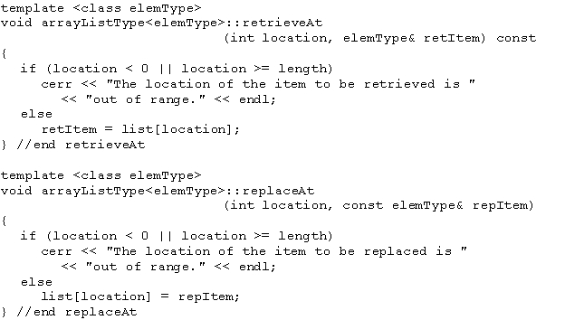

Array-Based Lists (cont’d.)
Template replaceAt and template clearList

Slide 44
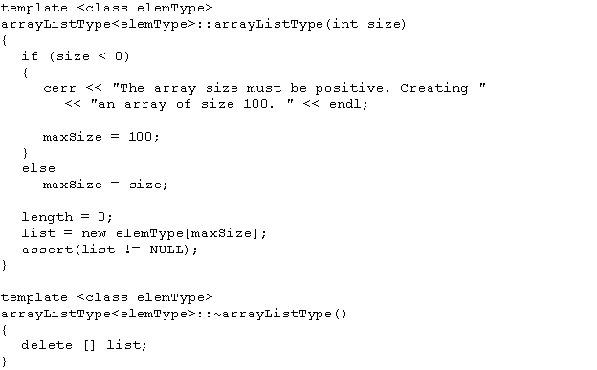
Array-Based Lists (cont’d.)
Definition of the constructor and the destructor

Slide 45
Array-Based Lists (cont’d.)
Copy constructor
Called when object passed as a (value) parameter to a function
Called when object declared and initialized using the value of another object of the same type
Copies the data members of the actual object into the corresponding data members of the formal parameter and the object being created

Slide 46
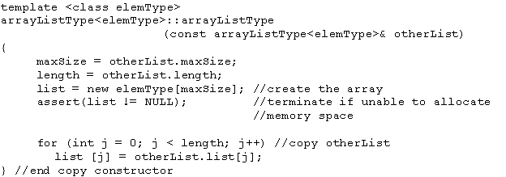
Array-Based Lists (cont’d.)
Copy constructor (cont’d.)
Definition

Slide 47
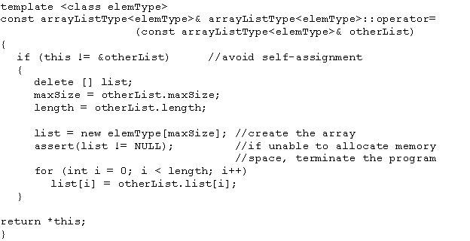
Array-Based Lists (cont’d.)
Overloading the assignment operator
Definition of the function template

Slide 48
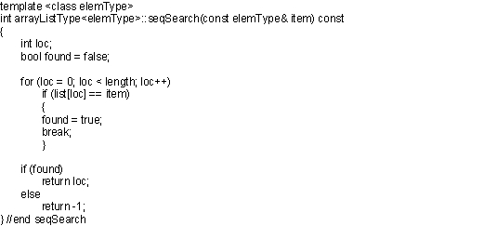
Array-Based Lists (cont’d.)
Searching for an element
Linear search example: determining if 27 is in the list
Definition of the function template
List of seven elements

Slide 49
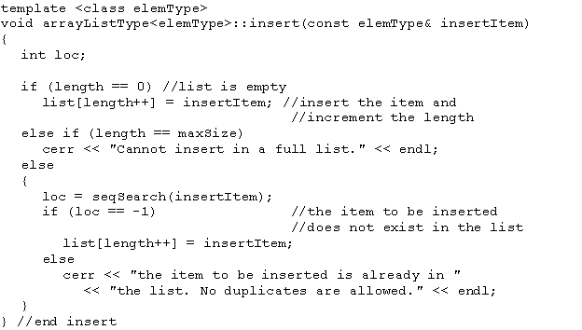
Array-Based Lists (cont’d.)
Inserting an element

Slide 50
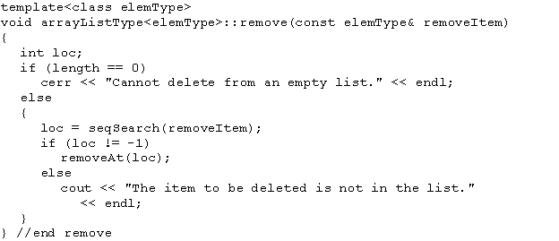
Array-Based Lists (cont’d.)
Removing an element

Slide 51
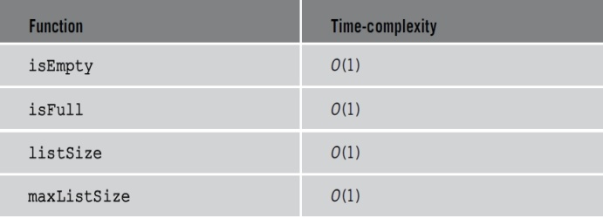
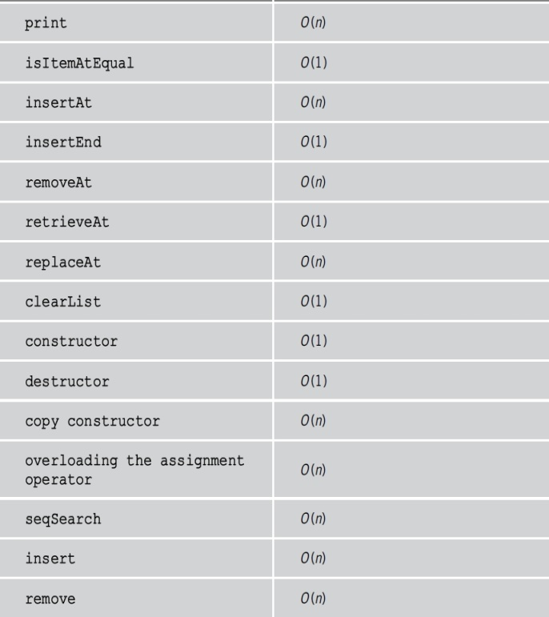
Time complexity of list operations

Slide 52
template <class elemType>
class arrayListType{
protected:
elemType *list;
int length;
int maxSize;
public:
arrayListType(int size = 100);
arrayListType(const arrayListType<elemType>& otherList);
~arrayListType();
const arrayListType<elemType>& operator=(const arrayListType<elemType>&);
bool isEmpty() const;
bool isFull() const;
int listSize() const;
int maxListSize() const;
void print() const;
bool isItemAtEqual(int location, const elemType& item) const;
void insertAt(int location, const elemType& insertItem);
void insertEnd(const elemType& insertItem);
void removeAt(int location);
void retrieveAt(int location, elemType& retItem) const;
void replaceAt(int location, const elemType& repItem);
void clearList();
int seqSearch(const elemType& item) const;
void insert(const elemType& insertItem);
void remove(const elemType& removeItem);};

Slide 53
class addressType
{
public:
void print() const;
void setAddress(string sAddress, string c, string s, string z);
void getAddress(string& sAddress, string& c,
string& s, string& z);
addressType(string sAddress = "", string c = "",
string s = "", string z = "");
private:
string streetAddress;
string city;
string state;
string zip;
};

Slide 54
class personType
{
private:
string firstName;
string lastName;
public:
personType(string first, string last);
personType();
void setName(string first, string last);
void getName(string& first, string& last);
void print() const;
};

Slide 55
class dateType
{
private:
bool isLeapYear(int y);
int dMonth;
int dDay;
int dYear;
public:
dateType(int month = 1, int day = 1, int year = 1900);
void setDate(int month, int day, int year);
void getDate(int& month, int& day, int& year);
void printDate() const;
};

Slide 56
class extPersonType: public personType //inheritance
{private:
addressType address; //composition
dateType dob; //composition
string phoneNumber;
string personStatus;
public:
extPersonType(string fName = "", string lName = "", int month = 1, int day = 1, int year = 1900,string street = "", string c = "", string s = "", string z = "", string phone = "", string pStatus = "");
void printAddress() const;
void printInfo() const;
void setInfo(string fName, string lName,int month, int day, int year,string street, string c,
string s, string z, string phone, string pStatus);
void setInfo(string fName, string lName, dateType d, addressType ad, string phone, string pStatus);
bool isLastName(string lName);
void getLastName(string& lName);
void getAddress(string& sAddress, string& c, string& s, string& z);
void getStatus(string& status);
void getPhoneNumber(string& phone);
bool isStatus(string status);
bool isDOB(int month, int day, int year);
void getDOB(int& month, int& day, int& year);
bool isMonth(int month);};

Slide 57
class addressBookType: public arrayListType<extPersonType>
{
public:
addressBookType();
void print() const;
void printNameInTheMonth(int month);
void printInfoOf(string lName);
void printNamesWithStatus(string status);
void printAt(int i);
void printNamesBetweenLastNames(string last1, string last2);
int search(string lName);
void saveData(ofstream&);
};

Slide 58
int main(){
addressBookType addressBook;
string str;
string str1;
string str2;
int choice;
int loc;
int month;
loadAddressBook(addressBook);
showMenu();
cin >> choice;
while (choice != 9)
{
switch (choice)
{
case 1:
cout << "Enter the last name of the person: ";
cin >> str;
cout << endl;
loc = addressBook.search(str);

Slide 59
if (loc != -1) cout << str << " is in the address book" << endl;
else cout << str << " is not in the address book" << endl; break;
case 2: cout << "Enter the last name of the person: ";
cin >> str;
cout << endl;
loc = addressBook.search(str);
if (loc != -1)
addressBook.printAt(loc);
else
cout << str << " is not in the address book" << endl; break;
case 3: cout << "Enter the month number: ";
cin >> month;
cout << endl;
addressBook.printNameInTheMonth(month); break;
case 4: cout << "Enter starting last name: ";
cin >> str1;
cout << endl;
cout << "Enter ending last name: ";
cin >> str2;
cout << endl;
addressBook.printNamesBetweenLastNames(str1, str2); break;
case 5: cout << "Enter person type Family, Friend, Business: ";
cin >> str;
cout << endl;
addressBook.printNamesWithStatus(str); break;
case 6: addressBook.print(); break;
case 7: saveData(addressBook); break;

Slide 60
default:
cout << "Invalid choice" << endl;
}
showMenu();
cin >> choice;
}
char response;
cout << "Save data Yes (Y/y) No(N/n)?: ";
cin >> response;
cout << endl;
if (response == 'y' || response == 'Y')
saveData(addressBook);
return 0;
}

Slide 61
cout << "Enter file name: ";
cin >> filename;
cout << endl;
infile.open(filename);
if (!infile)
{
cout << "Input file does not exists. "
<< "Program terminates!!!" << endl;
return;
}
int i = 0;
infile >> first >> last >> month >> day >> year;
infile.ignore(100,'\n');
getline(infile,street);
getline(infile,city);
getline(infile, state);
infile >> zip >> phone >> pStatus;
void loadAddressBook(addressBookType& adBook)
{ifstream infile;
char filename[50];
string first;
string last;
int month;
int day;
int year;
string street;
string city;
string state;
string zip;
string phone;
string pStatus;
extPersonType temp;

Slide 62
while (infile)
{
temp.setInfo(first,last,month,day,year,street,city,state,
zip,phone,pStatus);
adBook.insertAt(i, temp);
i++;
infile >> first >> last >> month >> day >> year;
infile.ignore(100,'\n');
getline(infile,street);
getline(infile,city);
getline(infile, state);
infile >> zip >> phone >> pStatus;
}
}
void saveData(addressBookType& adBook)
{
ofstream outfile;
char filename[50];
cout << "Enter file name: ";
cin >> filename;
cout << endl;
outfile.open(filename);
if (!outfile)
{
cout << "Input file does not exists. "
<< "Program terminates!!!" << endl;
return;
}
adBook.saveData(outfile);
}

Slide 63
void showMenu()
{
cout << "Welcome to the address book program.";
cout << "Choose among the following options:" << endl;
cout << "1: To see if a person is in the address book" << endl;
cout << "2: Print the information of a person" << endl;
cout << "3: Print the names of person having birthday in a particular month" << endl;
cout << "4: Print the names of persons between two last names" << endl;
cout << "5: Print the names of persons having a particular status" << endl;
cout << "6: Print the address book" << endl;
cout << "7: Save data" << endl;
cout << "9: Terminate the program" << endl;
}

Slide 64
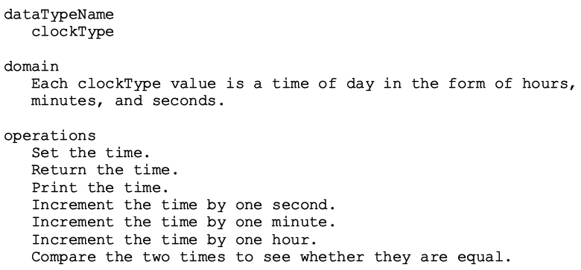
Data Abstraction, Classes, and Abstract Data Types
ADT
Example: defining the clockType ADT

Slide 65
Write the definition of the class dayType that implements the day of the week in a program. The class dayType should store the day, such as Sunday for Sunday. The program should be able to perform the following operations on an object of type dayType:
Set the day.
Print the day.
R eturn the day.
R eturn the next day.
R eturn the previous day.
Calculate and return the day by adding certain days to the current day.
For example, if the current day is Monday and we add 4 days, the day to be returned is Friday. Similarly, if today is Tuesday and we add 13 days, the day to be returned is Monday.
Add the appropriate constructors.

Slide 66
dayType.h
class dayType
{
private:
string weekDay;
public:
static string weekDays[7];
dayType();
dayType(string d);
void setDay(string d);
string getDay() const;
void print() const;
string nextDay() const;
string prevDay() const;
void addDay(int nDays);
};

Slide 67
int main()
{
dayType myDay("Monday");
dayType temp("Sunday");
myDay.print();
cout << endl;
cout << myDay.prevDay() << endl;
cout << myDay.nextDay() << endl;
temp.print();
cout << endl;
cout << temp.prevDay() << endl;
cout << temp.nextDay() << endl;
return 0;
}

Slide 68
Write all the functions !

Slide 69
The equation of a line in standard form is ax + by= c, where a and b both cannot be zero, and a, b, and c are real numbers. If b !=0, then –a / b is the slope of the line. If a 0, then it is a horizontal line, and if b 0, then it is a vertical line. The slope of a vertical line is undefined. Two lines are parallel if they have the same slope or both are vertical lines. Two lines are perpendicular if either one of the lines is horizontal and another is vertical, or if the product of their slopes is –1. Design the class lineType to store a line.

Slide 70
To store a line, you need to store the values of a (coefficient of x), b (coefficient of y), and c. Your class must contain the following operations:
If a line is nonvertical, then determine its slope.
Determine if two lines are perpendicular.
Determine if two lines are parallel.
If two lines are not parallel, then find the point of intersection.
. Determine if two lines are equal.
Add appropriate constructors to initialize variables of lineType. Also write a program to test your class

Slide 71
class lineType
{
private:
double xCoeff;
double yCoeff;
double constTerm;
bool hasSlope;
public:
lineType(double a = 0, double b = 0, double c = 0);
void setLine(double a = 0, double b = 0, double c = 0);
void equation() const;
double getXCoefficient() const;
double getYCoefficient() const;
double getCOnstantTerm() const;
void setXCoefficient(double coeff);
void setYCoefficient(double coeff);
void setConstantTerm(double c);
double slope() const; //Return the slope. This function does not check if the line is vertical. Because the slope of a
//vertical line is undefined, before calling this function check if the line is nonvertical.
bool verticalLine() const;
bool horizontalLine() const;
bool equalLines(lineType otherLine) const; //Returns true of both lines are the same.
bool parallel(lineType otherLine) const; //Function to determine if this line is parallel to otherLine.
bool perpendicular(lineType otherLine) const; //Function to determine if this line is perperdicular to otherLine.
void pointOfIntersection(lineType otherLine); //If lines intersect, then this function finds the point of intersection.
};

Slide 72
Write all the functions !

Slide 73
template <class elemType>
class arrayListType{
protected:
elemType *list;
int length;
int maxSize;
public:
arrayListType(int size = 100);
arrayListType(const arrayListType<elemType>& otherList);
~arrayListType();
const arrayListType<elemType>& operator=(const arrayListType<elemType>&);
bool isEmpty() const;
bool isFull() const;
int listSize() const;
int maxListSize() const;
void print() const;
bool isItemAtEqual(int location, const elemType& item) const;
void insertAt(int location, const elemType& insertItem);
void insertEnd(const elemType& insertItem);
void removeAt(int location);
void retrieveAt(int location, elemType& retItem) const;
void replaceAt(int location, const elemType& repItem);
void clearList();
int seqSearch(const elemType& item) const;
void insert(const elemType& insertItem);
void remove(const elemType& removeItem);};

Slide 74
class addressType
{
public:
void print() const;
void setAddress(string sAddress, string c, string s, string z);
void getAddress(string& sAddress, string& c,
string& s, string& z);
addressType(string sAddress = "", string c = "",
string s = "", string z = "");
private:
string streetAddress;
string city;
string state;
string zip;
};

Slide 75
class personType
{
private:
string firstName;
string lastName;
public:
personType(string first, string last);
personType();
void setName(string first, string last);
void getName(string& first, string& last);
void print() const;
};

Slide 76
class dateType
{
private:
bool isLeapYear(int y);
int dMonth;
int dDay;
int dYear;
public:
dateType(int month = 1, int day = 1, int year = 1900);
void setDate(int month, int day, int year);
void getDate(int& month, int& day, int& year);
void printDate() const;
};

Slide 77
class extPersonType: public personType //inheritance
{private:
addressType address; //composition
dateType dob; //composition
string phoneNumber;
string personStatus;
public:
extPersonType(string fName = "", string lName = "", int month = 1, int day = 1, int year = 1900,string street = "", string c = "", string s = "", string z = "", string phone = "", string pStatus = "");
void printAddress() const;
void printInfo() const;
void setInfo(string fName, string lName,int month, int day, int year,string street, string c,
string s, string z, string phone, string pStatus);
void setInfo(string fName, string lName, dateType d, addressType ad, string phone, string pStatus);
bool isLastName(string lName);
void getLastName(string& lName);
void getAddress(string& sAddress, string& c, string& s, string& z);
void getStatus(string& status);
void getPhoneNumber(string& phone);
bool isStatus(string status);
bool isDOB(int month, int day, int year);
void getDOB(int& month, int& day, int& year);
bool isMonth(int month);};

Slide 78
class addressBookType: public arrayListType<extPersonType>
{
public:
addressBookType();
void print() const;
void printNameInTheMonth(int month);
void printInfoOf(string lName);
void printNamesWithStatus(string status);
void printAt(int i);
void printNamesBetweenLastNames(string last1, string last2);
int search(string lName);
void saveData(ofstream&);
};

Slide 79
int main(){
addressBookType addressBook;
string str;
string str1;
string str2;
int choice;
int loc;
int month;
loadAddressBook(addressBook);
showMenu();
cin >> choice;
while (choice != 9)
{
switch (choice)
{
case 1:
cout << "Enter the last name of the person: ";
cin >> str;
cout << endl;
loc = addressBook.search(str);

Slide 80
if (loc != -1) cout << str << " is in the address book" << endl;
else cout << str << " is not in the address book" << endl; break;
case 2: cout << "Enter the last name of the person: ";
cin >> str;
cout << endl;
loc = addressBook.search(str);
if (loc != -1)
addressBook.printAt(loc);
else
cout << str << " is not in the address book" << endl; break;
case 3: cout << "Enter the month number: ";
cin >> month;
cout << endl;
addressBook.printNameInTheMonth(month); break;
case 4: cout << "Enter starting last name: ";
cin >> str1;
cout << endl;
cout << "Enter ending last name: ";
cin >> str2;
cout << endl;
addressBook.printNamesBetweenLastNames(str1, str2); break;
case 5: cout << "Enter person type Family, Friend, Business: ";
cin >> str;
cout << endl;
addressBook.printNamesWithStatus(str); break;
case 6: addressBook.print(); break;
case 7: saveData(addressBook); break;

Slide 81
default:
cout << "Invalid choice" << endl;
}
showMenu();
cin >> choice;
}
char response;
cout << "Save data Yes (Y/y) No(N/n)?: ";
cin >> response;
cout << endl;
if (response == 'y' || response == 'Y')
saveData(addressBook);
return 0;
}

Slide 82
void loadAddressBook(addressBookType& adBook)
{ifstream infile;
char filename[50];
string first;
string last;
int month;
int day;
int year;
string street;
string city;
string state;
string zip;
string phone;
string pStatus;
extPersonType temp;
cout << "Enter file name: ";
cin >> filename;
cout << endl;
infile.open(filename);
if (!infile)
{
cout << "Input file does not exists. "
<< "Program terminates!!!" << endl;
return;
}
int i = 0;
infile >> first >> last >> month >> day >> year;
infile.ignore(100,'\n');
getline(infile,street);
getline(infile,city);
getline(infile, state);
infile >> zip >> phone >> pStatus;

Slide 83
while (infile)
{
temp.setInfo(first,last,month,day,year,street,city,state,
zip,phone,pStatus);
adBook.insertAt(i, temp);
i++;
infile >> first >> last >> month >> day >> year;
infile.ignore(100,'\n');
getline(infile,street);
getline(infile,city);
getline(infile, state);
infile >> zip >> phone >> pStatus;
}
}
void saveData(addressBookType& adBook)
{
ofstream outfile;
char filename[50];
cout << "Enter file name: ";
cin >> filename;
cout << endl;
outfile.open(filename);
if (!outfile)
{
cout << "Input file does not exists. "
<< "Program terminates!!!" << endl;
return;
}
adBook.saveData(outfile);
}

Slide 84
void showMenu()
{
cout << "Welcome to the address book program.";
cout << "Choose among the following options:" << endl;
cout << "1: To see if a person is in the address book" << endl;
cout << "2: Print the information of a person" << endl;
cout << "3: Print the names of person having birthday in a particular month" << endl;
cout << "4: Print the names of persons between two last names" << endl;
cout << "5: Print the names of persons having a particular status" << endl;
cout << "6: Print the address book" << endl;
cout << "7: Save data" << endl;
cout << "9: Terminate the program" << endl;
}

