Slide 1
N. Rizk
COSC 2430 : Data Structures
College of Natural and Applied Sciences
Department of Computer Science
University of Houston

Slide 2



LISTS

Slide 3
Node contains at least one pointer
Collection of components (nodes)
Every node (except last)
Contains address of the next node
Node components
Data: stores relevant information
Link: stores address (or call it next)
Structure of a node

Slide 4

Linked Lists (cont’d.)
Head (first)
Address of the first node in the list
Arrow points to node address
Stored in node
Down arrow in last node indicates NULL link field
Linked list
Linked list and values of the links

Slide 5
Linked Lists (cont’d.)
Two node components
Declared as a class or struct
Data type depends on specific application
Link component: pointer
Data type of pointer variable: node type itself

Slide 6
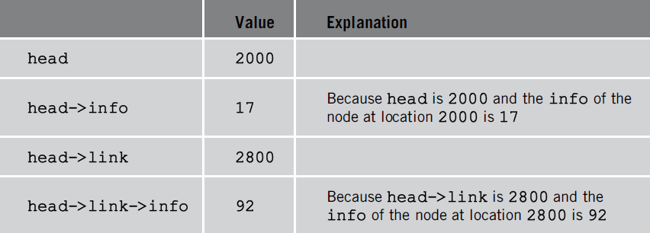
Linked Lists: Some Properties
Head stores address of first node
Info stores information
Link stores address of next node
Assume info type int
Values of head and some of
the nodes of the linked list in Figure 5-4
Linked list with four nodes

Slide 7
Linked Lists: Some Properties (cont’d.)
Pointer current: same type as pointer head
current = head;
Copies value of head into current
current = current->link;
Copies value of current->link (2800) into current
List after the statement
current = current->link; executes

Slide 9
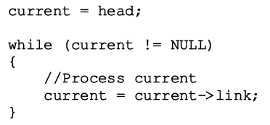
Traversing a Linked List
Basic linked list operations
Search list to determine if particular item is in the list
Insert item in list
Delete item from list
These operations require list traversal
Given pointer to list first node, we must step through list nodes

Slide 10

Item Insertion
1-New ➔create an empty location
➔put the address of the empty into pointer
2- Fill the data
3- Update the link(next) of the new node
4- Verify the pointer address of the new node

Slide 11
Deletion
Memory still occupied by node after deletion
Memory is inaccessible
Deallocate memory using a pointer to this node
1- Create temp node = address of the node to be deleted (or previous node)
2- Retrieve the data
3-Update the link(next) of the temp node
4- Verify the pointer address

Slide 12
Building a Linked List
If linked list data unsorted➔Ways to build linked list
Forward
New node always inserted at end of the linked list
Write a function buildListForward
Backward
New node always inserted at the beginning of the list
Write a function buildListBackward

Slide 13
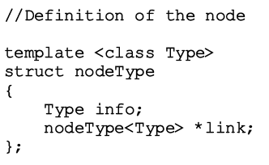
Two types of linked lists: sorted, unsorted
class linkedListType➔Implements basic linked list operations as an ADT
Derive two classes using inheritance
unorderedLinkedList and orderedLinkedList
Unordered linked list functions
buildListForward and buildListBackward
Two more functions accommodate both operations
insertFirst and insertLast

Slide 14
Extend the class linkedListType by adding the following operations
1- Write a function that returns the info of the kth element of the linked list. If no such element exists, terminate the program.
2- Write a function that deletes the kth element of the linked list. If no such element exists, output an appropriate message 5
template <class Type>
struct nodeType
{
Type info;
nodeType<Type> *link;
};
template <class Type>
class linkedListType
{
private:
void copyList(const linkedListType<Type>& otherList);
protected:
int count;
nodeType<Type> *first;
nodeType<Type> *last;
public:
linkedListType();
linkedListType(const linkedListType<Type>& otherList);
~linkedListType();
.

Slide 15
const linkedListType<Type>& operator=
(const linkedListType<Type>&);
void initializeList();
bool isEmptyList() const;
void print() const;
int length() const;
void destroyList();
Type front() const;
Type back() const;
virtual bool search(const Type& searchItem) const = 0;
virtual void insertFirst(const Type& newItem) = 0;
virtual void insertLast(const Type& newItem) = 0;
virtual void deleteNode(const Type& deleteItem) = 0;
linkedListIterator<Type> begin();
linkedListIterator<Type> end();
//To be added to the ADT
Type getKThElement(int k);
void deteteKthElement(int k);
};

Slide 16
template <class Type>
class unorderedLinkedList: public linkedListType<Type>
{
public:
bool search(const Type& searchItem) const;
void insertFirst(const Type& newItem);
void insertLast(const Type& newItem);
void deleteNode(const Type& deleteItem);
};

Slide 17
int main(){
unorderedLinkedList<int> list; int num;
cout << "Enter numbers ending with -999" << endl; cin >> num;
while (num != -999) {
list.insertLast(num);
cin >> num; }
cout << “\nList: ";
list.print();
cout << “\nLength of the list: " << list.length() << endl;
int k;
cout << "Enter the position of the item to be retrieved: " << endl;
cin >> k;
cout << endl;
int temp = list.getKThElement(k);
cout << "Item at position " << k << " = " << temp << endl;
cout << "Enter the position of the item to be removed: " << endl;
cin >> k;
cout << endl;
list.deteteKthElement(k);
cout << "List after removing the element at position " << k << "." << endl;
list.print();
cout << endl;
return 0;}

Slide 18
1- Implement all the functions of class linkedListType
2-Implement all the functions of class unorderedlinkedListType 3- Implement the additional 2 functions Type getKThElement(int k);
void deteteKthElement(int k);

Slide 19
Linked List as ADT (Abstract Data Type)
Default constructor
Initializes list to an empty state
Destroy the list
Deallocates memory occupied by each node
Initialize the list
Reinitializes list to an empty state
Must delete the nodes (if any) from the list
Default constructor, copy constructor
Initialized list when list object declared

Slide 20
Linked List as an ADT (cont’d.)
Print the list
Must traverse the list starting at first node
Length of a list
Number of nodes stored in the variable count
Function length
Returns value of variable count
Retrieve the data of the first node
Function front
Returns the info contained in the first node
If list is empty, assert statement terminates program

Slide 21
Linked List as an ADT (cont’d.)
Retrieve the data of the last node
Function back
Returns info contained in the last node
If list is empty, assert statement terminates program
Begin and end
Function begin returns an iterator to the first node in the linked list
Function end returns an iterator to the last node in the linked list

Slide 22
Linked List as an ADT (cont’d.)
Copy the list
Makes an identical copy of a linked list
Create node called newNode
Copy node info (original list) into newNode
Insert newNode at the end of list being created

Slide 23
Linked List as an ADT (cont’d.)
Destructor
When class object goes out of scope
Deallocates memory occupied by list nodes
Memory allocated dynamically
Resetting pointers first and last
Does not deallocate memory
Must traverse list starting at first node
Delete each node in the list
Calling destroyList destroys list

Slide 24
Linked List as an ADT (cont’d.)
Copy constructor
Makes identical copy of the linked list
Function copyListc checks whether original list empty
Checks value of first
Must initialize first to NULL
Before calling the function copyList
Overloading the assignment operator
Similar to copy constructor definition

Slide 25
Time-complexity of the operations of the
class linkedListType

Slide 26
Unordered Linked Lists
Derive class unorderedLinkedList from the abstract class linkedListType
Implement the operations search, insertFirst, insertLast, deleteNode
Defines an unordered linked list as an ADT
class unorderedLinkedList

Slide 27
Unordered Linked Lists (cont’d.)
Search the list
Steps
Step one: Compare the search item with the current node in the list. If the info of the current node is the same as the search item, stop the search; otherwise, make the next node the current node
Step two: Repeat Step one until either the item is found or no more data is left in the list to compare with the search item

Slide 28
Unordered Linked Lists (cont’d.)
Insert the first node
Steps
Create a new node
If unable to create the node, terminate the program
Store the new item in the new node
Insert the node before first
Increment count by one

Slide 29
Unordered Linked Lists (cont’d.)
Insert the last node
Similar to definition of member function insertFirst
Insert new node after last

Slide 30
Unordered Linked Lists (cont’d.)
Delete a node
Consider the following cases:
The list is empty
The node is nonempty and the node to be deleted is the first node
The node is nonempty and the node to be deleted is not the first node, it is somewhere in the list
The node to be deleted is not in the list

Slide 31
Unordered Linked Lists (cont’d.)
Time-complexity of the operations of the
class unorderedLinkedList
Create header file defining class unorderedListType
See class unorderedListType
Specifies members to implement basic properties of an unordered linked list
Derived from class linkedListType

Slide 32
Ordered Linked Lists
Derive class orderedLinkedList from class linkedListType
Provide definitions of the abstract functions:
insertFirst, insertLast, search, deleteNode
Ordered linked list elements are arranged using some ordering criteria
Assume elements of an ordered linked list arranged in ascending order

Slide 33
Unordered Linked list as ADT
Write functions:
Isempty()
Isfull()
Insertfirst
Insertlast
Deletefirst
Deletelast
Deleteall
Search by position
Search by contents

Slide 34
Ordered Linked Lists (cont’d.)
Search an ordered list
Steps describing algorithm
Step one: Compare the search item with the current node in the list. If the info of the current node is greater than or equal to the search item, stop the search; otherwise, make the next node the current node
Step two: Repeat Step one until either an item in the list that is greater than or equal to the search item is found, or no more data is left in the list to compare with the search item

Slide 35
Ordered Linked Lists (cont’d.)
Insert a node
Find place where new item goes
Insert item in the list
Definition of the function insert

Slide 36
Ordered Linked Lists (cont’d.)
Insert a node (cont’d.)
Consider the following cases

Slide 37
Ordered Linked Lists (cont’d.)
Insert first and insert last
Function insertFirst
Inserts new item at beginning of the list
Must be inserted at the proper place
Function insertLast
Inserts new item at the proper place

Slide 38
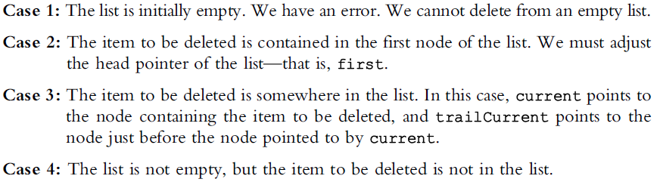
Ordered Linked Lists (cont’d.)
Delete a node
Several cases to consider
See function deleteNode code on page 306

Slide 39
Ordered Linked Lists (cont’d.)
Time-complexity of the operations of
the class orderedLinkedList

Slide 40
Doubly Linked Lists
Traversed in either direction
Typical operations
Initialize the list
Destroy the list
Determine if list empty
Search list for a given item
Insert an item
Delete an item, and so on
Class specifying members to implement properties of an ordered doubly linked list

Slide 41
Ordered Linked list as ADT
Write functions:
Isempty()
Isfull()
Insertfirst
Insertlast
Deletefirst
Deletelast
Deleteall
Search by position
Search by contents

Slide 42
Doubly Linked Lists (cont’d.)
Linked list in which every node has a next pointer and a back pointer
Every node contains address of next node
Except last node
Every node contains address of previous node
Except the first node

Slide 43
Doubly Linked Lists (cont’d.)
Default constructor
Initializes the doubly linked list to an empty state
isEmptyList
Returns true if the list empty
Otherwise returns false
List empty if pointer first is NULL

Slide 44
Doubly Linked Lists (cont’d.)
Destroy the list
Deletes all nodes in the list
Leaves list in an empty state
Traverse list starting at the first node; delete each node
count set to zero
Initialize the list
Reinitializes doubly linked list to an empty state
Can be done using the operation destroy
Length of the list
Length of a linked list stored in variable count
Returns value of this variable

Slide 45
Doubly Linked Lists (cont’d.)
Print the list
Outputs info contained in each node
Traverse list starting from the first node
Reverse print the list
Outputs info contained in each node in reverse order
Traverse list starting from the last node
Search the list
Function search returns true if searchItem found
Otherwise, it returns false
Same as ordered linked list search algorithm

Slide 46
Doubly Linked Lists (cont’d.)
First and last elements
Function front returns first list element
Function back returns last list element
If list empty
Functions terminate the program

Slide 47
Doubly Linked Lists (cont’d.)
Insert a node
Four cases
Case 1: Insertion in an empty list
Case 2: Insertion at the beginning of a nonempty list
Case 3: Insertion at the end of a nonempty list
Case 4: Insertion somewhere in a nonempty list
Cases 1 and 2 requirement: Change value of the pointer first
Cases 3 and 4: After inserting an item, count incremented by one

Slide 48
Doubly Linked Lists (cont’d.)
Delete a node
Four cases
Case 1: The list is empty
Case 2: The item to be deleted is in the first node of the list, which would require us to change the value of the pointer first
Case 3: The item to be deleted is somewhere in the list
Case 4: The item to be deleted is not in the list
See code on page 319
Definition of function deleteNode

Slide 49
Doubly Linked list as ADT
Write functions:
Isempty()
Isfull()
Insertfirst
Insertlast
Deletefirst
Deletelast
Deleteall
Search by position
Search by contents

Slide 50
Circular Linked list as ADT
Write functions:
Isempty()
Isfull()
Insertfirst
Insertlast
Deletefirst
Deletelast
Deleteall
Search by position
Search by contents

Slide 51
Write a program that prompts the user to input a string and then outputs the string in the pig Latin form. The rules for converting a string into pig Latin form :
If the string begins with a vowel, add the string "-way" at the end of the string. For example, the pig Latin form of the string "eye" is "eye-way".
If the string does not begin with a vowel, first add "-" at the end of the string. Then rotate the string one character at a time; that is, move the first character of the string to the end of the string until the first character of the string becomes a vowel. Then add the string "ay" at the end. For example, the pig Latin form of the string "There" is "ere-Thay“
Strings such as "by" contain no vowels. In cases like this, the letter y can be considered a vowel. So, for this program the vowels are a, e, i, o, u, y, A, E, I, O, U, and Y. Therefore, the pig Latin form of "by" is "y-bay“.
Strings such as "1234" contain no vowels. The pig Latin form of the string "1234" is "1234-way". That is, the pig Latin form of a string that has no vowels in it is the string followed by the string "-way"
Your program must store the characters of a string into a linked list and use the function void rotate () =>function to remove the first node and insert it at the end

