Slide 1
N. Rizk
COSC 2430 : Data Structures
College of Natural and Applied Sciences
Department of Computer Science
University of Houston

Slide 2
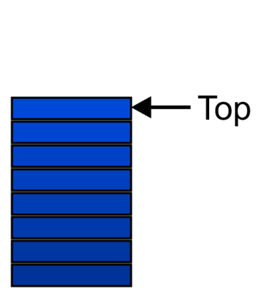
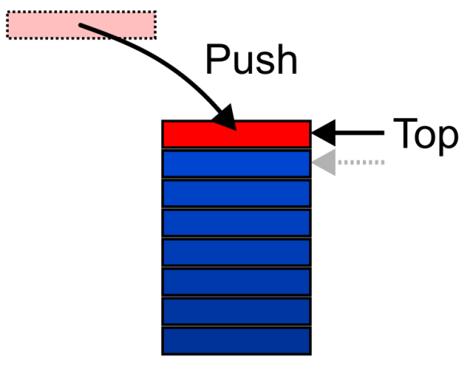
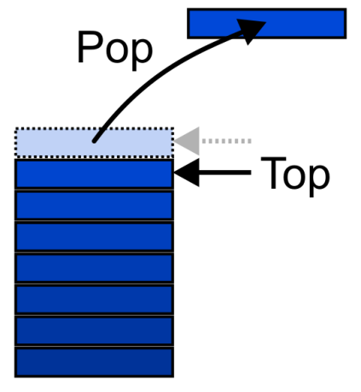
Abstract Stack
Also called a last-in–first-out (LIFO) behaviour
Graphically, we may view these operations as follows:
There are two exceptions associated with abstract stacks:
It is an undefined operation to call either pop or top on an empty stack

Slide 3
Stacks
a stack as an array
a stack as a linked list
stack applications
use a stack to remove recursion?

Slide 4
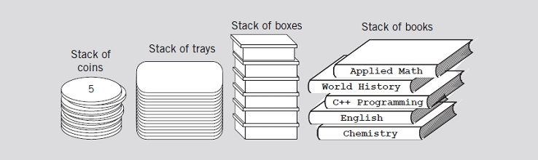
Stacks
Data structure
Elements added, removed from one end only
Last In First Out (LIFO)
Various examples of stacks

Slide 5
Stacks (cont’d.)
push operation
Add element onto the stack
top operation
Retrieve top element of the stack
pop operation
Remove top element from the stack

Slide 6

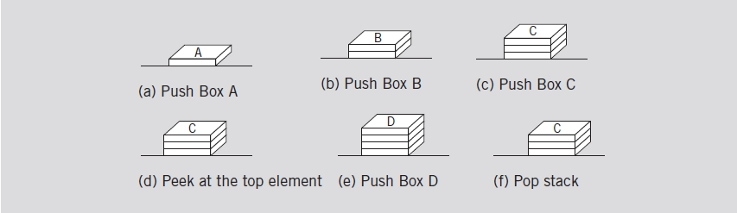
Stacks (cont’d.)
Empty stack
Stack operations

Slide 7
Stacks (cont’d.)
Stack element removal
Occurs only if something is in the stack
Stack element added only if room available
isFullStack operation
Checks for full stack
isEmptyStack operation
Checks for empty stack
initializeStack operation
Initializes stack to an empty state

Slide 8
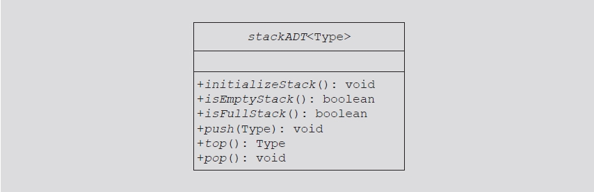
Stacks (cont’d.)
UML class diagram of the class stackADT

Slide 9
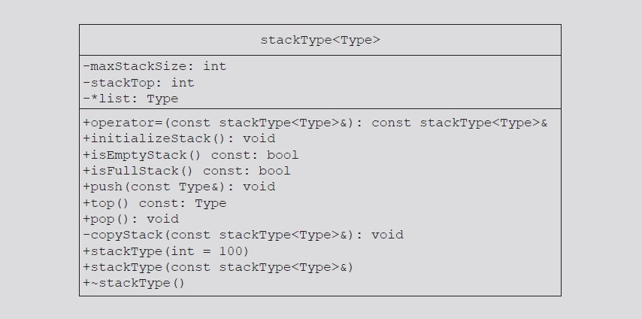
Implementation of Stacks as Arrays (cont’d.)
UML class diagram of the class stackType

Slide 10
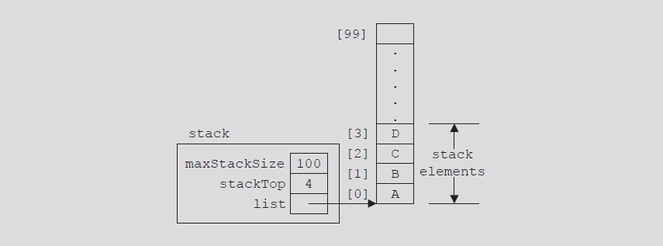
Implementation of Stacks as Arrays (cont’d.)
Example of a stack

Slide 11
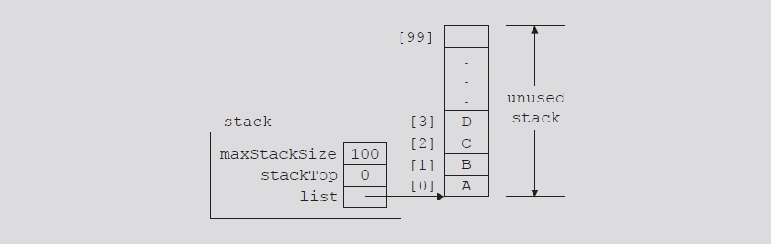
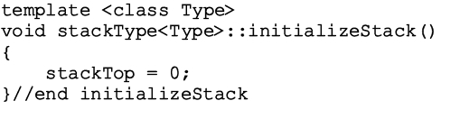
Initialize Stack
Value of stackTop if stack empty
Set stackTop to zero to initialize the stack
Definition of function initializeStack
Empty stack

Slide 12
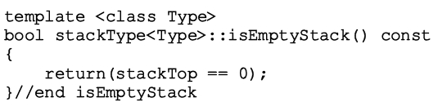
Empty Stack
Value of stackTop indicates if stack empty
If stackTop = zero: stack empty
Otherwise: stack not empty
Definition of function isEmptyStack

Slide 13
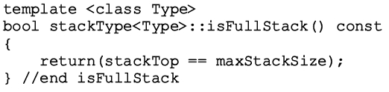
Full Stack
Stack full
If stackTop is equal to maxStackSize
Definition of function isFullStack

Slide 14
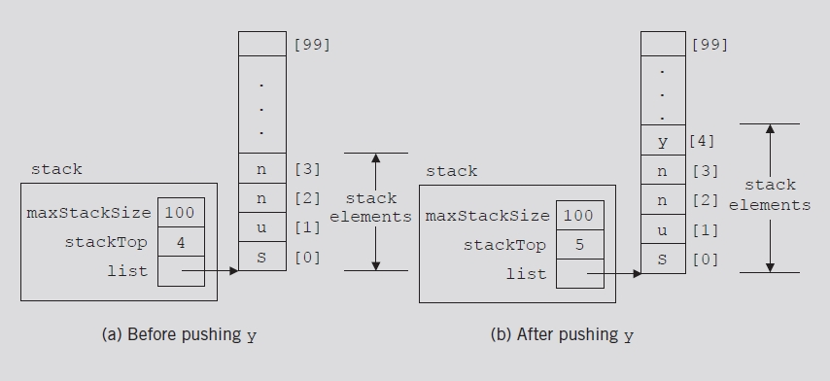
Push
Two-step process
Store newItem in array component indicated by stackTop
Increment stackTop
Stack before and after the push operation

Slide 15
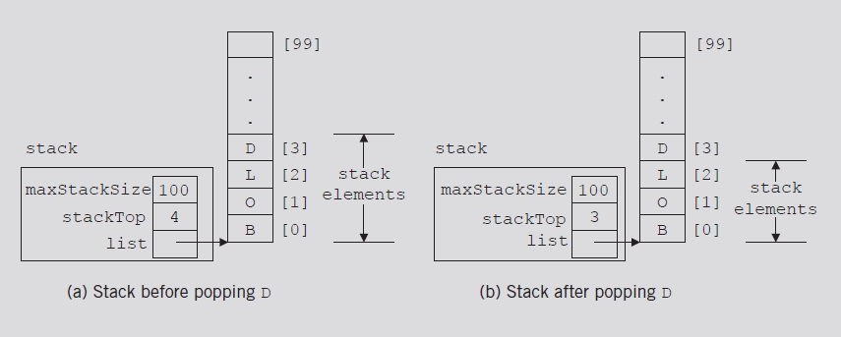
Pop
Remove (pop) element from stack
Decrement stackTop by one
FIGURE 7-9 Stack before and after the pop operation

Slide 16
Copy Stack
Definition of function copyStack

Slide 17
Constructor and Destructor

Slide 18
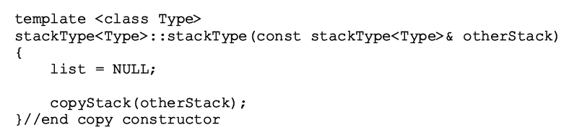
Copy Constructor
Definition of the copy constructor

Slide 19
Overloading the Assignment Operator (=)
Classes with pointer member variables
Assignment operator must be explicitly overloaded
Function definition to overload assignment operator for class stackType

Slide 20
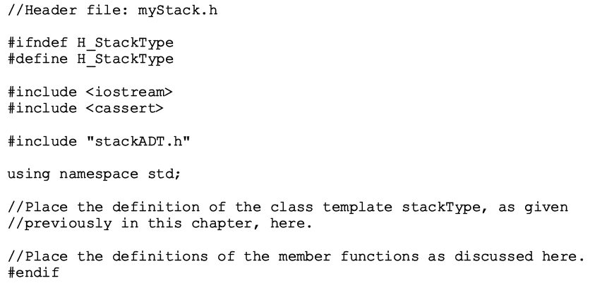
Stack Header File
myStack.h
Header file name containing class stackType definition

Slide 21
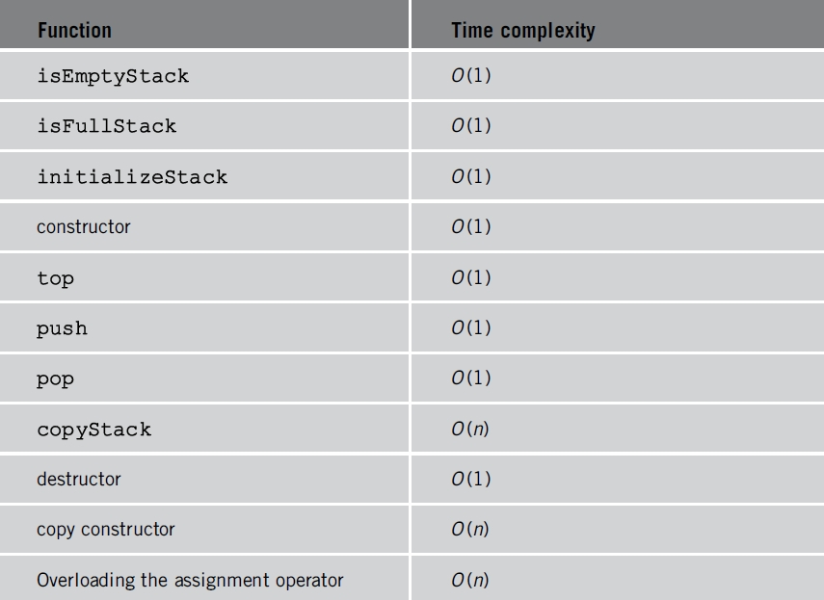
Time complexity of the operations of the class stackType on a stack with n elements

Slide 22
Write a program that takes as input an arithmetic expression. The program outputs whether the expression contains matching grouping symbols.
For example, the arithmetic expressions
{25 + (3 – 6) * 8}; and 7 + 8 * 2; contains matching grouping symbols. However, the expression
5 + {(13 + 7) / 8 - 2 * 9; does not contain matching grouping symbols
Hint:
stackType<char> stack(100);

Slide 23
Write a program that uses a stack to print the prime factors of a positive integer in descending order.
If the input is 100, the output consists of four factors 2, 2, 5 and 5.
To determine all prime factors of an n integer >= 2. It first removes all factors of 2. Then, removes all factors of 3, 5, 7, and so on. All factors must be prime numbers since ! when a factor is tried all of whose non-prime factors have already been removed
If the input is 16, the output consists of four factors 2, 2, 2 and 2.
If the input is 53, since it is a prime number, the output has only one factor: 53 itself.
If the input value is 586390350, the output consists of 10 factors 2, 3, 5, 5, 7, 7, 13, 17, 19 and 19.
This program factorizes any integer >= 2 --> 586390350
Factor # 1: 2
Factor # 2: 3
Factor # 3: 5
Factor # 4: 5
Factor # 5: 7
Factor # 6: 7
Factor # 7: 13
Factor # 8: 17
Factor # 9: 19
Factor # 10: 19

Slide 24
Instead of recursion convert a decimal number into an equivalent binary number. Write a program that uses a stack to convert a decimal number into an equivalent binary number.
Hint:
Push numbers divided by the base e.g 2.
While retrieving numbers use modulus. E.g 7 3 1 =➔ 1%2 …1
3%2….1
7%2…1
7 in binary 111

Slide 25
Linked Implementation of Stacks
Disadvantage of array (linear) stack representation
Fixed number of elements can be pushed onto stack
Solution
Use pointer variables to dynamically allocate, deallocate memory
Use linked list to dynamically organize data
Value of stackTop: linear representation
Indicates number of elements in the stack
Gives index of the array
Value of stackTop – 1
Points to top item in the stack

Slide 26
Linked Implementation of Stacks (cont’d.)
Review program on page 415
Class specifying basic operation on a stack as a linked list

Slide 27
Linked Implementation of Stacks (cont’d.)
Value of stackTop: linked representation
Locates top element in the stack
Gives address (memory location) of the top element of the stack
Stack: object of type linkedStackType
Empty and nonempty linked stacks

Slide 28
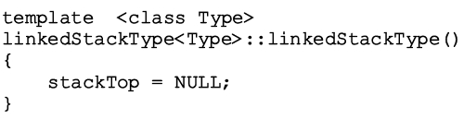
Default Constructor
When stack object declared
Initializes stack to an empty state
Sets stackTop to NULL
Definition of the default constructor

Slide 29
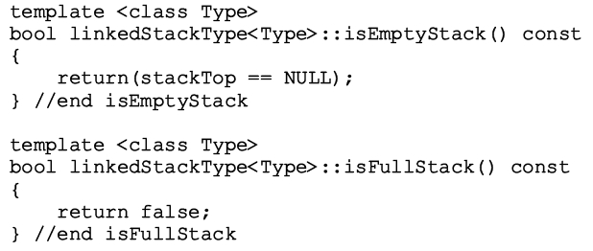
Empty Stack and Full Stack
Stack empty if stackTop is NULL
Stack never full
Element memory allocated/deallocated dynamically
Function isFullStack always returns false value

Slide 30
Initialize Stack
Reinitializes stack to an empty state
Because stack might contain elements and you are using a linked implementation of a stack
Must deallocate memory occupied by the stack elements, set stackTop to NULL
Definition of the initializeStack function

Slide 31
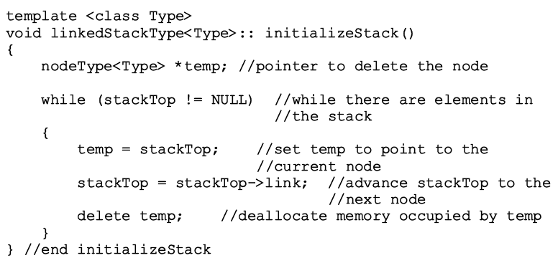
Initialize Stack (cont’d.)

Slide 32

Push
newElement added at the beginning of the linked list pointed to by stackTop
Value of pointer stackTop updated
Stack before the push operation

Slide 33
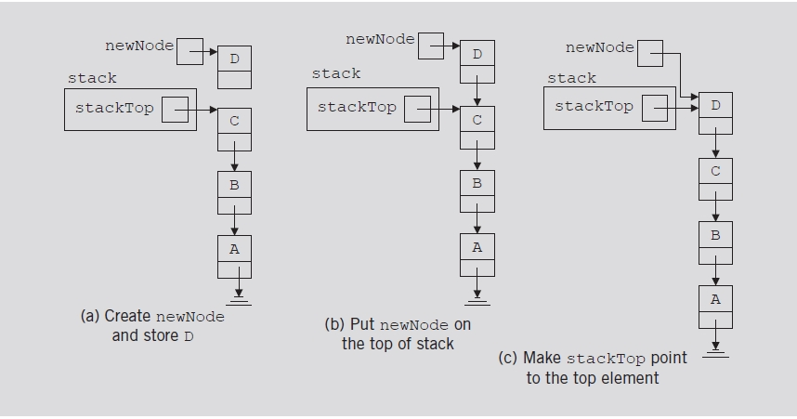
Push (cont’d.)
Push operation

Slide 34
Push (cont’d.)
Definition of the push function

Slide 35
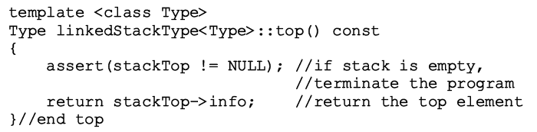
Return the Top Element
Returns information of the node to which stackTop pointing
Definition of the top function

Slide 36
Pop
Removes top element of the stack
Node pointed to by stackTop removed
Value of pointer stackTop updated

Slide 37
Pop (cont’d.)
Pop operation

Slide 38
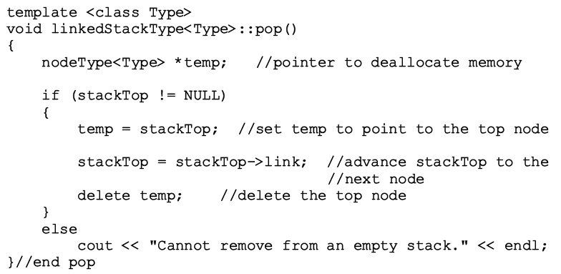
Pop (cont’d.)
Definition of the pop function

Slide 39
Copy Stack
Makes an identical copy of a stack
Definition similar to the definition of copyList for linked lists
Definition of the copyStack function

Slide 41
Constructors and Destructors
Definition of the functions to implement the copy constructor and the destructor

Slide 42
Overloading the Assignment Operator (=)
Definition of the functions to overload the assignment operator

Slide 43

Overloading the Assignment Operator (=)
Time complexity of the operations of the class linkedStackType on a stack with n elements

Slide 44
Stack as Derived from the class unorderedLinkedList
Stack push function, list insertFirst function
Similar algorithms
initializeStack and initializeList, isEmptyList and isEmptyStack, etc.
Shows that class linkedStackType is derived from class linkedListType
Functions pop and isFullStack implemented for linked stack
class linkedListType: abstract class
class unorderedLinkedListType: derived from class linkedListType

Slide 45
Application of Stacks: Postfix Expressions Calculator
Arithmetic notations
Infix notation: operator between operands
Prefix (Polish) notation: operator precedes operands
Reverse Polish notation: operator follows operands
Stack use in compliers
Translate infix expressions into some form of postfix notation
Translate postfix expression into machine code

Slide 46
Application of Stacks: Postfix Expressions Calculator (cont’d.)
Postfix expression: 6 3 + 2 * =
Evaluating the postfix expression: 6 3 + 2 * =

Slide 47
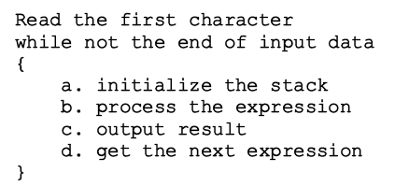
Application of Stacks: Postfix Expressions Calculator
Main algorithm pseudocode
Broken into four functions for simplicity
Function evaluateExpression
Function evaluateOpr
Function discardExp
Function printResult

Slide 48
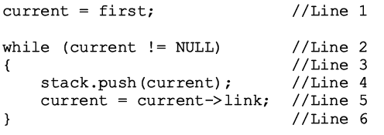
Removing Recursion: Nonrecursive Algorithm to Print a Linked List Backward
Stack
Used to design nonrecursive algorithm
Print a linked list backward
Use linked implementation of stack
Linked list

Slide 49
List after the statement
current = first; executes
List and stack after the statements stack.push(current); and current = current->link; execute

Slide 50
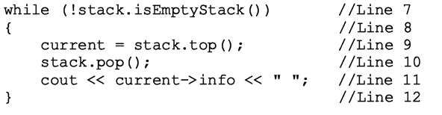
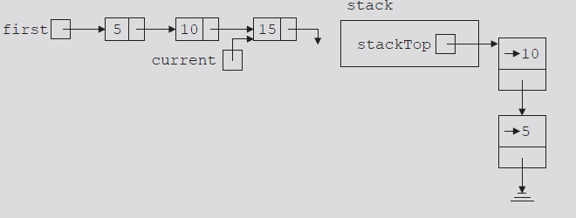
List and stack after the
while statement executes
List and stack after the statements current = stack.top(); and stack.pop(); execute

Slide 51

Standard Template Library
The Standard Template Library (STL) has a wrapper class stack with the following declaration:
template <typename T>
class stack {
public:
stack(); // not quite true...
bool empty() const;
int size() const;
const T & top() const;
void push( const T & );
void pop();
};

Slide 52
Standard Template Library
#include <iostream>
#include <stack>
using namespace std;
int main() {
stack<int> istack;
istack.push( 13 );
istack.push( 42 );
cout << "Top: " << istack.top() << endl;
istack.pop(); // no return value
cout << "Top: " << istack.top() << endl;
cout << "Size: " << istack.size() << endl;
return 0;
}

Slide 53
Standard Template Library
The reason that the stack class is termed a wrapper is because it uses a different container class to actually store the elements
The stack class simply presents the stack interface with appropriately named member functions:
push, pop , and top

Slide 54
STL class stack
Standard Template Library (STL) library class defining a stack
Header file containing class stack definition
stack
Operations on a stack object

Slide 55
Reverse-Polish Notation
Normally, mathematics is written using what we call in-fix notation:
(3 + 4) × 5 – 6
The operator is placed between to operands
One weakness: parentheses are required
(3 + 4) × 5 – 6 = 29
3 + 4 × 5 – 6 = 17
3 + 4 × (5 – 6) = –1
(3 + 4) × (5 – 6) = –7

Slide 56
Reverse-Polish Notation
Alternatively, we can place the operands first, followed by the operator:
(3 + 4) × 5 – 6
3 4 + 5 × 6 –
Parsing reads left-to-right and performs any operation on the last two operands:
3 4 + 5 × 6 –
7 5 × 6 –
35 6 –
29

Slide 57
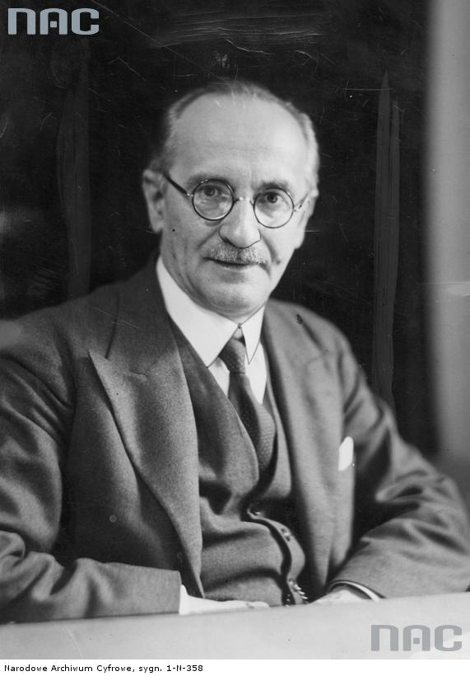
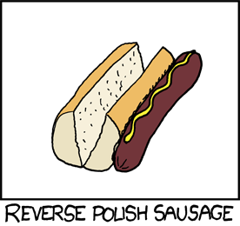
Reverse-Polish Notation
This is called reverse-Polish notation after the mathematician Jan Łukasiewicz
http://xkcd.com/645/
http://www.audiovis.nac.gov.pl/

Slide 58
Reverse-Polish Notation
Other examples:
3 4 5 × + 6 –
3 20 + 6 –
23 6 –
17
3 4 5 6 – × +
3 4 –1 × +
3 –4 +
–1

Slide 59
Reverse-Polish Notation
Benefits:
No ambiguity and no brackets are required
It is the same process used by a computer to perform computations:
operands must be loaded into registers before operations can be performed on them
Reverse-Polish can be processed using stacks

Slide 60
Reverse-Polish Notation
The easiest way to parse reverse-Polish notation is to use an operand stack:
operands are processed by pushing them onto the stack
when processing an operator:
pop the last two items off the operand stack,
perform the operation, and
push the result back onto the stack

Slide 61
Reverse-Polish Notation
Evaluate the following reverse-Polish expression using a stack:
1 2 3 + 4 5 6 × – 7 × + – 8 9 × +

Slide 62
Reverse-Polish Notation
Push 1 onto the stack
1 2 3 + 4 5 6 × – 7 × + – 8 9 × +
1

Slide 63
Reverse-Polish Notation
Push 1 onto the stack
1 2 3 + 4 5 6 × – 7 × + – 8 9 × +
2
1

Slide 64
Reverse-Polish Notation
Push 3 onto the stack
1 2 3 + 4 5 6 × – 7 × + – 8 9 × +
3
2
1

Slide 65
Reverse-Polish Notation
Pop 3 and 2 and push 2 + 3 = 5
1 2 3 + 4 5 6 × – 7 × + – 8 9 × +
5
1

Slide 66
Reverse-Polish Notation
Push 4 onto the stack
1 2 3 + 4 5 6 × – 7 × + – 8 9 × +
4
5
1

Slide 67
Reverse-Polish Notation
Push 5 onto the stack
1 2 3 + 4 5 6 × – 7 × + – 8 9 × +
5
4
5
1

Slide 68
Reverse-Polish Notation
Push 6 onto the stack
1 2 3 + 4 5 6 × – 7 × + – 8 9 × +
6
5
4
5
1

Slide 69
Reverse-Polish Notation
Pop 6 and 5 and push 5 × 6 = 30
1 2 3 + 4 5 6 × – 7 × + – 8 9 × +
30
4
5
1

Slide 70
Reverse-Polish Notation
Pop 30 and 4 and push 4 – 30 = –26
1 2 3 + 4 5 6 × – 7 × + – 8 9 × +
–26
5
1

Slide 71
Reverse-Polish Notation
Push 7 onto the stack
1 2 3 + 4 5 6 × – 7 × + – 8 9 × +
7
–26
5
1

Slide 72
Reverse-Polish Notation
Pop 7 and –26 and push –26 × 7 = –182
1 2 3 + 4 5 6 × – 7 × + – 8 9 × +
–182
5
1

Slide 73
Reverse-Polish Notation
Pop –182 and 5 and push –182 + 5 = –177
1 2 3 + 4 5 6 × – 7 × + – 8 9 × +
–177
1

Slide 74
Reverse-Polish Notation
Pop –177 and 1 and push 1 – (–177) = 178
1 2 3 + 4 5 6 × – 7 × + – 8 9 × +
178

Slide 75
Reverse-Polish Notation
Push 8 onto the stack
1 2 3 + 4 5 6 × – 7 × + – 8 9 × +
8
178

Slide 76
Reverse-Polish Notation
Push 1 onto the stack
1 2 3 + 4 5 6 × – 7 × + – 8 9 × +
9
8
178

Slide 77
Reverse-Polish Notation
Pop 9 and 8 and push 8 × 9 = 72
1 2 3 + 4 5 6 × – 7 × + – 8 9 × +
72
178

Slide 78
Reverse-Polish Notation
Pop 72 and 178 and push 178 + 72 = 250
1 2 3 + 4 5 6 × – 7 × + – 8 9 × +
250

Slide 79
Reverse-Polish Notation
Thus
1 2 3 + 4 5 6 × – 7 × + – 8 9 × +
evaluates to the value on the top: 250
The equivalent in-fix notation is
((1 – ((2 + 3) + ((4 – (5 × 6)) × 7))) + (8 × 9))
We reduce the parentheses using order-of-operations:
1 – (2 + 3 + (4 – 5 × 6) × 7) + 8 × 9

Slide 80
Reverse-Polish Notation
Incidentally,
1 – 2 + 3 + 4 – 5 × 6 × 7 + 8 × 9 = – 132
which has the reverse-Polish notation of
1 2 – 3 + 4 + 5 6 7 × × – 8 9 × +
For comparison, the calculated expression was
1 2 3 + 4 5 6 × – 7 × + – 8 9 × +

Slide 81
Summary
Stack
Last In First Out (LIFO) data structure
Implemented as array or linked list
Arrays: limited number of elements
Linked lists: allow dynamic element addition
Stack use in compliers
Translate infix expressions into some form of postfix notation
Translate postfix expression into machine code
Standard Template Library (STL)
Provides a class to implement a stack in a program

