Slide 1
N. Rizk
COSC 2430 : Data Structures
College of Natural and Applied Sciences
Department of Computer Science
University of Houston

Slide 2
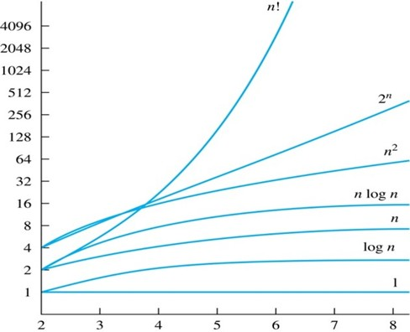
Complexity Theory Introduction
Algorithmic complexity theory: How fast does the running time of an algorithm grow with respect to input size?
Some algorithms scale better as input size grows
Input Size vs Running time
Running time
Input size

Slide 3
Complexity Theory
Complexity theory is concerned with expressing the running time of an algorithm with respect to input size
Idea 1: Express running time in terms of the number of operations – abstract away choice of hardware and PL
Idea 2: Not interested in exact number of operations, just an asymptotic estimate
Number of operations proportional to some function f (n) s.t. they become equal as n → ∞
3 1 2 11
e.g., instead of 2 · n + n + n + 4log (n), we just say
2
9
running time is cubic

Slide 4
Example
Associate a "cost" with each statement.
Find the "total cost“ by finding the total number of times each statement is executed.
Algorithm 1 Algorithm 2
Cost Cost
arr[0] = 0; c₁ for(i=0; i<N; i++) c₂
arr[1] = 0; c₁ arr[i] = 0; c₁
arr[2] = 0; c₁
... ...
arr[N-1] = 0; c₁
----------- -------------
c₁+c₁+...+c₁ = c₁ x N (N+1) x c₂ + N x c₁ =
(c₂ + c₁) x N + c₂

Slide 5
Another Example
Algorithm 3 Cost
sum = 0; c₁
for(i=0; i<N; i++) c₂
for(j=0; j<N; j++) c₂
sum += arr[i][j]; c₃
------------
c₁ + c₂ x (N+1) + c₂ x N x (N+1) + c₃ x N²

Slide 6
Asymptotic Analysis
To compare two algorithms with running times f(n) and g(n), we need a rough measure that characterizes how fast each function grows.
Hint: use rate of growth
Compare functions in the limit, that is, asymptotically!
(i.e., for large values of n)

Slide 7
Rate of Growth
Consider the example of buying elephants and goldfish:
Cost: cost_of_elephants + cost_of_goldfish
Cost ~ cost_of_elephants (approximation)
The low order terms in a function are relatively insignificant for large n
n⁴ + 100n² + 10n + 50 ~ n⁴
i.e., we say that n⁴ + 100n² + 10n + 50 and n⁴ have the same rate of growth

Slide 8
Asymptotic Notation
O notation: asymptotic “less than”:
f(n)=O(g(n)) implies: f(n) “≤” g(n)
Ω notation: asymptotic “greater than”:
f(n)= Ω (g(n)) implies: f(n) “≥” g(n)
Θ notation: asymptotic “equality”:
f(n)= Θ (g(n)) implies: f(n) “=” g(n)

Slide 9
Big-O Notation
We say f_{A}(n)=30n+8 is order n, or O (n) It is, at most, roughly proportional to n.
f_{B}(n)=n²+1 is order n², or O(n²). It is, at most, roughly proportional to n².
In general, any O(n²) function is faster- growing than any O(n) function.

Slide 10
Visualizing Orders of Growth
On a graph, as you go to the right, a faster growing function eventually becomes larger...
f_{A}(n)=30n+8
Value of function →
f_{B}(n)=n²+1
Increasing n →

Slide 11
More Examples …
n⁴ + 100n² + 10n + 50 is O(n⁴)
10n³ + 2n² is O(n³)
n³ - n² is O(n³)
constants
10 is O(1)
1273 is O(1)

Slide 12
Back to Our Example
Algorithm 1 Algorithm 2
Cost Cost
arr[0] = 0; c₁ for(i=0; i<N; i++) c₂
arr[1] = 0; c₁ arr[i] = 0; c₁
arr[2] = 0; c₁
...
arr[N-1] = 0; c₁
----------- -------------
c₁+c₁+...+c₁ = c₁ x N (N+1) x c₂ + N x c₁ =
(c₂ + c₁) x N + c₂
Both algorithms are of the same order: O(N)

Slide 13
Example (cont’d)
Algorithm 3 Cost
sum = 0; c₁
for(i=0; i<N; i++) c₂
for(j=0; j<N; j++) c₂
sum += arr[i][j]; c₃
------------
c₁ + c₂ x (N+1) + c₂ x N x (N+1) + c₃ x N² = O(N²)

Slide 14
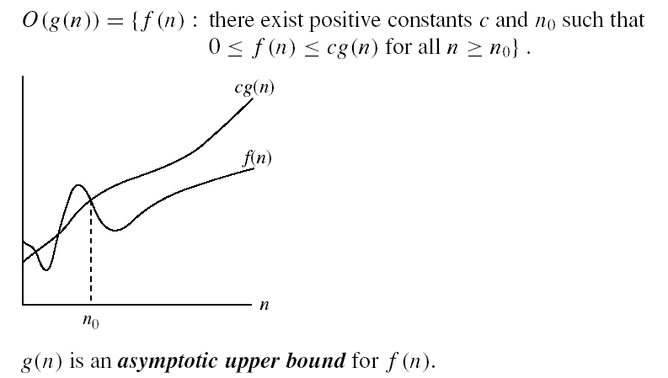
Asymptotic notations
O-notation

Slide 15
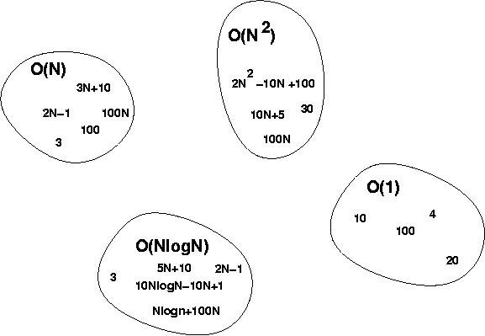
Big-O Visualization
O(g(n)) is the set of functions with smaller or same order of growth as g(n)

Slide 16
Examples
2n² = O(n³):
n² = O(n²):
1000n²+1000n = O(n²):
n = O(n²):
2n² ≤ cn³ ⇒ 2 ≤ cn ⇒ c = 1 and n₀= 2
n² ≤ cn² ⇒ c ≥ 1 ⇒ c = 1 and n₀= 1
1000n²+1000n ≤ 1000n²+ n² =1001n²⇒ c=1001 and n₀ = 1000
n ≤ cn² ⇒ cn ≥ 1 ⇒ c = 1 and n₀= 1

Slide 17
More Examples
Show that 30n+8 is O(n).
Show ∃c,n₀: 30n+8 ≤ cn, ∀n>n₀ .
Let c=31, n₀=8. Assume n>n₀=8. Then cn = 31n = 30n + n > 30n+8, so 30n+8 < cn.

Slide 18
Big-O example, graphically
Note 30n+8 isn’t less than n anywhere (n>0).
It isn’t even less than 31n everywhere.
But it is less than 31n everywhere to the right of n=8.
cn = 31n
30n+8
30n+8 ∈O(n)
Value of function →
n
n>n₀=8 →
Increasing n →

Slide 19
No Uniqueness
There is no unique set of values for n₀ and c in proving the asymptotic bounds
Prove that 100n + 5 = O(n²)
100n + 5 ≤ 100n + n = 101n ≤ 101n²
for all n ≥ 5
n₀ = 5 and c = 101 is a solution
100n + 5 ≤ 100n + 5n = 105n ≤ 105n² for all n ≥ 1
n₀ = 1 and c = 105 is also a solution
Must find SOME constants c and n₀ that satisfy the asymptotic notation relation

Slide 20
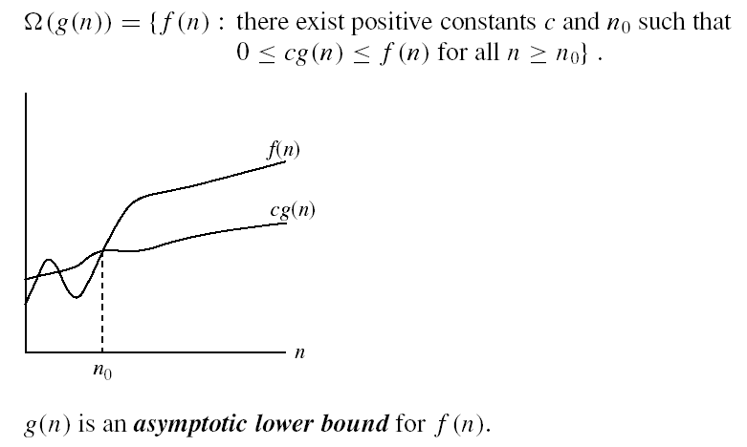
Asymptotic notations (cont.)
Ω - notation
Ω(g(n)) is the set of functions with larger or same order of growth as g(n)

Slide 21
Examples
5n² = Ω(n)
100n + 5 ≠ Ω(n²)
n = Ω(2n), n³ = Ω(n²), n = Ω(logn)
∃ c, n₀ such that: 0 ≤ cn ≤ 5n²
⇒ cn ≤ 5n²
⇒ c = 1 and n₀ = 1
∃ c, n₀ such that: 0 ≤ cn² ≤ 100n + 5
100n + 5 ≤ 100n + 5n (∀ n ≥ 1) = 105n
cn² ≤ 105n
⇒ n(cn – 105) ≤ 0
Since n is positive ⇒ cn – 105 ≤ 0
⇒ n ≤ 105/c
⇒ contradiction: n cannot be smaller than a constant

Slide 22

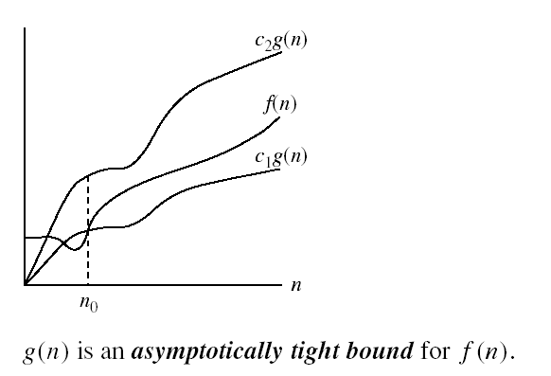
Asymptotic notations (cont.)
Θ-notation
Θ(g(n)) is the set of functions with the same order of growth as g(n)

Slide 23
Examples
n²/2 –n/2 = Θ(n²)
½ n² - ½ n ≤ ½ n² ∀n ≥ 0 ⇒ c₂= ½
½ n² - ½ n ≥ ½ n² - ½ n * ½ n ( ∀n ≥ 2 ) = ¼ n² ⇒ c₁= ¼
n ≠ Θ(n²): c₁ n² ≤ n ≤ c₂ n²
⇒ only holds for: n ≤ 1/c₁

Slide 24
Examples
6n³ ≠ Θ(n²): c₁ n² ≤ 6n³ ≤ c₂ n²
⇒ only holds for: n ≤ c₂ /6
n ≠ Θ(logn): c₁ logn ≤ n ≤ c₂ logn
⇒ c₂ ≥ n/logn, ∀ n≥ n₀ – impossible

Slide 25
Relations Between Different Sets
Subset relations between order-of-growth sets.
R→R
O( f )
Ω( f )
• f
Θ( f )

Slide 26
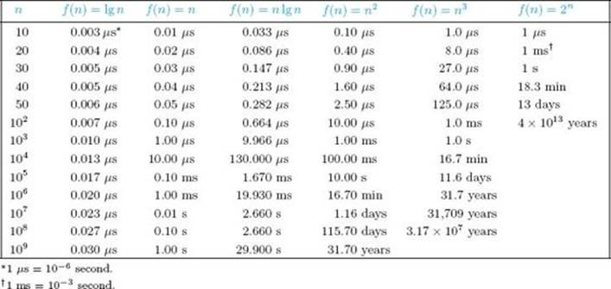
Common orders of magnitude

Slide 27
Logarithms and properties
In algorithm analysis we often use the notation “log n” without specifying the base
Binary logarithm
Natural logarithm

Slide 28
More Examples
For each of the following pairs of functions, either f(n) is O(g(n)), f(n) is Ω(g(n)), or f(n) = Θ(g(n)). Determine which relationship is correct.
f(n) = log n²; g(n) = log n + 5
f(n) = n; g(n) = log n²
f(n) = log log n; g(n) = log n
f(n) = n; g(n) = log² n
f(n) = n log n + n; g(n) = log n
f(n) = 10; g(n) = log 10
f(n) = 2^{n}; g(n) = 10n²
f(n) = 2^{n}; g(n) = 3^{n}
f(n) = Θ (g(n))
f(n) = Ω(g(n))
f(n) = O(g(n))
f(n) = Ω(g(n))
f(n) = Ω(g(n))
f(n) = Θ(g(n))
f(n) = Ω(g(n))
f(n) = O(g(n))

Slide 29
Properties
Theorem:
f(n) = Θ(g(n)) ⇔ f = O(g(n)) and f = Ω(g(n))
Transitivity:
f(n) = Θ(g(n)) and g(n) = Θ(h(n)) ⇒ f(n) = Θ(h(n))
Same for O and Ω
Reflexivity:
f(n) = Θ(f(n))
Same for O and Ω
Symmetry:
f(n) = Θ(g(n)) if and only if g(n) = Θ(f(n))
Transpose symmetry:
f(n) = O(g(n)) if and only if g(n) = Ω(f(n))

Slide 30
Asymptotic Notations in Equations
On the right-hand side
Θ(n²) stands for some anonymous function in Θ(n²)
2n² + 3n + 1 = 2n² + Θ(n) means:
There exists a function f(n) ∈ Θ(n) such that
2n² + 3n + 1 = 2n² + f(n)
On the left-hand side
2n² + Θ(n) = Θ(n²)
No matter how the anonymous function is chosen on the left-hand side, there is a way to choose the anonymous function on the right-hand side to make the equation valid.

Slide 31
Common Summations
Arithmetic series:
Geometric series:
Special case: |x| < 1:
Harmonic series:
Other important formulas:

Slide 32
Mathematical Induction
A powerful, rigorous technique for proving that a statement S(n) is true for every natural number n, no matter how large.
Proof:
Basis step: prove that the statement is true for n = 1
Inductive step: assume that S(n) is true and prove that S(n+1) is true for all n ≥ 1
Find case n “within” case n+1

Slide 33
Example
Prove that: 2n + 1 ≤ 2^{n} for all n ≥ 3
Basis step:
n = 3: 2 ∗ 3 + 1 ≤ 2³ ⇔ 7 ≤ 8 TRUE
Inductive step:
Assume inequality is true for n, and prove it for (n+1):
2n + 1 ≤ 2^{n} must prove: 2(n + 1) + 1 ≤ 2^{n+1}
2(n + 1) + 1 = (2n + 1 ) + 2 ≤ 2^{n} + 2 ≤
≤ 2^{n} + 2^{n} = 2^{n+1}, since 2 ≤ 2^{n} for n ≥ 1

Slide 34
Types of Analysis
Worst case
Provides an upper bound on running time
An absolute guarantee that the algorithm would not run longer, no matter what the inputs are
Best case
Provides a lower bound on running time
Input is the one for which the algorithm runs the fastest
Average case
Provides a prediction about the running time
Assumes that the input is random

Slide 35
Example 1
Prove that 4n + 2 is O (n)
We need to find constant C , k s.t. 4n + 2 ≤ Cn for n > k
These constants are said to be witnesses to the relationship that f (n) if O (g (n))
For our example, pick C = 5 and k = 2
We have ∀n > 2, 4n + 2 ≤ 5n ✓

Slide 36
Example 2
Prove that 2n² + n is O (n²)
What are constants C , k s.t. 2n² + n ≤ Cn² for n > k ?
C = 3, k = 1
We have ∀n > 1, 2n² + n ≤ 3n² ✓

Slide 37
Example 3
Prove that ¹ n² is not O (n)
2
Proof by contradiction – suppose there was some C , k s.t.:
∀n > k 1/2n² ≤ Cn
Implies ∀n > k, n ≤ 2C
But this is not true because k, C are constants and we can make n arbitrarily large
∀n > k, ₂ n ≤ Cn
Implies ∀n > k, n ≤ 2C
But this is not true because k, C are constants and we can make n arbitrarily large

Slide 38
Example 4
Prove that n! is O (n^{n} )
Pick C = 1 and k = 1
Need to prove: ∀n > 1, n! ≤ n^{n}
Since n ≥ n − i for all 0 ≤ i ≤ n and n > 1, then
n! = n · (n − 1) · · · 2 · 1 ≤ n · n · · · n · n = n^{n}

Slide 39
Example 5
Prove that log₂(3n² + 1) is O (log₂n)
Need to show ∃C , k s.t log₂(3n² + 1) ≤ C · log₂n
Recall: C · log₂n = log₂n^{C}
What are C , k such that
2 C
∀n > k, 3n + 1 ≤ n
C = 3, k = 4

Slide 40
Big-O Estimates for Some Important Functions
Use big-O notation to estimate the sum of the first n positive integers.
1 + 2 + · · · + n is O (n²) with C = 1, k = 1
Use big-O notation to estimate the factorial function
f (n) = n!
n! is O (n^{n} ) with C = 1, k = 1
Use big-O notation to estimate log(n!)
Since n! < n^{n} , then log(n!) ≤ log(n^{n} ) = n · log(n). Therefore, log(n!) is O (n log(n)) with C = 1, k = 1.

Slide 41
Big-Omega Notation
Big-O notation is useful for giving an upper bound for f (n)
for large values of n
But sometimes we are also interested in a lower bound!
For this purpose, we use the Big-Omega Ω notation, which represents asymptotic lower bounds

Slide 42
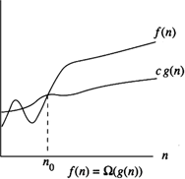
Formal Definition of Big-Omega
A function f (n) is Ω(g (n)) if there exist positive constants C , k
such that:
∀n > k, |f (n)| ≥ C |g (n)|
i.e., for sufficiently large n, f (n) is bounded from below by a function proportional to g (n)
As before, we will assume f (n) and g (n) are positive

Slide 43
Example
1
Prove that 2n² + n is Ω(n)
Find a C and k : C = 1, k = 1
∀n > 1, 2n² + n ≥ n ✓
Prove that 5n + 1 is not Ω(n²)
Suppose there exists constants such that:
2
2
∀n > k, 5n + 1 ≥ C · n
Implies ∀n > k, C · n² − 5n − 1 ≤ 0
But since C > 0, C · n² − 5n − 1 is an upward-looking looking parabola ⇒ for n large enough, C · n² − 5n − 1 is positive.

Slide 44
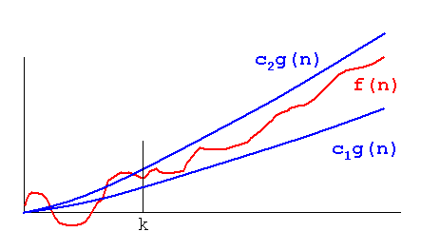
Big Theta
So far: Big-O gives asymptotic upper bounds, and Big-Omega gives asymptotic lower bounds
But sometimes we are interested in a function that serves both as an asymptotic lower and upper bound
This is expressed using Big-Theta notation

Slide 45
Example I
Prove that 10n + 4^{log2n} is Θ(n²)
Observe: Can be rewritten to n² + 10n
Since it’s of degree 2, from earlier theorem O (n²)
Also Ω(n²) – pick C = 1, k = 1

Slide 46
Example II
Prove that log(n!) = Θ(n logn)
First show log(n!) is O (n logn): log(n!) = log(1 · 2 · . . . · n)
≤ log (n · n · . . . · n) (for n ≥ 1)
= log n + log n + . . . + log n (n times)
= n logn

Slide 47
Example II, cont.
Now show that log n! is Ω(n logn):
log(n!) = log(1 · 2 · . . . · n)
= log 1 + log 2 + . . . + log n
n n
≥ log + log ( + 1) + . . . + log n
2 2
n n
≥ · log
2 2
n
= · (logn − 1)
2
n
≥ log n (for n ≥ 4)
4

Slide 48
A Useful Theorem
1
f (x ) is O (g (x )) if:
f (x )
lim | | < ∞
x →∞ g (x )
2
f (x ) is Ω(g (x )) if:
f (x )
lim | | > 0
x →∞ g (x )
3
f (x ) is Θ(g (x )) if:
f (x )
0 < lim | | < ∞
x →∞ g (x )

Slide 49
Example I
Show that ^{x 2+1} is Θ(x )
x +1
Use previous theorem:
x ² + 1 1
lim · = 1
x →∞ x + 1 x
Hence, it’s case (3) ⇒ Θ(x )

Slide 50
Example II
Is log(log n) O (log n)?
Is it Ω(log n)?

Slide 51
Example
True or false?
2^{n} is Θ(2^{2n} )
False, not Ω(4^{n} )
2^{n} is Θ(2^{n+1})
1 n+1
n 1 n+1
True, ·
2 ≤ 2 ≤ ·
2
2
2
^{x 2+1} is Θ(x )
x +1
True

Slide 52
Example
Use the definition of Big-O/Big-Omega/Big-Theta to show that:
3x ⁴ − 2x
3
is O (x )
5x − 1
7x ² + 1 is Θ(x ²)

