Slide 1
N. Rizk
COSC 2430 : Data Structures
College of Natural and Applied Sciences
Department of Computer Science
University of Houston

Slide 2
Queues
a queue as an array
a queue as a linked list
Discover queue applications
The STL class queue

Slide 3
Introduction
Queue data structure
Elements added at one end (rear), deleted from other end (front)
First In First Out (FIFO)
Middle elements inaccessible

Slide 4
Queue Operations
Two key operations
addQueue
deleteQueue
Additional operations
initializeQueue, isEmptyQueue, isFullQueue, front, back
queueFront, queueRear pointers
Keep track of front and rear

Slide 5
Implementation of Queues as Arrays
Four member variables
Array to store queue elements
Variables queueFront, queueRear
Variable maxQueueSize
Using queueFront, queueRear to access queue elements
queueFront: first queue element index
queueRear: last queue element index
queueFront changes after each deleteQueue operation
queueRear changes after each addQueue operation

Slide 6
Implementation of Queues as Arrays (cont’d.)
Execute operation
addQueue(Queue,'A');
Execute
addQueue(Queue,'B');
addQueue(Queue,'C');
Execute
deleteQueue();

Slide 7
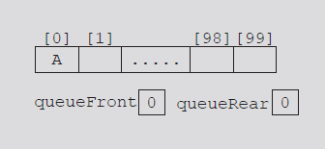
Queue after the first addQueue operation
Queue after two more addQueue operations
Queue after the deleteQueue operation

Slide 8
Implementation of Queues as Arrays
Consider the sequence of operations: AAADADADADADADADA...
Eventually index queueRear points to last array position
Looks like a full queue
Reality: queue has two or three elements, array empty in the front
Queue after the sequence
of operations AAADADADADADA...

Slide 9
Implementation of Queues as Arrays (cont’d.)
First solution
Upon queue overflow to the rear
Check value of queueFront
If room in front: slide all queue elements toward first array position
Works if queue size very small
Second solution: assume circular array
Circular queue

Slide 10
Implementation of Queues as Arrays (cont’d.)
queueRear = (queueRear + 1) % maxQueueSize;
Advances queueRear (queueFront) to next array position
Queue before and after the add operation

Slide 11
Implementation of Queues as Arrays (cont’d.)
If queueRear < maxQueueSize – 1
queueRear + 1 <= maxQueueSize – 1
(queueRear + 1) % maxQueueSize = queueRear + 1
If queueRear == maxQueueSize – 1
queueRear + 1 == maxQueueSize
(queueRear + 1) % maxQueueSize = 0
queueRear set to zero
First array position

Slide 12
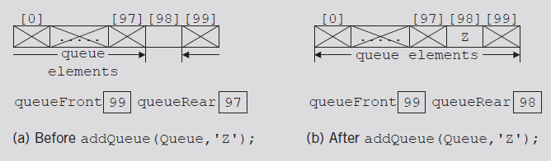
Implementation of Queues as Arrays (cont’d.)
Two cases with identical queueFront, queueRear values
Figure 8-7(b) represents an empty queue
Figure 8-8(b) represents a full queue
Queue before and after the delete operation
Queue before and after the add operation

Slide 13
Implementation of Queues as Arrays (cont’d.)
First solution: use variable count
Incremented when new element added
Decremented when element removed
Functions initializeQueue, destroyQueue initialize count to zero

Slide 14
Implementation of Queues as Arrays (cont’d.)
Second solution
queueFront indicates index of array position preceding first element of the queue
Assume queueRear indicates index of last element
Empty queue if queueFront == queueRear
Slot indicated by index queueFront is reserved
Queue is full
If next available space represents special reserved slot

Slide 15
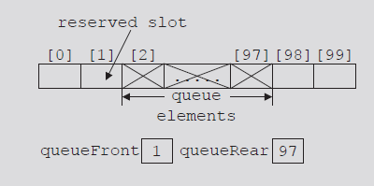
Implementation of Queues as Arrays (cont’d.)
FIGURE 8-9 Array to store the queue
elements with a reserved slot
See code on pages 459-460
Uses first solution

Slide 16
Empty Queue and Full Queue
Empty queue
If count == 0
Full queue
If count == maxQueueSize

Slide 17
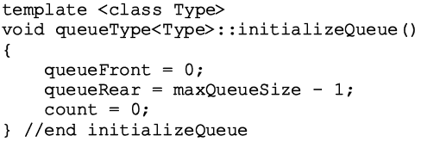
Initialize Queue
Initializes queue to empty state
First element added at the first array position
Initialize queueFront to zero, queueRear to maxQueueSize - one, count to zero
Empty queue

Slide 18
Front
Returns first queue element
If the queue nonempty
Element indicated by index queueFront returned
Otherwise
Program terminates

Slide 19
Back
Returns last queue element
If queue nonempty
Returns element indicated by index queueRear
Otherwise
Program terminates

Slide 20
Add Queue

Slide 21
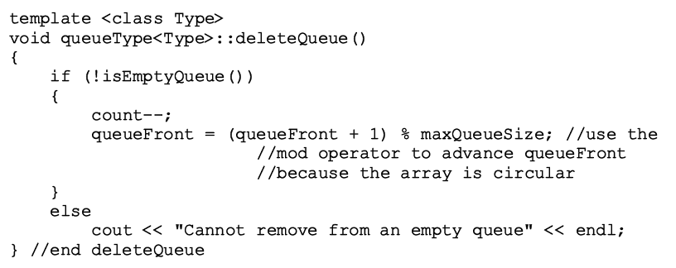
Delete Queue

Slide 22
Constructors and Destructors

Slide 23
Constructors and Destructors (cont’d.)
Array storing queue elements
Created dynamically
When queue object goes out of scope
Destructor deallocates memory occupied by the array storing queue elements

Slide 24
Write a program that reads a line of text from the keyboard, changes each uppercase letter to lowercase, and places each letter both in a queue and onto a stack. The program should then verify whether the line of text is a palindrome (a set of letters or numbers that is the same whether read forward or backward).
Hint
int main()
{
queueType<char> queue(200);
stackType<char> stack(200);
string text;

Slide 25
Linked Implementation of Queues
Array implementation issues
Fixed array size
Finite number of queue elements
Requires special array treatment with the values of the indices queueFront, queueRear
Linked implementation of a queue
Simplifies special cases of the array implementation
Queue never full
See code on pages 464-465

Slide 26
Empty and Full Queue
Empty queue if queueFront is NULL
Memory allocated dynamically
Queue never full
Function implementing isFullQueue operation returns the value false

Slide 27
Initialize Queue
Initializes queue to an empty state
Empty if no elements in the queue

Slide 28
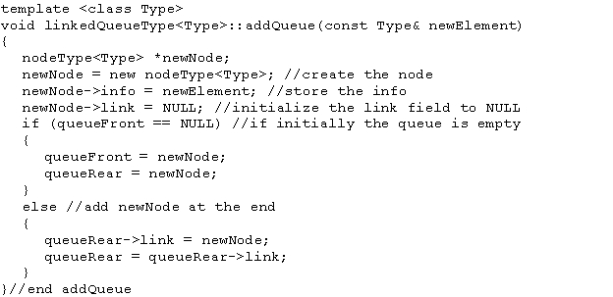
addQueue, front, back, and deleteQueue Operations
addQueue operation adds a new element at end of the queue
Access the pointer queueRear

Slide 29
addQueue, front, back, and deleteQueue Operations (cont’d.)
If queue nonempty
Operation front returns first element
Element indicated queueFront returned
If queue empty: front terminates the program

Slide 30
addQueue, front, back, and deleteQueue Operations (cont’d.)
If queue nonempty
Operation back returns last element
Element indicated by queueRear returned
If queue empty: back terminates the program

Slide 31
addQueue, front, back, and deleteQueue Operations (cont’d.)
If queue nonempty
Operation deleteQueue removes first element
Access pointer queueFront

Slide 32
addQueue, front, back, and deleteQueue Operations (cont’d.)
Default constructor
When queue object goes out of scope
Destructor destroys the queue
Deallocates memory occupied by the queue elements
Function definition similar to function initializeQueue

Slide 33
Queue Derived from the class unorderedLinkedListType
Linked queue implementation
Similar to forward manner linked list implementation
Similar operations
add Queue, insertFirst
initializeQueue , initializeList
isEmptyQueue, isEmptyList
deleteQueue operation implemented as before
Same pointers
queueFront and first, queueRear and last

Slide 34
Queue Derived from the class unorderedLinkedListType
Linked queue implementation (cont’d.)
Can derive the class to implement the queue from the class linkedListType
class linkedListType
An abstract
Does not implement all operations
class unorderedLinkedListType
Derived from class linkedListType
Provides definitions of the abstract functions of the class linkedListType

Slide 35
STL class queue (Queue Container Adapter)
Standard Template Library (STL)
Provides a class to implement queues in a program
Queue
Name of class defining the queue
Name of header defining class queue

Slide 36
STL class queue (cont’d.)
Queue container class
Provides relational operators comparing two queues
Operations on a queue object

Slide 37
Priority Queues
Queue structure ensures items processed in the order received
Priority queues
Customers (jobs) with higher priority pushed to the front of the queue
Implementation
Ordinary linked list
Keeps items in order from the highest to lowest priority
Treelike structure
Very effective

Slide 38
STL class priority_queue
class template priority_queue<elemType>
Queue element data type specified by elemType
Contained in the STL header file queue
Specifying element priority
Default priority criteria for the queue elements
Less-than operator (<)
Overloading the less-than operator (<)
Compare the elements
Defining a comparison function to specify the priority

Slide 39
Application of Queues: Simulation
Simulation
Technique in which one system models the behavior of another system
Computer simulation
Represents objects being studied as data
Actions implemented with algorithms
Programming language implements algorithms with functions
Functions implement object actions

Slide 40
Application of Queues: Simulation (cont’d.)
Computer simulation (cont’d.)
C++ combines data, data operations into a single unit using classes
Objects represented as classes
Class member variables describe object properties
Function members describe actions on data
Change in simulation results occurs if change in data value or modification of function definitions occurs
Main goal
Generate results showing the performance of an existing system
Predict performance of a proposed system

Slide 41
Application of Queues: Simulation (cont’d.)
Queuing systems
Computer simulations
Queues represent the basic data structure
Queues of objects
Waiting to be served by various servers
Consist of servers and queues of objects waiting to be served

Slide 42
Designing a Queuing System
Server
Object that provides the service
Customer
Object receiving the service
Transaction time (service time)
Time required to serve a customer
Queuing system consists of servers, queue of waiting objects
Model system consisting of a list of servers; waiting queue holding the customers to be served

Slide 43
Designing a Queuing System (cont’d.)
Modeling a queuing system: requirements
Number of servers, expected customer arrival time, time between customer arrivals, number of events affecting system
Time-driven simulation
Clock implemented as a counter
Passage of time
Implemented by incrementing counter by one
Run simulation for fixed amount of time
Example: run for 100 minutes
Counter starts at one and goes up to 100 using a loop

Slide 44
class customerType
private:
int customerNumber;
int arrivalTime;
int waitingTime;
int transactionTime;
class serverType
private:
customerType currentCustomer;
string status;
int transactionTime;
class serverListType
private:
int numOfServers;
serverType *servers;
class waitingCustomerQueueType: public queueType<customerType>

Slide 45
Customer
Has a customer number, arrival time, waiting time, transaction time, departure time
With known arrival time, waiting time, transaction time
Can determine departure time (add these three times)
See class customerType code on pages 475-476
Implements customer as an ADT
Member function definitions
Functions setWaitingTime, getArrivalTime, getTransactionTime, getCustomerNumber
Left as exercises

Slide 46
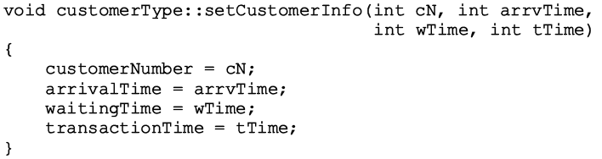

Slide 47
Server
At any given time unit
Server either busy serving a customer or free
String variable sets server status
Every server has a timer
Program might need to know which customer served by which server
Server stores information of the customer being served
Three member variables associated with a server
status, transactionTime, currentCustomer

Slide 48
Server (cont’d.)
Basic operations performed on a server
Check if server free
Set server as free
Set server as busy
Set transaction time
Return remaining transaction time
If server busy after each time unit
Decrement transaction time by one time unit
See class serverType code on page 477
Implements server as an ADT
Member function definitions

Slide 49
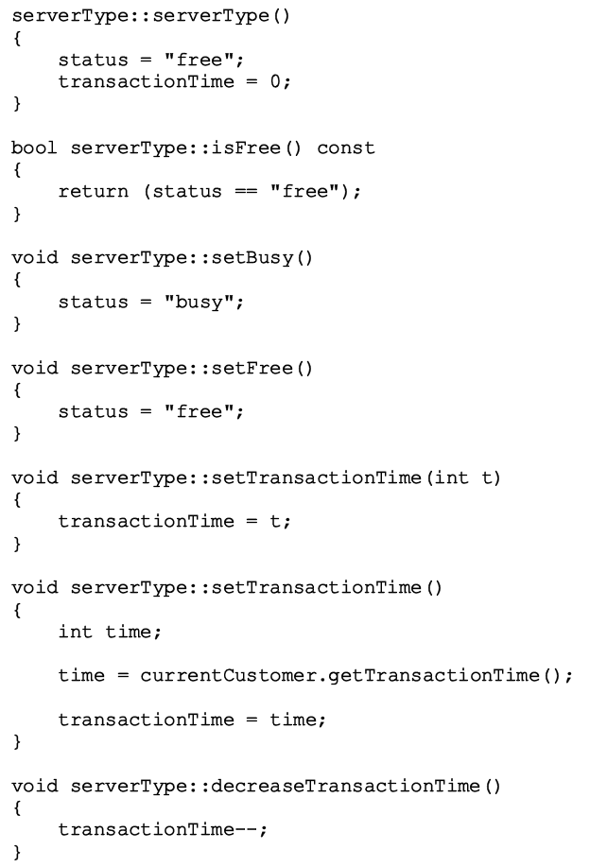

Slide 50
Server List
Set of servers
class serverListType
Two member variables
Store number of servers
Maintain a list of servers
List of servers created during program execution
Several operations must be performed on a server list
See class serverListType code on page 481
Implements the list of servers as an ADT
Definitions of member functions

Slide 51
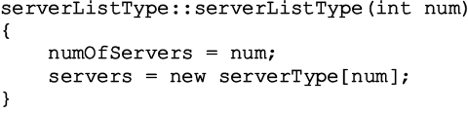

Slide 53
Waiting Customers Queue
Upon arrival, customer goes to end of queue
When server available
Customer at front of queue leaves to conduct transaction
After each time unit, waiting time incremented by one
Derive class waitingCustomerQueueType from class queueType
Add additional operations to implement the customer queue
See code on page 485

Slide 54
Main Program
Run the simulation
Need information (simulation parameters)
Number of time units the simulation should run
The number of servers
Transaction time
Approximate time between customer arrivals
Function setSimulationParameters
Prompts user for these values
See code on page 487

Slide 55
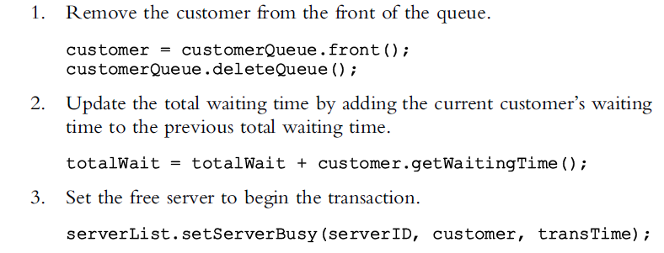
Main Program (cont’d.)
General algorithm to start the transaction

Slide 56
Main Program (cont’d.)
Use the Poisson distribution from statistics
Probability of y events occurring at a given time
Where λ is the expected value that y events occur at that time
Function runSimulation implements the simulation
Function main is simple and straightforward
Calls only the function runSimulation

Slide 57
Introduction to the Poisson Distribution
Poisson distribution is for counts—if events happen at a constant rate over time, the Poisson distribution gives the probability of X number of events occurring in time T.

Slide 58
Poisson Mean and Variance
Mean
For a Poisson random variable, the variance and mean are the same!
Variance and Standard Deviation
where λ = expected number of hits in a given time period

Slide 59
Poisson Distribution, example
The Poisson distribution models counts, such as the number of new cases of SARS that occur in women in New England next month.
The distribution tells you the probability of all possible numbers of new cases, from 0 to infinity.
If X= # of new cases next month and X ~ Poisson (λ), then the probability that X=k (a particular count) is:

Slide 60
Example
For example, if new cases of West Nile Virus in New England are occurring at a rate of about 2 per month, then these are the probabilities that: 0,1, 2, 3, 4, 5, 6, to 1000 to 1 million to… cases will occur in New England in the next month:

Slide 61
Poisson Probability table
X
P(X)
0
=.135
1
=.27
2
=.27
3
=.18
4
=.09
5
…
…

Slide 62
Example: Poisson distribution
Suppose that a rare disease has an incidence of 1 in 1000 person-years. Assuming that members of the population are affected independently, find the probability of k cases in a population of 10,000 (followed over 1 year) for k=0,1,2.
The expected value (mean) =λ = .001*10,000 = 10
10 new cases expected in this population per year→

Slide 63
more on Poisson…
“Poisson Process” (rates)
Note that the Poisson parameter λ can be given as the mean number of events that occur in a defined time period OR, equivalently, λ can be given as a rate, such as λ=2/month (2 events per 1 month) that must be multiplied by t=time (called a “Poisson Process”) →
X ~ Poisson (λ)
E(X) = λt
Var(X) = λt

Slide 64
Example
For example, if new cases of West Nile in New England are occurring at a rate of about 2 per month, then what’s the probability that exactly 4 cases will occur in the next 3 months?
X ~ Poisson (λ=2/month)
Exactly 6 cases?

Slide 65
Practice problems
1a. If calls to your cell phone are a Poisson process with a constant rate λ=2 calls per hour, what’s the probability that, if you forget to turn your phone off in a 1.5 hour movie, your phone rings during that time?
1b. How many phone calls do you expect to get during the movie?

Slide 66
Answer
1a. If calls to your cell phone are a Poisson process with a constant rate λ=2 calls per hour, what’s the probability that, if you forget to turn your phone off in a 1.5 hour movie, your phone rings during that time?
X ~ Poisson (λ=2 calls/hour)
P(X≥1)=1 – P(X=0)
∴P(X≥1)=1 – .05 = 95% chance
1b. How many phone calls do you expect to get during the movie?
E(X) = λt = 2(1.5) = 3

Slide 67
Summary
Queue
First In First Out (FIFO) data structure
Implemented as array or linked list
Linked lists: queue never full
Standard Template Library (STL)
Provides a class to implement a queue in a program
Priority Queue
Customers with higher priority pushed to the front
Simulation
Common application for queues

Slide 68
Multiple Queues
template <typename Type, int M>
class Multiqueue {
private:
queue<Type> queue_array[M];
int queue_size;
public:
Multiqueue();
bool empty() const;
Type top() const;
void push( Type const &, int );
Type pop();
};
template <typename Type, int M>
Multiqueue<Type>::Multiqueue():
queue_size( 0 ) {
// The compiler allocates memory for the M queues
// and calls the constructor on each of them
}
template <typename Type, int M>
bool Multiqueue<Type>::empty() const{
return ( queue_size == 0 );
}

Slide 69
Multiple Queues
template <typename Type, int M>
void Multiqueue<Type>::push( Type const &obj, int pri ) {
if ( pri < 0 || pri >= M ) {
throw illegal_argument();
}
queue_array[pri].push( obj );
++queue_size;
}
template <typename Type, int M>
Type Multiqueue<Type>::top() const {
for ( int pri = 0; pri < M; ++pri ) {
if ( !queue_array[pri].empty() ) {
return queue_array[pri].front();
}
}
// The priority queue is empty
throw underflow();
}
template <typename Type, int M>
Type Multiqueue<Type>::pop() {
for ( int pri = 0; pri < M; ++pri ) {
if ( !queue_array[pri].empty() ) {
--queue_size;
return queue_array[pri].pop();
}
}
// The priority queue is empty
throw underflow();
}

Slide 70
Multiple Queues
The run times are reasonable:
Push is Θ(1)
Top and pop are both O(M)
Unfortunately:
It restricts the range of priorities
The memory requirement is Θ(M + n)

