Slide 1
In class
Programming

Slide 2


Slide 3

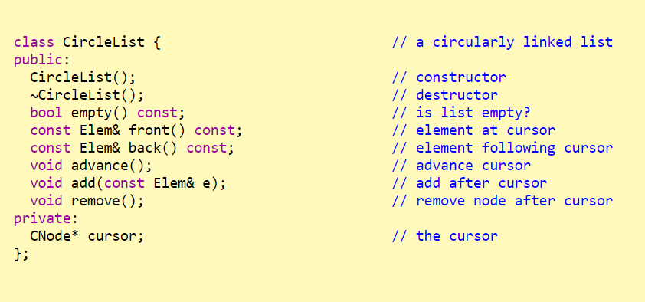

Slide 4



Slide 5
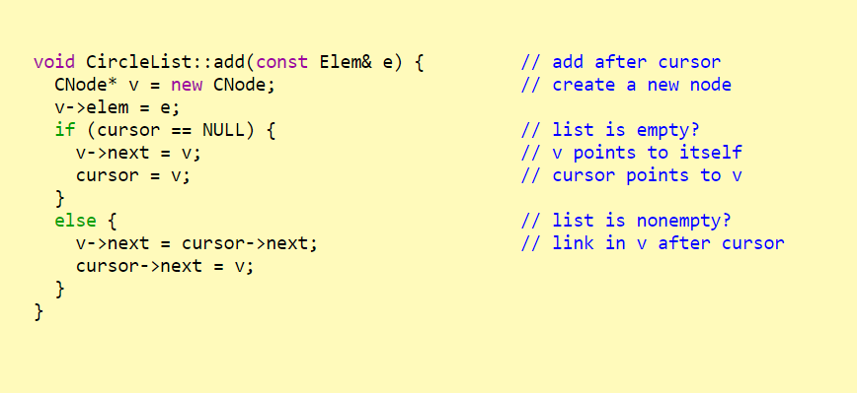

Slide 6


Slide 7
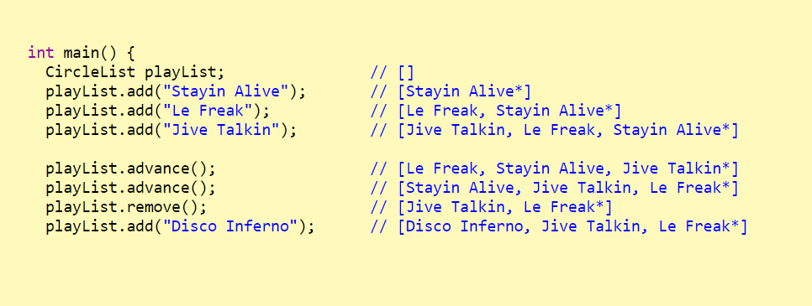

Slide 8

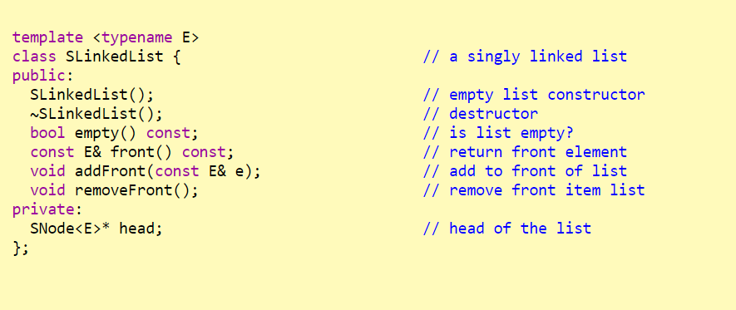

Slide 9

