Slide 1
Stick Diagrams by
S.N.Bhat,
Lecturer,
Dept of E&C Engg.,
M.I.T Manipal.
Sn.bhat@manipal.edu / msnbhat@yahoo.com
Stick Diagrams
S.N.Bhat, Faculty, Dept. of E&C Engineering, M.I.T Manipal

Slide 2
Stick Diagrams
Stick Diagrams
Objectives:
  To know what is meant by stick diagram.
  To understand the capabilities and limitations of stick diagram.
  To learn how to draw stick diagrams for a given MOS circuit.
Outcome:
  At the end of this module the students will be able draw the stick diagram for simple MOS circuits.
S.N.Bhat, Faculty, Dept. of E&C Engineering, M.I.T Manipal

Slide 3
Stick Diagrams
Stick Diagrams
N+
N+
S.N.Bhat, Faculty, Dept. of E&C Engineering, M.I.T Manipal

Slide 4
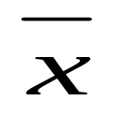

Stick Diagrams
Stick Diagrams
V_{DD}
V_{DD}
X
Stick
Diagram
X
X
X
Gnd
Gnd
S.N.Bhat, Faculty, Dept. of E&C Engineering, M.I.T Manipal

Slide 5
Stick Diagrams
Stick Diagrams
V_{DD}
V_{DD}
X
X
X
X
Gnd
Gnd
S.N.Bhat, Faculty, Dept. of E&C Engineering, M.I.T Manipal

Slide 6
Stick Diagrams
Stick Diagrams
VLSI design aims to translate circuit concepts onto silicon.
stick diagrams are a means of capturing topography and layer information using simple diagrams.
Stick diagrams convey layer information through colour codes (or monochrome encoding).
Acts as an interface between symbolic circuit and the actual layout.
S.N.Bhat, Faculty, Dept. of E&C Engineering, M.I.T Manipal

Slide 7
Stick Diagrams
Stick Diagrams
Does show all components/vias.
It shows relative placement of components.
Goes one step closer to the layout
Helps plan the layout and routing
A stick diagram is a cartoon of a layout.
S.N.Bhat, Faculty, Dept. of E&C Engineering, M.I.T Manipal

Slide 8
Stick Diagrams
Stick Diagrams
Does not show
  Exact placement of components
  Transistor sizes
  Wire lengths, wire widths, tub boundaries.
  Any other low level details such as parasitics..
S.N.Bhat, Faculty, Dept. of E&C Engineering, M.I.T Manipal

Slide 9
Stick Diagrams – Notations
Stick Diagrams
Metal 1
poly
ndiff
pdiff
Can also draw
in shades of
gray/line style.
Similarly for contacts, via, tub etc..

Slide 10
Stick Diagrams – Some rules
Stick Diagrams
Rule 1.
When two or more ‘sticks’ of the same type cross or touch each other that represents electrical contact.

Slide 11
Stick Diagrams – Some rules
Stick Diagrams
Rule 2.
When two or more ‘sticks’ of different type cross or touch each other there is no electrical contact.
(If electrical contact is needed we have to show the connection explicitly).

Slide 12
Stick Diagrams – Some rules
Stick Diagrams
Rule 3.
When a poly crosses diffusion it represents a transistor.
Note: If a contact is shown then it is not a transistor.
S.N.Bhat, Faculty, Dept. of E&C Engineering, M.I.T Manipal

Slide 13
Stick Diagrams – Some rules
Stick Diagrams
Rule 4.
In CMOS a demarcation line is drawn to avoid touching of p-diff with n-diff. All pMOS must lie on one side of the line and all nMOS will have to be on the other side.
S.N.Bhat, Faculty, Dept. of E&C Engineering, M.I.T Manipal

Slide 14
How to draw Stick Diagrams
Stick Diagrams
S.N.Bhat, Faculty, Dept. of E&C Engineering, M.I.T Manipal

Slide 15
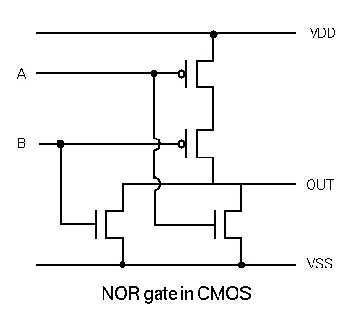
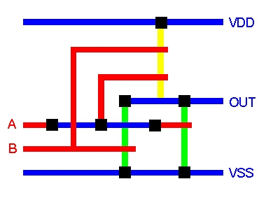
Stick Diagrams
S.N.Bhat, Faculty, Dept. of E&C Engineering, M.I.T Manipal

Slide 16
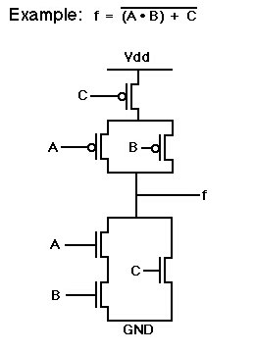
Stick Diagrams
Power
A
Out
C
B
Ground
S.N.Bhat, Faculty, Dept. of E&C Engineering, M.I.T Manipal

Slide 17
Stick Diagrams
Stick Diagrams
Summary:
  What is stick diagram?
  Why stick diagram?
  Conventions and rules related to stick diagram.
  Drawing stick diagrams.
S.N.Bhat, Faculty, Dept. of E&C Engineering, M.I.T Manipal

Slide 18
Stick Diagrams
Stick Diagrams
One minute paper.
S.N.Bhat, Faculty, Dept. of E&C Engineering, M.I.T Manipal

Slide 19
Stick Diagrams
Stick Diagrams
Home work:
  Draw the stick diagram for two input CMOS NAND gate.
  Draw the stick diagram for two input NAND gate using NMOS Logic.
  Draw the stick diagram for 2:1 MUX using
  a) Pass transistors
  b) Transmission gates.
  Drawing stick diagram is truly Fun!!. Enjoy it.
S.N.Bhat, Faculty, Dept. of E&C Engineering, M.I.T Manipal

