Slide 1

Visvesvaraya National Institute of Technology, Nagpur
Electronics and Communication Engineering Department
Executive M.Tech. in Applied AI & Communications
Cohort 3B sem. 3, Summer 2026
Eval. 2 (10/05/2026)
Subject- Natural Language Processing ECL545
CounterProbe.text- An AI based tool for news analysis
Presented by
Shubhankar Bagchi (MT24AAC006)
V Sadasiva Rao (MT24AAI168)
Mohd. Deen Ul Haq (MT24AA166)
Under the supervision of
Dr. Saugata Sinha Sir
VNIT Nagpur

Slide 2
Table of Contents:
Problem Statement & Datasets
Methods & Individual Contributions
Training Data & Testing Data
Algorithm
Work Done & Flowchart
Results Obtained

Slide 3
Problem Statement
Predicting the probability of correctness and of the news related to the geopolitics, strategic operations based on the publically available data given by the official authority channels that comes in the social media posts or blogs and main stream media articles and making it easier to understand for the civilians.
Fake News Detection Datasets | Kaggle https://share.google/iYTh4zJhFfHVqYlQp

Slide 4
Methods (NLP Pipeline) & Individual Contributions
By Mohd. Deen Ul Haq
Dataloading
Preprocessing
By Shubhankar Bagchi
Encoding
Tokenization
Model building (Bi LSTM model)
By V Sadasiva Rao
Training
Evaluation

Slide 5
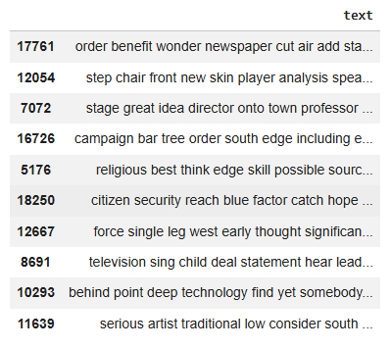
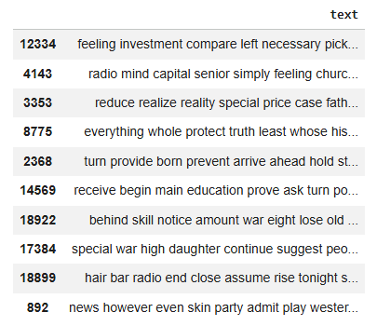
Training Data Testing Data

Slide 6
Algorithms (Bi LSTM)
Bidirectional Long Short-Term Memory (BiLSTM) is a deep learning algorithm. It is a sophisticated type of Recurrent Neural Network (RNN) designed for sequence data, which enhances standard LSTMs by processing data in both forward and backward directions to capture, for instance, a word's past and future context simultaneously.

Slide 7
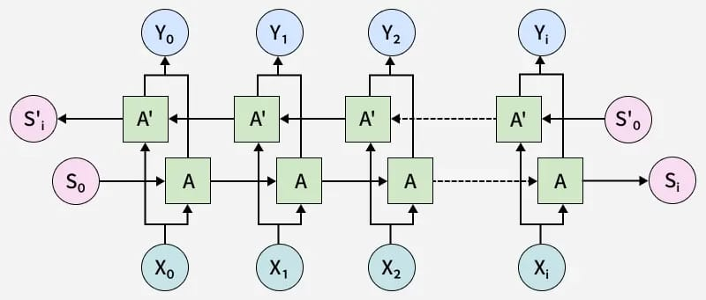
Bi LSTM Diagram

Slide 8
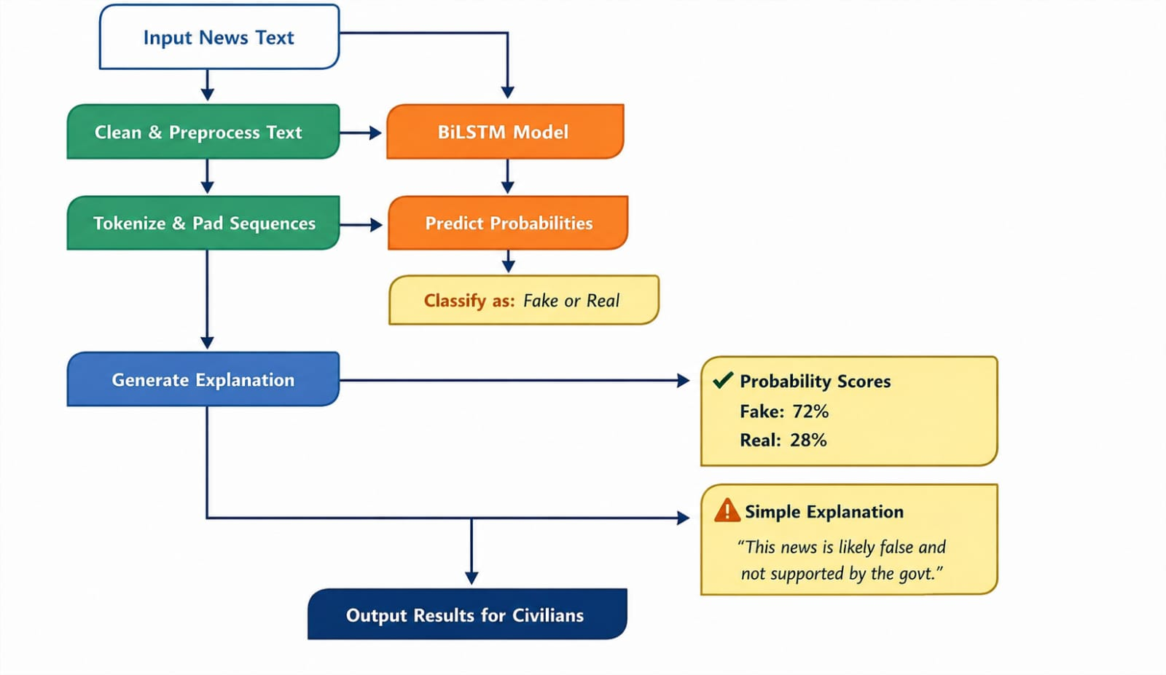
Work & Flowchart

Slide 9
Result Obtained
Enter news text: stock market is going to crash during this week
Prediction: fake
Probabilities:
fake: 0.5921
real: 0.4079
Explanation: This news appears misleading. Official government sources do not support this claim. It may be exaggerated or false.

Slide 10
Enter news text: southern part will start to experience heat wave
Prediction: real
Probabilities:
fake: 0.3903
real: 0.6097
Explanation: This news aligns with official government information. It is likely accurate.

Slide 11
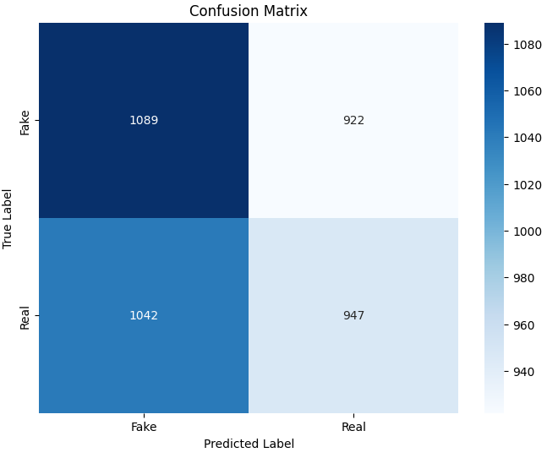
Confusion Matrix
Total parameters: 6,081,608 (23.20 MB)
Trainable parameters: 2,027,202 (7.73 MB)
Non-trainable parameters: 0 (0.00 B)
Optimizer parameters: 4,054,406 (15.47 MB)
Accuracy- 85% in the BiLSTM Model

Slide 12
Thank you
Git hub repository Link - https://github.com/sadavaranasi/news-analysis

