Slide 1

WIPRO NGA Program – Java Selenium Automation Testing
Capstone Project Presentation – 17 Feb 2025 - 25 March 2025
Project Title - Urbanladder Capstone Project
Presented by - Sada Yoosuf
www.rpsconsulting.in

Slide 2

INTRODUCTION
Comprehensive Test Automation – This project focuses on automating the core functionalities of the Urban Ladder e-commerce platform using Selenium WebDriver. It follows the Behavior-Driven Development (BDD) approach with Cucumber and the Page Object Model (POM) for better readability, maintainability, and scalability.
Cross-Browser Compatibility & Build Management – The framework supports Chrome, Firefox, and Edge to ensure a consistent user experience across multiple environments. Maven is used for dependency management and build automation.
Reporting & Execution – Automated test execution is managed using TestNG, and results are logged using Extent Reports and screenshot capture for debugging.
2
2024 - RPS Consulting all rights reserved

Slide 3
OBJECTIVE
•Ensure Reliability: Automate UI testing to validate the core functionalities of the UrbanLadder website.
•Improve Efficiency: Reduce manual testing efforts by implementing an automated test suite using Selenium, Cucumber (BDD), and POM.
•Enhance Test Coverage: Validate essential features like home page sections, product search, filters, cart operations, and user authentication.
•Generate Comprehensive Reports: Use Extent Reports to capture test execution results with screenshots for failures.
•Enable Cross-Browser Testing: Ensure compatibility across multiple browsers (Chrome, Firefox, Edge).
2
2024 - RPS Consulting all rights reserved

Slide 4
ABOUT THE APPLICATION
•UrbanLadder is a leading online furniture and home décor retailer, offering a wide range of products, including sofas, beds, dining tables, storage solutions, and home accessories. The platform provides a seamless e-commerce experience, allowing users to browse, search, and purchase furniture online.
•Key Functionalities Tested:
•Home Page: Verified the presence of key sections like Top Offers, Recommended for You, and Navigation Menus.
•User Authentication: Automated user registration, login, and password reset/edit profile settings.
•Search & Filters: Automated search functionality, filtering products by category, price range and new arrivals.
•Product Details Page: Validated product title, description, images, price, and stock availability.
•Wishlist & Cart: Tested adding/removing items to wishlist and shopping cart, updating quantities, and proceeding to checkout.
•Payment Processing: Skipped; displayed "Product Purchased" and captured screenshots instead.
2
2024 - RPS Consulting all rights reserved

Slide 5
Testing process
The testing process for the Urban Ladder automation project follows a structured approach using Selenium, Cucumber (BDD), TestNG, and Jenkins for CI/CD integration. Below is a step-by-step breakdown of the testing process.
1. Test Planning :
Define test scenarios for key functionalities:
Home Page, Search, Product Details, Cart, Checkout, and User Authentication.
Identify required tools: Selenium WebDriver, Cucumber, TestNG, Maven, and Jenkins.
Set up the test environment with Chrome, Firefox, and Edge browsers.
2. Test Case Design (BDD with Cucumber):
Write test scenarios using Gherkin language in .feature files.
Each step in .feature files is mapped to step definitions in Java.
3. Test Execution (POM & Step Definitions):
Page Object Model (POM) organizes locators and actions for each webpage.
Step Definitions execute test steps using Selenium WebDriver.
TestRunner.java triggers the execution.
Hooks.java handles @Before (setup) and @After (teardown) tasks.
2
2024 - RPS Consulting all rights reserved

Slide 6
4. Reporting & Logging:
Extent Reports generate HTML test execution reports.
Screenshots captured on failures for debugging.
Logs track execution flow.
5. Jenkins Integration :
Automated Test Execution – Jenkins is used to execute test cases and generate reports automatically.
GitHub Integration with Jenkins – The project is stored in GitHub, and Jenkins pulls the latest code from the repository to execute the test suite, ensuring up-to-date testing.
HTML Report Generation – Test execution results are captured and displayed using Extent Reports, which are integrated into Jenkins.
2
2024 - RPS Consulting all rights reserved

Slide 7
Major functionalities automated
1. Home Page:
Verify UI elements: Top Offers, Recommended Products, Search Bar.
2. Search Functionality :
Automate product search with inputs.
Apply filters (New Arrivals, Price Range) and verify results.
3. Product Details Page:
Validate product title, description, price, stock availability.
Test adding products to Wishlist & Cart.
4. Shopping Cart:
Verify adding multiple products, updating quantities, and removing items from cart.
Automate checkout initiation and redirection to the payment page.
5. User Registration & Login:
Automate new user registration with valid data.
Verify login functionality with correct/incorrect credentials.
Test updating account settings (e.g., changing the password).
6. UI & Cross-Browser Testing:
Ensure responsive UI across Chrome, Firefox, Edge.
7. Jenkins integration & Reporting:
Execute test cases using Jenkins .
Generate Extent Reports for test execution summary.
2
2024 - RPS Consulting all rights reserved

Slide 8
Sample feature files
Feature files in Cucumber (BDD) define test scenarios in Given-When-Then format.
They serve as human-readable test scripts that automate UI functionality using Selenium WebDriver.
Each feature file maps to Step Definition methods that execute the test steps.
- Created 5 Feature Files in urbanladder project, that are:
1. HomePage.feature:
Validates UI elements like Top Offers, Recommended Products, and Search Bar.
2. Login.feature:
Automates user registration & login with valid/invalid credentials.
Tests account settings update (password change, profile edit).
3. Search.feature :
Tests product search with inputs and validate it.
Automates applying filters (New Arrivals, Price Range) and verifies filtered results.
4. ProductDetails.feature :
Validates product information (title, description, price, stock availability).
Tests and validate by adding items from Wishlist & Cart.
5.Cart.feature:
Verifies adding/removing products in the shopping cart.
Tests quantity updates, clicks on checkout button and take screenshot.
2
2024 - RPS Consulting all rights reserved

Slide 9
PROJECT STRUCTURE
The project follows a structured hybrid automation framework using Page Object Model (POM) with BDD (Cucumber). It is well-organized into different packages and directories to maintain modularity, reusability, and readability.
1. src/test/java (Test Code Directory)
com.urbanladder.objectrepo – Contains Locators.java, which stores all web element locators for easy access.
com.urbanladder.pages – Implements Page Object Model (POM) with individual classes for Homepage, Product Details Page, Cart Page, User Authentication Page, and Search Page to maintain reusability.
com.urbanladder.stepdefinition – Holds Step Definition files that link Cucumber feature files to Java methods. Hooks.java manages pre/post-test execution setup.
com.urbanladder.runner – Contains TestRunner.java, which executes the feature files using Cucumber and TestNG.
com.urbanladder.utils – Utility package with helper classes like Base.java (browser setup), Report.java (Extent Report integration), and PropertyReader.java (configuration handling).
2
2024 - RPS Consulting all rights reserved

Slide 10
2. src/test/resources (Test Data & Configuration Directory)
config – Stores config.properties, which includes browser settings, URLs, and credentials for flexible test execution.
feature – Contains Cucumber feature files defining test scenarios in Gherkin syntax.
This structured approach ensures modularity, reusability, and easy maintenance while making the automation framework scalable and efficient.
2
2024 - RPS Consulting all rights reserved

Slide 11
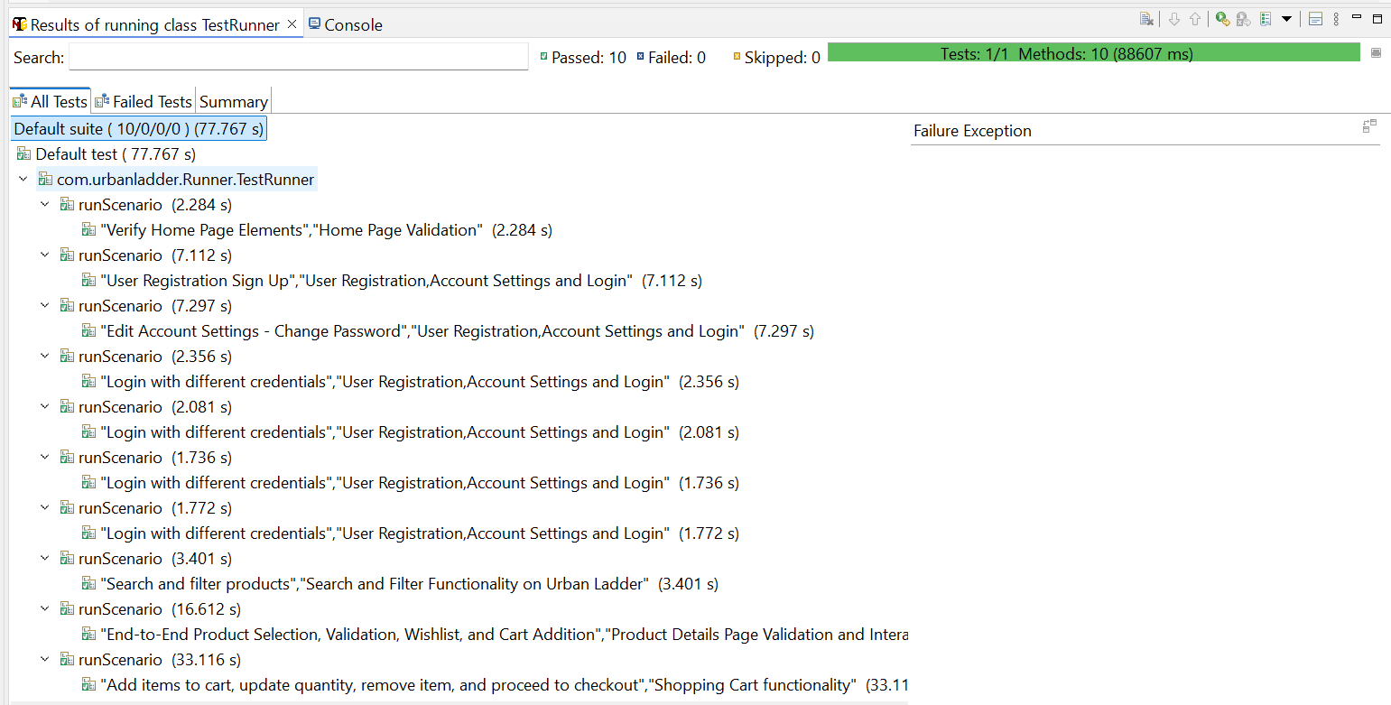
Screenshots of test cases, reports, screenshots and log
1. Running Tests Through TestNG (Test Execution Screenshot):
2
2024 - RPS Consulting all rights reserved

Slide 12
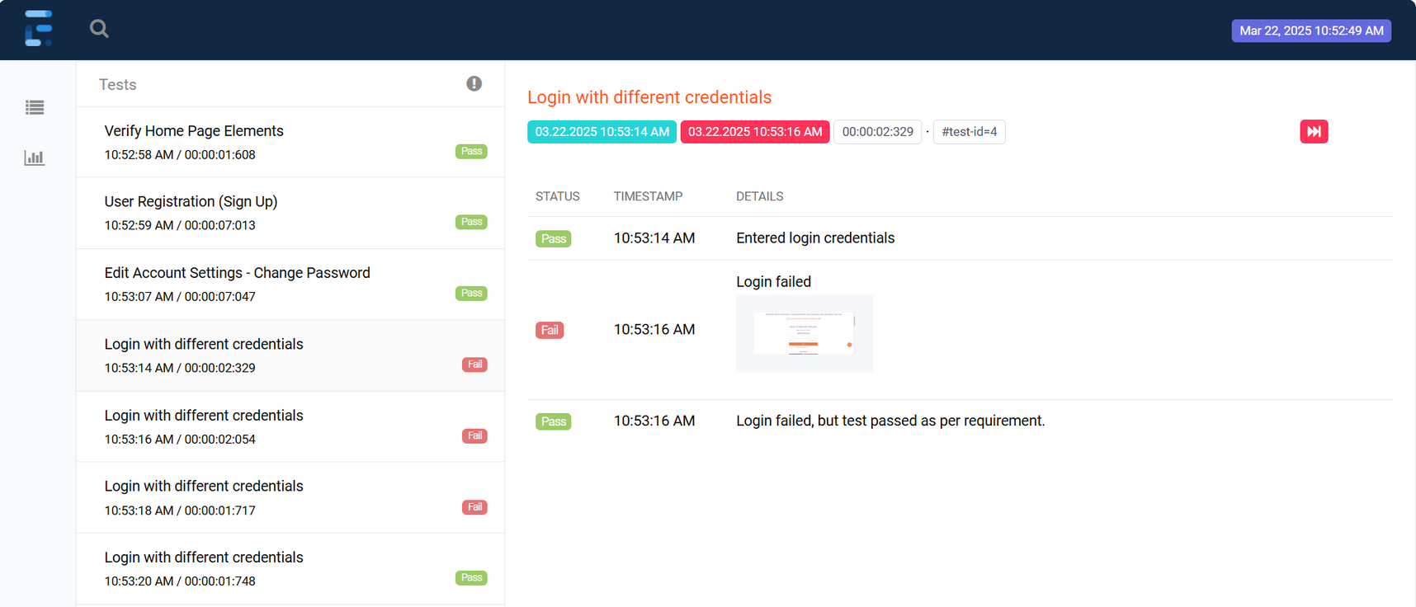
2.Extent Reports (Test Report Screenshot):
2
2024 - RPS Consulting all rights reserved

Slide 13
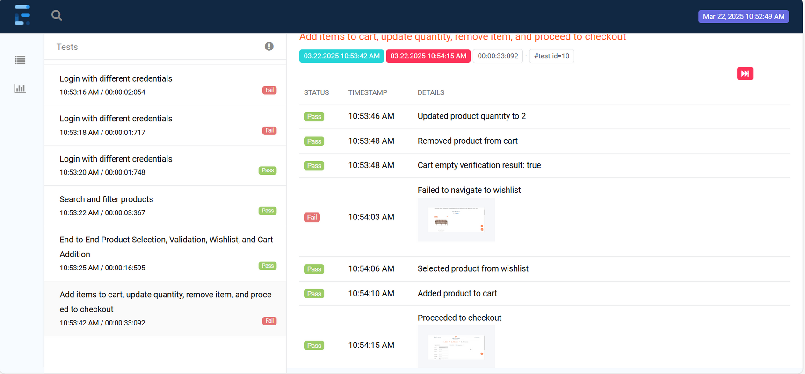

Slide 14
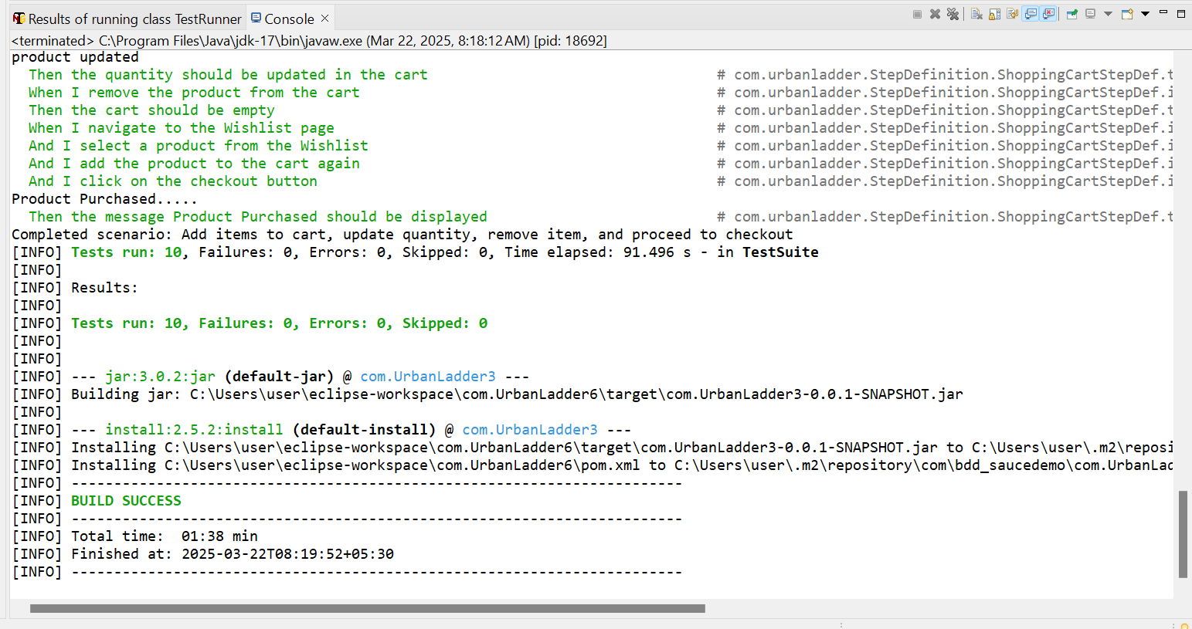
3.Running Tests from Maven:
2
2024 - RPS Consulting all rights reserved

Slide 15
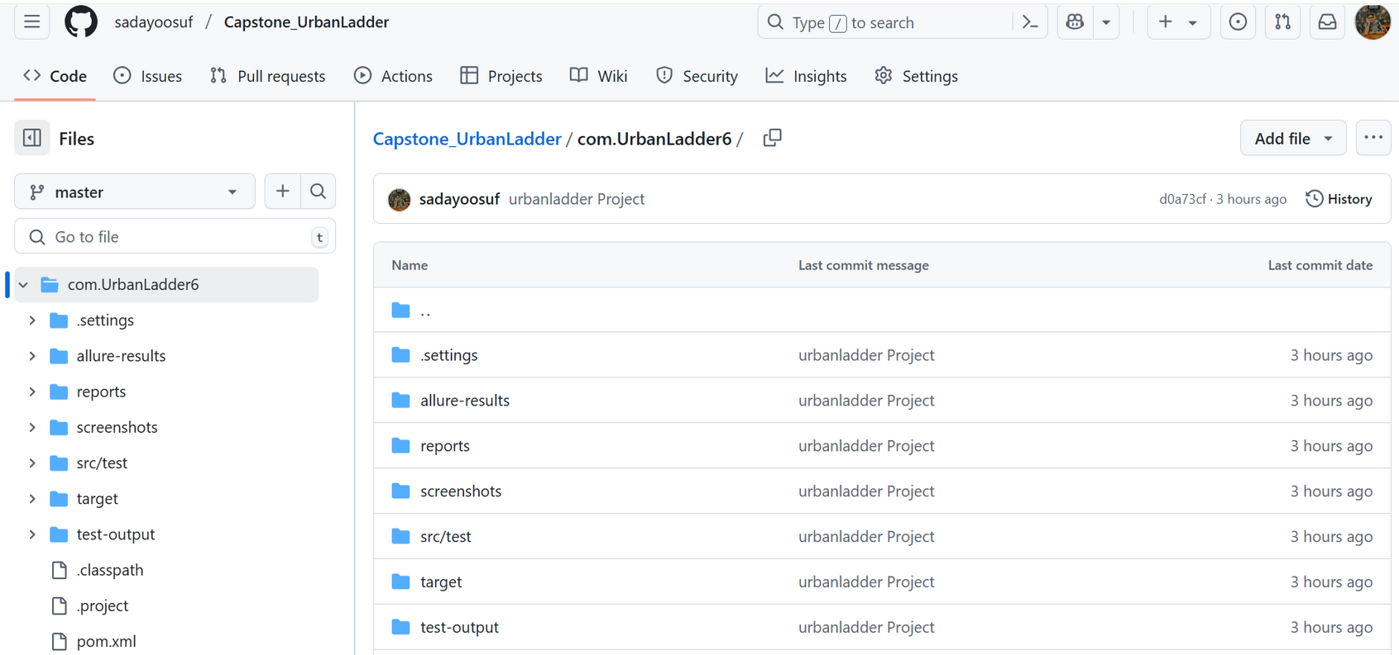
4. Project Pushed to GitHub
2
2024 - RPS Consulting all rights reserved

Slide 16
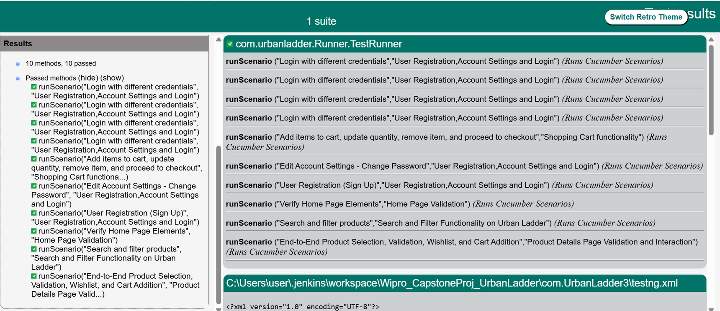
5.Jenkins HTML Report :
2
2024 - RPS Consulting all rights reserved

Slide 17
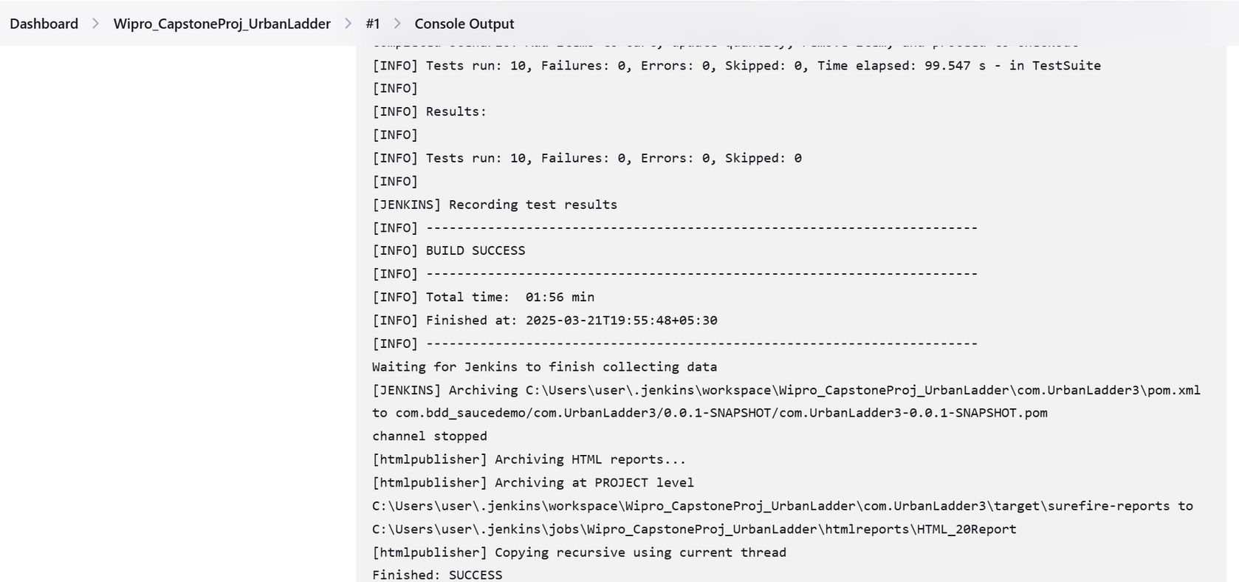
6.Jenkins Console Output:
2
2024 - RPS Consulting all rights reserved

Slide 18
Conclusion
The Urban Ladder Automation Project efficiently automates key e-commerce functionalities using Selenium, Cucumber (BDD), and TestNG, ensuring faster execution and improved accuracy. It provides comprehensive test coverage, validates critical features like Homepage, Search, Cart, and Checkout, and supports cross-browser testing on Chrome, Firefox, and Edge. With Jenkins integration, Extent Reports, and TestNG Reports, it ensures detailed logging and quick defect identification. The Page Object Model (POM) enhances scalability and maintainability, making the framework a robust, reusable, and efficient solution for e-commerce UI testing.
2
2024 - RPS Consulting all rights reserved

