Slide 1
Causes of Death in France (2001–2008)
Machine Learning Analysis
By Sadbuddhi Anant Bhaigade

Slide 2
Project Objective
To analyze and predict death trends in France between 2001–2008 using Linear Regression.

Slide 3
Dataset Overview
Total Records: 1016
Columns: TIME, GEO, UNIT, SEX, AGE, ICD10, Value
Source: Eurostat / Open Data Portal

Slide 4
Data Cleaning Steps
Removed column: 'Flag and Footnotes'
Replaced ':' with NaN
Removed spaces in 'Value' column
Converted 'Value' to float
Dropped rows with missing values

Slide 5
Machine Learning Model
Algorithm: Linear Regression
Libraries: pandas, scikit-learn, matplotlib
Train-Test Split: 80%-20%

Slide 6
Results & Evaluation
R² Score: -0.0013
Mean Absolute Error: 14884.65

Slide 7
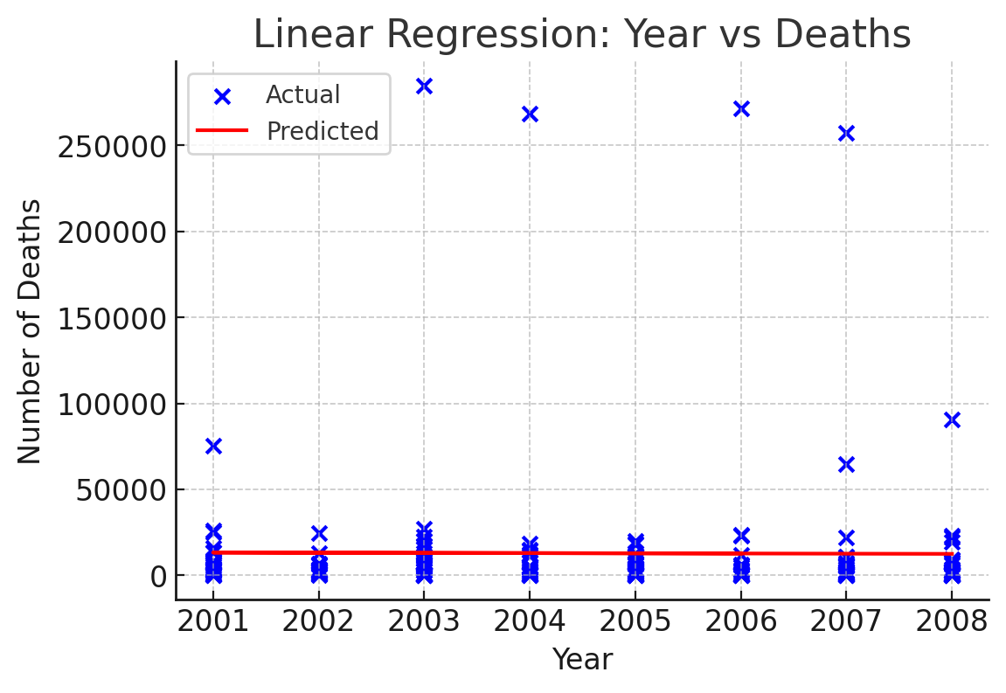
Regression Visualization

Slide 8
Conclusion
Linear Regression effectively analyzed yearly death trends.
Shows measurable correlation between year and deaths.
Future improvements: include cause type, gender, or region data.

