Slide 1
API
Maret, Minggu keempat, Pertemuan ke-1

Slide 2
DB
DB
BACKEND
request
response
Desktop
WEBSITE
Android
GET
API
POST
backend.com/api/v1/users
backend.com/api/v1/products
PUT
DELETE
request
request
response
response
response
request
MOBILE
DESKTOP
WEBSITE

Slide 3
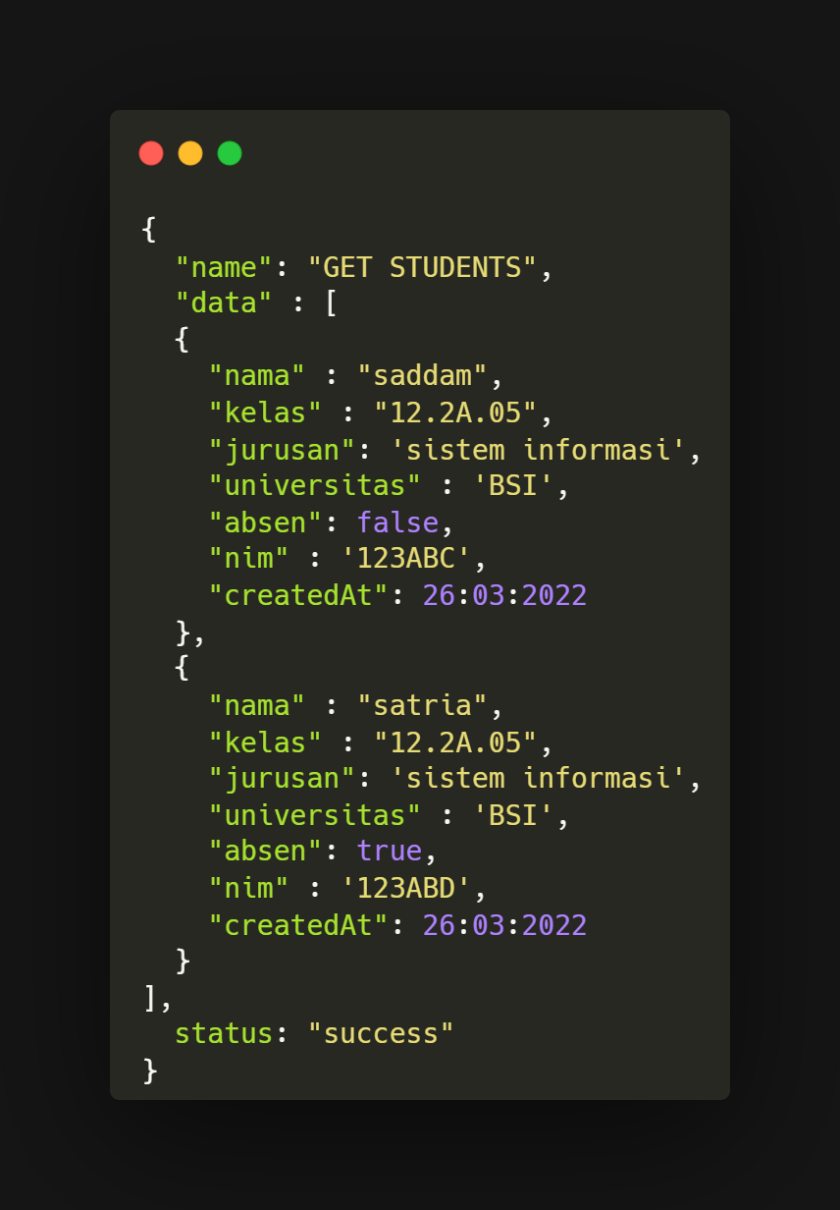
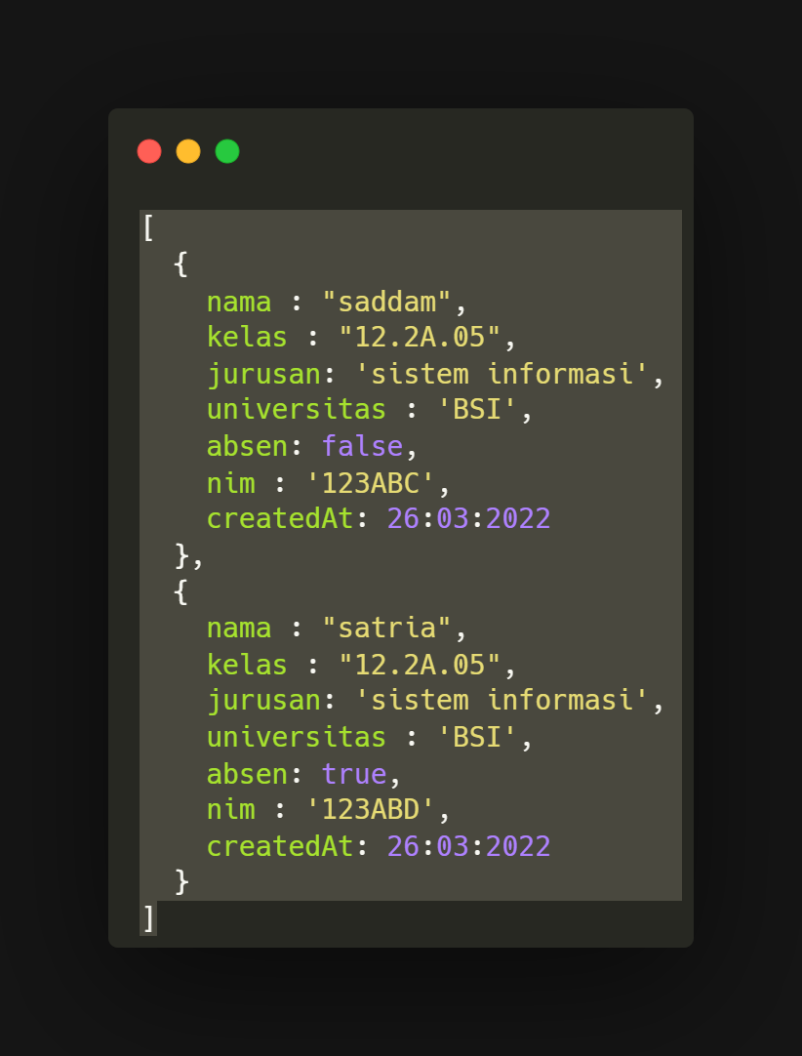
JSON
Array / collection entity
nama | kelas | jurusan
FRONTEND
response
BACKEND
response
DB
request
Query
backend.com/api/v1/students
SELECT * FROM `students`
GET

Slide 4
Problem API

Slide 5
GRAPHQL
DB
= Current Data
= New Data
BACKEND
Nama
Jurusan
request
response
GraphQL
Kelas
Universitas
MUTATION
backend.com/graphql
QUERY
request
request
response
response
response
request
MOBILE
DESKTOP
WEBSITE
Satu endpoint bisa ngequery banyak hal

Slide 6
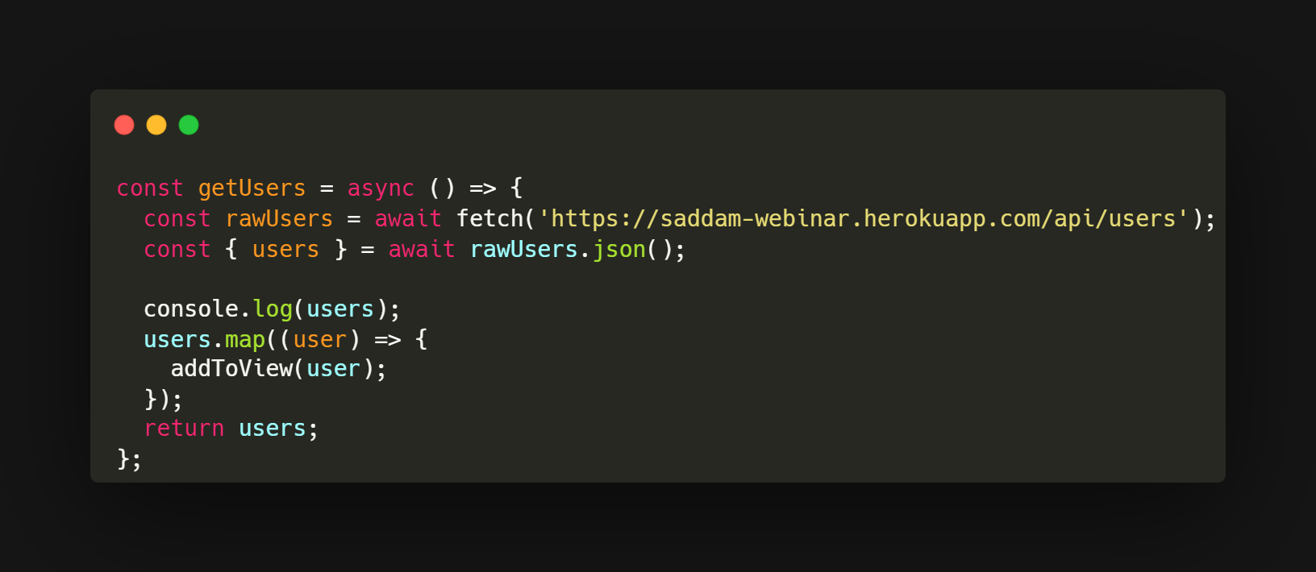
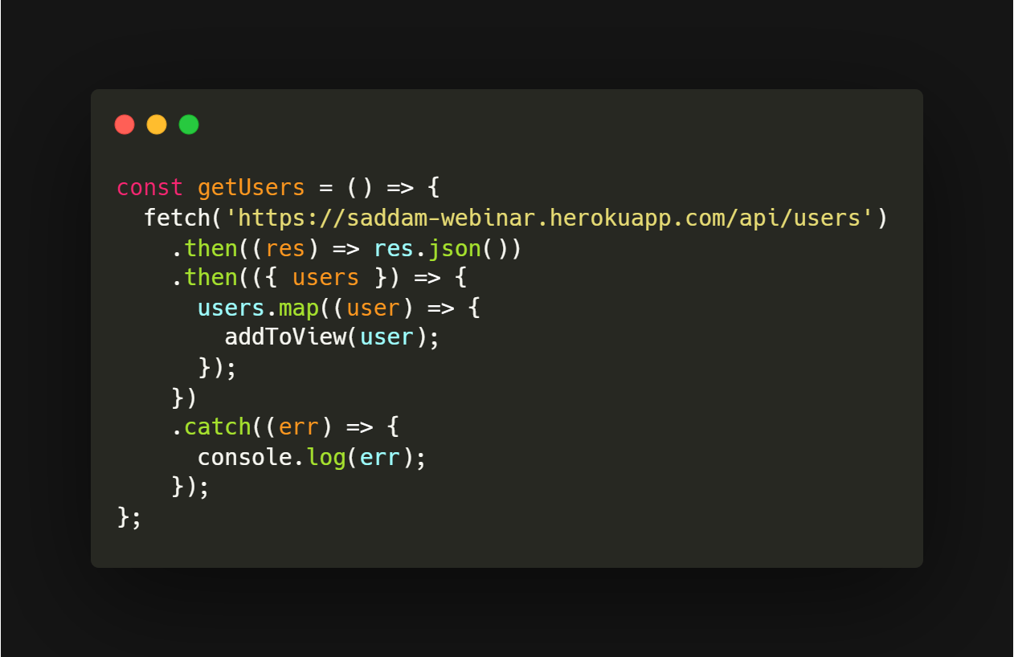
Async await vs promise

Slide 7
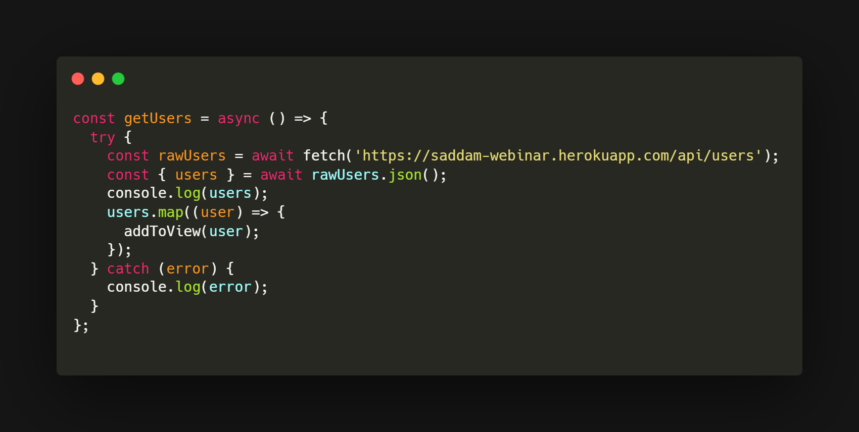
Try Catch

Slide 8
QUESTIONS

