Slide 1

IIMT COLLEGE OF ENGINEERING
Presentation on
Airlines management system
Team member :-
Saddam Hussain(leader)
Kumar Adarsh
Prabhat jha
Anand shankar
Himanshu gupta
Kumar saurabh
Guided by :-
Deepa Basantani

Slide 2
Airlines management system
1. Synopsis Presentation Presented by:- House Stark (FLIGH HIGH).
Airline Reservation System contains the details about flight schedules and its fare tariffs, passenger reservations and ticket records. An airline’s inventory contains all flights with their available seats. (ARS) is a computerized system used to store and retrieve information.
Modules
Registration module
Administrative module
Passenger Module

Slide 3
PROJECT PROFILE
Project title: airlines management system.
Project description: passenger can make his/her reservation easily.
Front end tool: html, css, bootstrap.
Back end tool: mysql, servlet,JSP.

Slide 4
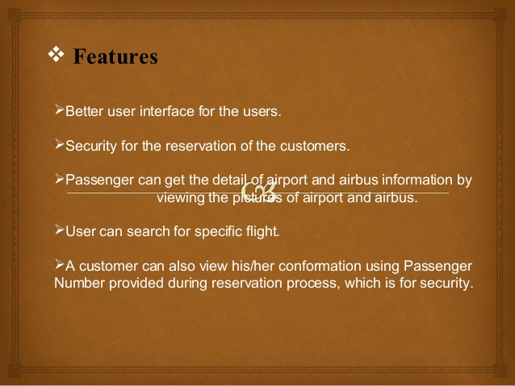

Slide 5
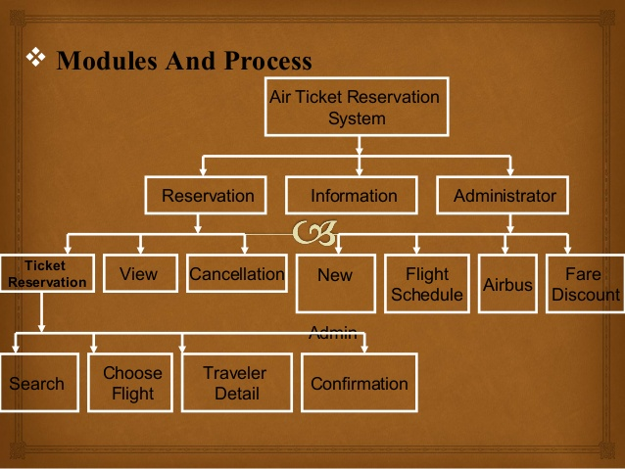

Slide 6
PROJECT WORKING
Firstly we ask passenger to give his details . ▪ After registering the passenger can logon to his/her own account and book his flight. ▪ Once Passenger registered with us can book any number of tickets.
It is provided for the sake of administrators to manage the site and update the content at regular intervals, The major operations included in this module are: ▪ Create and maintain airline schedule, fare and timings of the Flight.
It is meant for passengers, where a user logging into his/her owns account will view this panel. The major operations included in this module were ▪ View all airline schedules, timings, fare details and seats availability. ▪ Book for the tickets.

Slide 7
Cont….
Firstly we ask passenger to give his details . ▪ After registering the passenger can logon to his/her own account and book his flight. ▪ Once Passenger registered with us can book any number of tickets. Registration Module
It is provided for the sake of administrators to manage the site and update the content at regular intervals, The major operations included in this module are: ▪ Create and maintain airline schedule, fare and timings of the Flight.
It is meant for passengers, where a user logging into his/her owns account will view this panel. The major operations included in this module were ▪ View all airline schedules, timings, fare details and seats availability. ▪ Book for the tickets.

Slide 8
Need of airline system
Airline Reservation System make the life of passengers very easy as they don’t need to stand in queues for getting their seats reserved and they can easily make reservations on any airline just from a single system. The purpose of Airline reservation system project is to build an application program which airline could use to manage the reservation of airlines ticket.
FLIGH HIGH is online reservation system, which enable customer to check the availability tickets & book their tickets . ▪ It makes the customer easy to get ticket online instead of queue up to buy the tickets.

Slide 9
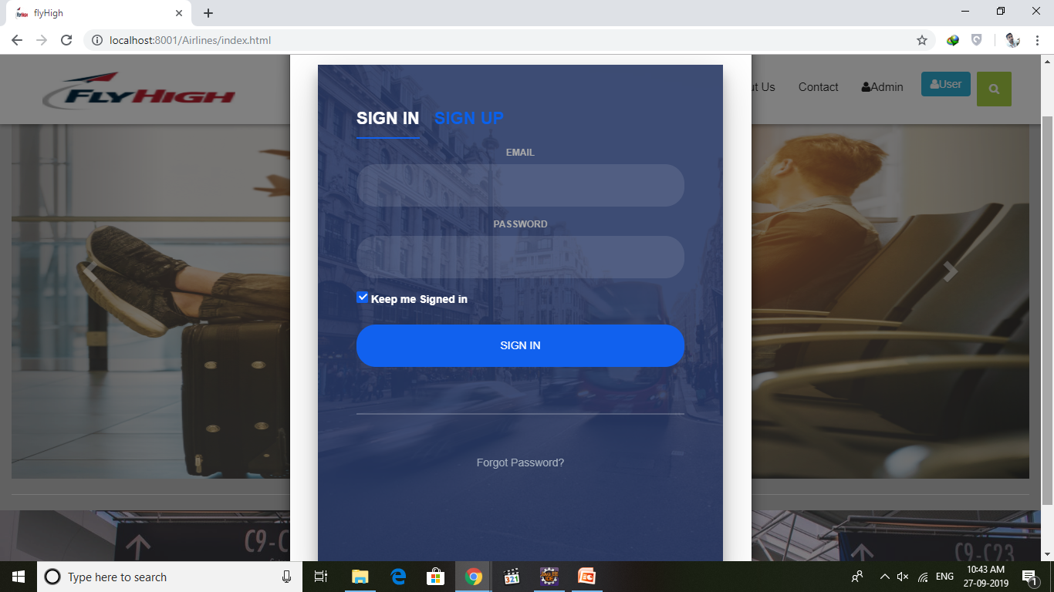

Slide 10
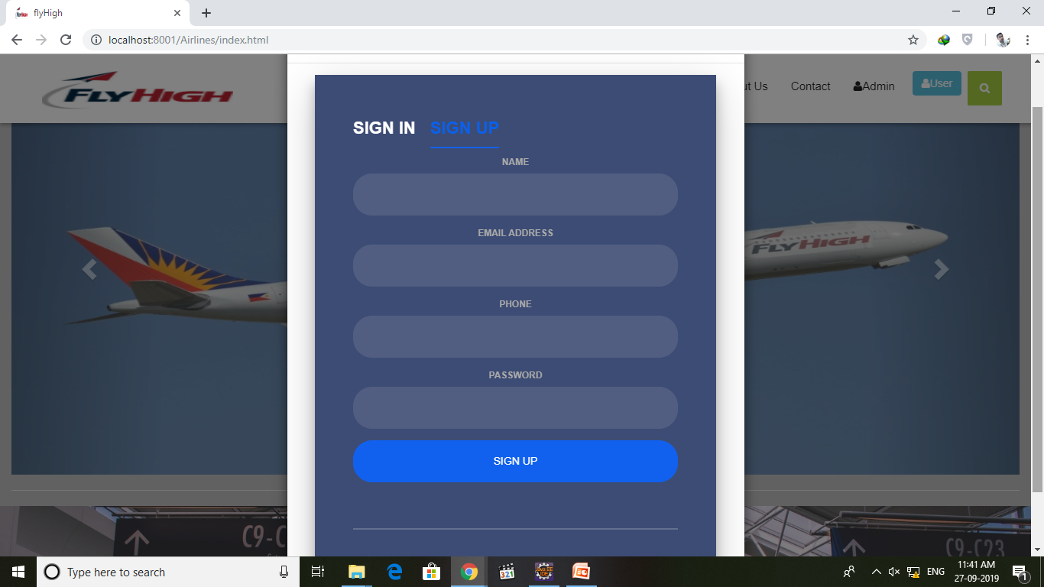

Slide 11
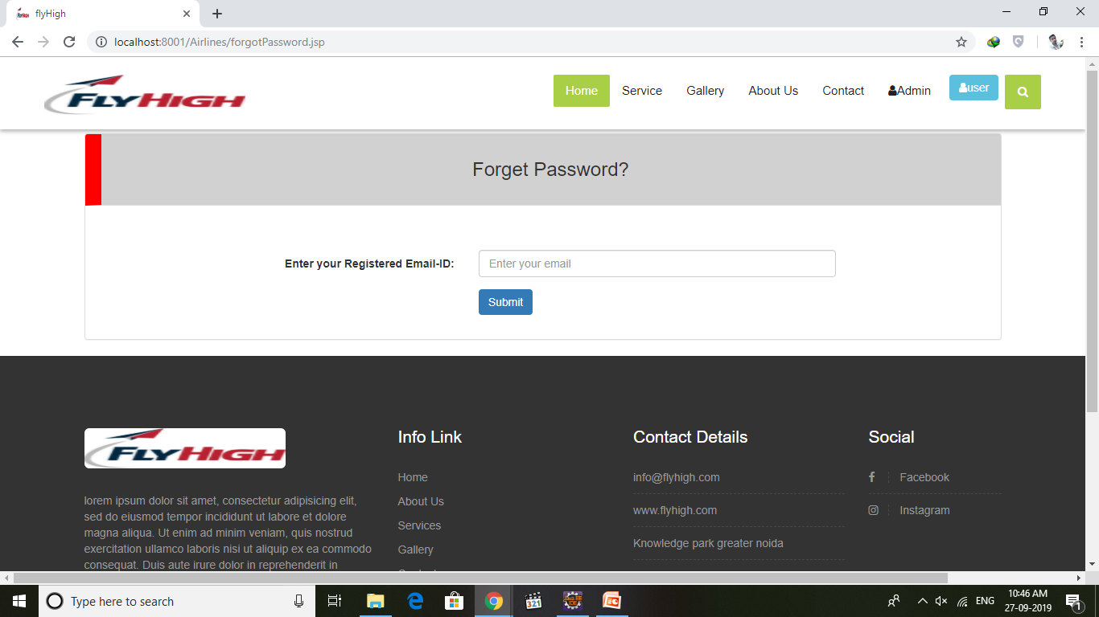

Slide 12
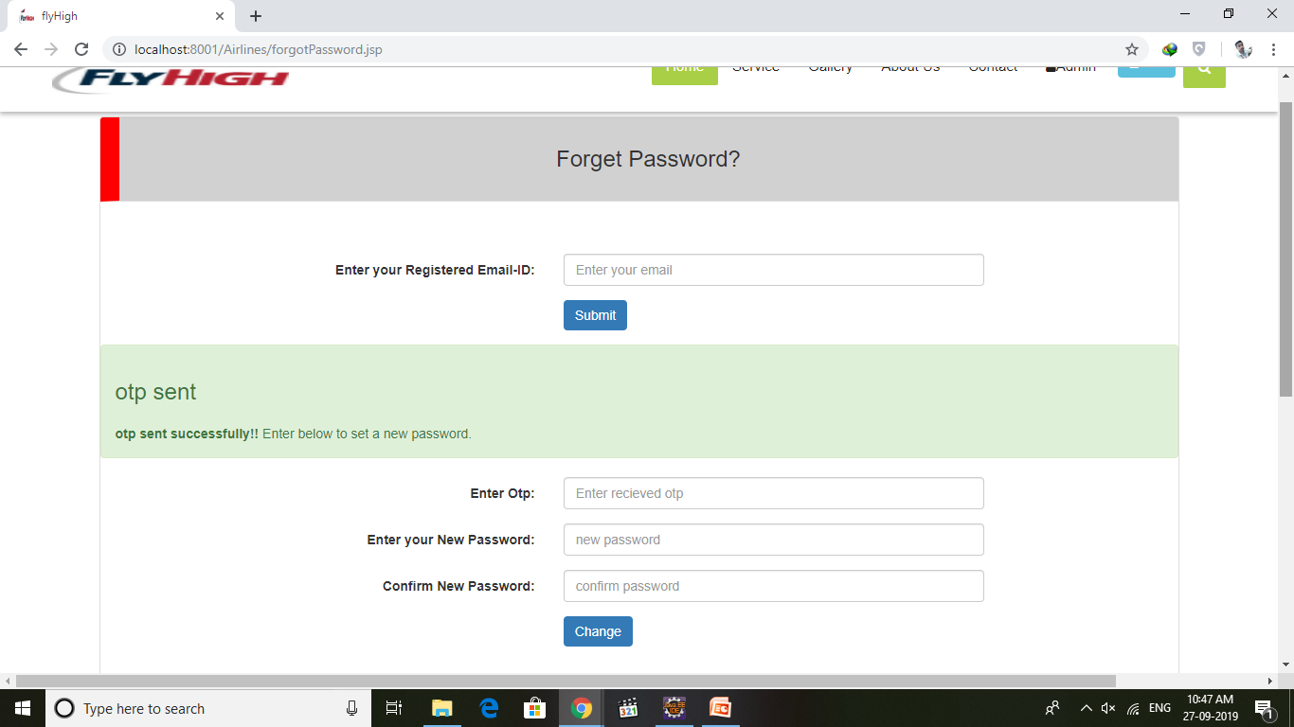

Slide 13
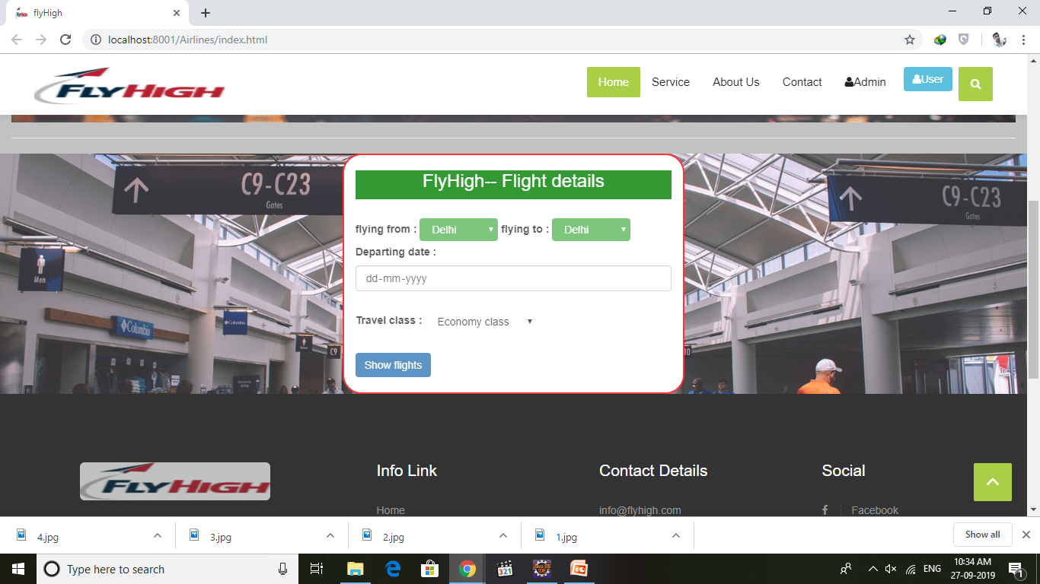

Slide 14
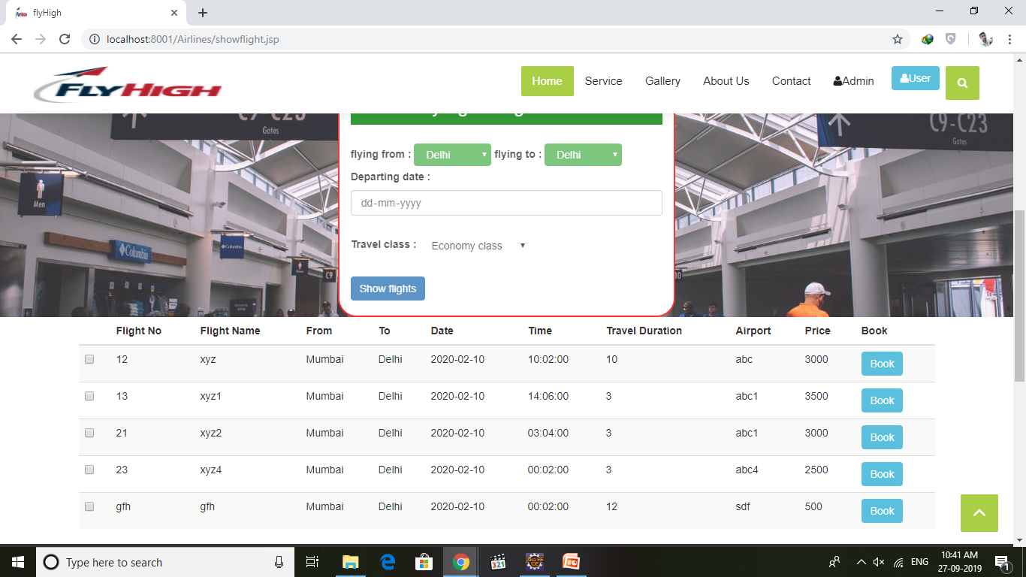

Slide 15
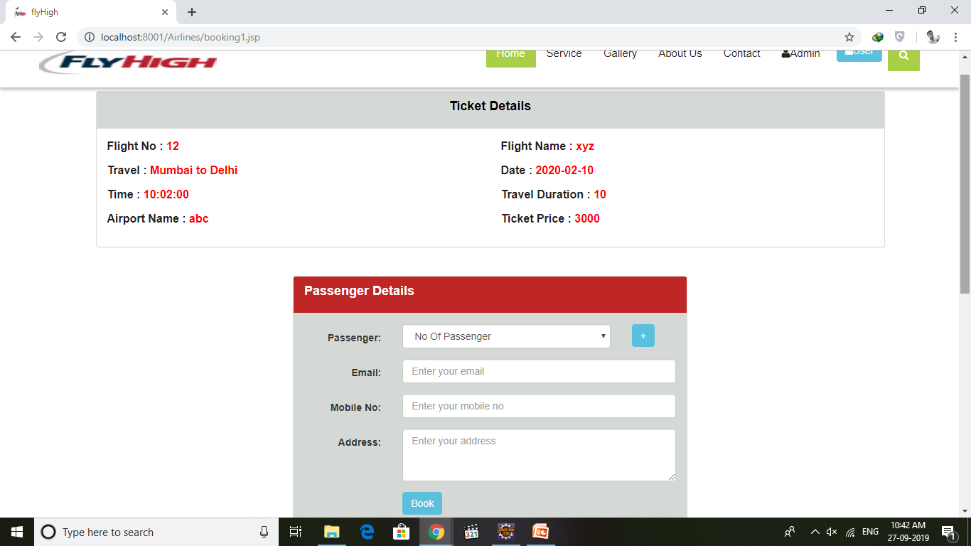

Slide 16
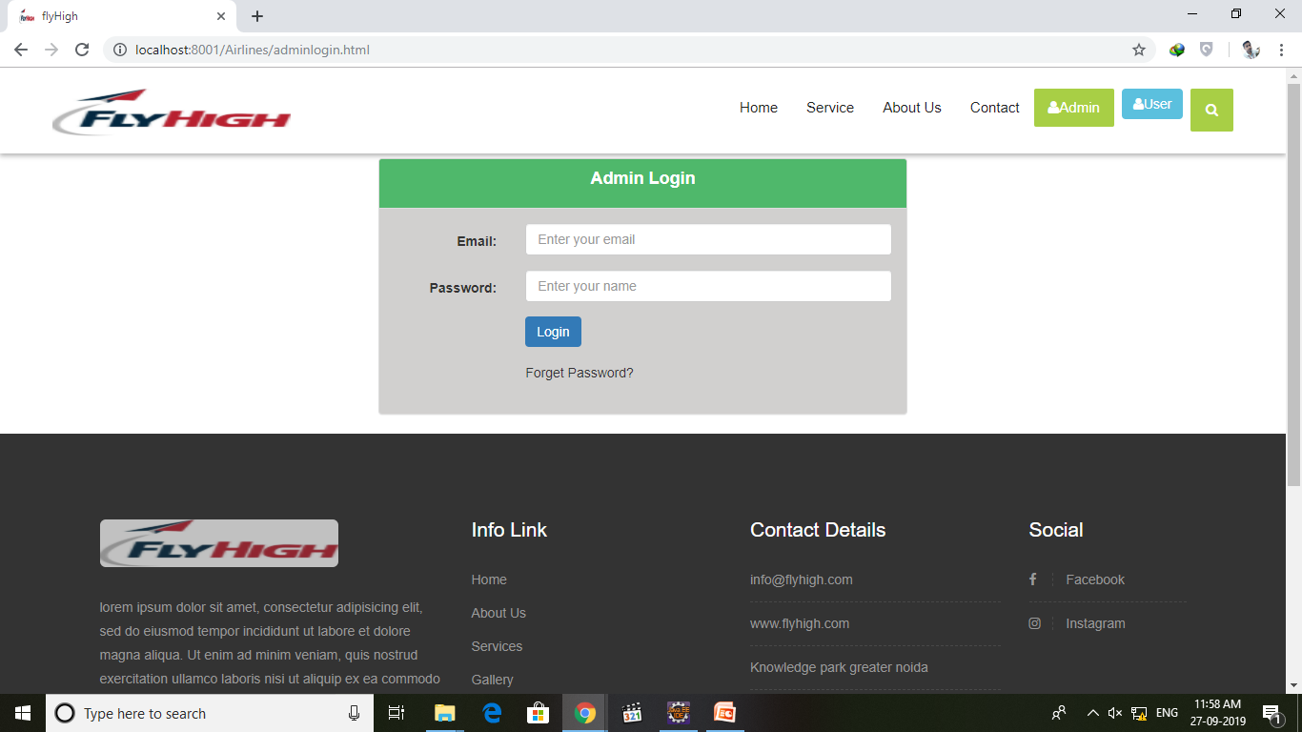

Slide 17
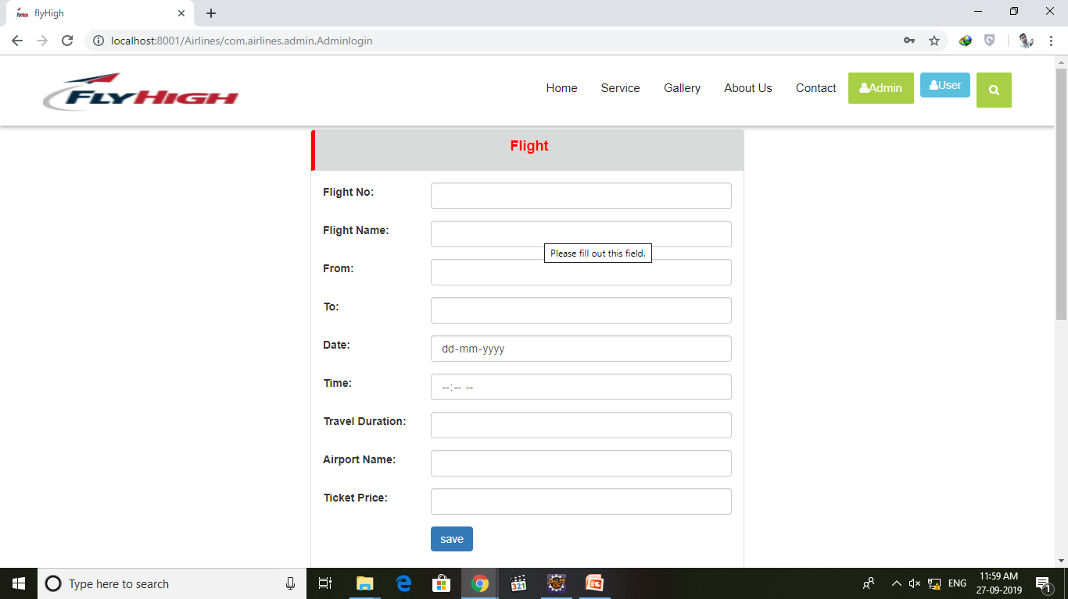

Slide 18
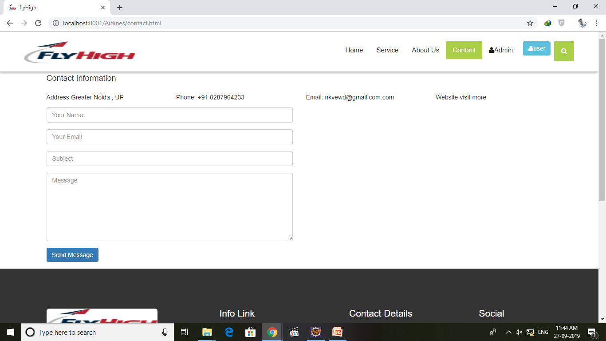

Slide 19
THANK YOU

