Slide 1
WELCOME TO MY PRESENTATION

Slide 2
Grocery Management System

Slide 3
Course Title : Software Development Project- I and Industrial Tour Course Code : CSE-2112
SUBMITTED BY :
Saddam Hossen
ID : CE-18046
SUPERVISOR :
Md. Mahfuz Reza
Associate Professor
Dept. of Computer Science and Engineering

Slide 4
INTRODUCTION
“Grocery Management System” is a simple c++ language based application.
Main objective to create this application is:
Display product.
Update product.
Sell product.

Slide 5
HOW IT WORKS
First ask me what will to do. And give some option with indicator. According to our demand we take the indicator input and go forward. Such we can buy product, see product list & update product list.
Display product: Customer can see all product with price, stock.
Update: Shopkeeper can update any product price and stock if needed.
Buy: Customer can buy different type of product. Finally have given a Memo.
Nothing: if customer do not want to buy any product, then application will close

Slide 6
FLOW CHART
START
Declare variables and start from the main function
Functions
Display Product
Buy
Update

Slide 7
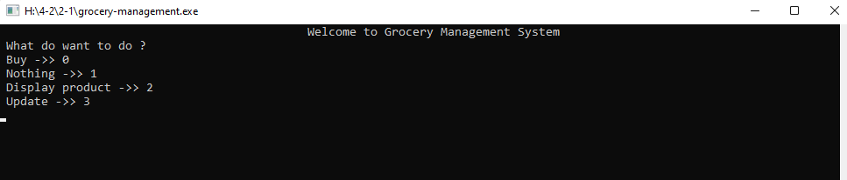
PROJECT OUTPUTS

Slide 8
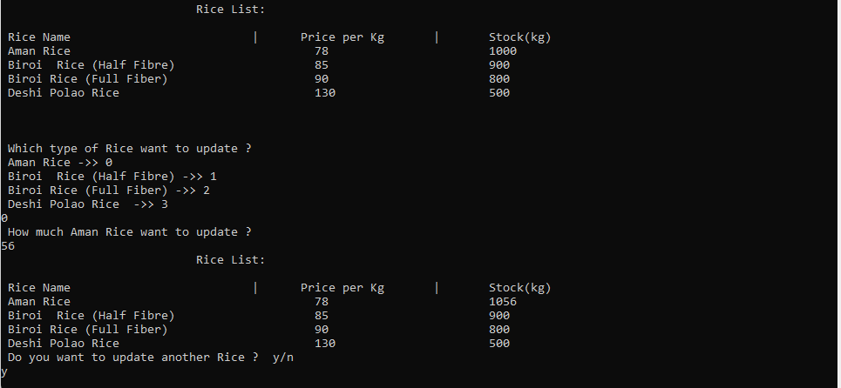
UPDATE

Slide 9
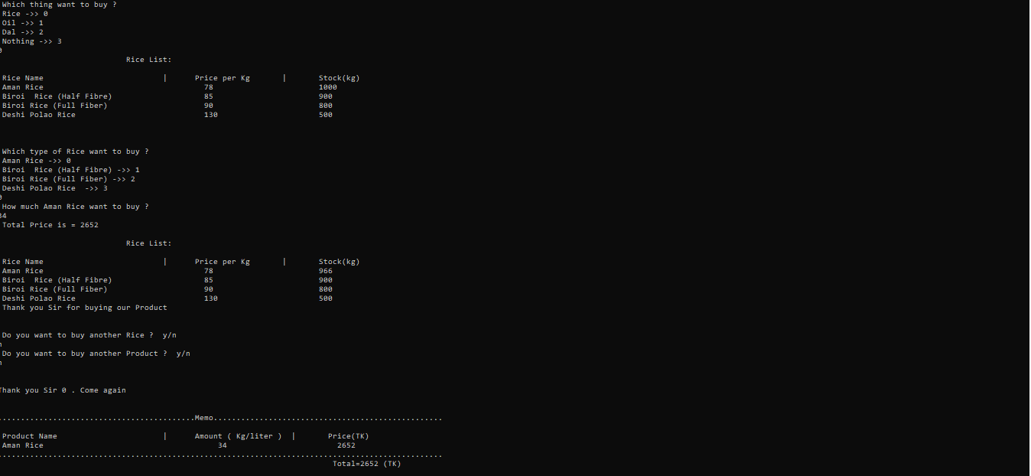
BUY

Slide 10
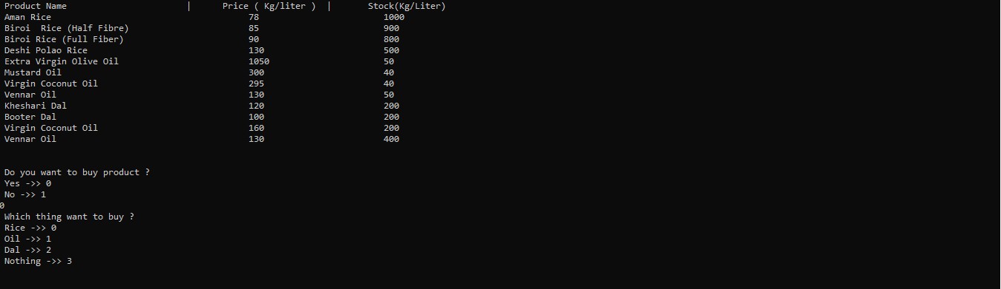
DISPLAY PRODUCT

Slide 11
LIMITATIONS
Product cannot update from inside the function
Product list limited.
Cannot buy same type of product repeating.

Slide 12
FUTURE WORKS
In future I will try to solve the limitations:
Product update limitation
Product list limitation
Buying same type of product repeating limitation

Slide 13
THANK
YOU

