Slide 1
CSE 687: Object Oriented Design
Campus Shuttle For Syracuse University
Team 40
Kashyap Chaganti
Amrith Sai Bharath Kumar
Janvi Saddi

Slide 2
Motivation
We have been using DPS for almost 2 years and felt that we can somehow optimize the pickup and drop off times which have been quite excruciatingly painful. So, we decided to come up with an algorithm which solves this.

Slide 3
Introduction
Mobile App for Campus Rides:
Students use an app to request campus rides.
Log in with SUID credentials for authentication.
Campus Shuttle Requests:
Request a ride from the campus shuttle within the app.
Expected Response:
App displays the Estimated Time of Arrival (ETA).
Inspiration from SU Public Safety Shuttle:
App design inspired by SU Public Safety Shuttle.

Slide 4
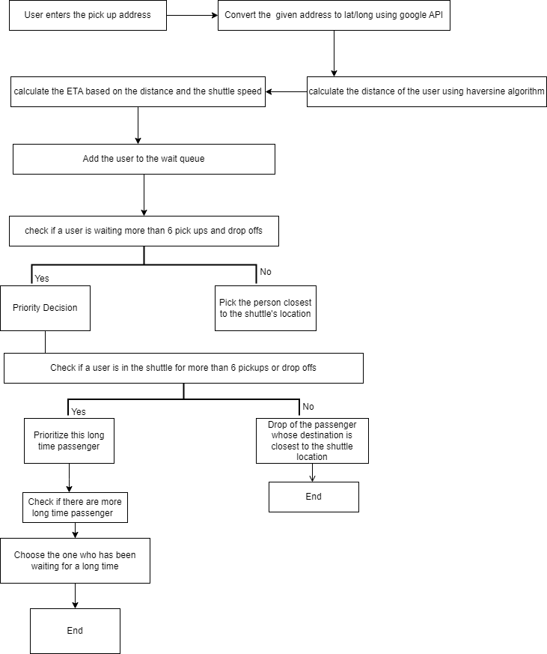
Algorithm

Slide 5
​
Structure
Controllers:
DistanceCalculator
GeoCodeController
RegisterController
ShuttleController
ShuttleLocation
StudentController
Entity:
Coordinates
Passenger
Shuttle
Student
UserStatus
Repository:
PassangerRespository
StudentRespository
Database Schema
Table Name: coordinates
Columns: id(Primary key), latitude, longitude
Table Name: passengers
Columns: suid (Primary Key)
pickup_lat, drop_lat, pickup_lng, drop_lng,
counter_since_requested, eta, user_status (Enum: IDLE, WAITING, PICKEDUP)
Foreign Key: pickup_coordinates_id (References coordinates.id)
drop_coordinates_id (References coordinates.id)
Table Name:shuttles
Columns: id (Primary Key)
Speed, college_place_lat, college_place_lng
Foreign Key: coordinates_id (References coordinates.id)
Table Name:students
Columns: suid (Primary Key), name, home_address, user_status (Enum: IDLE, WAITING, PICKEDUP)
APIs
Distance Calculator
GET /api/distanceCalculator
Request Parameters: Latitude(x, a) Longitude(y, b)
Response Object: String
Geo Code Controller
GET /api/geoCoord
Request Parameters: address
Response Object: String
Register Controller
POST /api/register
Request Parameters: JSON Object
Response Object: Student
Shuttle Controller
GET /api/pickedPassenger
Response object: String
Shuttle Location
GET /api/shuttleLocation
Response object: String
Student Controller
GET /api/requestPickup
Request Parameters: suid, pickup_address, drop_address
Response object: String
T
T

Slide 6
Thank You. Now let's move to the demonstration

